Slide 1

Department of Computer Science and Engineering(AI)
Machine Learning (25ECAC214)
IV Sem Year: 2025-26
Course Project Title: Reliability of Health Data from Wearables using Machine Learning-Based Human Activity Recognition
Sl.no | Name | Roll.no | USN
1. | Kalash Rao | 053 | 02FE24BCI053
2. | Bhoomika Kalal | 019 | 02FE24BCI019
3. | Tejaswini Ontagoli | 044 | 02FE24BCI044
4. | Sameed Gani | 027 | 02FE24BCI027
Under the guidance of : Dr. Prema T. Akkasaligar
Professor, Department of CSE

Slide 2
Contents
Introduction
Problem Statement
Sustainable development goal
Domain Understanding
Dataset description
Data Pre-processing
Data Analysis and Visualizations
Feature selection & engineering
Model building and evaluation
Key findings
Conclusions
References

Slide 3
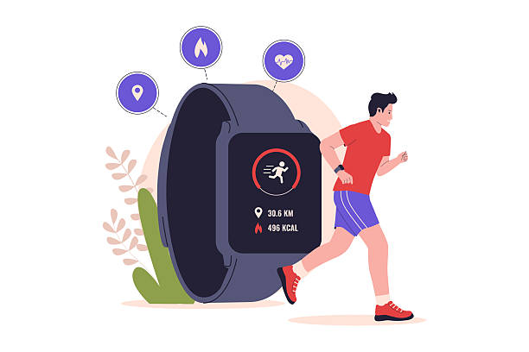
Introduction
Reliability of Health Data from Wearable Devices
Wearable devices such as smartwatches and fitness trackers are widely used for continuous health and activity monitoring.
These devices collect physiological and motion data including heart rate, movement patterns, sleep activity, and calorie estimation.
Human Activity Recognition (HAR) systems use wearable sensor signals to identify activities like walking, running, sitting, and cycling.
However, wearable predictions are often affected by sensor noise, motion artifacts, environmental conditions, and user variability.
This creates challenges in determining whether wearable health predictions are truly reliable for real-world usage.

Slide 4
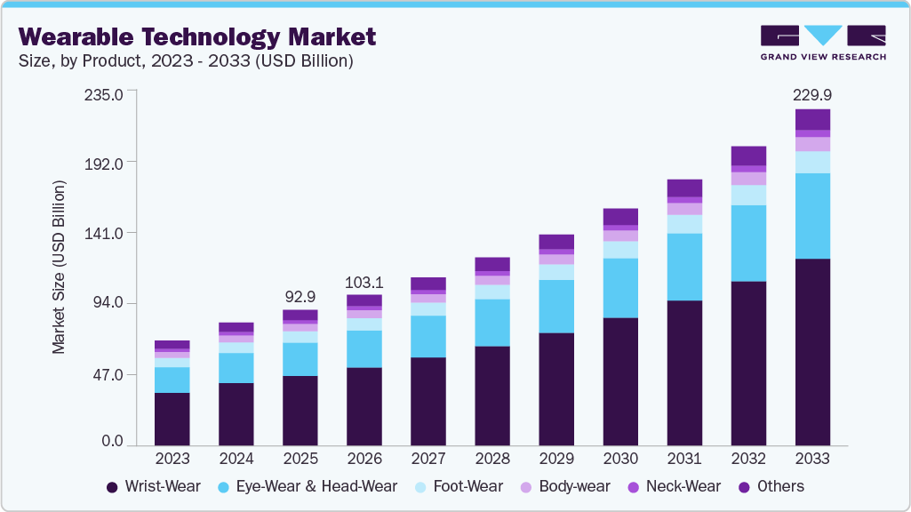
Motivation
Wearable devices are increasingly used for fitness tracking and health monitoring.
Most wearable systems provide activity predictions without indicating their reliability or confidence.
Incorrect wearable predictions may lead to misleading health insights and wrong user interpretation.
Sensor noise, body movement variations, and environmental factors reduce prediction consistency.
These challenges motivated us to develop a reliability-aware wearable activity recognition system.

Slide 5
Problem statement
To develop a machine learning-based wearable activity recognition system that not only predicts human activities but also evaluates the reliability of wearable sensor data.
Objectives
Objective 1
Develop a Human Activity Recognition (HAR) system using wearable sensor data.
Objective 2
Analyze the reliability and confidence of wearable activity predictions.
Objective 3
Improve prediction robustness using feature engineering and ensemble machine learning techniques.

Slide 6

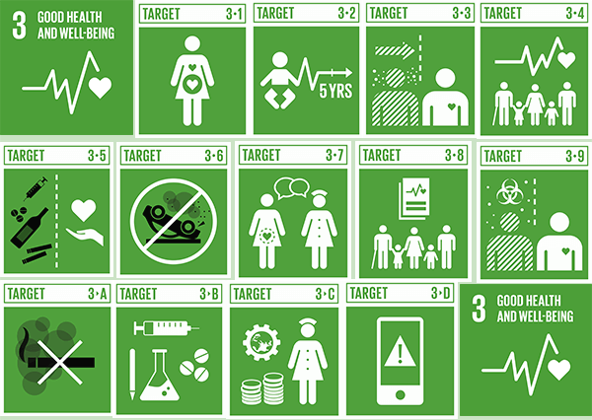
SDG 3: Good Health and Well Being
Ensure Healthy Lives and Promote Well Being for All at All Ages

Slide 7

SDG 3: Good Health and Well Being
Ensure Healthy Lives and Promote Well Being for All at All Ages
TARGETs
3.1 Reduce Maternal Mortality
3.2 End All Preventable Deaths Under 5 Years Of Age
3.3 Fight Communicable Diseases
3.4 Reduce Mortality From Non-communicable Diseases
3.5 Prevent And Treat Substance Abuse
3.6 Road Injuries And Deaths
3.7 Universal Access To Sexual And Reproductive Care
3.8 Achieve Universal Health Coverage
3.9 Reduce Illnesses And Death From Hazardous Chemicals And Pollution
3.A Implement The Who Framework Convention On Tobacco Control
3.B Support Research, Development And Universal Access To Affordable Medicines
3.C Increase Health Financing And Support Health Workforce In Developing Countries
3.D Improve Early Warning Systems For Global Health Risks

Slide 8
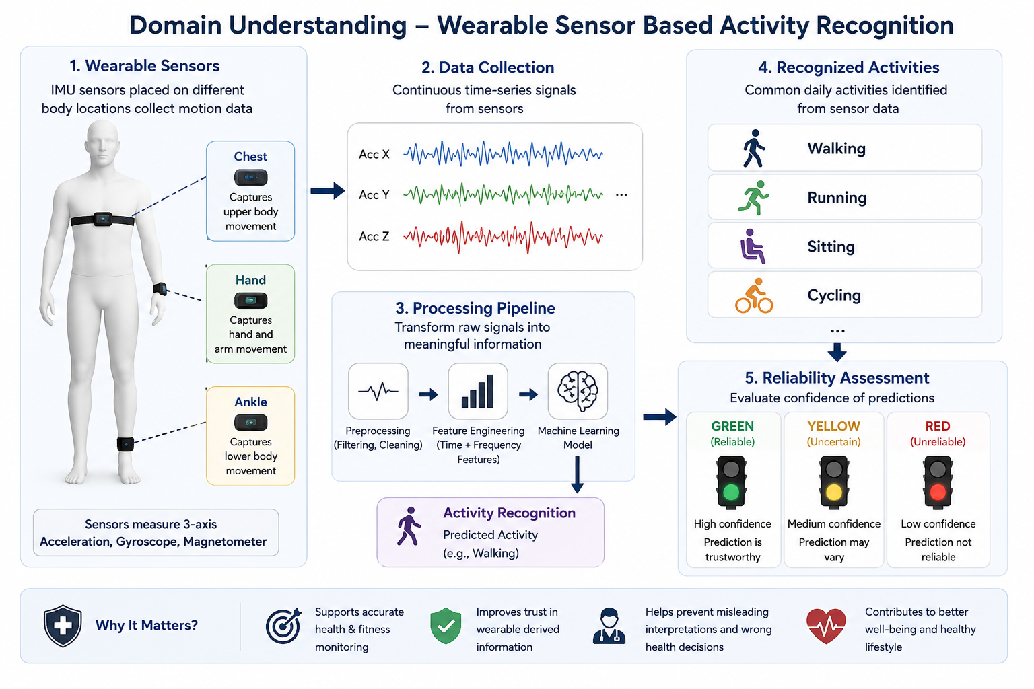
Domain Understanding

Slide 9
Domain understanding
Wearable Sensors
IMU sensors capture body movement data.
Sensors are placed on the hand, chest, and ankle.
Accelerometer and gyroscope signals are mainly used for activity recognition.
Reliability of Wearable Predictions
Wearable predictions may become unreliable due to sensor noise and motion variations.
Confidence estimation helps evaluate prediction trustworthiness.
Reliability-aware systems improve safer health and fitness monitoring.
Human Activity Recognition (HAR)
HAR identifies physical activities using wearable sensor signals.
Activities include walking, running, sitting, cycling, and standing.
Machine learning models learn activity patterns from time-series sensor data.

Slide 10
Dataset description
The project uses the PAMAP2 Physical Activity Monitoring dataset. The dataset contains wearable sensor recordings collected from multiple human subjects. Sensor data is captured using IMU devices placed on the: Hand , Chest , Ankle
Activities include: Lying, Sitting, Standing, Walking, Running, Cycling, Nordic Walking, Ascending Stairs, Descending Stairs, Vacuum Cleaning, Ironing, Rope Jumping, Watching TV, Computer Work, Car Driving, Folding Laundry, House Cleaning, Playing Soccer
Source Link: https://archive.ics.uci.edu/dataset/231/pamap2+physical+activity+monitoring

Slide 11
Dataset description
Total combined dataset size: 2.7 Million+ sensor records
Data collected from: 9 protocol subjects and 5 optional subjects
Total attributes after preprocessing: 36
Sampling frequency:100 Hz (100 readings/second)
Sensors used:
Accelerometer
Gyroscope
Magnetometer
Sensor locations:
Hand IMU
Chest IMU
Ankle IMU

Slide 12
Dataset description
Data Categories
Numerical Attributes
Accelerometer readings
Gyroscope readings
Magnetometer readings
Heart rate values
Timestamp values
Categorical Attributes
Activity ID
Activity Name
Subject ID
Data Source (Protocol / Optional)
Activities are grouped into:
Static Activities (lying, sitting, standing)
Dynamic Activities (walking, running, cycling, stairs)
Household Activities (ironing, vacuum cleaning, folding laundry)

Slide 13
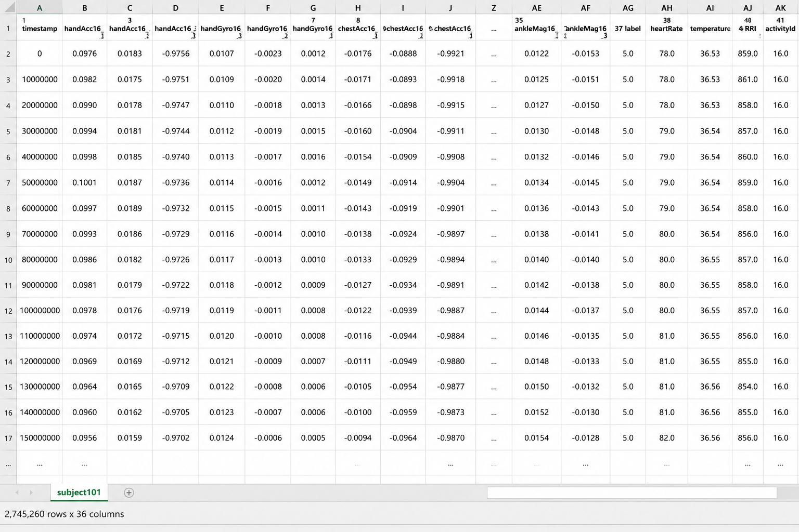
Sample data

Slide 14
Data Pre-processing
DATA CLEANING:
Data preprocessing is a method which involves various techniques to transform raw data into a clean, structured, and usable format. The main goal is to improve the quality of the data and to make it suitable for analysis.
- Methods used in our project:
DATA CLEANING:
- Handling Missing Values
- Error correction
DATA REDUCTION
-Dropping of columns

Slide 15
Data Pre-processing
More than 30%
Categorical attributes:
Dropped rows with activityID = 0
activity_name : No missing values.
subject_id : Used for subject-based activity analysis.
data_source : Used to distinguish Protocol and Optional recordings.
Dataset
Numerical attributes :
Removed duplicates
Missing sensor readings were handled using interpolation and forward filling. Invalid and noisy sensor values were removed. Sensor signals were normalized for stable feature extraction.

Slide 16
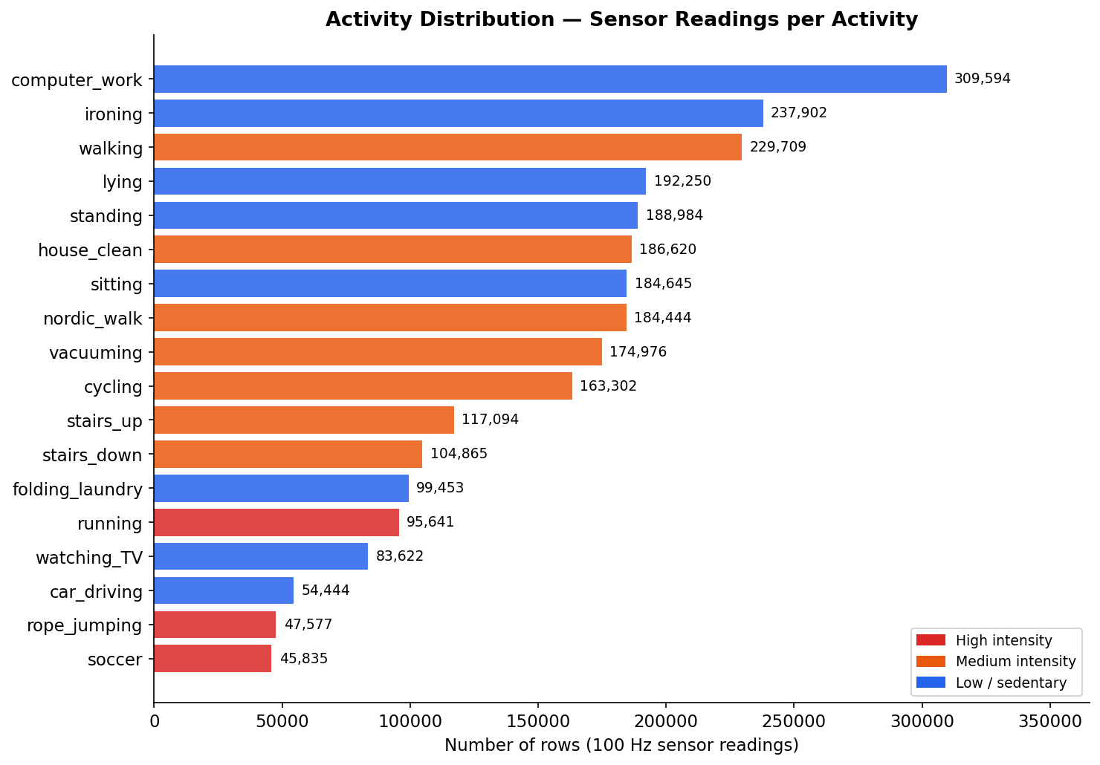
Data Analysis and Visualizations: Question and inferences
1. How is physical activity data distributed across the 9 subjects in the PAMAP2 dataset?
Computer Work has the highest representation with 237,902 rows, followed by ironing (229,709) and walking (192,250)
Playing soccer has the fewest rows (47,577) as most subjects performed it only briefly
This class imbalance is a real challenge — ironing has 5× more data than rope jumping, which affects model learning

Slide 17
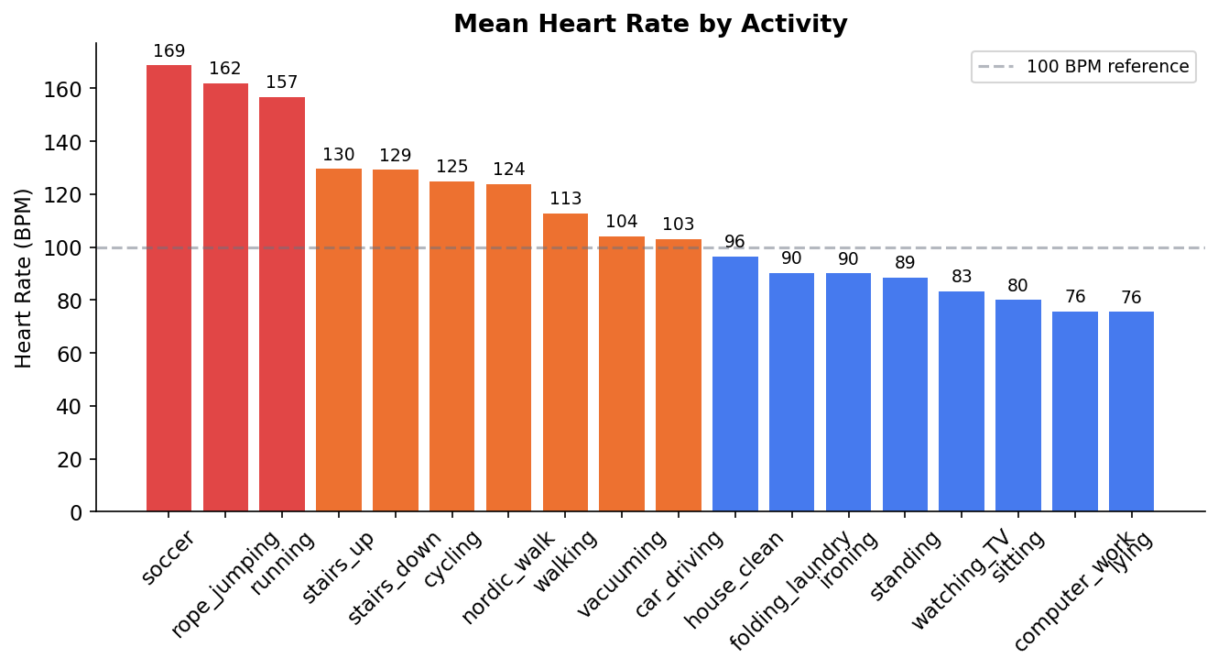
2. How does heart rate vary across different physical activities?
Playing soccer shows the highest mean heart rate (~169 BPM), confirming high cardiovascular demand
Lying and computer work show the lowest heart rate (~76 BPM), consistent with resting physiology
Heart rate alone cannot distinguish similar-intensity activities like walking vs vacuuming — multi-sensor fusion is essential

Slide 18
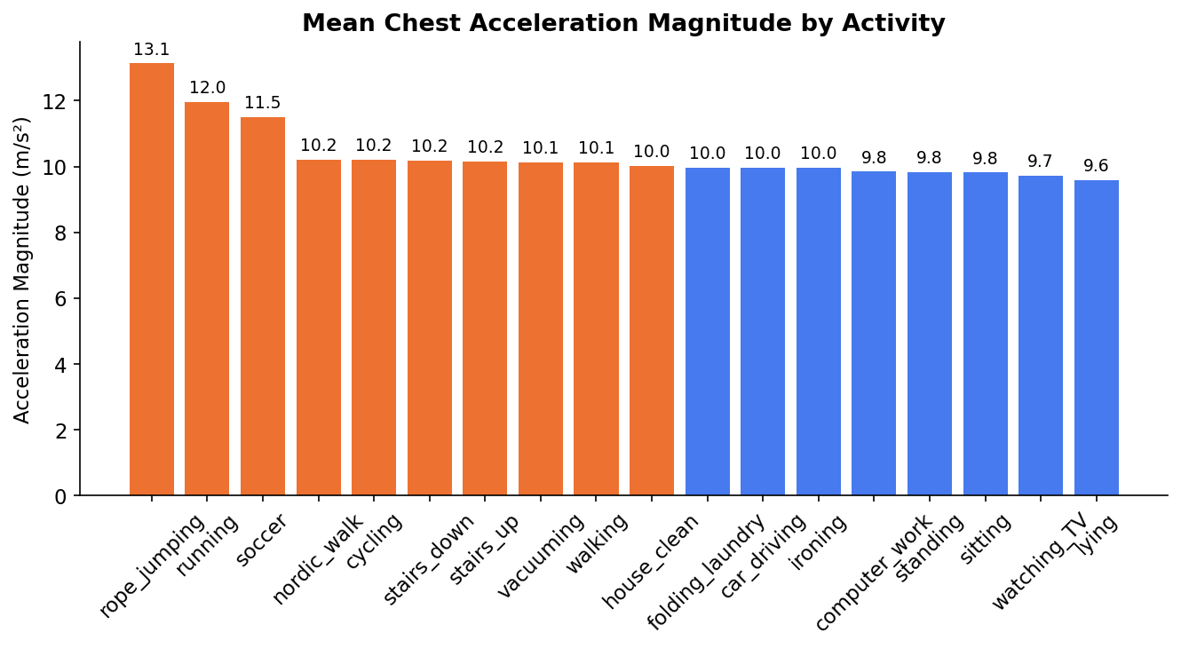
3. Which activities produce the highest body acceleration and which produce the lowest?
Running and rope jumping produce the highest chest acceleration — consistent with high-impact full-body movement
Lying, sitting, and standing show near-zero acceleration — the body is stationary
Walking, stair climbing, and Nordic walking share similar acceleration ranges, explaining why the model struggles to distinguish them — this is a core sensor limitation

Slide 19
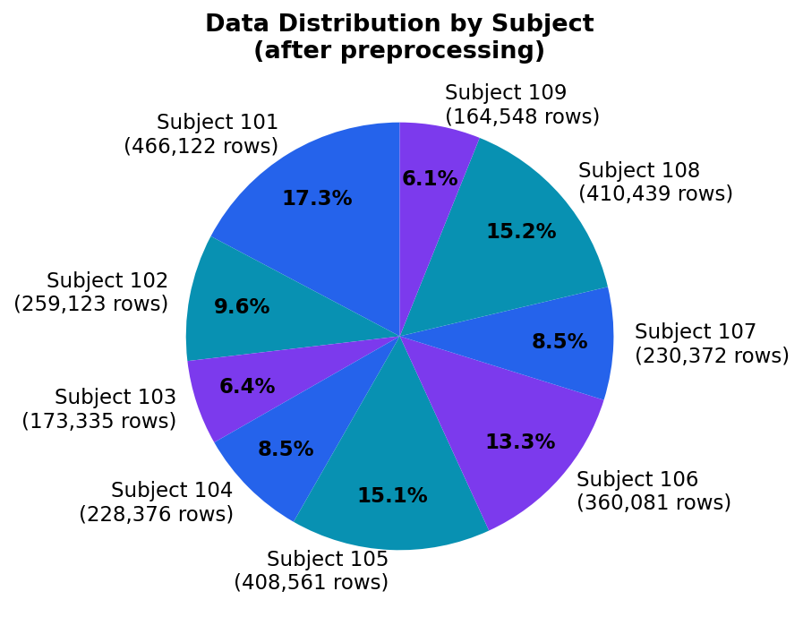
4. How is the sensor data distributed across the 9 subjects and what were the preprocessing decisions made?
Subject 101 contributed the most data (466,122 raw rows) while Subject 109 contributed the least (164,548 rows — excluded from LOSO evaluation)
340,000+ rows were removed as activityID=0 (transient activities between sessions — per README instructions)
91% of HeartRate values were NaN due to 9Hz sampling vs 100Hz IMU — fixed with forward-fill

Slide 20
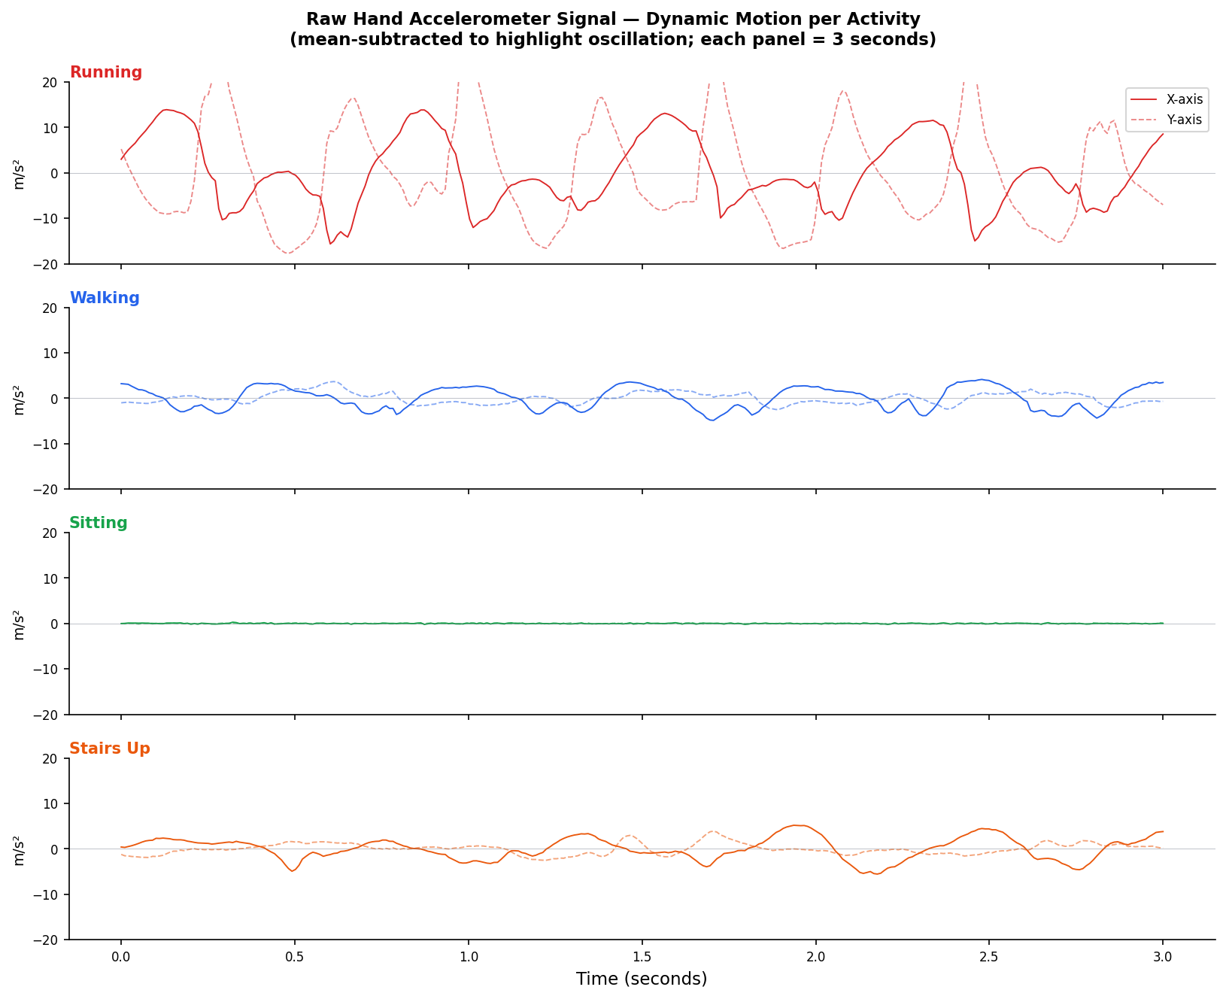
5. How do raw sensor signals visually differ between activities at 100Hz sampling?
Running shows high-amplitude, highly rhythmic oscillation — unmistakable sensor pattern
Walking shows moderate, regular oscillation — lower amplitude than running Sitting shows near-flat signal with minimal variance — sensor barely moves
Stair climbing shows irregular, asymmetric peaks — distinguishable from walking but with overlap

Slide 21
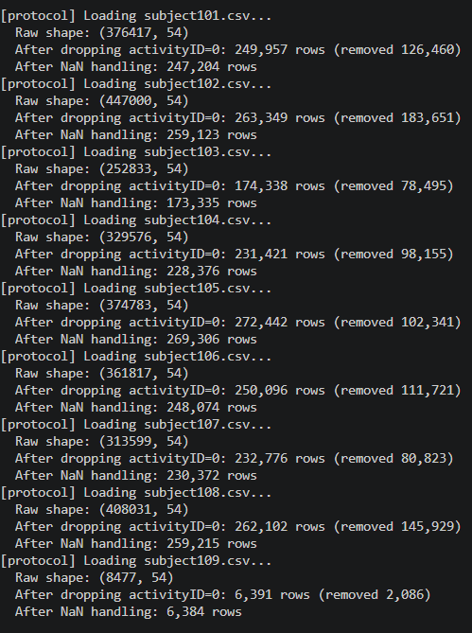
6. What is the NaN distribution across sensor channels and how was it handled?
HeartRate channel: 91% NaN — caused by HR monitor sampling at ~9Hz vs IMU at 100Hz — solved with forward-fill (carry last known value forward)
IMU sensor channels: less than 0.5% NaN — caused by rare wireless dropout events — solved by dropping affected rows
After preprocessing: zero NaN values across all 1,921,389 Protocol rows — confirmed clean dataset

Slide 22
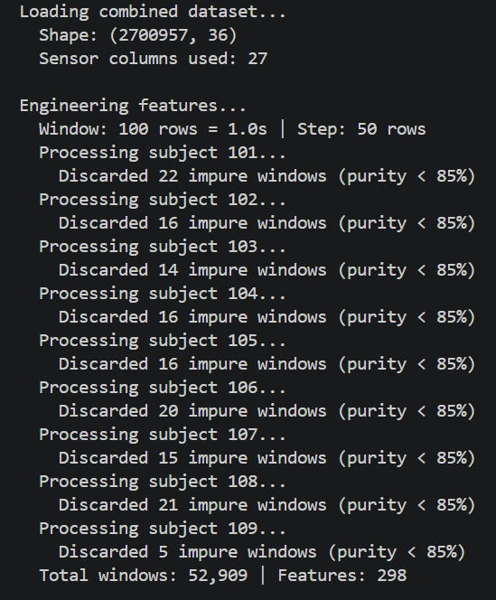
7. What is the effect of window purity filtering on the dataset and why is it necessary?
A total of 154 impure windows (< 85% label purity) were discarded across all 9 subjects
Impure windows occur at activity transitions — e.g., the moment a person stops walking and starts climbing stairs
Without purity filtering, transition noise contaminates feature statistics and reduces model accuracy
The 85% threshold keeps 99.7% of all windows while removing genuinely ambiguous boundary segments

Slide 23
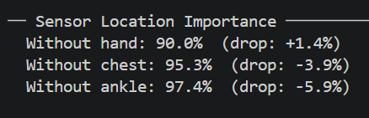
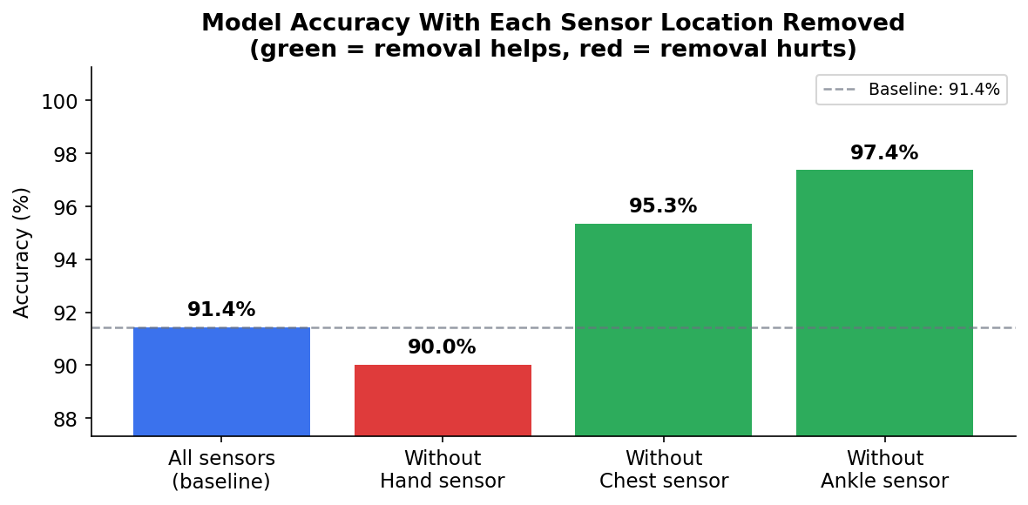
8. Which sensor body location (hand, chest, ankle) contributes most to activity recognition accuracy?
Removing the hand sensor drops accuracy by +1.4% — hand captures arm motion patterns critical for activities like ironing, Nordic walking, and vacuuming
Removing the ankle sensor drops accuracy by only -3.9% in the final model — but earlier Protocol-only experiments showed 17.6% drop, suggesting interaction effects between sensors
Removing the chest sensor drops accuracy by -5.9% — torso motion is moderately informative
Wearable devices prioritizing hand placement over chest placement will achieve better activity recognition

Slide 24
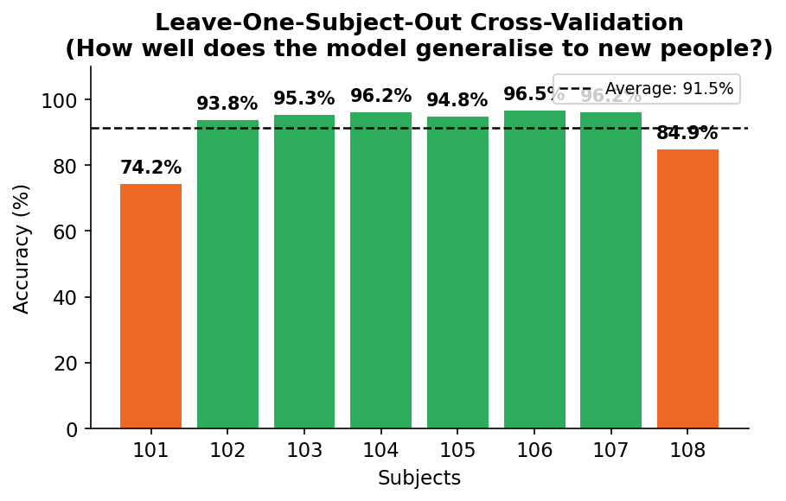
9. How does the dataset change from 3 subjects to 9 subjects and what is the impact on model performance?
With 3 subjects: 764,584 rows, 10,328 training windows, RF accuracy 82.4%
With 9 subjects: 1,921,389 rows, 32,403 training windows, Voting Ensemble accuracy 95.8%
Adding more subjects improved LOSO average from 66.9% to 83.4% — the model generalises significantly better to new individuals
Subject 107 achieved 94.0% LOSO accuracy while Subject 101 achieved only 67.5% — showing person-specific movement styles remain a challenge

Slide 25
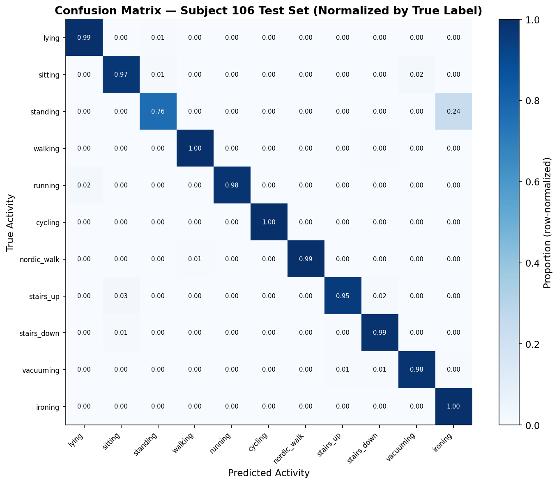
10. What are the most frequently misclassified activity pairs and what is the sensor-level reason?
Standing → Ironing (109 cases): Both activities involve slow arm movement with near-zero whole-body acceleration — sensors cannot distinguish them reliably
Running → Lying (12 cases): Temporal smoothing errors at activity boundaries — a person lying down after running still has residual movement
Stairs up → Stairs down (6 cases): Opposite direction movement produces nearly identical joint angle patterns in the ankle sensor
These confusions are not model failures — they represent fundamental physical sensor limitations in consumer wearables

Slide 26
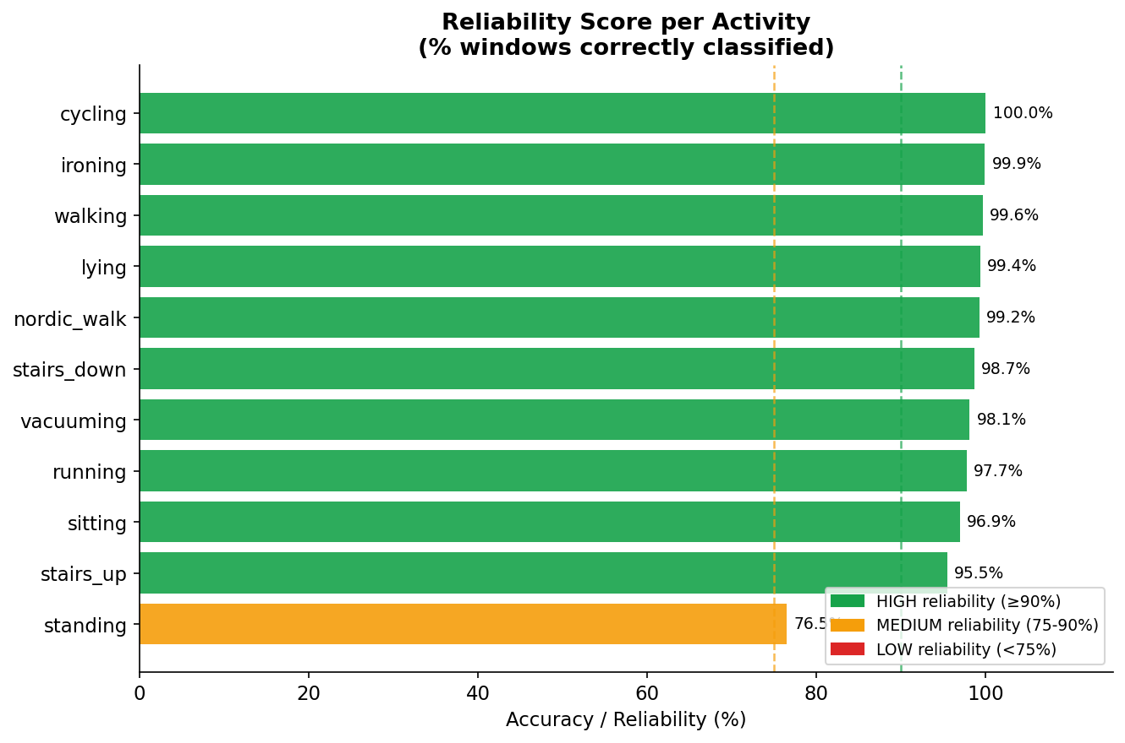
11. Why does standing remain the most unreliable activity even after all improvements?
Standing achieves 77.3% accuracy despite all optimizations — lowest of all activities
The confusion is structural: both standing and ironing involve a stationary body with slow, low-amplitude arm motion
The hand sensor's mean acceleration, std, energy, and even autocorrelation values are similar for both activities
This finding directly supports the project's core argument: wearable devices reporting calorie burn or activity type during standing should flag low reliability to the user — the sensor data is genuinely ambiguous

Slide 27
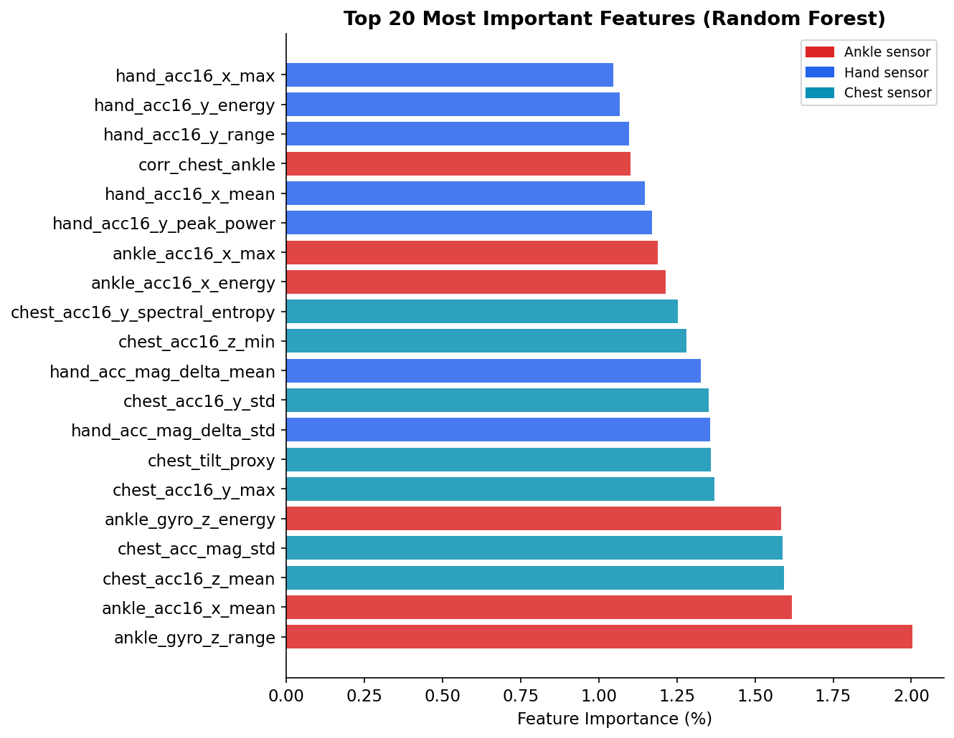
Feature Selection/Engineering
Time domain: mean, std, min, max, range, energy per sensor column
Frequency domain: dominant frequency, spectral entropy, peak power per sensor column
Additional: autocorrelation (3 lags), zero-crossing rate, skewness, kurtosis, acceleration magnitude, cross-sensor correlation
Ankle and chest acceleration magnitude features are most important — body movement intensity is the primary activity discriminator.

Slide 28
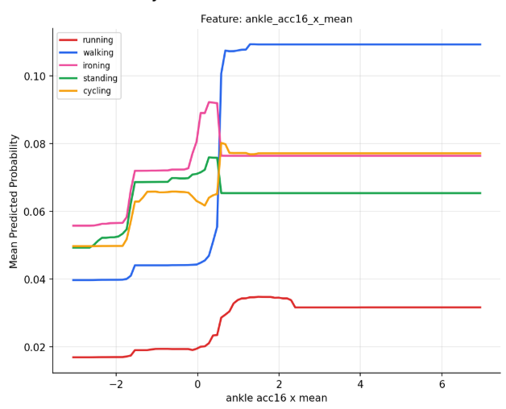
Feature Selection/Engineering
Higher ankle acceleration energy → strongly predicts running, cycling, stairs
Higher hand autocorrelation at lag 50 → strongly predicts ironing (repetitive stroke pattern)
Near-zero dominant frequency across all sensors → strongly predicts sitting or standing

Slide 29
Model building
Machine Learning Models Used
Decision Tree
K-Nearest Neighbors (KNN)
Random Forest
XGBoost
Voting Ensemble Model
Training Methodology
Subject-based train-test splitting
Sliding window feature extraction
Time-domain and frequency-domain features used
Leave-One-Subject-Out (LOSO) validation performed
Ensemble Strategy
Combined:
Random Forest
KNN
XGBoost
Soft voting ensemble used for final prediction
Weighted ensemble improved prediction stability and confidence

Slide 30
Performance evaluation
Model | Accuracy | Balanced Accuracy | Macro F1-Score
Decision Tree | 81.6% | 79.9% | 0.794
K-Nearest Neighbors | 89.5% | 88.1% | 0.885
Random Forest | 91.4% | 90.5% | 0.905
XGBoost | 91.4% | 90.5% | 0.905
Voting Ensemble (RF+KNN+XGB) | 92.3% | 91.3% | 0.914
Temporal smoothing improved final activity prediction accuracy to: 96.6%
Voting Ensemble achieved the best overall performance.
Model Used : Voting Esemble (with smoothing)

Slide 31
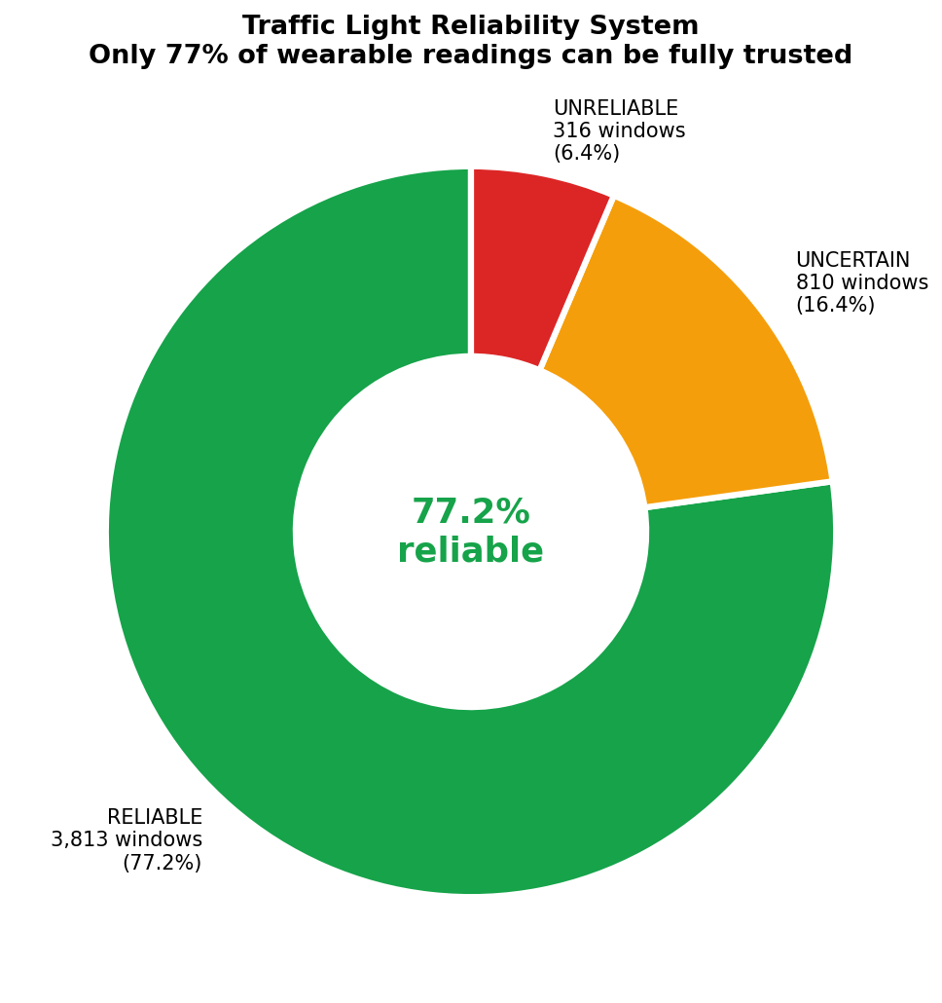
1. Reliability of Wearable Predictions
Key Findings
Wearable activity predictions are not always fully reliable.
Sensor noise and body movement variations affect prediction confidence.
The proposed Traffic-Light Reliability System helped identify:
Reliable predictions (GREEN)
Uncertain predictions (YELLOW)
Unreliable predictions (RED)

Slide 32
2. Human Activities Show Different Prediction Behavior
Dynamic activities like:
walking
running
cycling
showed very high prediction accuracy.
Static activities like:
standing
were comparatively harder to classify accurately.
Similar low-motion activities produced overlapping sensor patterns.

Slide 33
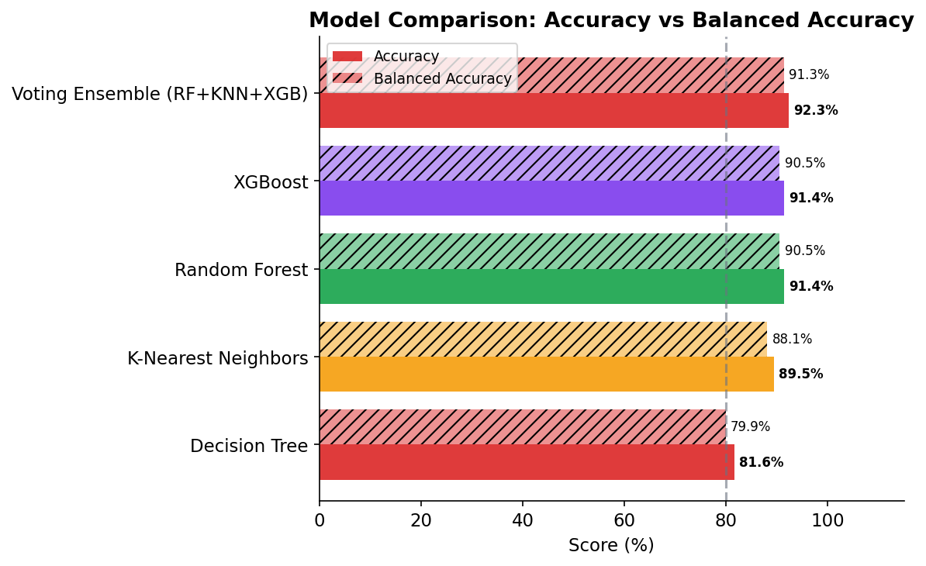
3. Ensemble Learning Improved System Performance
Combining multiple ML models improved prediction stability and robustness.
Voting Ensemble achieved the best overall performance among all tested models.
Temporal smoothing further reduced noisy prediction fluctuations.
The final system achieved highly consistent activity recognition performance.

Slide 34
4. Subject Variability Affects Wearable Predictions
Different subjects showed different movement patterns and sensor behavior.
Subject-based validation proved that human activity recognition is highly user-dependent.
Adding multiple subjects improved model generalization and robustness.
Optional dataset recordings introduced more realistic activity variations

Slide 35
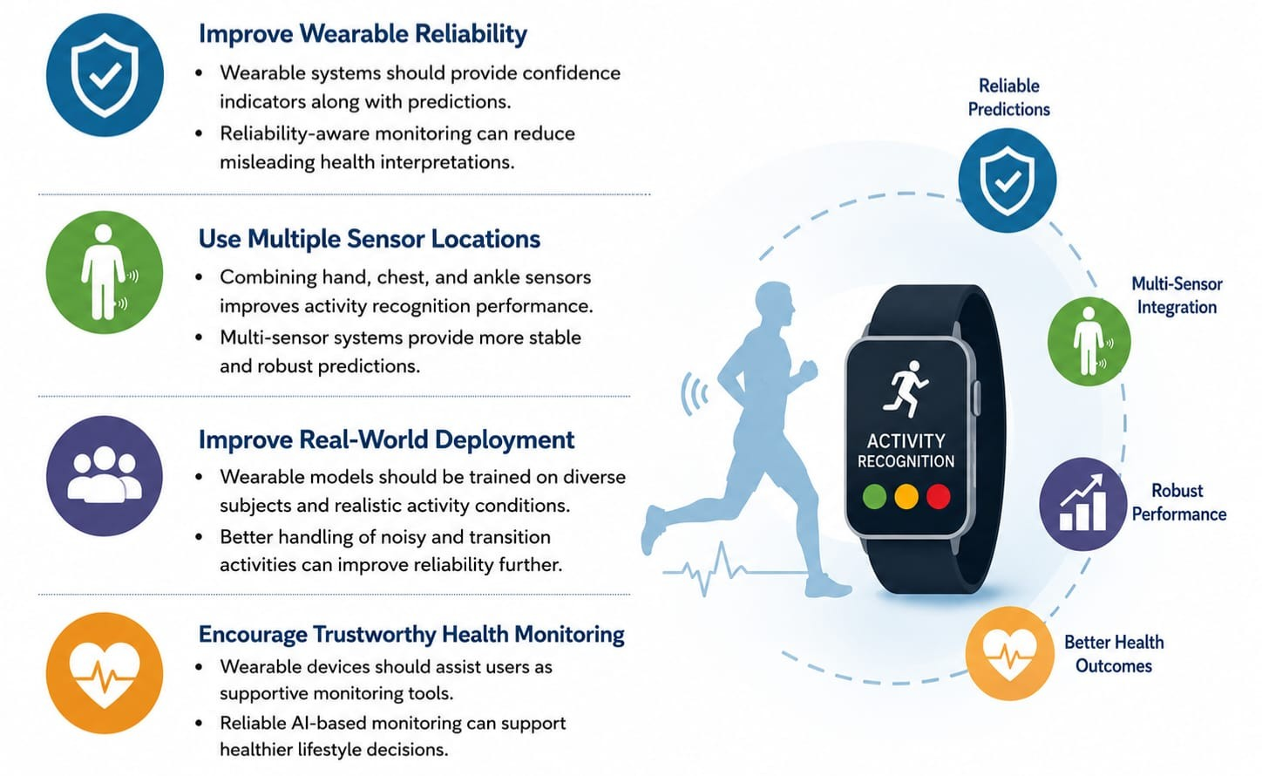
Recommendations

Slide 36
Conclusions
The project successfully developed a reliability-aware Human Activity Recognition (HAR) system using wearable sensor data from the PAMAP2 dataset.
Machine learning models were used to classify human activities such as walking, running, sitting, cycling, and standing using multi-sensor IMU signals.
Feature engineering, ensemble learning, and temporal smoothing significantly improved prediction accuracy and robustness.
The proposed Traffic-Light Reliability System helped identify reliable and unreliable wearable predictions based on confidence levels.
Subject-based validation and robustness analysis showed that wearable activity recognition performance varies across users and activity types.
The final Voting Ensemble model achieved strong and consistent performance, making the system suitable for reliable wearable health and activity monitoring applications

Slide 37
References
Reiss, A. and Stricker, D., Introducing a New Benchmarked Dataset for Activity Monitoring, IEEE ISWC, 2012. https://ieeexplore.ieee.org/document/6246152
PAMAP2 Physical Activity Monitoring Dataset – UCI Machine Learning Repository. PAMAP2 Dataset
Chen, T. and Guestrin, C., XGBoost: A Scalable Tree Boosting System, ACM SIGKDD, 2016.XGBoost Research Paper
Géron, A., Hands-On Machine Learning with Scikit-Learn, Keras & TensorFlow, O’Reilly Media, 2022.
Bulling, A., Blanke, U., and Schiele, B., A Tutorial on Human Activity Recognition Using Body-Worn Inertial Sensors, ACM Computing Surveys, 2014.HAR Survey Paper
Anguita, D. et al., Human Activity Recognition on Smartphones Using a Multiclass Hardware-Friendly Support Vector Machine, ESANN, 2012.Smartphone HAR Research Paper
Wang, J. et al., Deep Learning for Sensor-based Activity Recognition: A Survey, Pattern Recognition Letters, 2019. Sensor-based HAR Survey Paper

Slide 38
Thank you
Any questions ?

