Slide 1

Department of Data Science, IoT and Cyber Security
Design and Development of an Autonomous Cyber Threat Hunting Agent Using Reinforcement Learning
Presented By
07-Kalash Singh
17-Riya Dhopre
37-Ayush Wanjari
Guided By
Dr. Nekita Chavhan Morris
(HOD DIC)

Slide 2
Contents
  Introduction
  Problem Definition
  Objectives
  Data Collection and Preprocessing
  Environment Design
  Visualisation and Deployment
  References

Slide 3
Introduction
Cybersecurity has become one of the most critical challenges in today's digital landscape due to the increasing sophistication of cyber threats. Modern enterprise networks are continuously targeted by Advanced Persistent Threats (APTs), zero-day exploits, ransomware, and other evolving attack techniques that can evade traditional defence mechanisms. Conventional security solutions such as Intrusion Detection Systems (IDS) and Security Information and Event Management (SIEM) platforms primarily rely on signature-based detection and predefined rules, making them less effective against previously unseen or adaptive attacks.
Although machine learning techniques have improved threat detection through anomaly detection and classification, they are generally designed for static prediction tasks and lack the capability to make continuous, adaptive decisions during an ongoing cyberattack. As a result, Security Operations Center (SOC) analysts still perform most threat hunting manually, leading to alert fatigue, increased Mean Time to Detect (MTTD), and delayed incident response.

Slide 4
Problem Definition
To address these challenges, this research work proposes an Autonomous Cyber Threat Hunting Agent using Reinforcement Learning (RL). By learning through interaction with a simulated network environment, the RL agent can continuously observe network behaviour, identify suspicious activities, prioritize potential threats, and recommend or execute appropriate response actions. This approach aims to move beyond passive detection toward intelligent, adaptive, and autonomous cyber defence.

Slide 5
Objectives
To design an autonomous cyber threat hunting framework capable of monitoring network events and identifying malicious activities without continuous human intervention. To develop a Reinforcement Learning agent that learns optimal threat hunting strategies through interaction with a simulated cybersecurity environment.
To detect and prioritize cyber threats by analysing network traffic, security logs, and attack patterns using adaptive decision-making techniques. To reduce false positives and improve detection accuracy compared with conventional rule-based security systems.
To minimize Mean Time to Detect (MTTD) and Mean Time to Respond (MTTR) by enabling automated threat identification and response recommendations. To evaluate the effectiveness of the proposed framework using benchmark cybersecurity datasets and standard performance metrics such as Precision, Recall, F1-score, Detection Rate, and Cumulative Reward.

Slide 6

Dataset Collection and Preprocessing
The dataset is for The CICIoT2023 dataset is used as the primary cybersecurity dataset for this project. It contains network traffic representing both benign and malicious activities generated from an IoT-based network environment.
st examined to understand its features, attack categories, and data distribution. The collected network traffic is then prepared for use by the proposed cyber threat-hunting environment.
The preprocessing stage includes:
Loading and analysing the CICIoT2023 dataset
Removing irrelevant or inconsistent data
Handling missing values, if present
Selecting relevant network traffic features
Converting categorical information into numerical representation
Normalizing/scaling numerical features
Mapping the processed information into a format suitable for the RL environment
The final processed features are converted into state representations that can be observed by the RL agent.

Slide 7
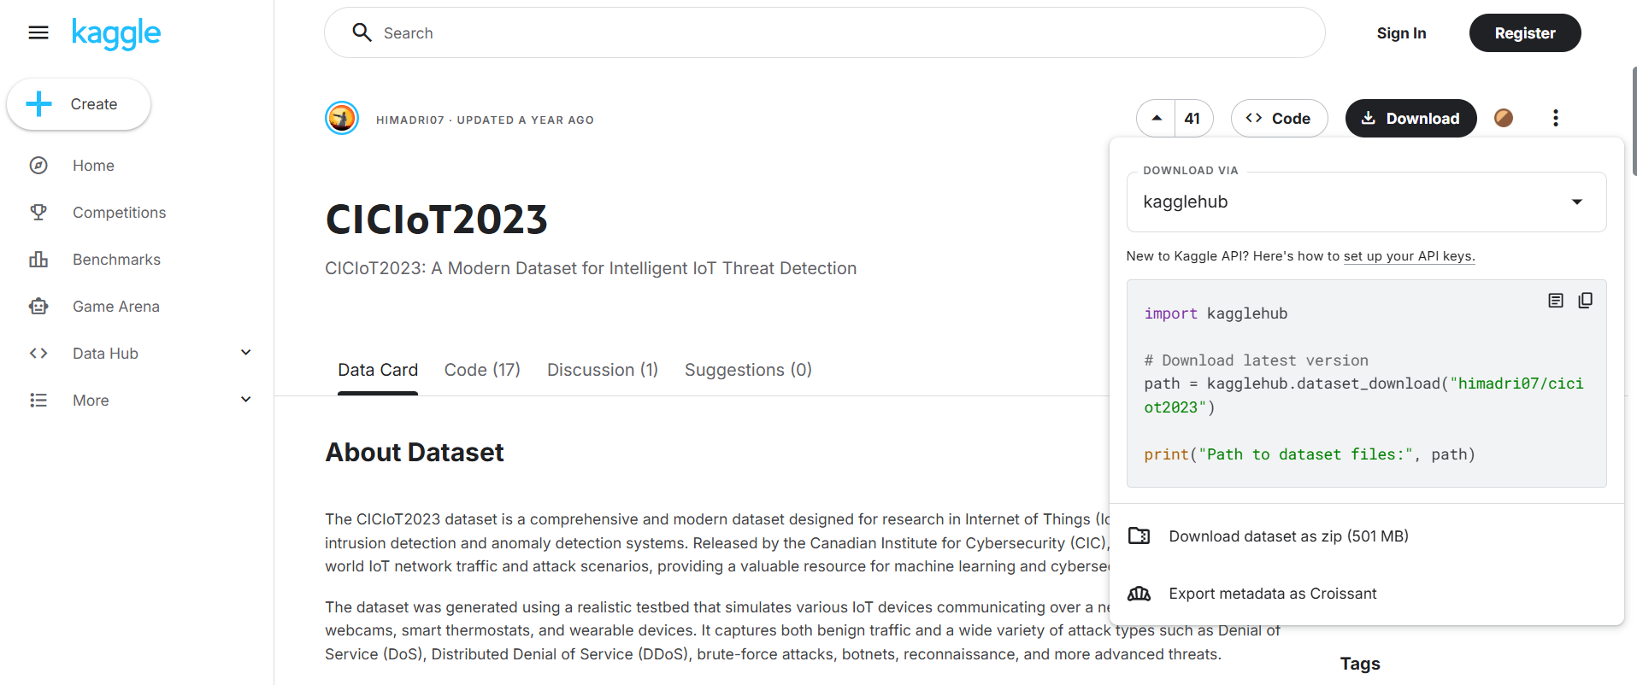
Dataset Collection and Preprocessing

Slide 8
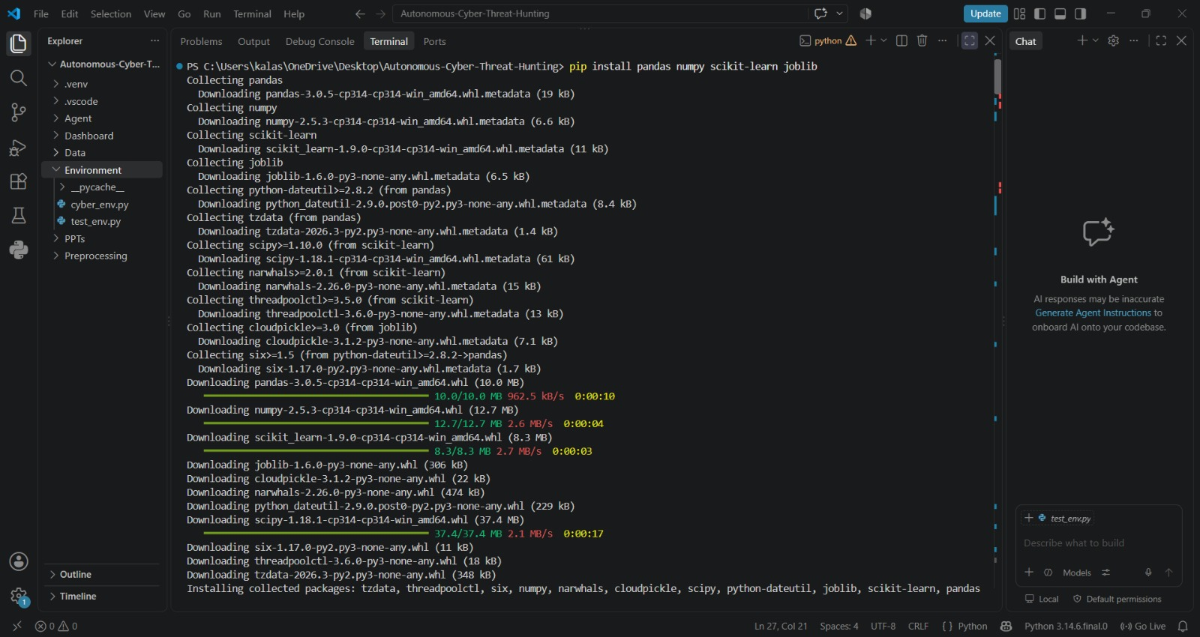
Dataset Collection and Preprocessing

Slide 9
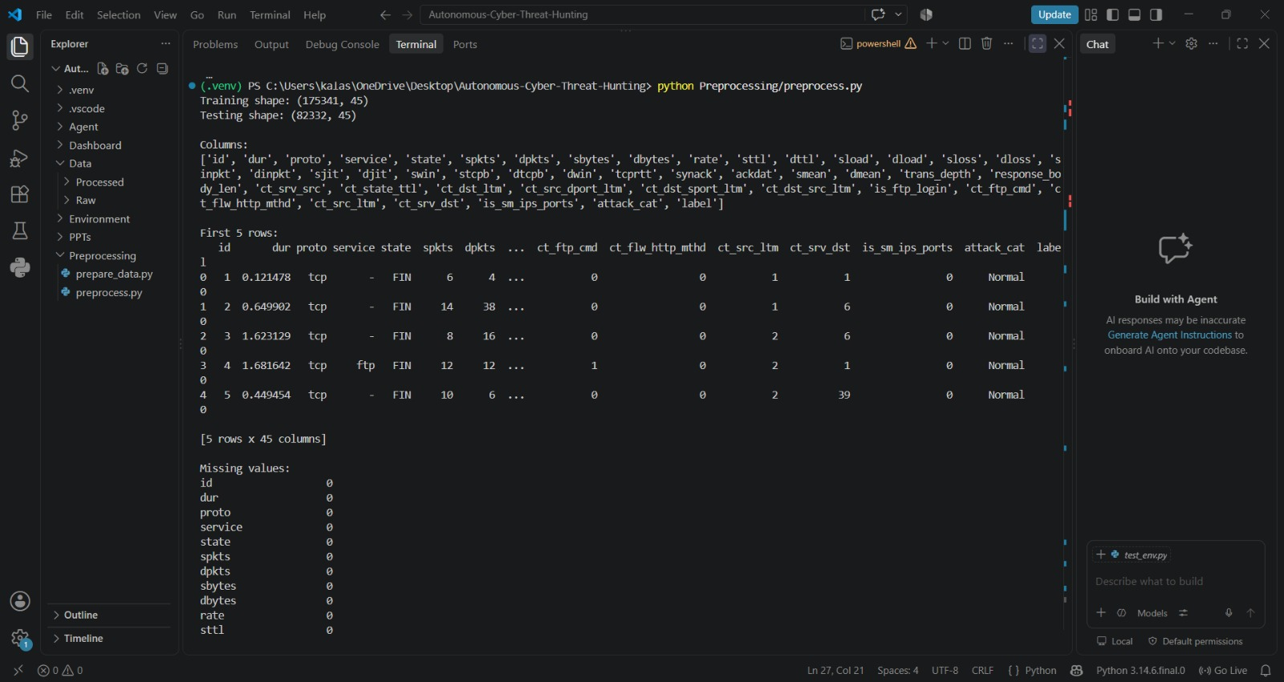
Dataset Collection and Preprocessing

Slide 10
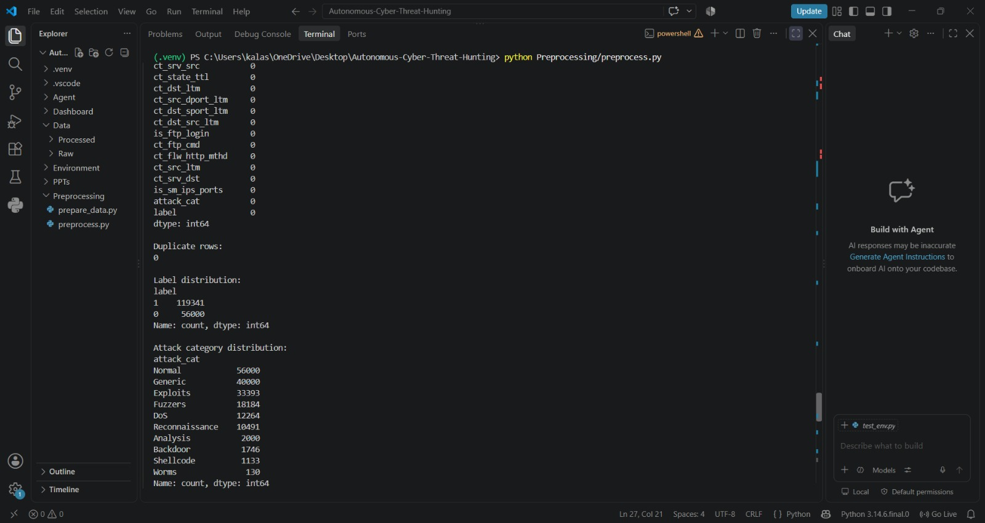
Dataset Collection and Preprocessing

Slide 11
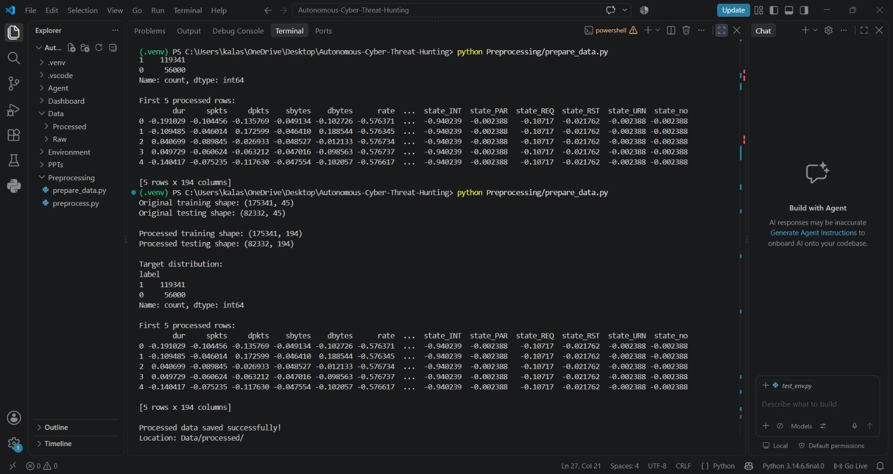
Dataset Collection and Preprocessing

Slide 12
Environment Design
After preparing the dataset, a simulated cybersecurity environment is developed.
The environment acts as an interaction layer between the CICIoT2023 data and the RL agent.
It consists of:
State Space → Action Space → Reward Function
The current implementation successfully generates:
194 features per state
3 available actions
A reward after an action is performed
The agent observes the current network state, selects an action, and receives a reward from the environment.

Slide 13
Environment Design
Action
Reward Function
Action | Meaning
0 | Monitor
1 | Investigate
2 | Contain
Actual traffic | Monitor | Investigate | Contain
Normal | +1 | -0.2 | -2
Attack | -1 | +1 | +2

Slide 14
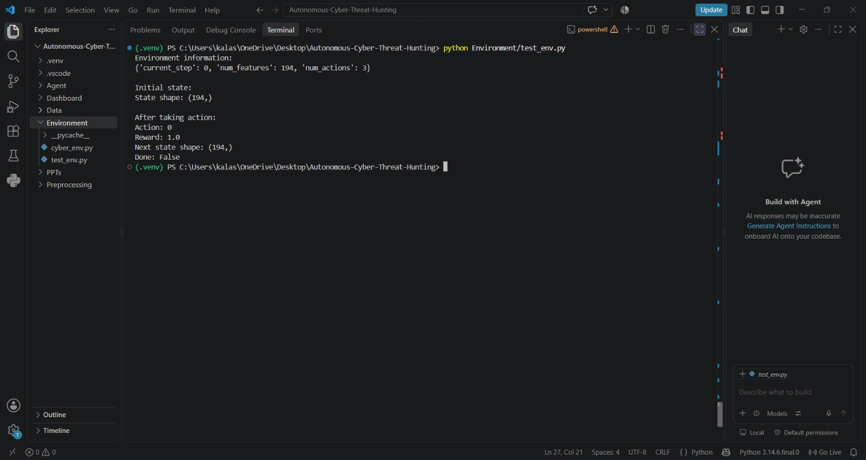
Environment Design

Slide 15
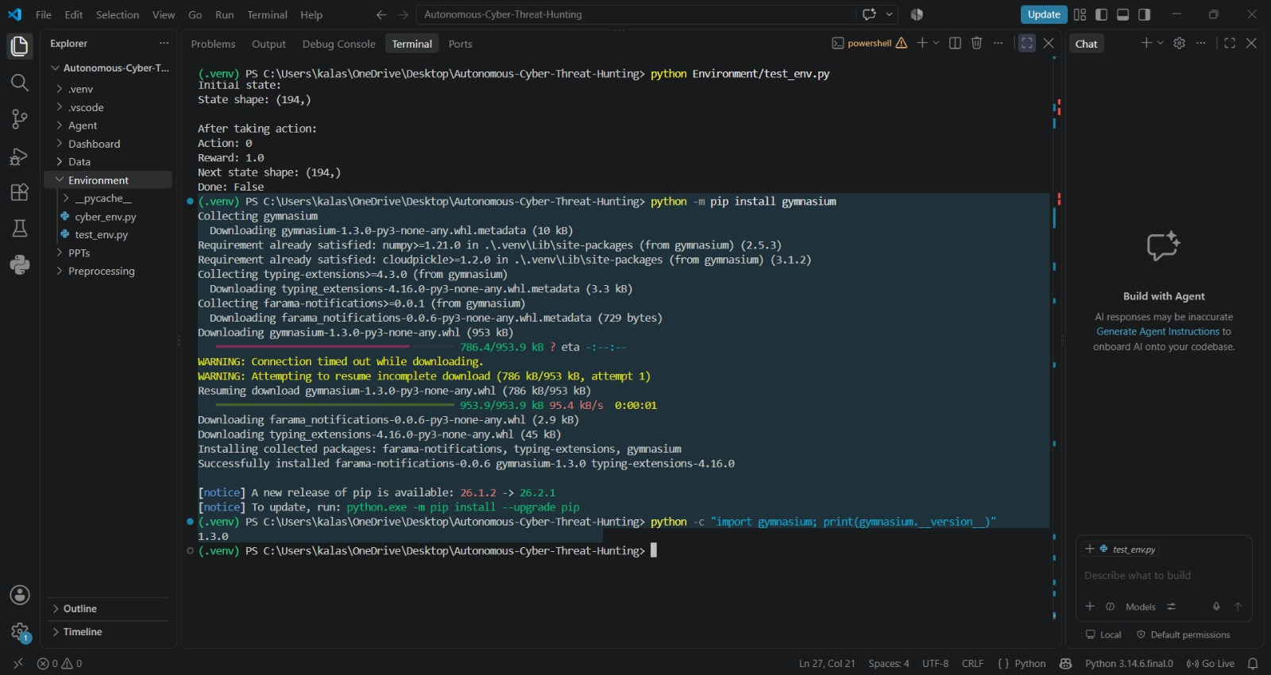
Environment Design

Slide 16
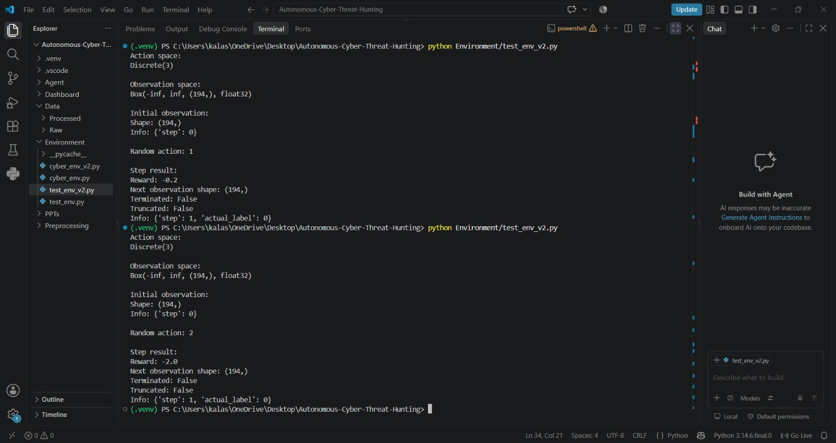
Environment Design

Slide 17
Environment Design
Running a random agent for multiple steps.
This will verify that:
the environment can run continuously,
actions are accepted correctly,
rewards are being generated,
episodes terminate correctly,
there are no hidden environment bugs.

Slide 18
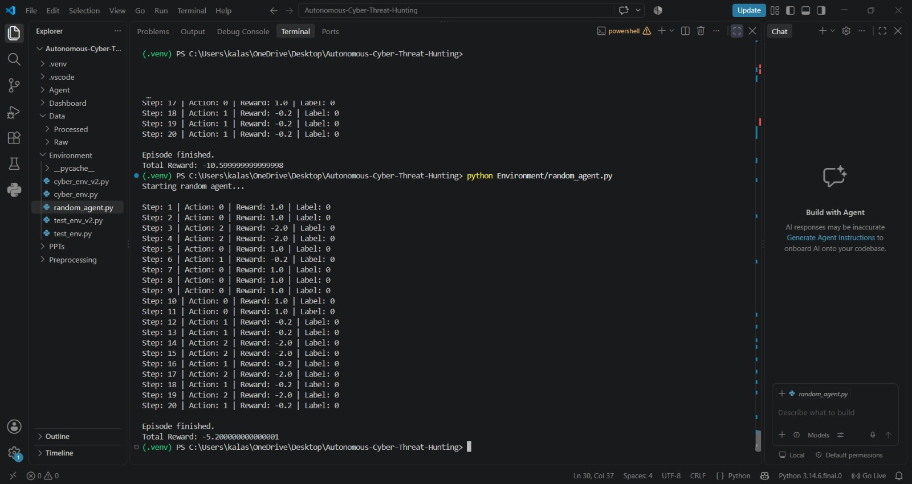
Environment Design

Slide 19
Difference Between Environment V1 and V2
Feature | Environment V1 | Environment V2
Purpose | Basic proof-of-concept | Proper RL-ready environment
RL framework | None | Gymnasium
Class | Normal Python class | gym.Env
State | 194 features | 194 features
Actions | 3 actions | 3 actions
Actions | Monitor, Investigate, Contain | Same
Reward | Basic reward function | Same for now
reset() | Returns state only | Returns (observation, info)
step() | Returns 3 values | Returns 5 values
Action space | Just num_actions = 3 | Discrete(3)
Observation space | Not formally defined | Box(..., shape=(194,))
Episode handling | Basic done | terminated + truncated
RL algorithm compatibility | Not directly | Yes
Testing | Manual | Standardized

Slide 20
Environment Design
RL Environment Setup and Implementation
Set up a dedicated Python virtual environment for the project.
Installed the required Reinforcement Learning libraries and dependencies.
Integrated Stable-Baselines3 for implementing RL algorithms.
Prepared the project structure for agent, environment, data, preprocessing, and dashboard modules.
Developed and tested the cybersecurity environment before integrating the RL agent.
Verified the successful installation and working version of the RL framework.
This setup provides the foundation for training and evaluating the autonomous cyber threat-hunting agent.

Slide 21
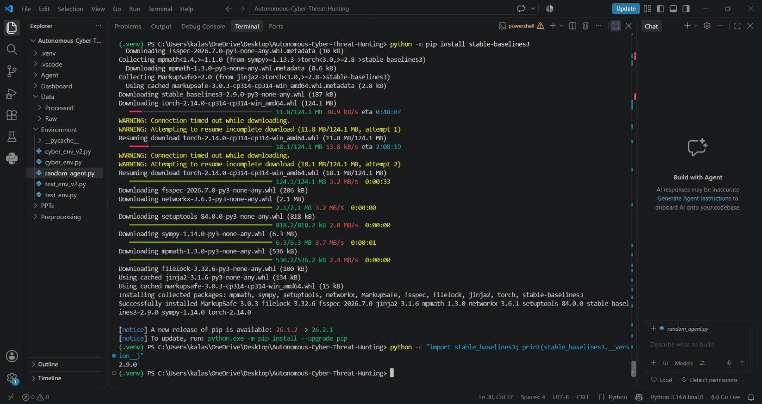

Slide 22
Visualisation and Deployment
The developed AI Cyber Threat Hunting Command Center provides a centralized visual interface for monitoring network activity, analysing threats, observing agent decisions, and maintaining security records.
1. Real-Time Stream Analytics
Provides a live overview of the network events being processed by the system.
Displays important performance indicators such as accuracy, precision, recall, and reward balance.
Shows the traffic status, extracted network features, and the action selected by the autonomous agent.
Helps in continuously monitoring the system's threat detection and decision-making process.
2. Performance & Agent Diagnostics
Provides visual analysis of the overall performance of the threat-hunting system.
Uses a confusion matrix to compare actual network conditions with the system's predictions.
Displays the cumulative reward trend, helping to observe the agent's decision-making performance over multiple events.
Provides a comparison of different reinforcement-learning models based on key performance measures.

Slide 23
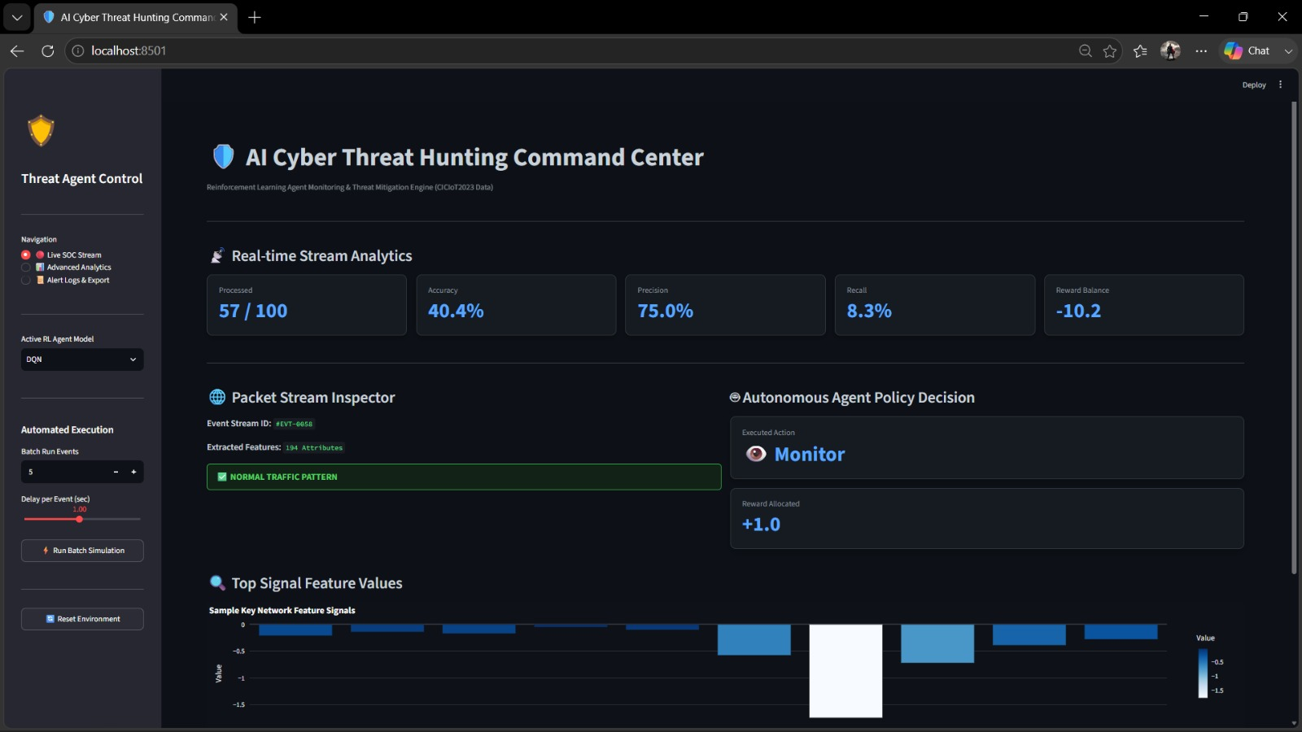
Visualisation and Deployment

Slide 24
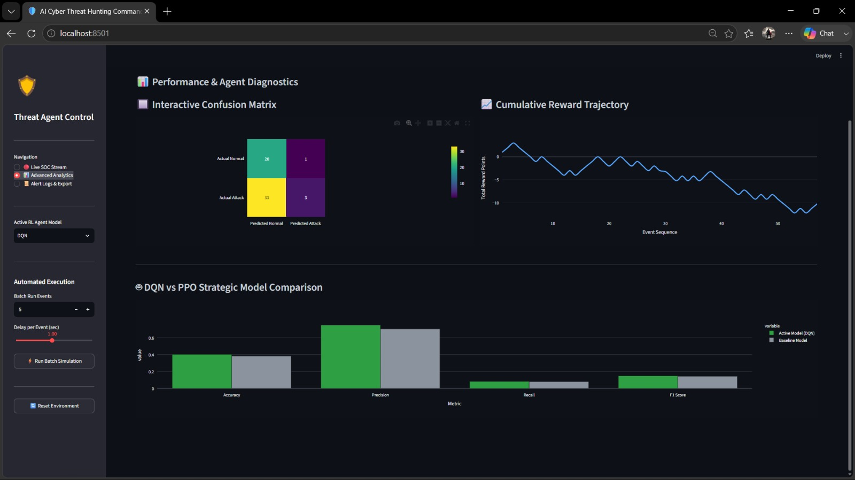
Visualisation and Deployment

Slide 25
Visualisation and Deployment
3. Threat Incident Audit Logs
Maintains a record of previously processed network events.
Stores information such as traffic type, system prediction, agent action, reward, and event status.
Helps identify correct decisions and misclassified events for further analysis.
Provides filtering options and CSV export for maintaining and analysing security records.
4. Packet Stream Inspector
Provides a detailed view of an individual network event.
Displays the event ID, extracted network attributes, and identified traffic pattern.
Shows the action taken by the autonomous agent and the corresponding reward.
Visualizes selected network feature values to help understand the characteristics of the processed event.

Slide 26
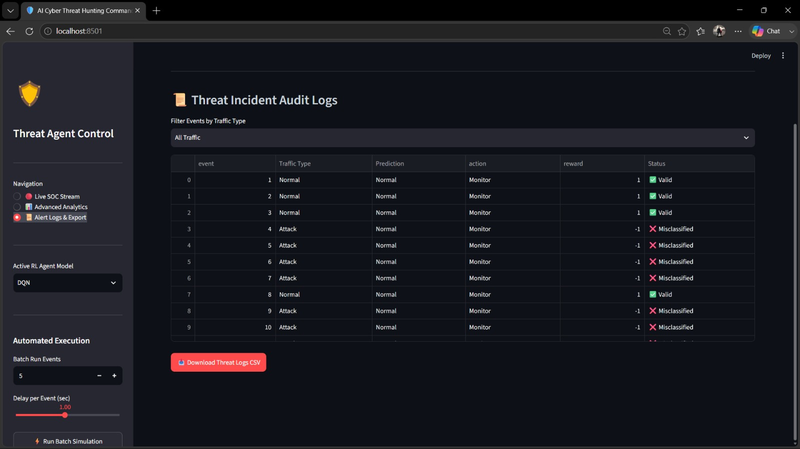
Visualisation and Deployment

Slide 27
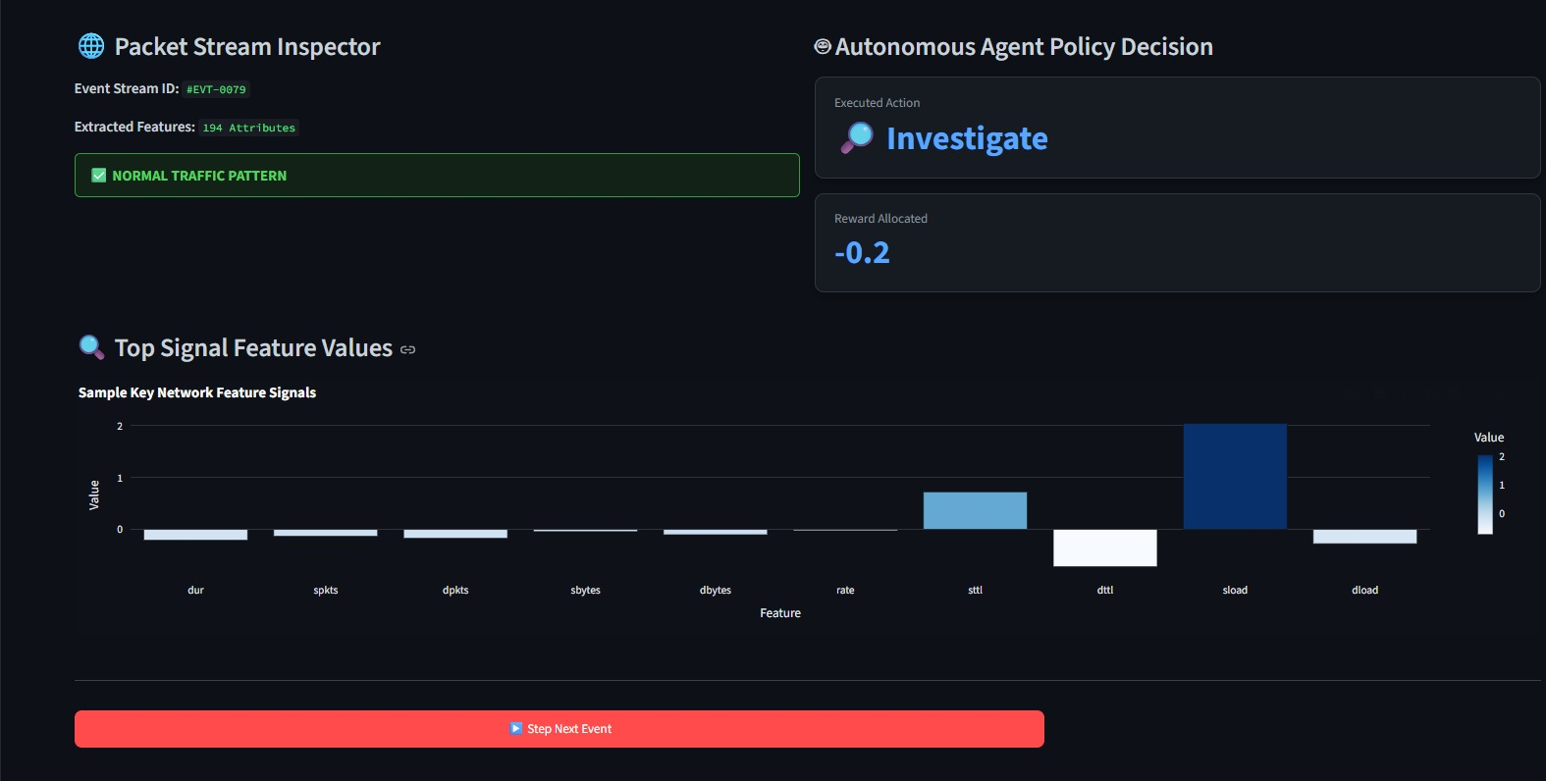
Visualisation and Deployment

Slide 28
References
https://www.kaggle.com/datasets/himadri07/ciciot2023
https://docs.streamlit.io/get-started/installation
https://gymnasium.farama.org/
https://stable-baselines3.readthedocs.io/en/master/

Slide 29
Thank You!

