Slide 1
Name: Amos Kipngeno Rotich
Reg Number: S084-01-2742/2021
Course: Mathematics And Modelling Processes
Department: Mathematics And Physical Sciences
Title: Mathematical Modelling Of Substance Abuse By Commercial Drivers

Slide 2
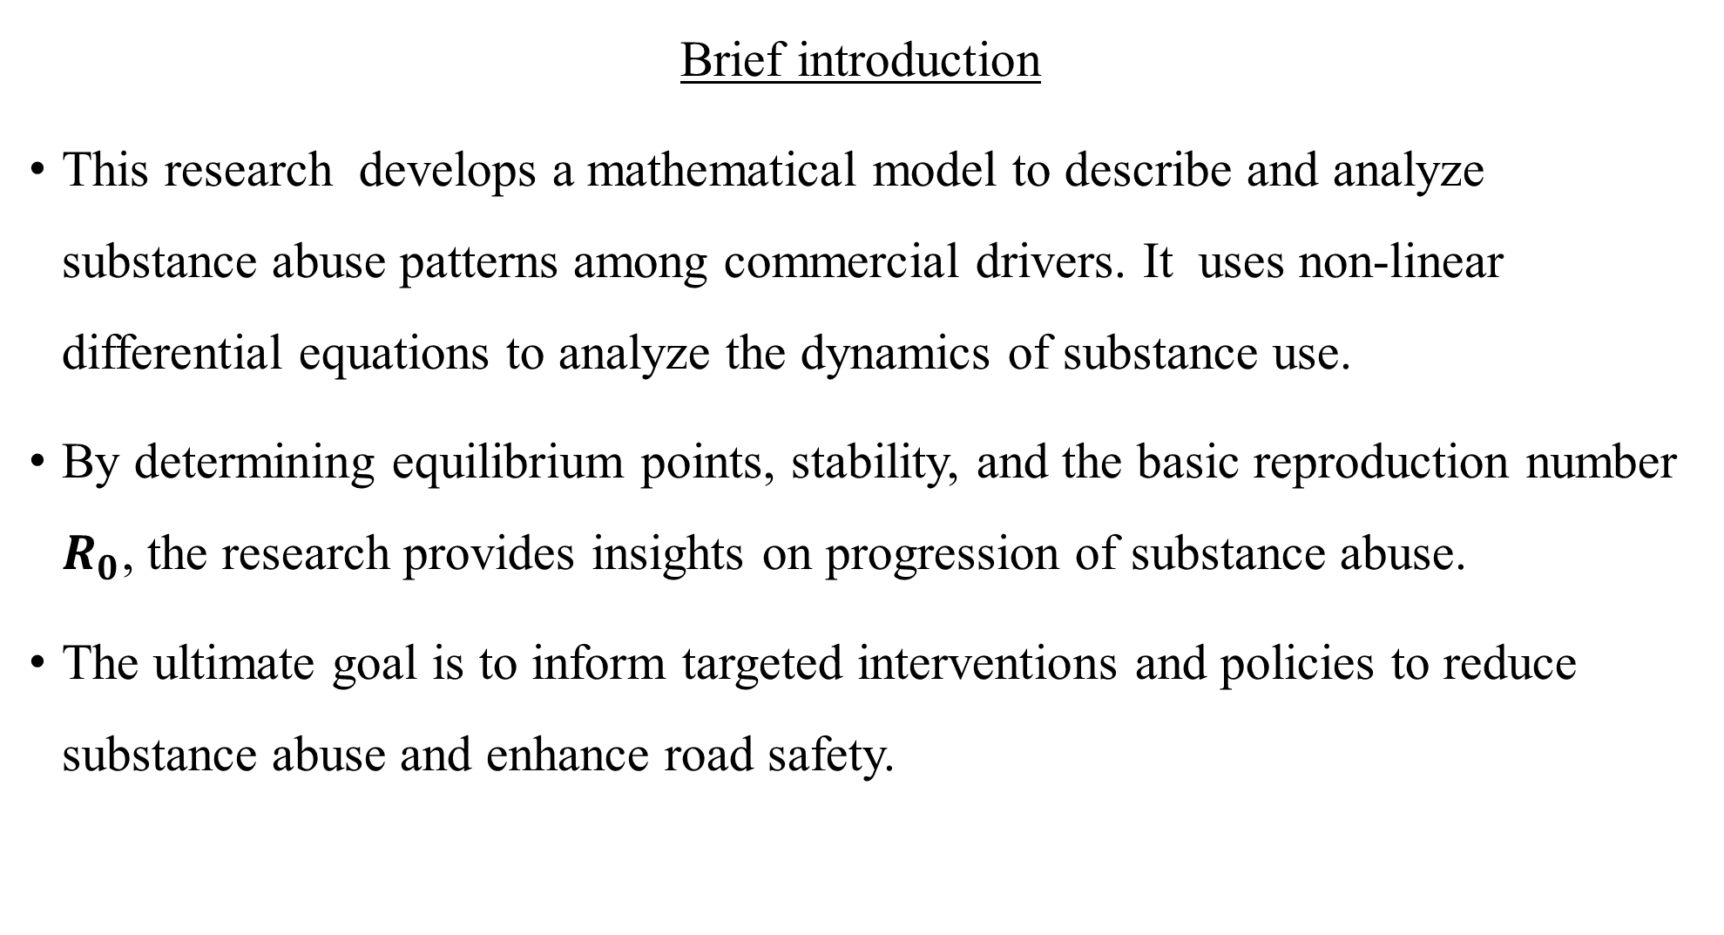
Brief introduction
This research develops a mathematical model to describe and analyze substance abuse patterns among commercial drivers. It uses non-linear differential equations to analyze the dynamics of substance use.
By determining equilibrium points, stability, and the basic reproduction number $R_{0}$, the research provides insights on progression of substance abuse.
The ultimate goal is to inform targeted interventions and policies to reduce substance abuse and enhance road safety.

Slide 3
General Objective:
To formulate a mathematical model to describe the patterns of substance abuse among commercial drivers.
Specific Objectives
1.Develop a mathematical model
2. To determine the equilibrium points of the mathematical model and investigate their stabilities.
3. Utilize the developed model to analyze the dynamics of substance abuse behaviors among commercial drivers and identify factors influencing driving under the influence.
4. Identify strategies that effectively reduce substance abuse among commercial drivers.

Slide 4


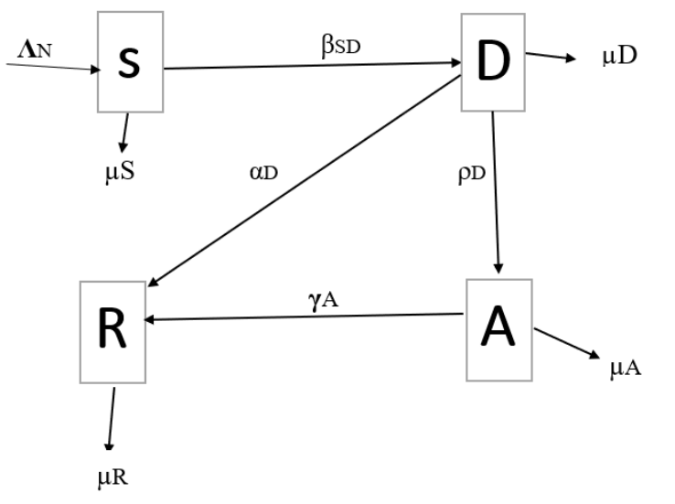


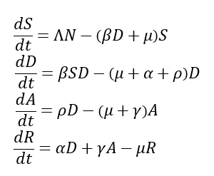

Slide 5
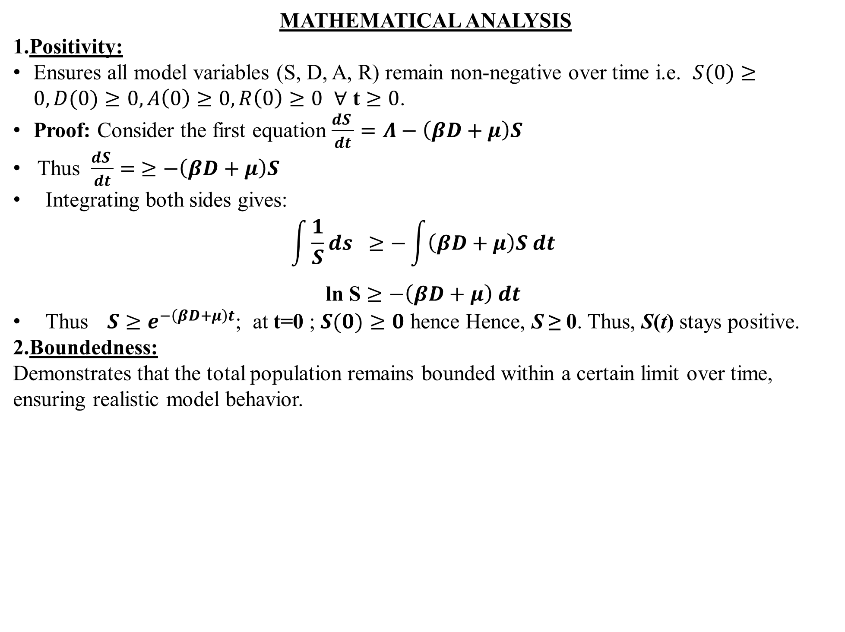
MATHEMATICAL ANALYSIS
1.Positivity:
Ensures all model variables (S, D, A, R) remain non-negative over time i.e. $S(0)≥0, D(0)≥0, A\left(0\right)≥0,R\left(0\right)≥0$ $∀$ t $≥0$.
Proof: Consider the first equation $\frac{dS }{dt}=Λ−\left(βD+μ\right)S$
Thus $\frac{dS }{dt}= ≥−\left(βD+μ\right)S$
Integrating both sides gives:
$$\int{\frac{1}{S}ds } ≥−\int{\left(βD+μ\right)S dt }$$
$\text{l}$n S $≥−\left(βD+μ\right) dt$
Thus$S≥e^{−\left(βD+μ\right)t}$; at t=0 ; $S(0)≥0$ hence Hence, S ≥ 0. Thus, S(t) stays positive.
2.Boundedness:
Demonstrates that the total population remains bounded within a certain limit over time, ensuring realistic model behavior.

Slide 6
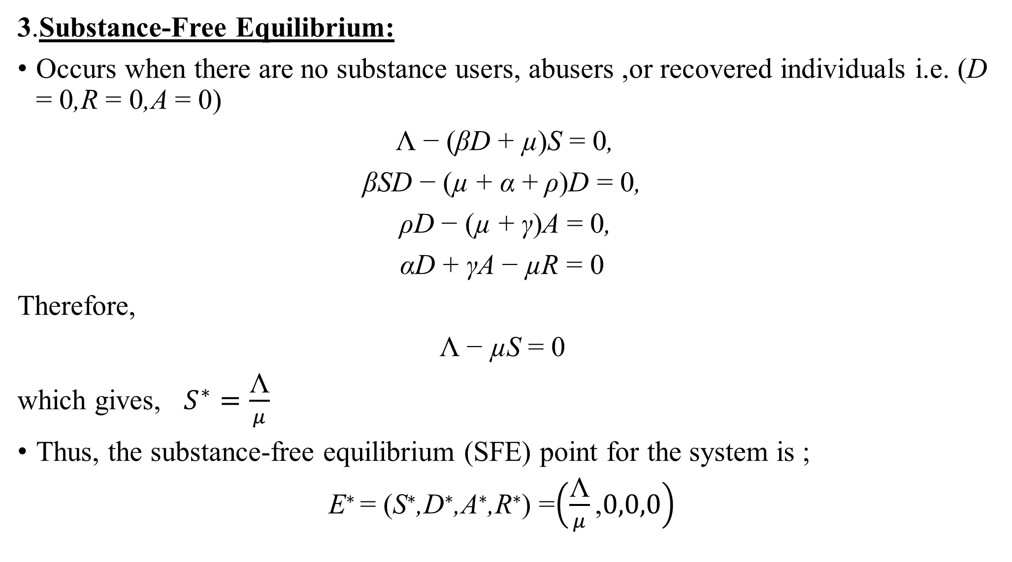
3.Substance-Free Equilibrium:
Occurs when there are no substance users, abusers ,or recovered individuals i.e. (D = 0,R = 0,A = 0)
Λ − (βD + µ)S = 0,
βSD − (µ + α + ρ)D = 0,
ρD − (µ + γ)A = 0,
αD + γA − µR = 0
Therefore,
Λ − µS = 0
which gives, $S^{∗}=\frac{\text{Λ}}{μ}$
Thus, the substance-free equilibrium (SFE) point for the system is ;
E∗ = (S∗,D∗,A∗,R∗) =$\left(\frac{\text{Λ}}{μ}\text{,}0,0,0\right)$
.

Slide 7
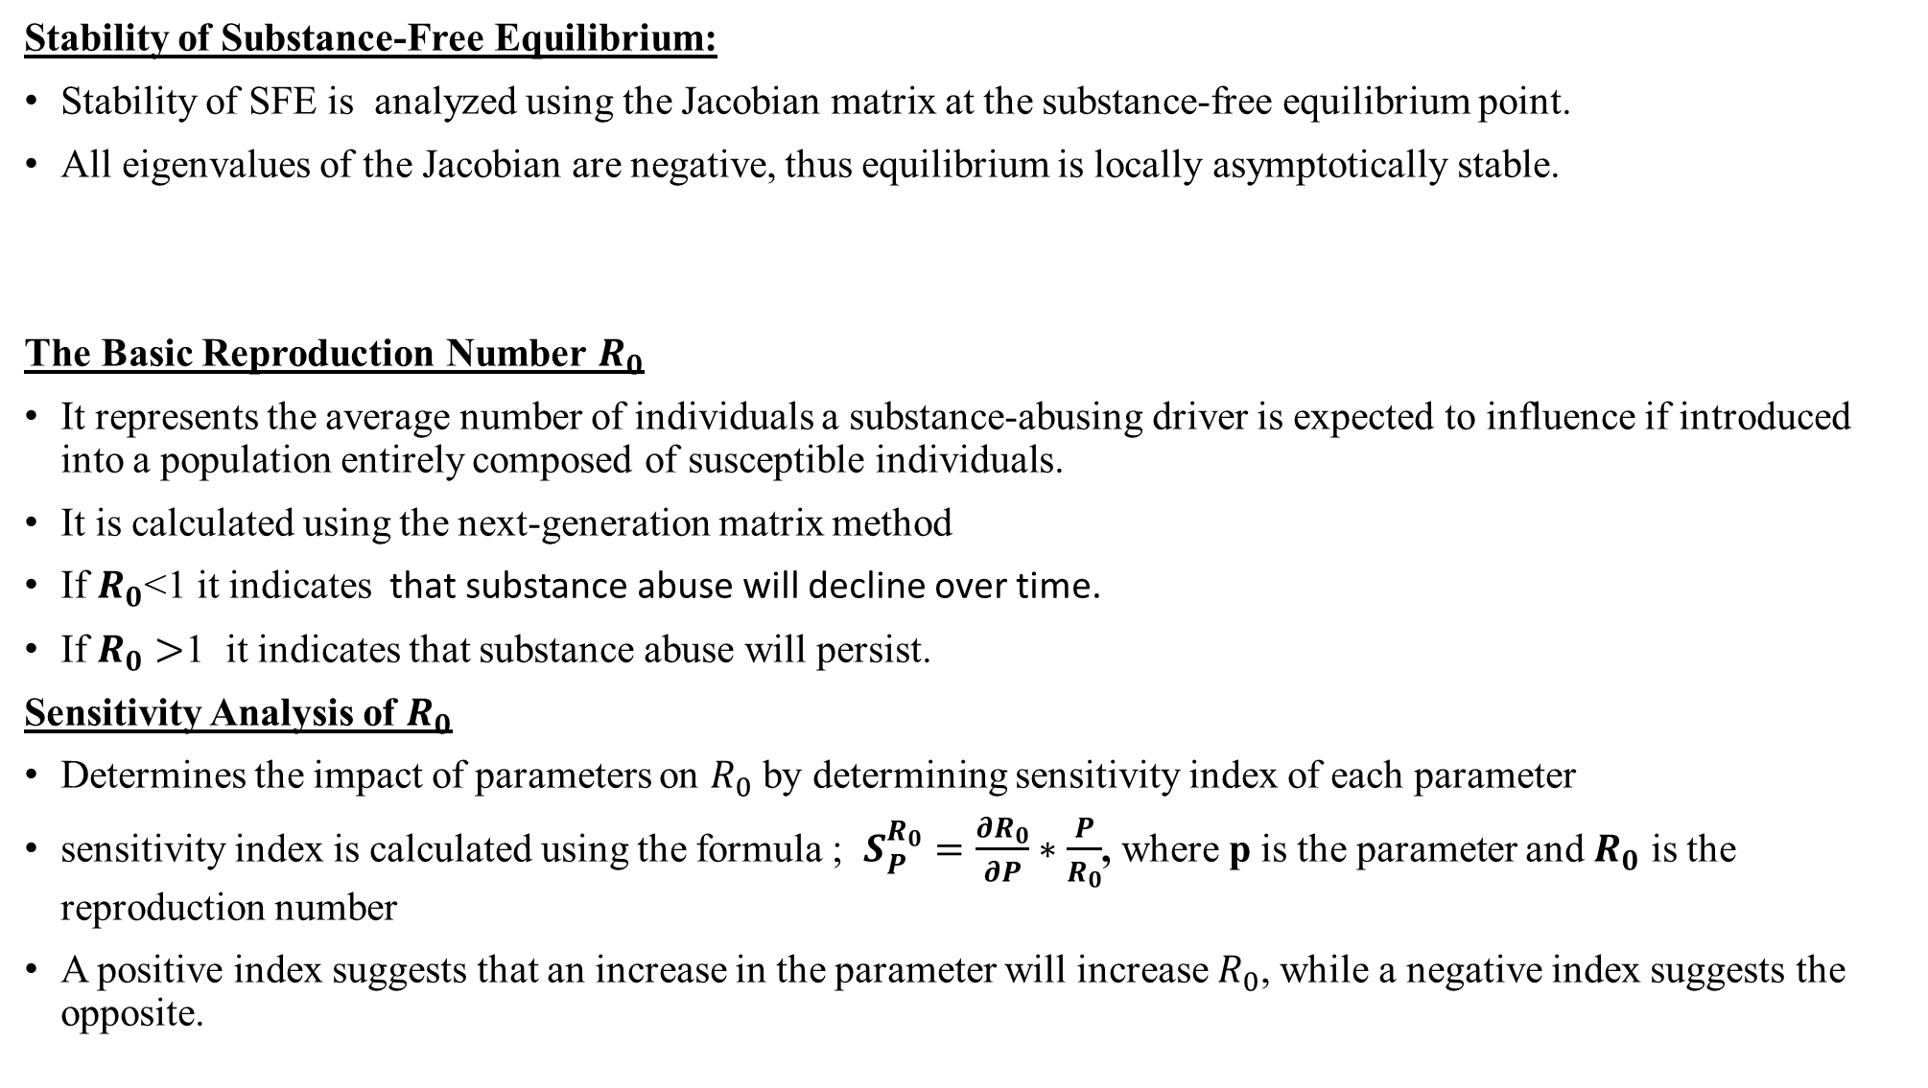
Stability of Substance-Free Equilibrium:
Stability of SFE is analyzed using the Jacobian matrix at the substance-free equilibrium point.
All eigenvalues of the Jacobian are negative, thus equilibrium is locally asymptotically stable.
The Basic Reproduction Number $R_{0}$
It represents the average number of individuals a substance-abusing driver is expected to influence if introduced into a population entirely composed of susceptible individuals.
It is calculated using the next-generation matrix method
If $R_{0}$<1 it indicates that substance abuse will decline over time.
If $R_{0}>$1 it indicates that substance abuse will persist.
Sensitivity Analysis of $R_{0}$
Determines the impact of parameters on $R_{0}$ by determining sensitivity index of each parameter
sensitivity index is calculated using the formula ; $S_{P}^{R_{0}}=\frac{∂R_{0}}{∂P}∗\frac{P}{R_{0}}$, where p is the parameter and $R_{0}$ is the reproduction number
A positive index suggests that an increase in the parameter will increase $R_{0}$, while a negative index suggests the opposite.

