Slide 1

SMART WASTE COLLECTION SYSTEM
For Villages and Towns
IoT Telemetry, Priority-Engine Routing & AI Demand Forecasting Platform
📡 IoT Bin Telemetry
⚡ Weighted Priority Score
🤖 AI Waste Demand Forecast
📱 Installable PWA App
Demonstrated in Narasipuram & Coimbatore Town Panchayats | Powered by Supabase Realtime & OSRM

Slide 2
BACKGROUND & PROBLEM STATEMENT
Rural & Town Waste Collection Challenges
Why traditional fixed-schedule collection fails in semi-urban and village local bodies
🚚 1. Wasteful Fixed-Route Trips
Vehicles run identical routes daily regardless of fill status, wasting 40%+ fuel visiting empty bins while filled bins overflow.
⚠️ 2. Market & Festival Surges
Weekly village markets (shanthi) and temple festivals trigger sudden waste volume spikes that exceed standard bin capacity.
🚫 3. Zero Realtime Admin Visibility
Panchayat administrators lack live data on bin fill levels, vehicle GPS locations, worker progress, or overdue alerts.
😷 4. Health & Environmental Hazards
Unattended waste piles breed disease vectors (mosquitoes/flies), emit odors, and trigger unmonitored civic grievances.

Slide 3
PROJECT OVERVIEW & SOLUTION
SmartWaste: Data-Driven Collection Architecture
End-to-end platform connecting Citizens, Drivers, and Panchayat Administrators
1. Dual-Source Telemetry Input
Ultrasonic IoT bin sensors paired with geotagged Citizen PWA waste reports and photo attachments.
2. Realtime Supabase Cloud
Instant WebSocket synchronization connecting PostgreSQL database tables across Citizen, Driver & Admin web portals.
3. Algorithmic Priority Engine
Dynamic weighted scoring (0-100) prioritizing urgent cleanup requests based on fill %, age, and urgency.
4. OSRM Shortest-Path Dispatch
Turn-by-turn dynamic routes generated via OSRM API and pushed directly to driver mobile app.

Slide 4
TECHNOLOGY STACK
Full-Stack Technology Architecture
Built using modern, high-performance open-source tools and cloud infrastructure
Frontend & UI Layer
• Next.js 15 (App Router, Server Actions)
• React 18 & TypeScript (Type-safe schemas)
• Tailwind CSS 3 (Responsive glassmorphism)
• Lucide Icons & Recharts Data Visualization
Backend & Realtime Layer
• Supabase Cloud (PostgreSQL Database)
• Supabase Realtime (WebSocket Sync)
• Supabase Auth (Role-Based Access Control)
• @supabase/ssr (Server-side middleware)
GIS & PWA Infrastructure
• Leaflet.js & OpenStreetMap (Interactive maps)
• OSRM API (Open Source Routing Machine)
• Service Worker & Web App Manifest (PWA)
• Vercel Cloud Edge Hosting (Global CDN)

Slide 5

CORE INTELLIGENCE & AI
Smart Scoring & Predictive Analytics Engine
Automated priority weighting and market day surge forecasting
🤖 AI Waste-Demand Forecasting
• Predicts 24-48h upcoming surge volumes based on day-of-week filling rates and market calendar patterns.
• Proactively recommends vehicle dispatch before bins overflow during village peak days.
🚨 Automated Overdue Alert Engine
• Automatically escalates reports and bins uncollected for over 24 hours to high-priority status.
• Triggers sound alerts and notifications on Panchayat Admin and Driver dashboards.

Slide 6
MULTI-ROLE WORKFLOWS
Dedicated User Portals & Features
Role-based user experiences tailored for Citizens, Drivers, and Administrators
👨‍👩‍👧 Citizen Portal
• Geotagged waste report submission with GPS location picker
• Photo attachment upload & status tracking (Pending → Assigned → Collected)
• Missed collection scheduling & personal report history log
🚛 Driver / Worker Portal
• Assigned dynamic route list & turn-by-turn navigation map
• Guided collection workflow: START → ARRIVE → COLLECT → VERIFY
• Mandatory collection photo proof upload before resolving tasks
🏛️ Admin Dashboard
• Real-time Leaflet map of all bins, report markers & driver vehicles
• Priority queue management & dynamic route generation tool
• IoT telemetry sensor simulator & volume analytics reporting

Slide 7
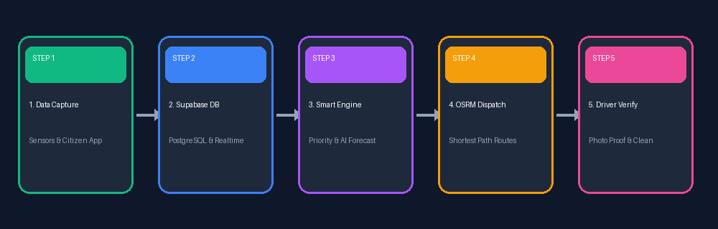
SYSTEM ARCHITECTURE
End-to-End Data Pipeline & System Workflow
How data flows seamlessly from sensors and citizens to driver execution and admin monitoring
Key Pipeline Strengths: Realtime Supabase WebSockets stream instant database changes to maps without page reload. OSRM API calculates true road distance routes rather than straight lines.

Slide 8
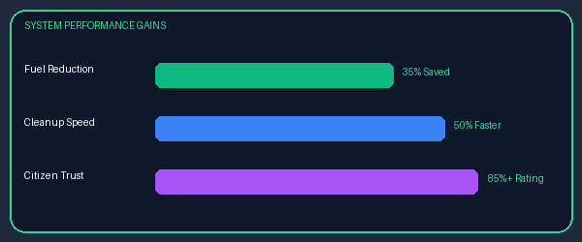
MEASURED IMPACT & FUTURE SCOPE
System Benefits & Future Expansion Scope
Transforming village waste management with data, efficiency, and sustainability
📊 Key Project Outcomes
⛽ 35% Fuel Savings: Dynamic OSRM routes eliminate trips to empty bins.
⏱️ 50% Faster Response: Automated priority alerts dispatch vehicles quickly.
🍃 85%+ Citizen Trust: Transparent reporting & live cleanup verification.
🚀 FUTURE EXPANSION ROADMAP
• 1. LoRaWAN IoT Mesh Network: Ultra-low-power long-range rural sensor connectivity without cellular SIM costs.
• 2. Satellite & Drone AI Vision: Computer vision surveys detecting open illegal dump yards in rural outskirts.
• 3. Recycling Token Rewards: Gamified citizen reward points for household dry/wet waste segregation at source.

