Slide 1

Enhancing Search Engine Relevance for Video Subtitles
By,
1. Charishma Maradapu - IN1240249
2. Shraddha Kalaskar - IN1241033
Team ID – T211082

Slide 2
OBJECTIVE
Develop an advanced search engine application that efficiently retrieves subtitles based on user queries, with a specific emphasise on subtitle content. The primary goal is to leverage natural language processing and machine learning techniques to enhance the relevance and accuracy of search results.

Slide 3
Introduction
In the fast-evolving landscape of digital content, effective search engines play a pivotal role in connecting users with relevant information. For Google, providing a seamless and accurate search experience is paramount. This project focuses on improving the search relevance for video subtitles, enhancing the accessibility of video content.

Slide 4
TYPES OF SEARCH ENGINES
Keyword-Driven Search Engines: These search systems heavily prioritize exact matches between user queries and indexed documents based on specific keywords.
Semantic Search Engines: These sophisticated search platforms surpass basic keyword matching, diving deeper into the meaning and context of user queries and documents to provide richer and more insightful results

Slide 5
Keyword-Based vs Semantic Search Engine
Keyword-Based Search Engine: These search engines rely heavily on exact keyword matches between the user query and the indexed documents.
Semantic Search Engines: Semantic search engines go beyond simple keyword matching to understand the meaning and context of user queries and documents.
Comparison: While keyword-based search engines focus primarily on matching exact keywords in documents, semantic-based search engines aim to understand the deeper meaning and context of user queries to deliver more relevant and meaningful search results

Slide 6
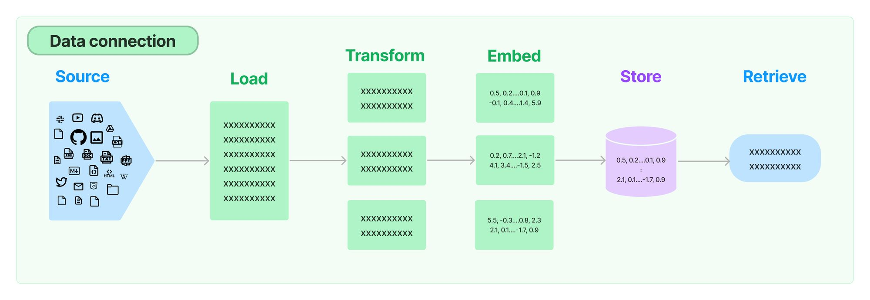
WorkFlow
Part 1: Ingesting Documents
Data Sampling
Document chuker
Data Preprocessing
Text Vectorization
Storing embeddings in a ChromaDB database

Slide 7
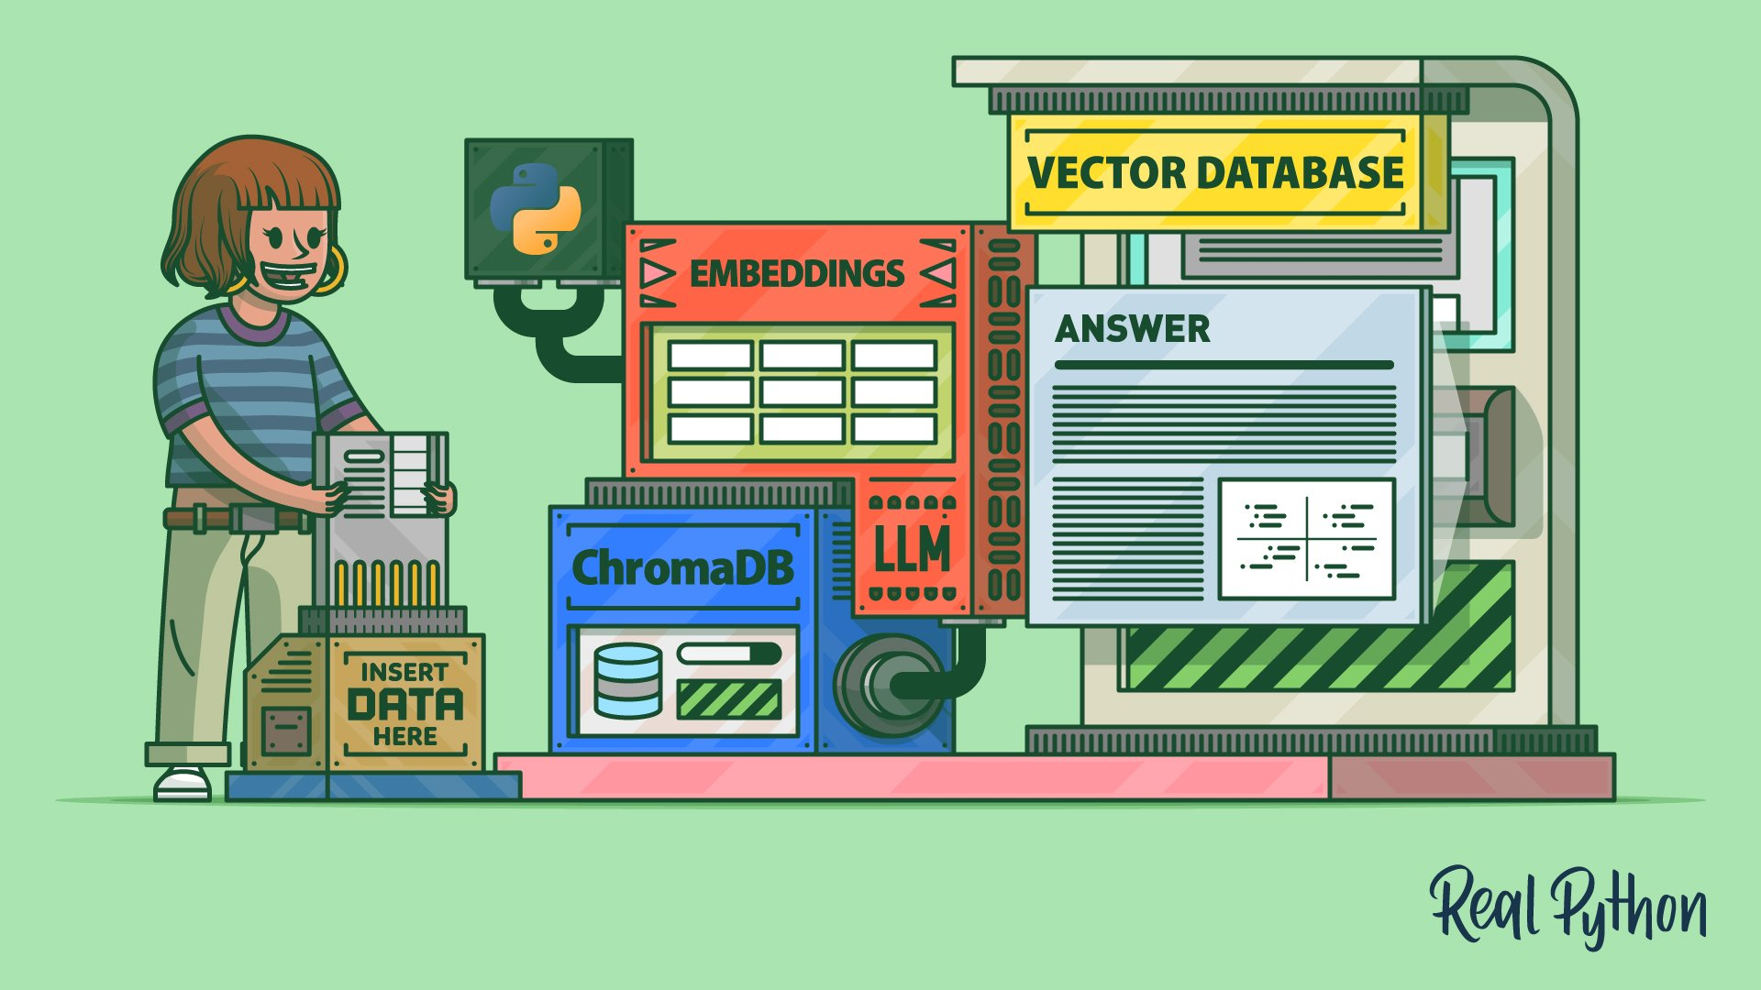
Part 2: Retrieving Document
Take the user's search query.
Preprocess the query (if required).
Create query embedding.
Using cosine distance, calculate the similarity score between embeddings of documents and user search query embedding.
These cosine similarity scores will help in returning the most relevant candidate documents as per user’s search query.

Slide 8
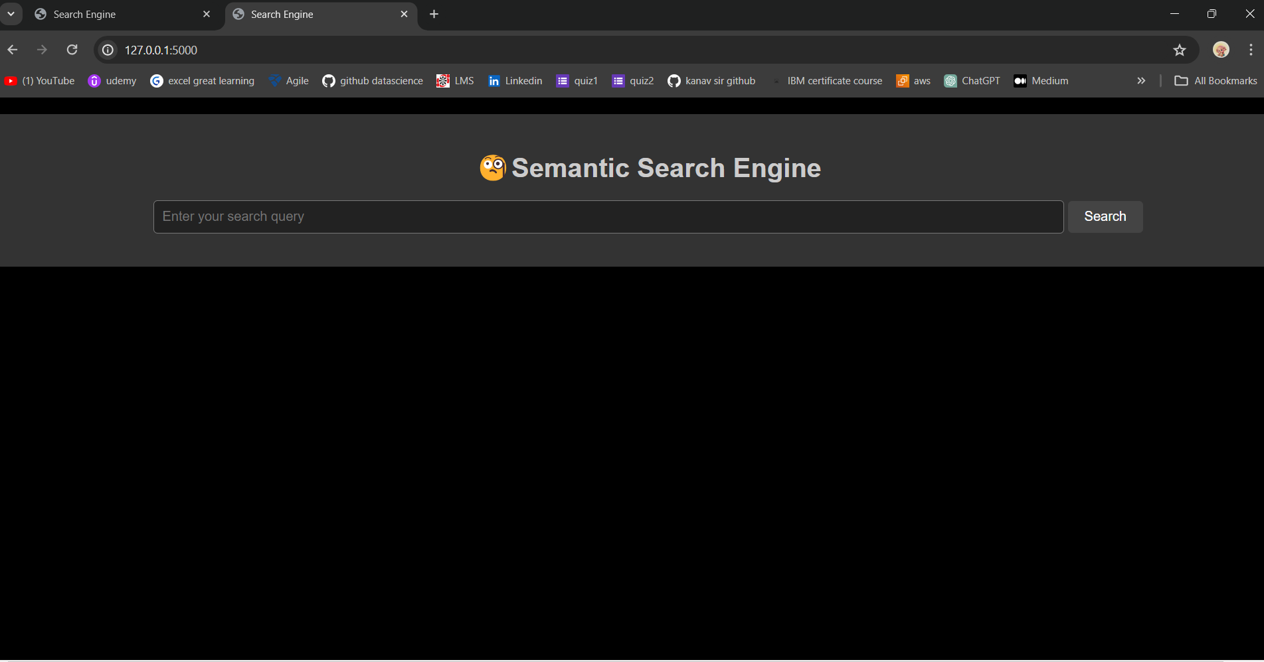
User Interface

Slide 9
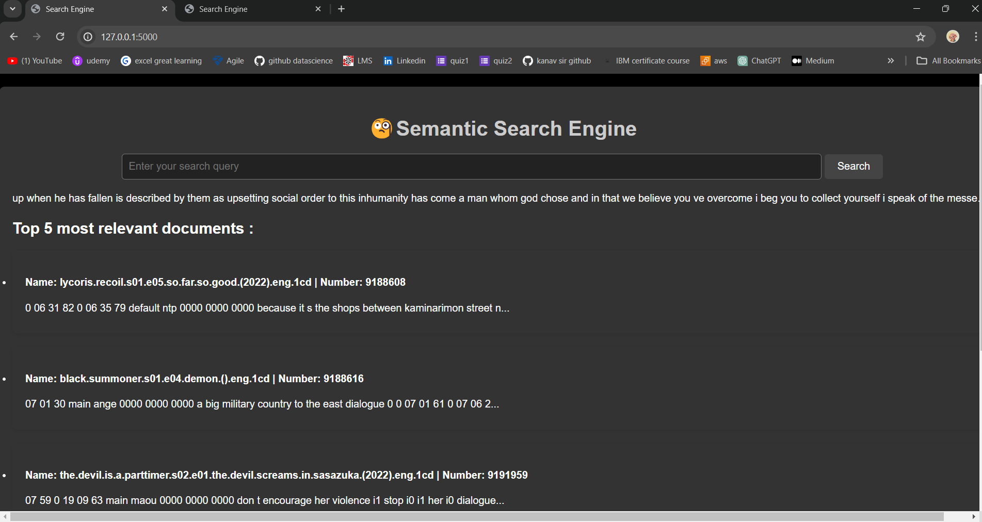
Results

Slide 10
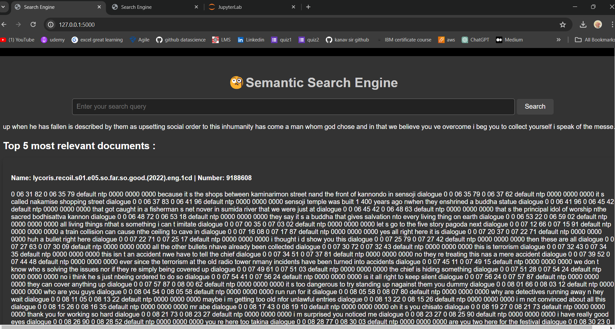
Results

Slide 11
Conclusion
The project successfully improved the search relevance of video subtitles, enhancing the accessibility of video content for users. Leveraging advanced search engine applications, we achieved more accurate and meaningful search results. By preprocessing data, vectorizing documents and user queries, and calculating cosine similarity, we delivered enhanced user experiences for searching their subtitles for required movies/Series.

Slide 12

THANK YOU

