Slide 1
COURSE-BASED PROJECT | C PROGRAMMING
STUDENT GRADE CHECKER
& PERFORMANCE MANAGEMENT SYSTEM
A file-based academic record and performance analysis application developed in C
PERFORMANCE
TOTAL
428 / 500
PRESENTED BY
PERCENTAGE
85.6%
Kalava Harsith Reddy| 1602-25-733-079
T.Jathin Sai | 1602-25-733-080
Koushya Sri | 1602-25-733-081
SGPA
9.0 / 10
C • STRUCTURES • FILES
Department of Computer Science & Engineering • Academic Year 2026–27

Slide 2
ABSTRACT
The Student Grade Checker and Performance Management System is a menu-driven C application that stores student profiles and subject-wise academic records in a binary file. It automates total marks, percentage, letter-grade and credit-weighted GPA calculations. The system also produces individual report cards, class-level performance analytics, percentage-based rankings and a semester progress comparison. A personalized improvement plan highlights backlogs or the weakest subject and flags attendance below the 75% threshold. The program uses structures, arrays, functions and standard C file operations to provide persistent, organized academic record management.
DATA STORAGE
AUTOMATED EVALUATION
PERFORMANCE INSIGHTS
Student records are saved in students.dat using binary file handling.
Marks, percentage, grades, SGPA and an estimated CGPA are calculated.
Reports, rankings, class analytics and improvement guidance.
02 / 08

Slide 3
INTRODUCTION
PROJECT OVERVIEW
CORE OBJECTIVES
The application maintains student identity, department, semester, attendance and subject records. Each subject stores obtained marks, maximum marks and credits. The program provides a direct console menu for adding students, searching reports, updating marks and reviewing performance.
• Reduce manual effort in academic calculations.
• Maintain records across program executions.
• Apply a consistent grade and pass/fail scheme.
• Identify weak subjects and students with backlogs.
• Compare student and class-level performance.
IMPLEMENTATION SCOPE
LANGUAGE
PERSISTENCE
CAPACITY
SUBJECTS
SEMESTERS
C
Binary file
100 students
Up to 10 / student
1–8
03 / 08

Slide 4
ALGORITHM & SYSTEM WORKFLOW
START
Initialize program
ACADEMIC CALCULATION
1. Total = sum of obtained subject marks
2. Percentage = (Total / Maximum Total) × 100
3. Grade and grade point are selected from percentage bands.
4. SGPA = Σ(grade point × subject credits) / Σ(credits)
5. CGPA is estimated using previous percentage-derived GPA and current SGPA.
6. PASS requires no subject below 40% and attendance ≥ 75%.
LOAD
Read student count and records from students.dat
MENU
Display options and accept a validated choice
PROCESS
Add / search / update / analyze / rank / compare
SAVE
Write updated records to the binary file
GRADE BANDS (PERCENTAGE)
END
Exit when option 7 is selected
O
A+
A
B+
B
C
F
90+
80–89
70–79
60–69
50–59
40–49
<40
04 / 08

Slide 5
CODE — CORE IMPLEMENTATION
Selected excerpts from the submitted C program
1 | STRUCTURES — STUDENT & SUBJECT
2 | PERCENTAGE & GPA CALCULATION
typedef struct {
char name[MAX_NAME];
float marks, maxMarks;
int credits;
} Subject;
typedef struct {
int id;
char name[MAX_NAME], department[MAX_NAME];
int semester, subjectCount;
float attendance, previousPercentage;
Subject subjects[MAX_SUBJECTS];
} Student;
float gpa(Student s) {
float weightedPoints = 0;
int credits = 0;
for (int i = 0; i < s.subjectCount; i++) {
float p = (s.subjects[i].marks /
s.subjects[i].maxMarks) * 100;
weightedPoints += gradePoint(p) *
s.subjects[i].credits;
credits += s.subjects[i].credits;
}
if (credits == 0) return 0;
return weightedPoints / credits;
}
3 | BINARY FILE STORAGE
OTHER IMPORTANT FUNCTIONS
void saveData() {
FILE *fp = fopen(FILE_NAME, "wb");
if (fp == NULL) return;
fwrite(&studentCount, sizeof(int), 1, fp);
fwrite(students, sizeof(Student), studentCount, fp);
fclose(fp);
}
loadData() restores records at startup • findStudent() searches by ID • grade() maps percentage to a letter grade • ranking() sorts by percentage • improvementPlan() identifies academic risk.
05 / 08

Slide 6
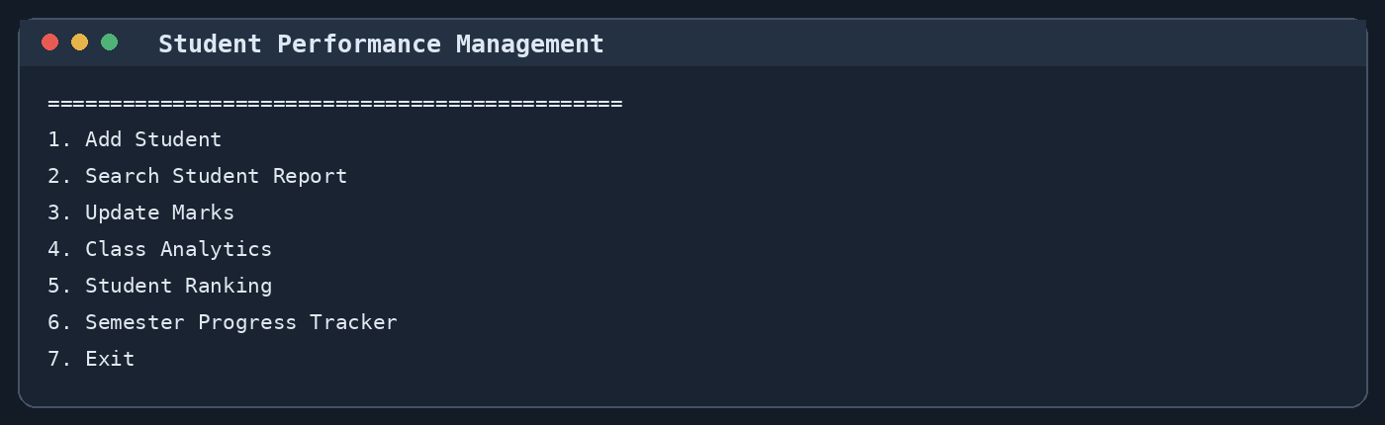
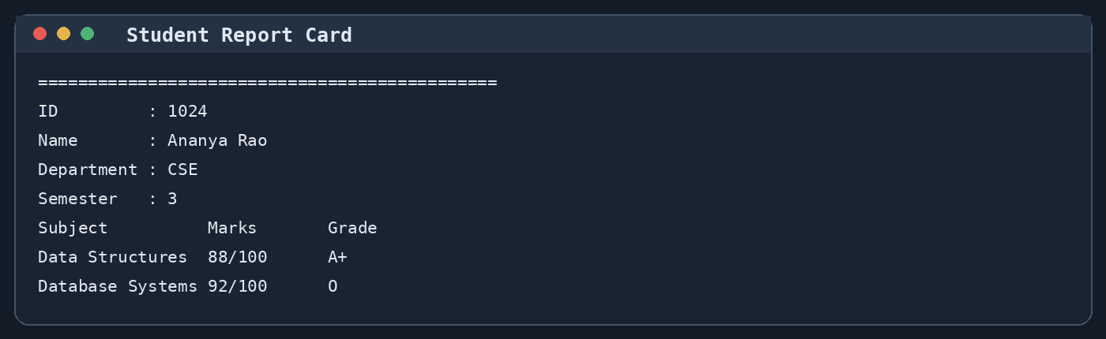
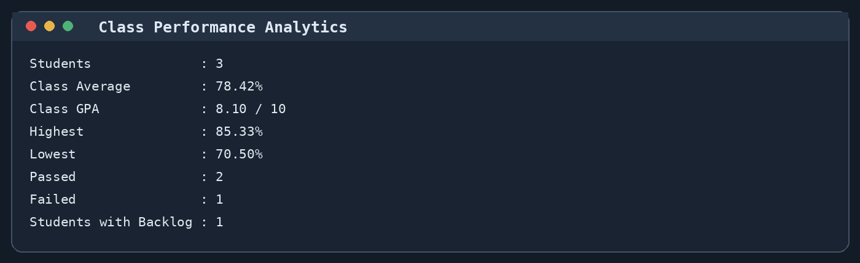
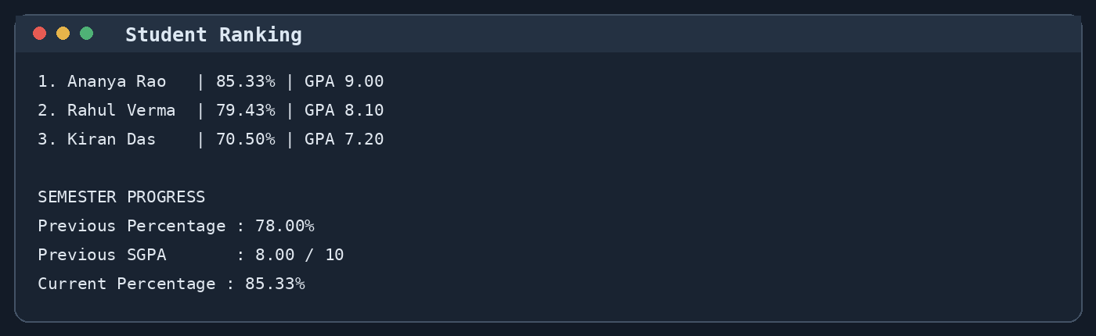
IMPORTANT OUTPUT SCREENSHOTS
Representative console captures using sample student data (illustrative values)
MENU
INDIVIDUAL REPORT
CLASS ANALYTICS
RANKING & PROGRESS
06 / 08

Slide 7
CONCLUSION
The project demonstrates how core C programming concepts can be combined to build a practical academic record management application. It reduces repetitive calculations and provides structured visibility into individual and class performance.
ACHIEVEMENTS
C IMPLEMENTATION
CURRENT LIMITATION
Persistent student records, automated grading, weighted GPA, reports, rankings and performance insights.
Structures, arrays, functions, input validation, searching, sorting and binary file I/O.
CGPA is an estimate based on previous percentage, not a calculation from stored semester-wise GPA records.
POSSIBLE FUTURE ENHANCEMENTS
Add record deletion and full edit options • Store actual GPA for every semester • Export reports to text files • Introduce configurable grading bands and institutional rules
07 / 08

Slide 8
REFERENCES
1
Submitted project source code
Student Grade Checker and Performance Management System (C program).
2
C standard library — stdio.h
File operations including fopen, fread, fwrite, fclose, fgets and printf.
3
C language — structures and arrays
Struct data types, arrays, functions, conditional logic and loops.
4
cppreference: C input/output
https://en.cppreference.com/w/c/io
5
GNU Compiler Collection (GCC)
https://gcc.gnu.org/onlinedocs/
Thank you
08 / 08

