Slide 1
Preprocessing and Filtering
Alison Greenlaw

Slide 2
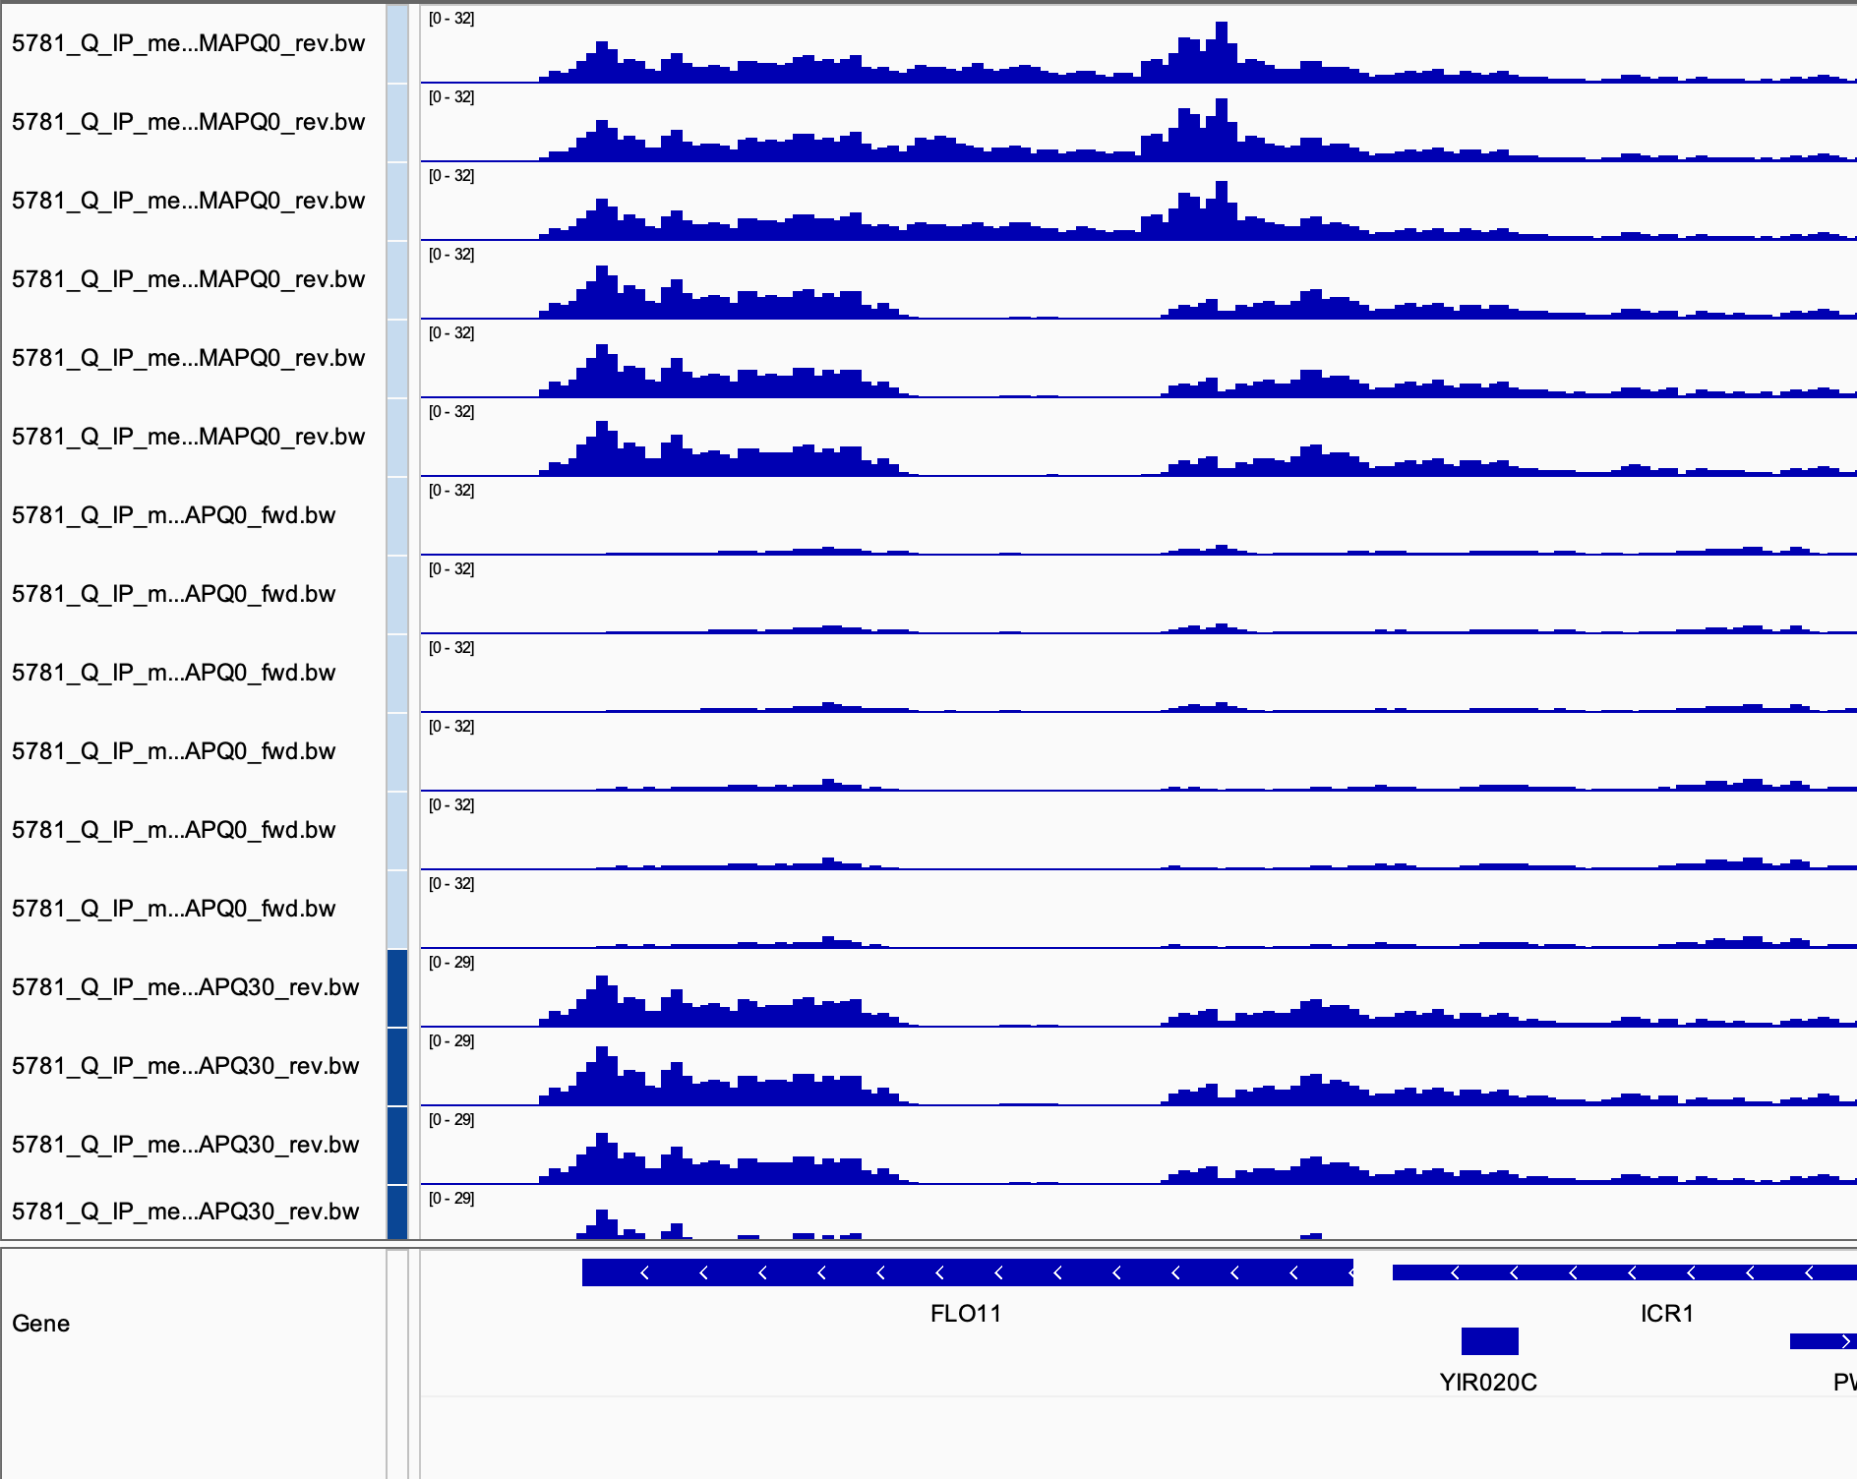
Without multi-hit mode, important coverage is excluded
I think this is coverage we want!
Multi hit mode 10, No MapQ filtering (no visually apparent differences with other preprocessing to me)
Reverse
Multi hit mode 1, No MapQ filtering
Forward
Multi hit mode 10, + MapQ > 30 filtering
Reverse

Slide 3
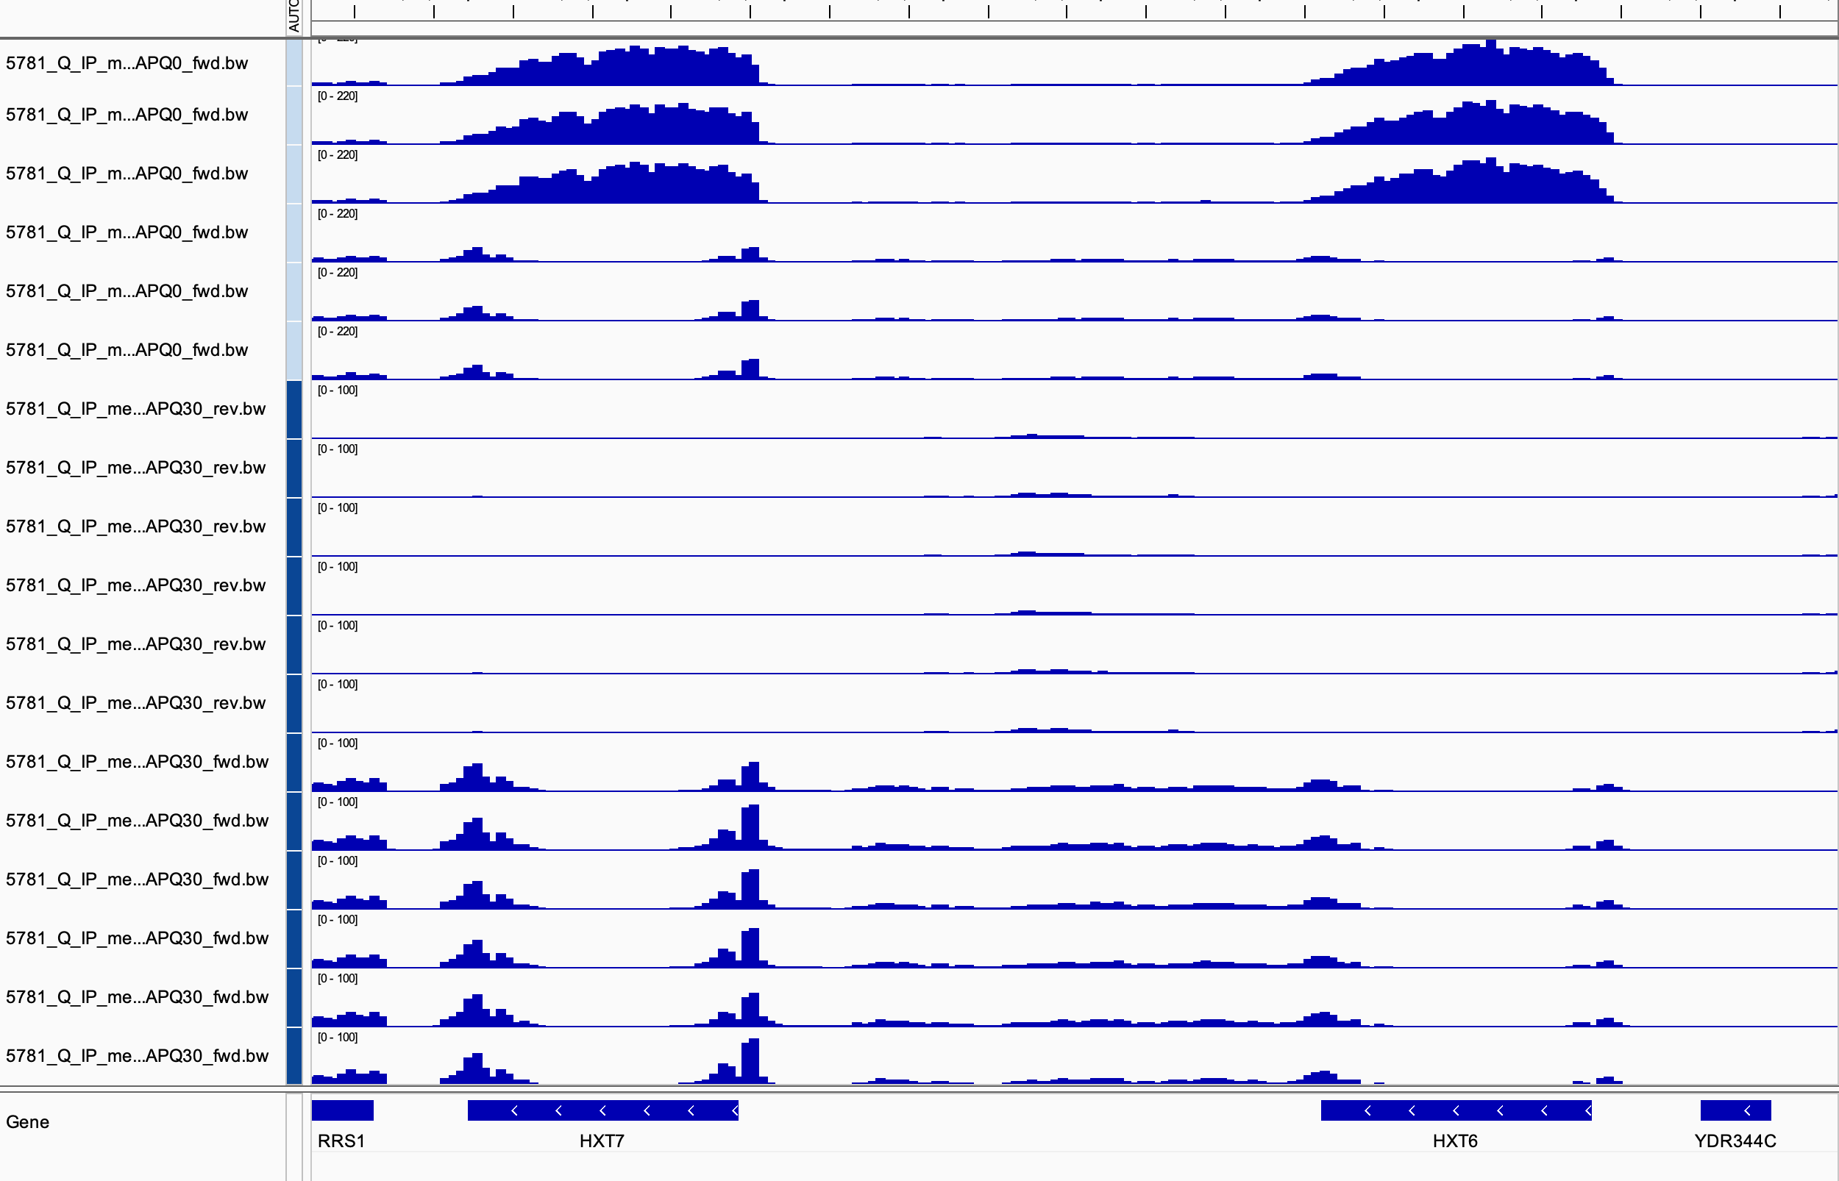
Paralogs lost when lots of filtering performed
I think this is coverage we want!
Multi hit mode 10, No MapQ filtering
Forward
Multi hit mode 1, No MapQ filtering
Reverse
Multi hit mode 10, + MapQ filtering
Forward
Multi hit mode 1, + MapQ filtering

Slide 4
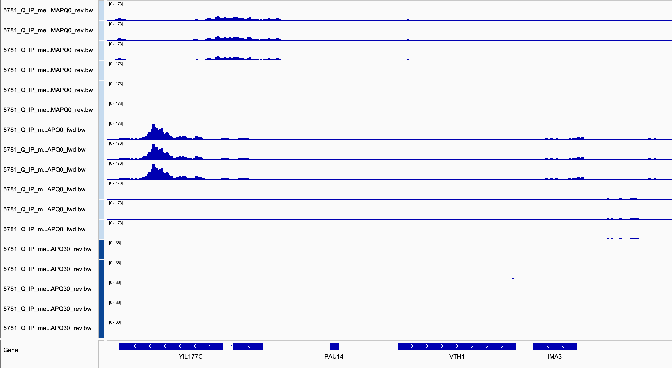
A lot of filtering is achieving the same things having a blacklist would achieve
Multi hit mode 10, No MapQ filtering
Reverse
Multi hit mode 1, No MapQ filtering
Multi hit mode 10, No MapQ filtering
Forward
Multi hit mode 1, No MapQ filtering
Multi hit mode 10, + MapQ filtering
Reverse
chrIX, Left telomere

Slide 5
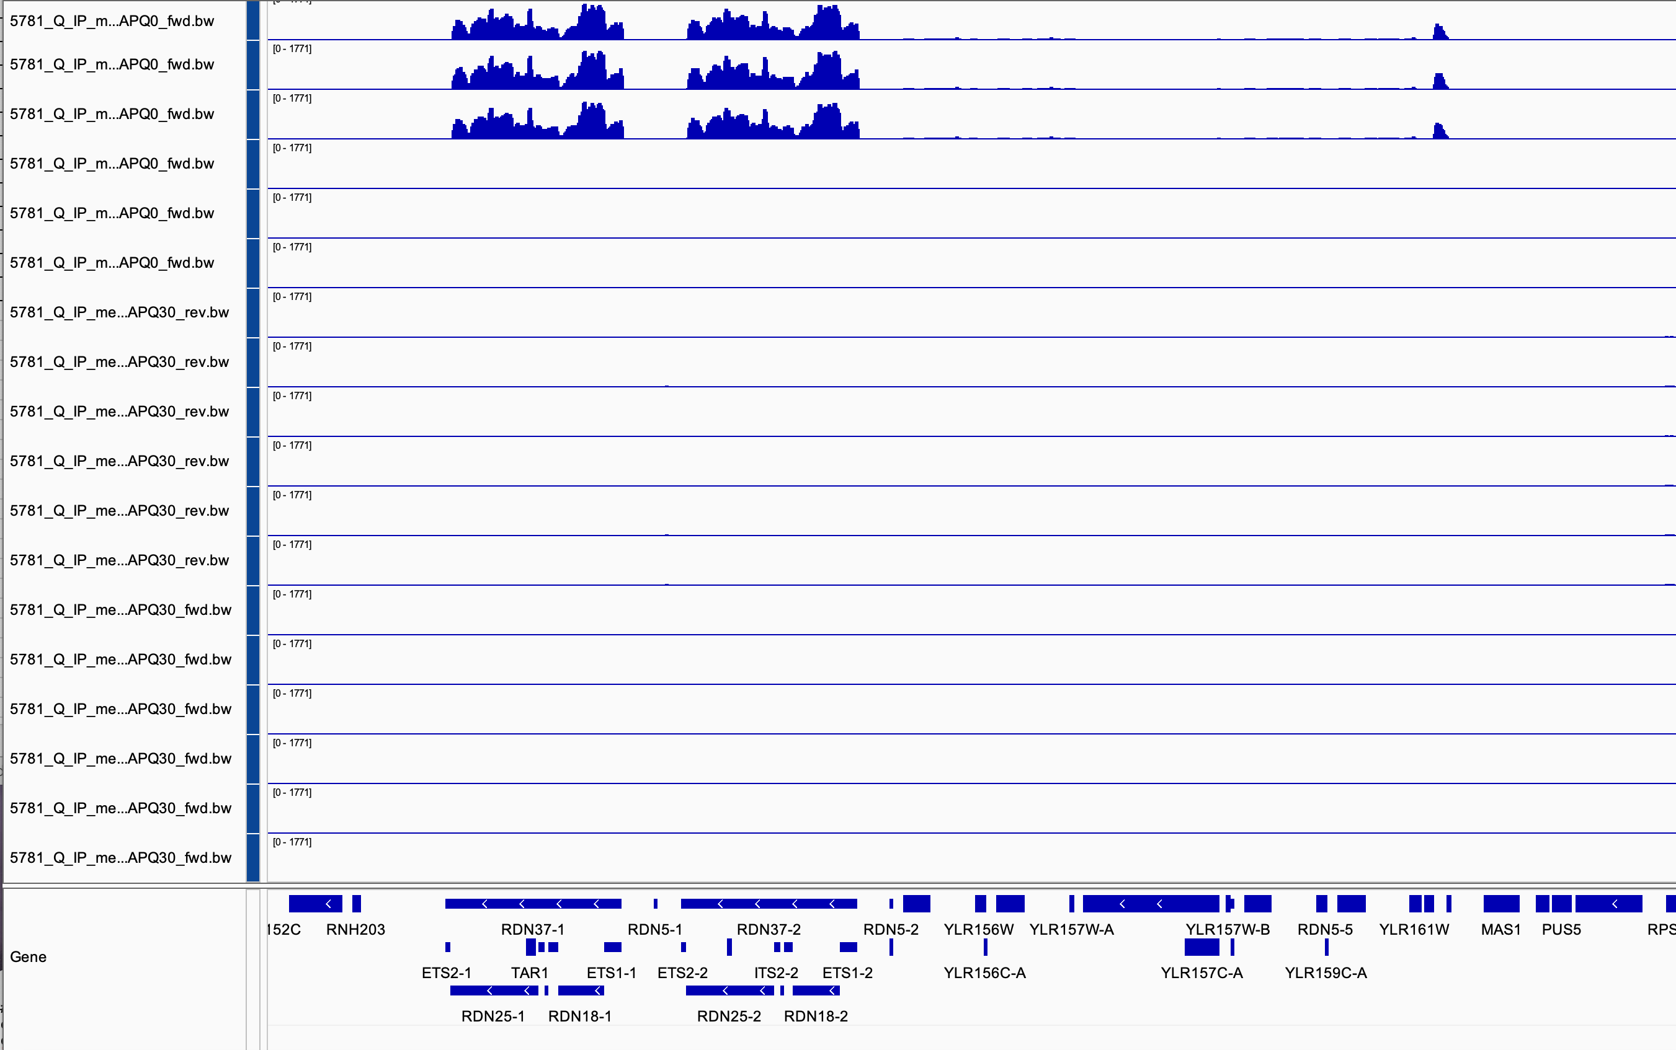
rDNA region similar to telomere – only gets coverage in multi hit mode, no filtering
Multi hit mode 10, No MapQ filtering
Forward
Multi hit mode 1, No MapQ filtering
Reverse
Multi hit mode 1 + MapQ filtering
Forward
Multi hit mode 10, + MapQ filtering

Slide 6
Thoughts
At first glance there doesn’t seem to be much difference between unprocessed/, preprocessed/, and preprocessed-full/
This might not be the case when trinity interacts with this data! Something to look at!
Many types of filtering seem to have redundant functionality in certain regions
Repetitive regions can be excluded either through MAPQ filtering or by retaining only one alignment per read
However – in both cases this will also affect other regions of the genome while a blacklist will not
MapQ filtering might be more appropriate if we use W303 genome build, however as is I believe we will throw out correct reads that have SNPs with MAPQ filtering
I suspect a blacklist will fix our repetitive region problem without affecting other areas of the genome like other kinds of filtering will. However…. How trinity will deal with this is another matter!
I will check out the gffs next!

