Slide 1
More alignment thoughts
Greenlaw
12/20/22

Slide 2
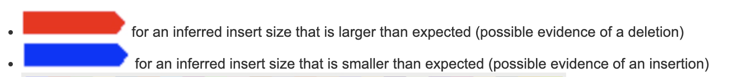
IGV color code
Reads that are colored red have larger than expected inferred sizes, and therefore indicate possible deletions.
Reads that are colored blue have smaller than expected inferred sizes, and therefore indicate insertions.
Low mapping quality reads are still represented in unshaded white.
Each mismatch base seems to have it’s own color but I cannot find that color code

Slide 3
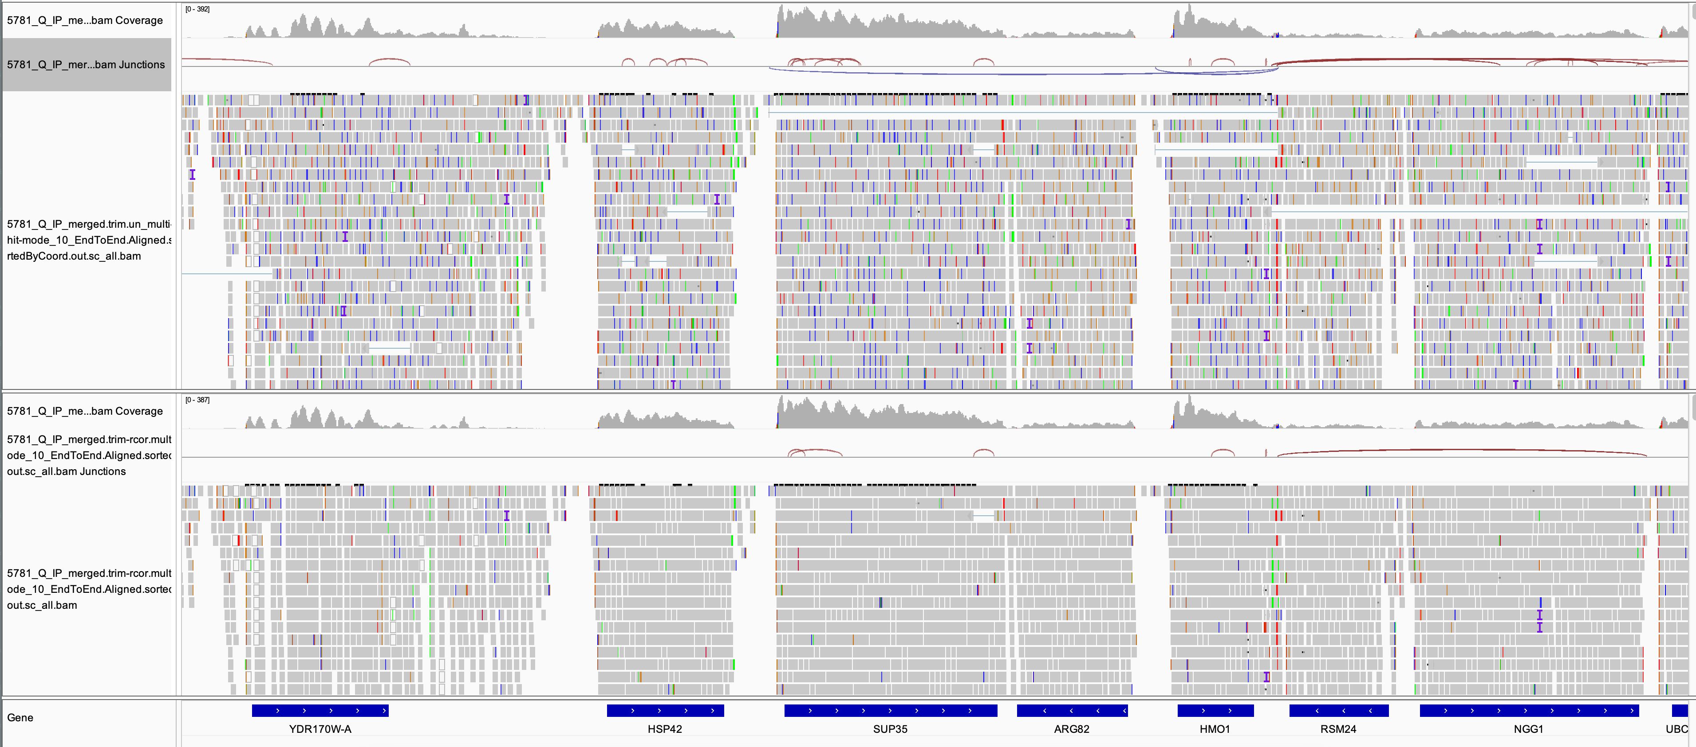
rcor has drastic visually apparent effect!
Preprocessed
Preprocessed-full
Colors are different kinds of errors

Slide 4
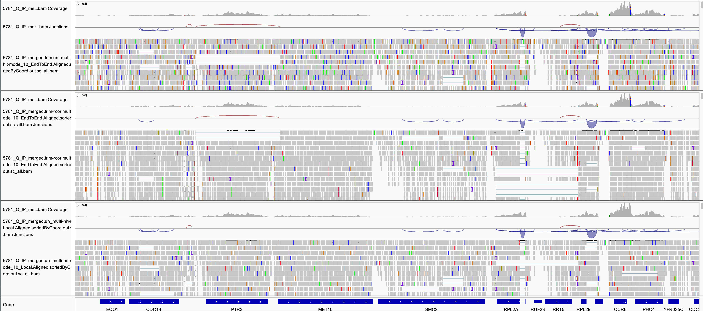
“preprocessed” looks worse than “preprocessed-full” and “unprocessed”
Preprocessed
Preprocessed-full
unprocessed

Slide 5
I was initially confused by this – how was trimming reads resulting in more errors?
However, when I zoomed in and was able to zero in on specific reads, I found that “soft clipping” visually hides errors in IGV
Example on next slide

Slide 6
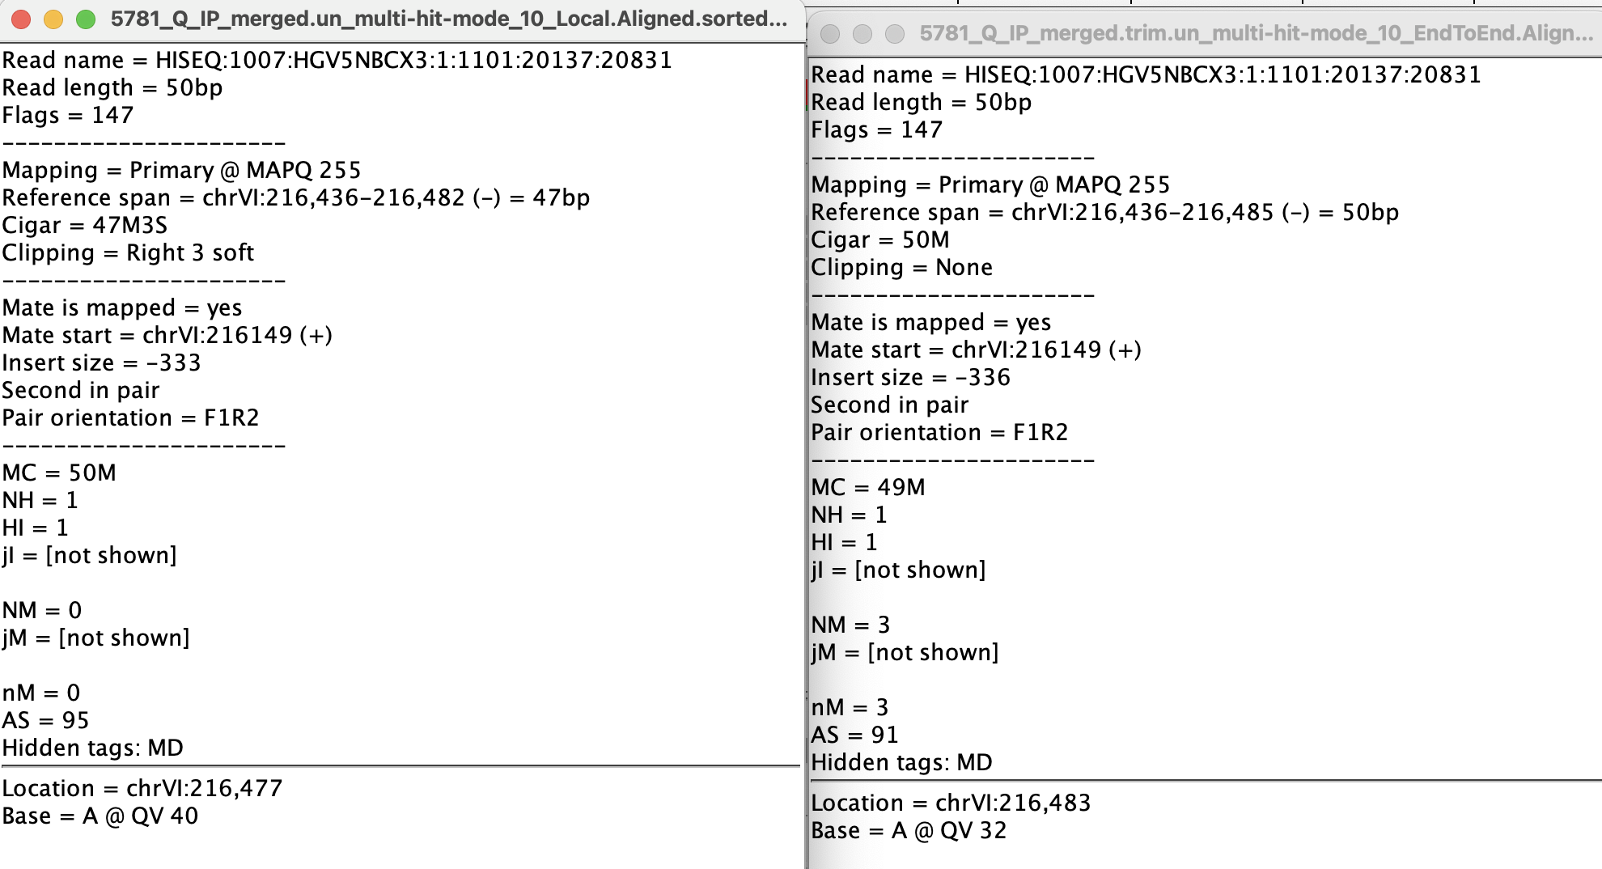
Soft clipping increases read quality score
Unprocessed
Preprocessed
Read Name is same
Cigar length is same
Clipping is different
Read quality is different

Slide 7
Is soft clipping better?
I am unsure! Would appreciate your thoughts on this
If its not too logistically challenging it might be interesting to try rcor with soft clipping allowed
Things to try
Rcor with and without
Trim galore
Soft clipping
Local vs end to end
Every combination?
Please let me know what you think might work!
Also PASA true false setting we talked about on Monday as well as going up and down on gene overlap and stringent overlap by 10 percent

