Slide 2
This work necessitates the creation of a new transcriptome assembly built from the 4tU-seq data—but why? And what will we do with it?
Using quiescent yeast cells, we seek to perform a comprehensive characterization of cryptic transcription
Something
Something
Something

Slide 3
The 4tU-seq-derived assembly makes it possible to characterize cryptic transcription—but what does custom transcriptome assembly entail?
Why do we need a new transcriptome assembly, and what will we do with it?
Something
Something
Something

Slide 4
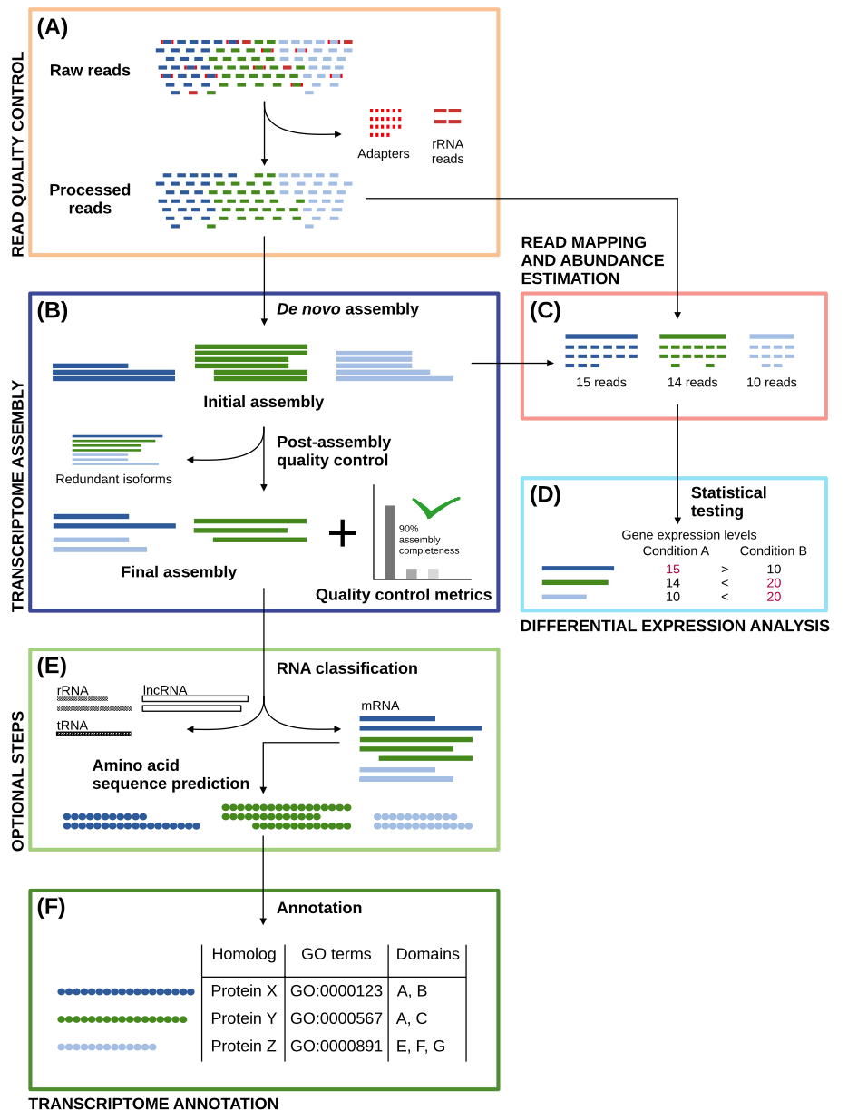
What is it to make a custom transcriptome assembly? What is the workflow?
In transcriptome assembly, millions of "short" reads are pieced together to match or closely resemble their genomic sequences of origin: These are the assembled transcripts
In general, reads can be assembled through either (a) reference genome-guided or (b) de novo—a.k.a., genome-free—approaches
In the genome-guided approach, transcriptome assembly occurs through the alignment of reads to the reference genome
In the genome-free approach, assembly is accomplished using the information contained in the reads alone
In our recent work, we perform a hybrid approach—but before diving into that, it's important to discuss the general workflow for transcriptome assembly

Slide 5
What is it to make a custom transcriptome assembly? What is the workflow?
(A) The sequencing data is quality controlled
(B) Then, the data is assembled to obtain the reference transcriptome; afterwards, it’s further quality controlled to produce an artifact-free assembly
(C, D) Read alignment and transcript abundance estimation (C) are performed as measures of quality control, and differential transcript expression levels can be estimated (D)
(E) If the RNA-seq data are suspected to contain non-mRNA species, RNA classification can be carried out to classify and filter the data
(E) Transcriptomic sequences can be translated into their amino acid counterparts
(F) The nucleotide (and/or translated protein) sequences can be annotated to assign identifiers and elucidate biological roles

Slide 6
What is it to make a custom transcriptome assembly? What is the workflow?
For read quality control, we use trim_galore to perform adapter removal, trim low-quality read ends, filter out very short reads
We use Rcorrector to fix random errors generated in sequencing
We use Trinity for transcriptome assembly, performing both genome-free and genome-guided approaches to generate a “comprehensive transcriptome database”
We use PASA for post-assembly quality control,
Notes:
If a genome sequence is available, Trinity offers a method whereby reads are first aligned to the genome, partitioned according to locus, followed by de novo transcriptome assembly at each locus. In this use-case, the genome is only being used as a substrate for grouping overlapping reads into clusters that will then be separately fed into Trinity for de novo transcriptome assembly. This is very much unlike typical genome-guided approaches (eg. cufflinks) where aligned reads are stitched into transcript structures and where transcript sequences are reconstructed based on the reference genome sequence. Here, transcripts are reconstructed based on the actual read sequences.

