Slide 2
Our data are a high-dimensional matrix
observations
variables
sample1
sample2
sample3
…
Gene1
Gene2
Gene3
…
Genes = “features”

Slide 3
Features (genes) are dimensions

Slide 4
Features (genes) are dimensions

Slide 5
Features reveal structure

Slide 6
Many types of structure can exist in data

Slide 7
More dimensions = more accurate structure

Slide 8
We can only see in 3D—and definitely not in 6600D

Slide 10
Thought exercise: Reduce this to 1D

Slide 11
Thought exercise: Reduce this to 1D

Slide 12
Thought exercise: Reduce this to 1D

Slide 13
Principal component analysis (PCA)

Slide 14
Covariance matrix
Notes:
The variance of a variable is the difference between the observation and expectation (prediction) for the variable—but what is the expectation for the variable?
“The expected value of a random variable” or “expectation for a variable” is equivalent to the concept of the arithmetic mean
That is, the average value in the dataset is considered the “expectation” of that dataset
A random variable is not a set of observations, but rather “a distribution over a domain”
The center of mass of that distribution—that’s the expected value
The average distance from that center of mass in the distribution—that’s the variance
Covariance generalizes the average distance from the center of mass in the distribution to a two-variable regime

Slide 15
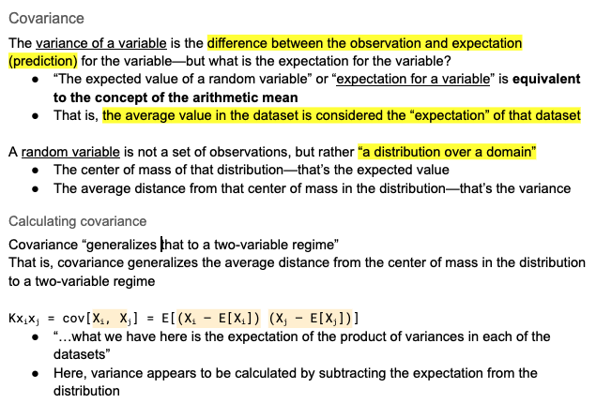
Covariance matrix

Slide 23
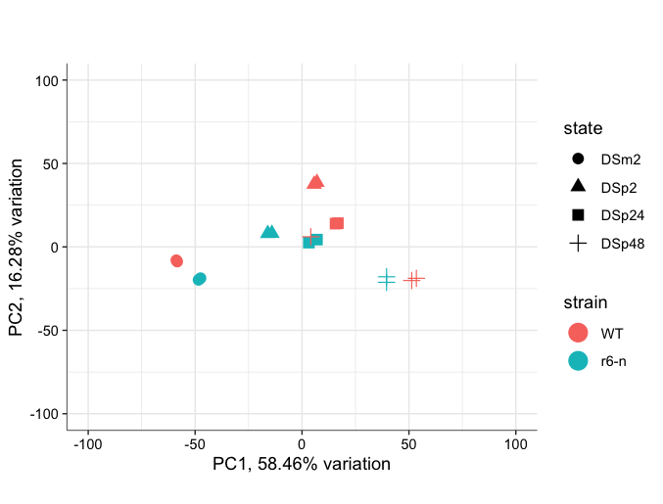
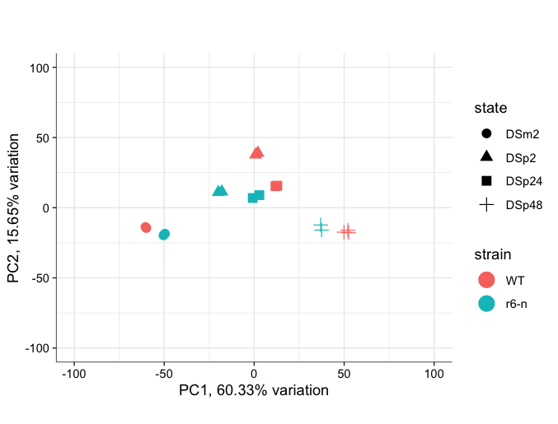
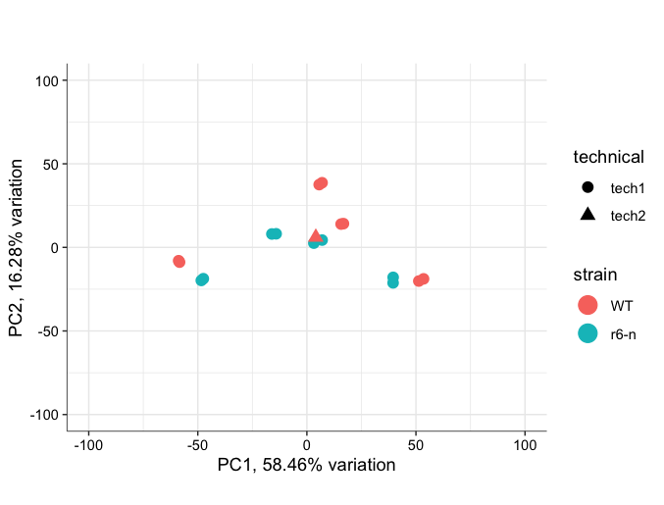
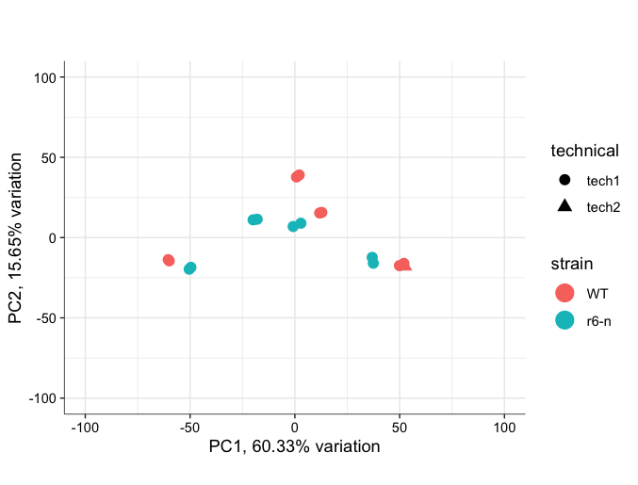
Example of data prior to and after batch-effect correction
tc_SS_wt_r6

Slide 24
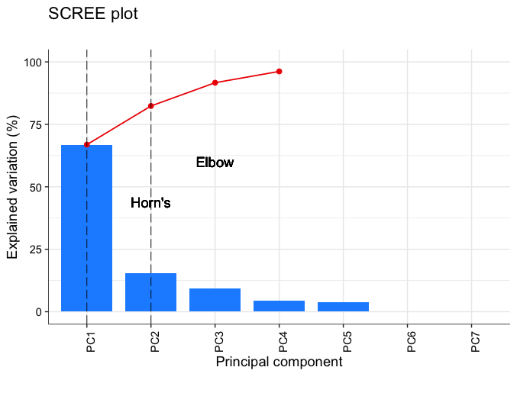
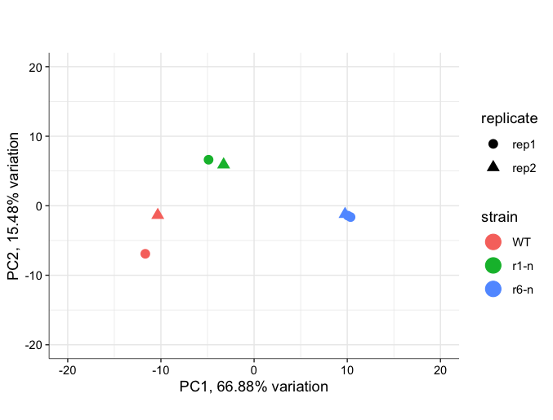
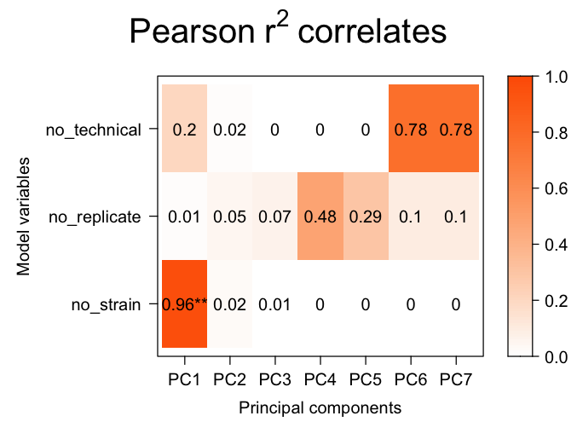
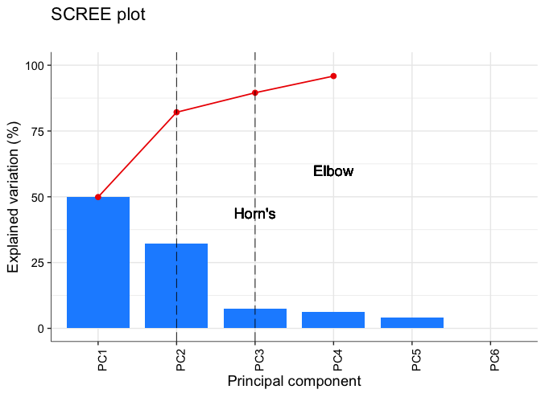
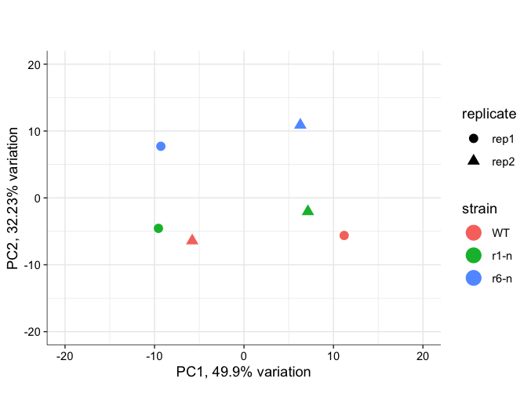
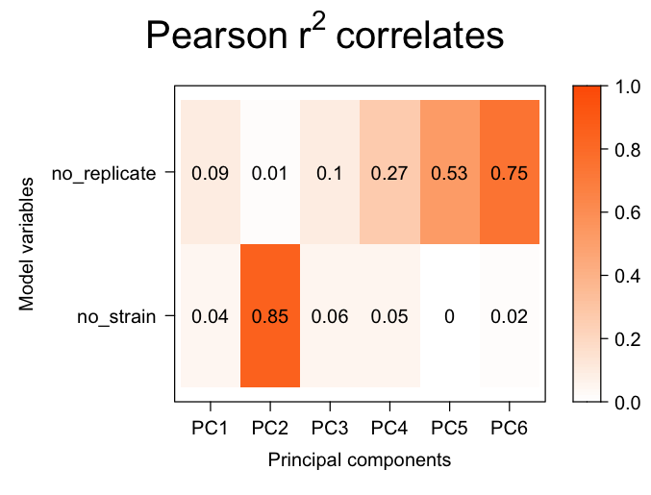
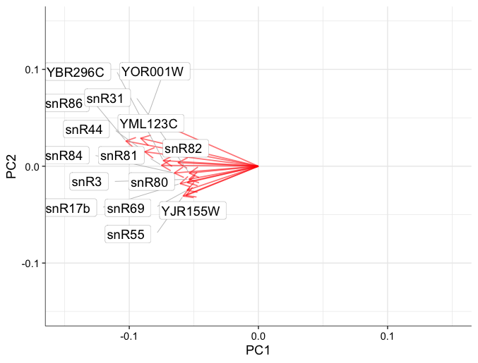
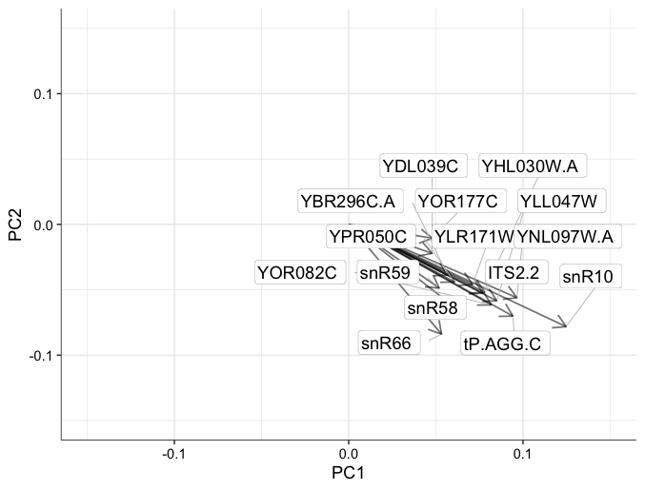
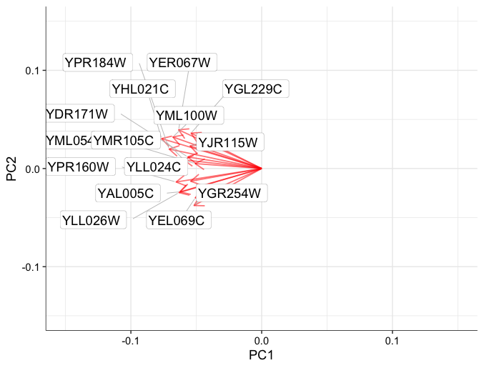
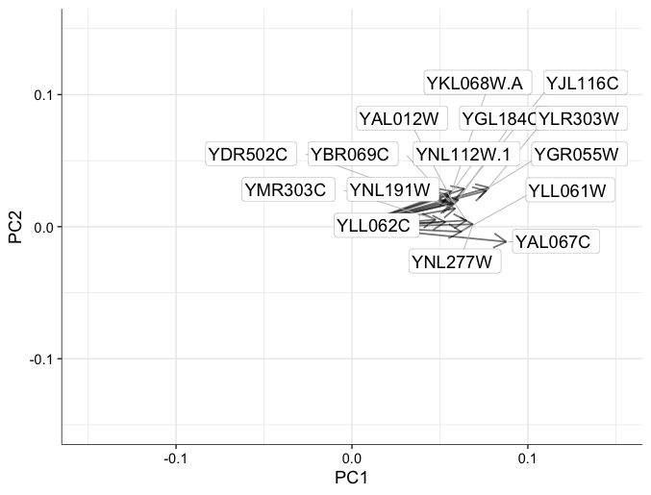
Example of correction of batch effect
Q_SS_wt_r1_r6

Slide 25
Example of unexplained variation in our data
Q_N_wt_r1_r6

Slide 26
Strategy for handling unwanted sources of variation with DESeq2
The steps performed by the DESeq function are documented in its manual page ?DESeq and here; briefly, they are:
estimation of size factors s by estimateSizeFactors
estimation of dispersion α by estimateDispersions
negative binomial GLM fitting for β and Wald statistics by nbinomWaldTest
In GLM, model β for metafactors—strain, state, replicate, batch, etc.—then regress out βs in reduced model (the pairwise comparison)

