Slide 1
Setting optimization exploration
Greenlaw
1/6/2023

Slide 2
Goals of annotation
To accurately describe transcription during quiescence
To count and classify types of noncoding transcription
Including antisense, intergenic and upstream
To count and classify changes in mRNA transcription
Change in termination site, and change in start site/upstream transcript
Change in termination causes Antisense, so this is both separate and related to #1
To compare above between G1 and Q, and without and without NNS in Q
Understanding non-coding changes is one big goal but not the only one
Accurately annotating mRNA helps both 1 and 2 be achievable

Slide 3
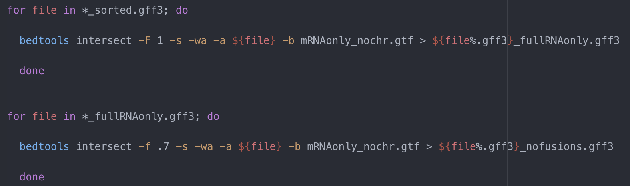
Two layers of filtering to find # of correct mRNAs (Same test as previously implemented)
First: only take annotations where 100% of CDS (-b) is covered by annotation (-a)
Second: from first file generated in last step, take only annotations where CDS (b) covers 70% of annotation (a)
(I started with 80% but this seemed to throw out correct things - could finesse this number more later)

Slide 4
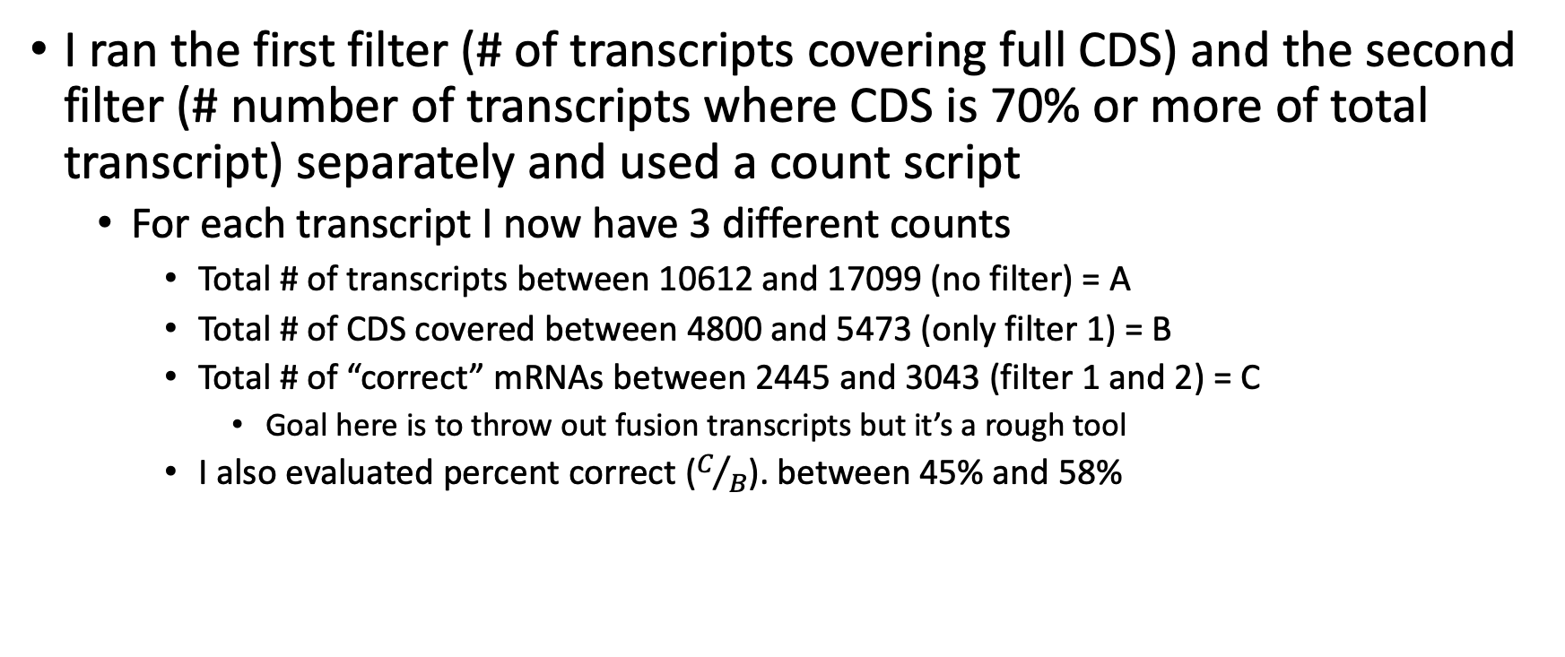
I wanted a way to evaluate 399 gff3s quickly
I ran the first filter (# of transcripts covering full CDS) and the second filter (# number of transcripts where CDS is 70% or more of total transcript) separately and used a count script
For each transcript I now have 3 different counts
Total # of transcripts between 10612 and 17099 (no filter) = A
Total # of CDS covered between 4800 and 5473 (only filter 1) = B
Total # of “correct” mRNAs between 2445 and 3043 (filter 1 and 2) = C
Goal here is to throw out fusion transcripts but it’s a rough tool
I also evaluated percent correct ($C/B$). between 45% and 58%

Slide 5
Broad conclusions
Gene overlap consistently wins over stringent overlap and minimal overlap
This is the strongest trend
End to End consistently wins over local alignment
Trim+rcor seems to be best, and rcor only second best
Which # of alignments seems to be dependent on percentage called by PASA settings – 10 is a pretty safe bet but sometimes 100 wins

Slide 6
The Central Problem
“Happy families are all alike; every unhappy family is unhappy in its own way.”
- Leo Tolsoy, Anna Karenina
So far, every annotation is flawed in its own way

Slide 7
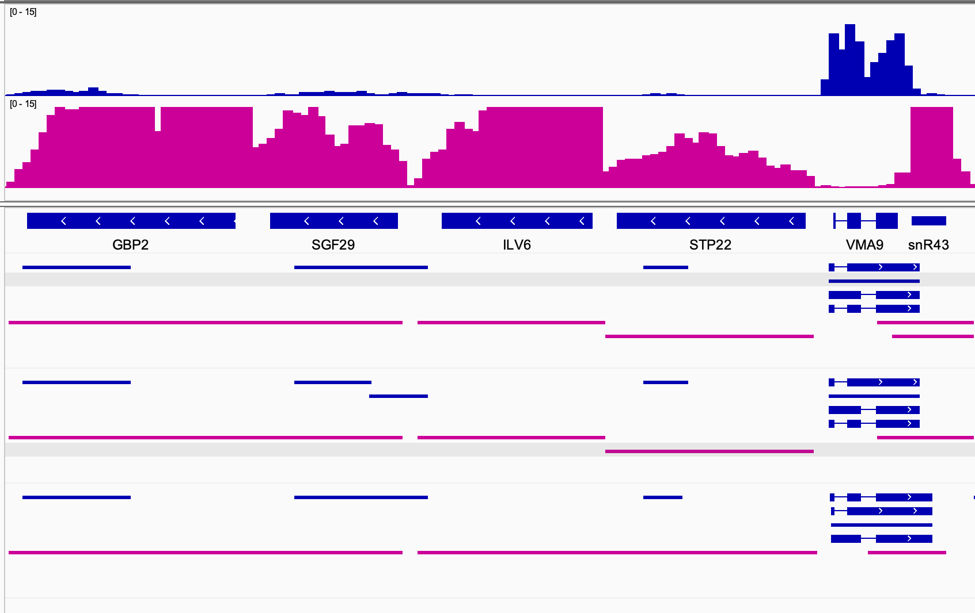
Defining transcript boundaries is a key challenge
Forward stand transcription Q
Reverse stand transcription Q
Trim_rcor
Gene_overlap_30
Hit mode 10
End to End
One of best by “mRNA test”
Trim_rcor
Stringent_alignment_20
Hit mode 10
End to End
One of best Stringent alignment by “mRNA test”
Unprocessed
Minimal_overlap_10
Hit mode 10
Local
One of worst by “mRNA test”
No mode splits these into separate transcripts
Minimal overlap lumps these together inappropriately

Slide 8
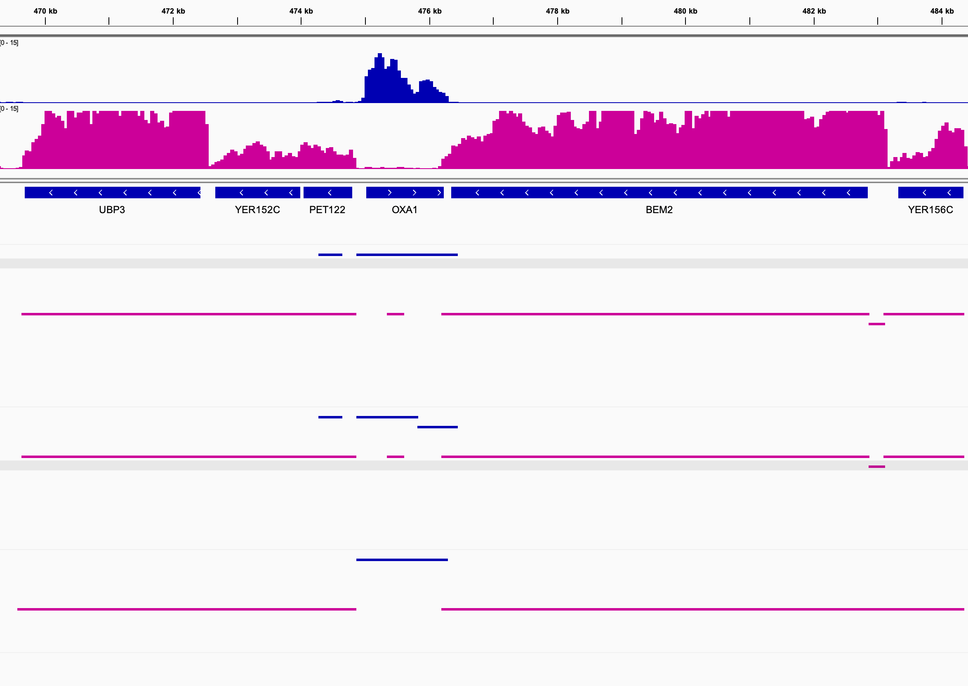
Defining transcript boundaries is a key challenge cont.
Forward stand transcription Q
Reverse stand transcription Q
Trim_rcor
Gene_overlap_30
Hit mode 10
End to End
One of best by “mRNA test”
Trim_rcor
Stringent_alignment_20
Hit mode 10
End to End
One of best Stringent alignment by “mRNA test”
Unprocessed
Minimal_overlap_10
Hit mode 10
Local
One of worst by “mRNA test”
Stringent overlap splits these inappropriately

Slide 9
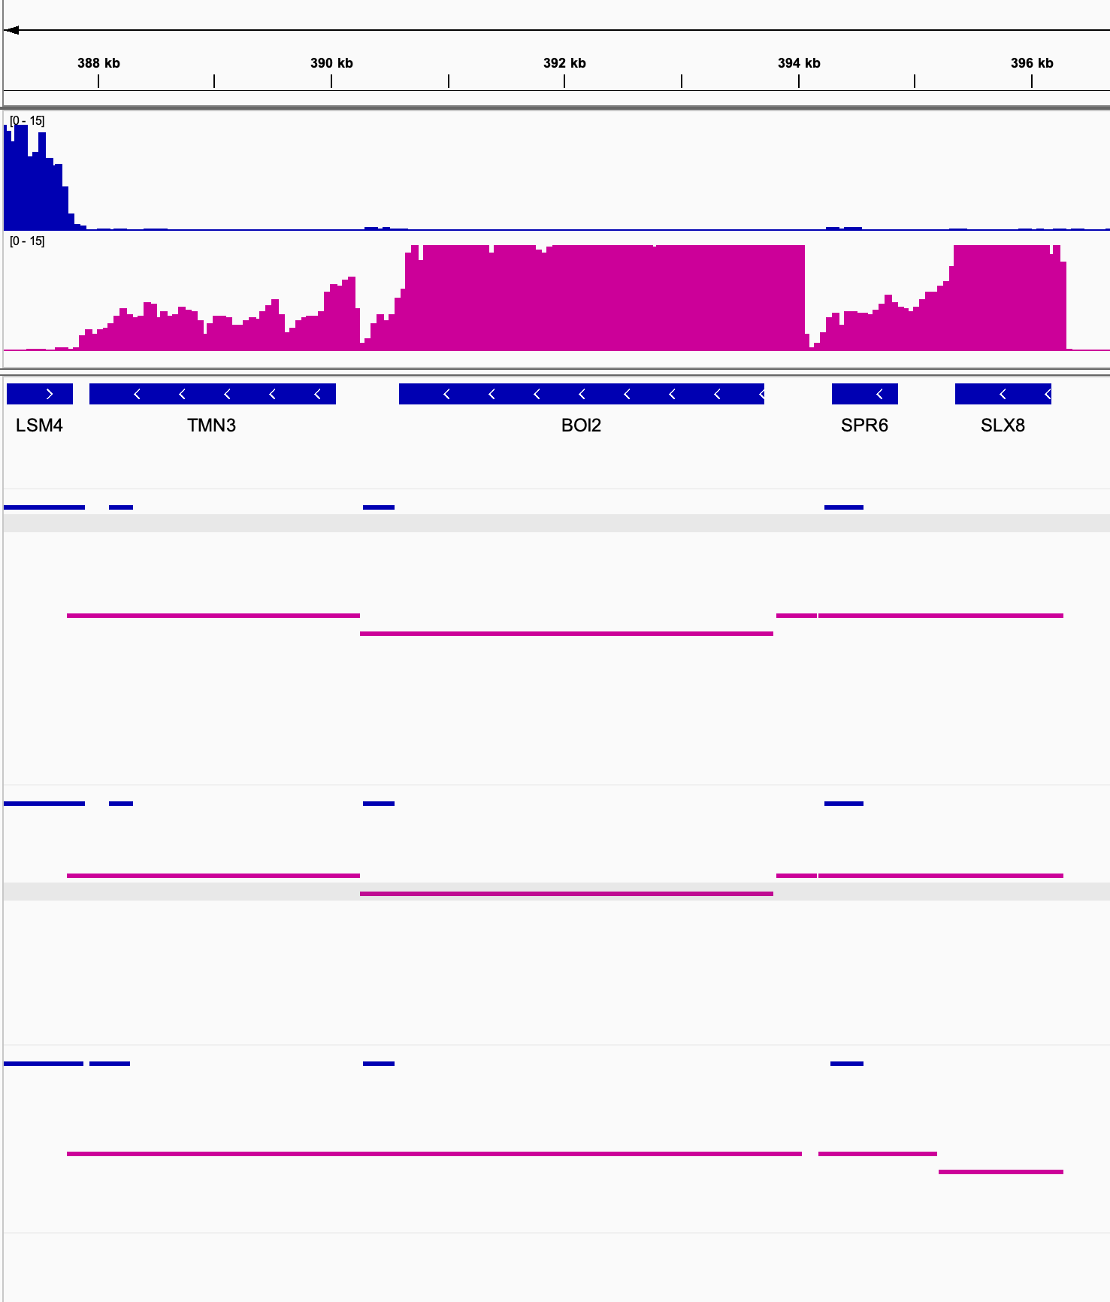
No mode is always best ☹
Forward stand transcription Q
Reverse stand transcription Q
Trim_rcor
Gene_overlap_30
Hit mode 10
End to End
One of best by “mRNA test”
Trim_rcor
Stringent_alignment_20
Hit mode 10
End to End
One of best Stringent alignment by “mRNA test”
Unprocessed
Minimal_overlap_10
Hit mode 10
Local
One of worst by “mRNA test”
Minimal Overlap bad here
Minimal Overlap better here here

Slide 10
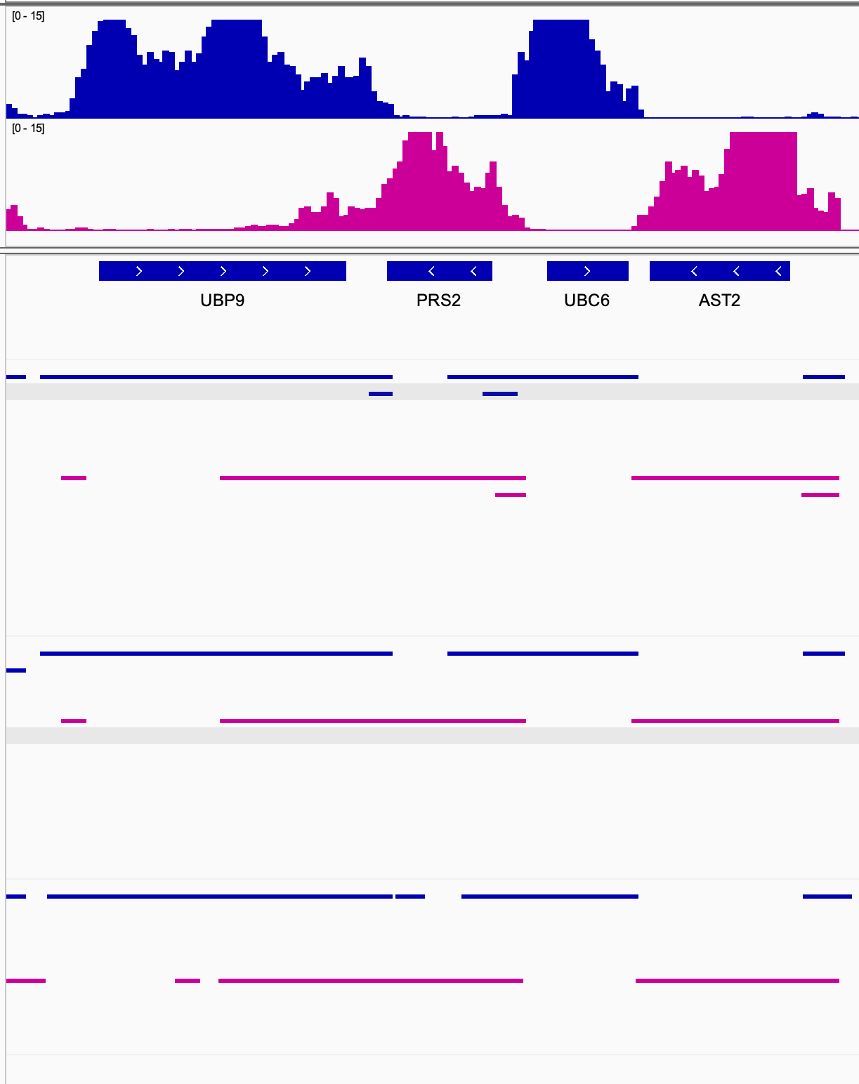
Gene overlap mode generates small additional fragments – unclear if these are “real” or not
Forward stand transcription Q
Reverse stand transcription Q
Trim_rcor
Gene_overlap_30
Hit mode 10
End to End
These seem like they would be easy to remove but I thought I would let you know about this
One of best by “mRNA test”
Trim_rcor
Stringent_alignment_20
Hit mode 10
End to End
One of best Stringent alignment by “mRNA test”
Unprocessed
Minimal_overlap_10
Hit mode 10
Local
One of worst by “mRNA test”

Slide 11
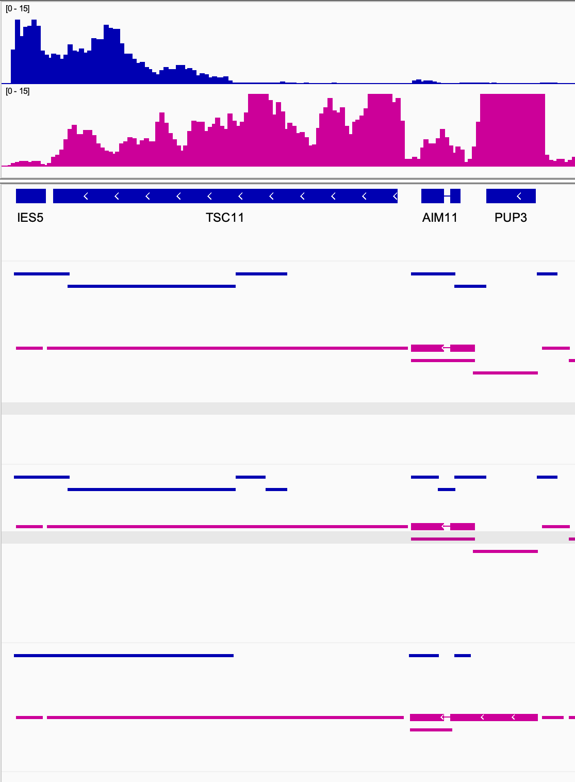
Minimal Overlap can be better at capturing lowly expressed transcripts but this has drawbacks
Forward stand transcription Q
Reverse stand transcription Q
Trim_rcor
Gene_overlap_30
Hit mode 10
End to End
One of best by “mRNA test”
Trim_rcor
Stringent_alignment_20
Hit mode 10
End to End
One of best Stringent alignment by “mRNA test”
Unprocessed
Minimal_overlap_10
Hit mode 10
Local
One of worst by “mRNA test”
Minimal overalap also makes this one transcript :(
Minimal overalap makes this one transcript!

Slide 12
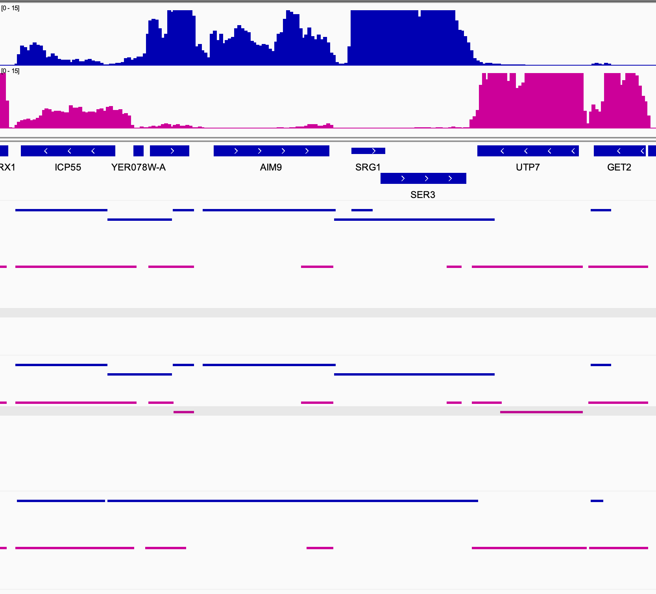
Minimal Overlap can be better at capturing lowly expressed transcripts but this has drawbacks
Forward stand transcription Q
Reverse stand transcription Q
Trim_rcor
Gene_overlap_30
Hit mode 10
End to End
One of best by “mRNA test”
Trim_rcor
Stringent_alignment_20
Hit mode 10
End to End
One of best Stringent alignment by “mRNA test”
Unprocessed
Minimal_overlap_10
Hit mode 10
Local
One of worst by “mRNA test”
Split into multiple but unclear if correct boundaries
Minimal overlap makes this one transcript inappropriately

