Slide 2
This work necessitates the creation of a new transcriptome assembly built from the 4tU-seq data—but why? And what will we do with it?
Using quiescent yeast cells, we seek to perform a comprehensive characterization of cryptic transcription
Something
Something
Something

Slide 3
The 4tU-seq-derived assembly makes it possible to characterize cryptic transcription—but what does custom transcriptome assembly entail?
Why do we need a new transcriptome assembly, and what will we do with it?
Something
Something
Something

Slide 4
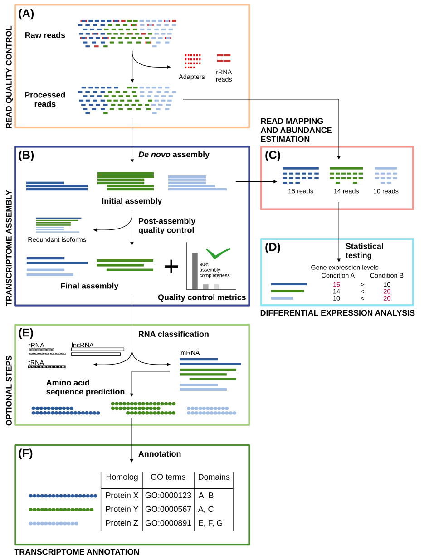
What is it to make a custom transcriptome assembly? What is the workflow?
In transcriptome assembly, millions of "short" reads are pieced together to accurately represent their genomic sequences of origin: These are the assembled transcripts
This is achieved by examining overlaps between reads—or subsequences thereof—in order to concatenate them into longer contiguous sequences (a.k.a., contigs) [15, 56]
In general, reads can be assembled through one of two approaches:
reference genome-guided approach: Assembly occurs through the alignment of reads to the reference genome
genome-free—a.k.a., de novo—approach: Assembly is accomplished using the information contained in the reads alone
In our recent work, we leverage a hybrid strategy
...but before diving into that, it's important to discuss the general workflow for transcriptome assembly

Slide 5
What is it to make a custom transcriptome assembly? What is the workflow?
(A) The sequencing data is quality controlled
(B) Then, the data is assembled to obtain the reference transcriptome; afterwards, it’s further quality controlled to produce an artifact-free assembly
(C, D) Read alignment and transcript abundance estimation (C) are performed as measures of quality control, and differential transcript expression levels can be estimated (D)
(E) If the RNA-seq data are suspected to contain non-mRNA species, RNA classification can be carried out to classify and filter the data
(E) Transcriptomic sequences can be translated into their amino acid counterparts
(F) The nucleotide (and/or translated protein) sequences can be annotated to assign identifiers and elucidate biological roles
Today, I will show data from steps (A) and (B)

Slide 6
What is it to make a custom transcriptome assembly? What is the workflow?
For read quality control, we use trim_galore to...
perform adapter removal
trim low-quality read ends
filter out very short reads
We use Rcorrector to fix random errors generated in sequencing
For transcriptome assembly, we run the assembly program Trinity in both its genome-free and genome-guided modes
We use the output of Trinity as input to PASA (Program to Assemble Spliced Alignments), which...
aligns the newly assembled transcripts to the genome
filters invalid alignments and transcripts likely to be artifacts of the RNA-Seq assembly process
and reconstructs more complete transcripts using its alignment assembly algorithm
Notes:
On Trinity genome-guided mode
If a genome sequence is available, Trinity offers a method whereby reads are first aligned to the genome, partitioned according to locus, followed by de novo transcriptome assembly at each locus. In this use-case, the genome is only being used as a substrate for grouping overlapping reads into clusters that will then be separately fed into Trinity for de novo transcriptome assembly. This is very much unlike typical genome-guided approaches (e.g., Cufflinks) where aligned reads are stitched into transcript structures and where transcript sequences are reconstructed based on the reference genome sequence. Here, transcripts are reconstructed based on the actual read sequences.
Transcript reconstruction from RNA-Seq and incorporation into gene annotations
¶1
Transcript reconstruction from RNA-Seq reads was performed using a hybrid approach leveraging genome alignments coupled with de novo RNA-Seq read assembly. RNA-Seq reads were first aligned to genome sequences using TopHat (73) requiring a minimum intron length of 25 bases and a maximum intron length of 1 kb. Unmapped reads were identified and realigned to the genome using the more sensitive BLAT (74) alignment tool. Based on genome alignment coordinates and strand-specificity, reads were partitioned into disjoint strand-specific ‘coverage regions’, and neighboring coverage regions within 1 kb were merged into larger regions. The reads corresponding to alignments in the merged coverage regions were subjected to de novo assembly as part of the transcript reconstruction process described below.
¶2
Prior to de novo assembly, operations were performed to mitigate the errant fusion of adjacent and minimally overlapping transcripts by considering the evidence for transcription contiguity based on read pairing support. A pair contiguity sensor was devised as follows: A 200 base window was slid across each covered region with a step size of 33 bases. The RNA-Seq fragments (defined by either read of pairs derived from single fragments) overlapping the first 50 bases (segment A) and the last 50 bases (segment B) of the 200 base window were identified as fragment sets (A, B). The contiguity of fragment coverage was computed as a Jaccard similarity coefficient: (AB)/(AB). Similarity coefficient values at or below 0.05 trigger a search for a covered region clip point. First, the smallest coefficient value within 100 bases is defined as a candidate clip point. If regions of greater transcript read pair contiguity exist within 300 bases of both sides of the candidate clip point, the covered region is clipped at the candidate site, partitioning the reads into disjoint read sets and ultimately precluding the co-assembly of reads that are divided by the dissection. Read sequences corresponding to alignments within the resulting disjoint coverage regions were de novo assembled using the Inchworm RNA-Seq assembly tool (http://inchworm.sourceforge.net/), using a k-mer length of 25 and requiring a minimum contig length of 100 bases.
¶3
We enhanced the PASA annotation pipeline (75) to leverage RNA-Seq for transcript reconstruction and genome annotation by leveraging strand-specific Inchworm RNA-Seq assemblies similarly to expressed sequence tags (ESTs) as follows. Inchworm-assembled transcript sequences were aligned to the genome using GMAP (76), reporting only the single best-scoring alignment for each transcript.
¶4
Valid transcript alignments were required to align to the genome across at least 90% of their length and with at least 95% sequence identity. Spliced transcript alignments were required to include consensus (GT-AG, GC-AG, AT-AC) dinucleotide splice pairs at intron boundaries. The read-derived k-mer coverage of each inchworm-assembled transcript (a proxy for transcript expression) exists as an attribute of each sequence, incorporated into the accession of the fasta-formatted Inchworm-assembled transcript. The PASA pipeline piles the inchworm transcripts along each strand of the genome with pile height prioritized by the k-mer coverage value, adding transcripts with greater coverage (expression) to piles first. Tentative RNA-Seq assembly artifacts, corresponding to transcripts with >= 30% overlap (by shortest length) of a dominant (prioritized) transcript and at most 10% the k-mer coverage of the dominant transcript were discarded. Remaining valid Inchworm-generated transcript alignments were treated identically to EST alignments in the PASA pipeline and integrated into gene annotations as previously described (75).

Slide 7
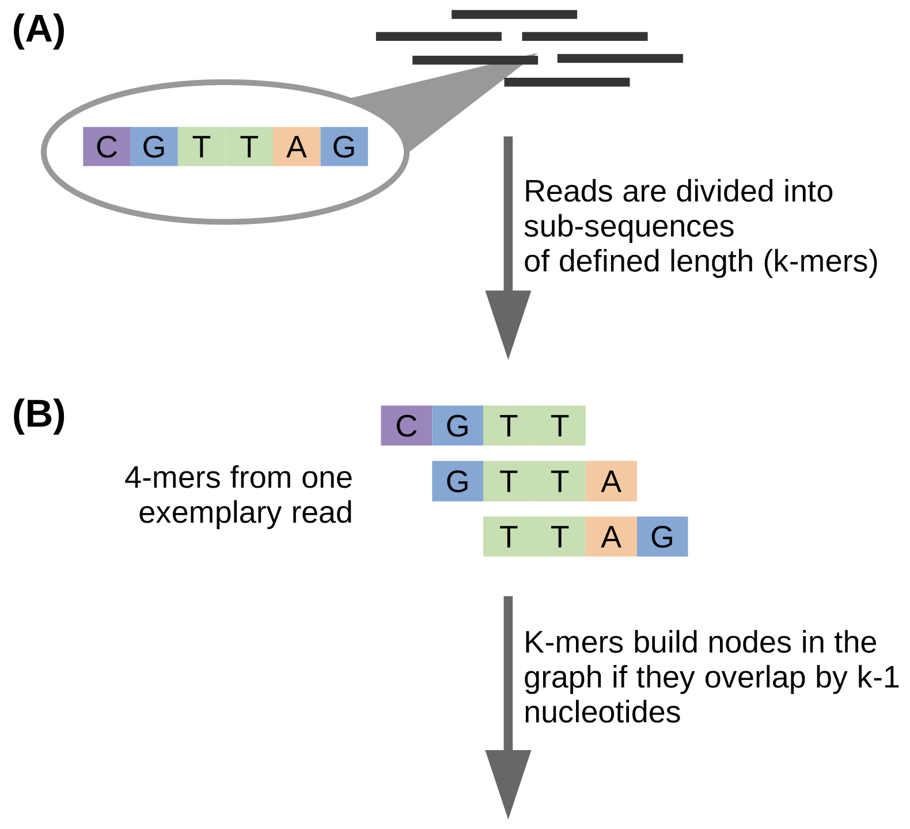
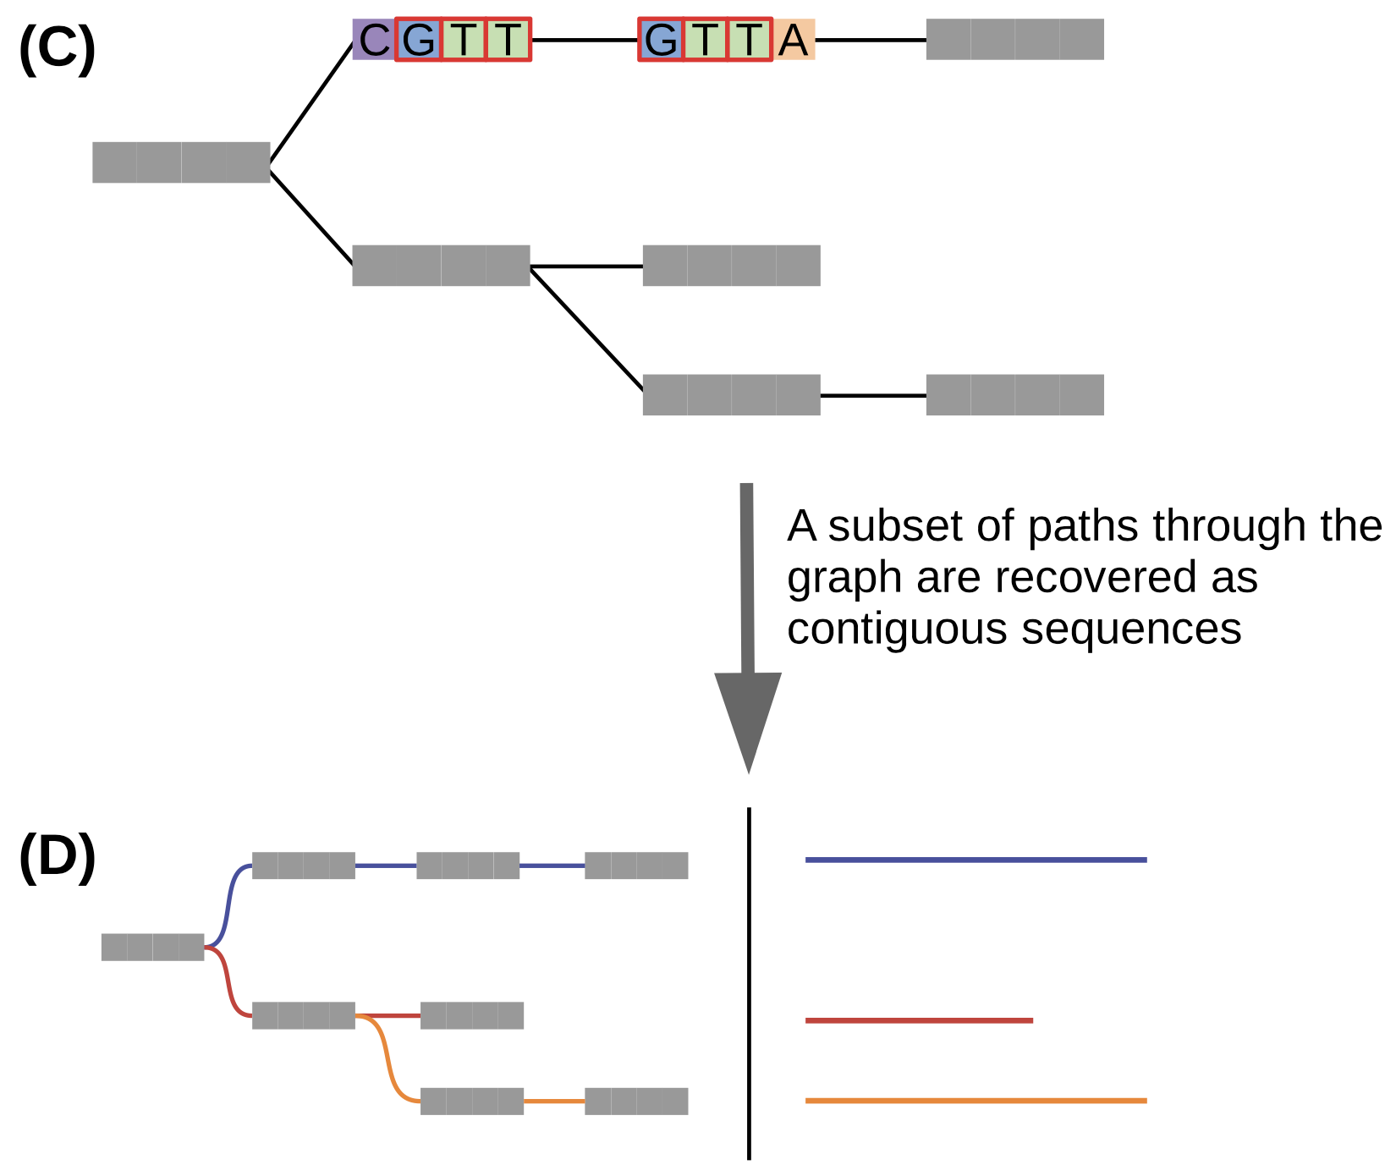
The 4tU-seq-derived assembly makes it possible to characterize cryptic transcription—but what does custom transcriptome assembly entail?
Why do we need a new transcriptome assembly, and what will we do with it?
Something
Something
Something

