Slide 1
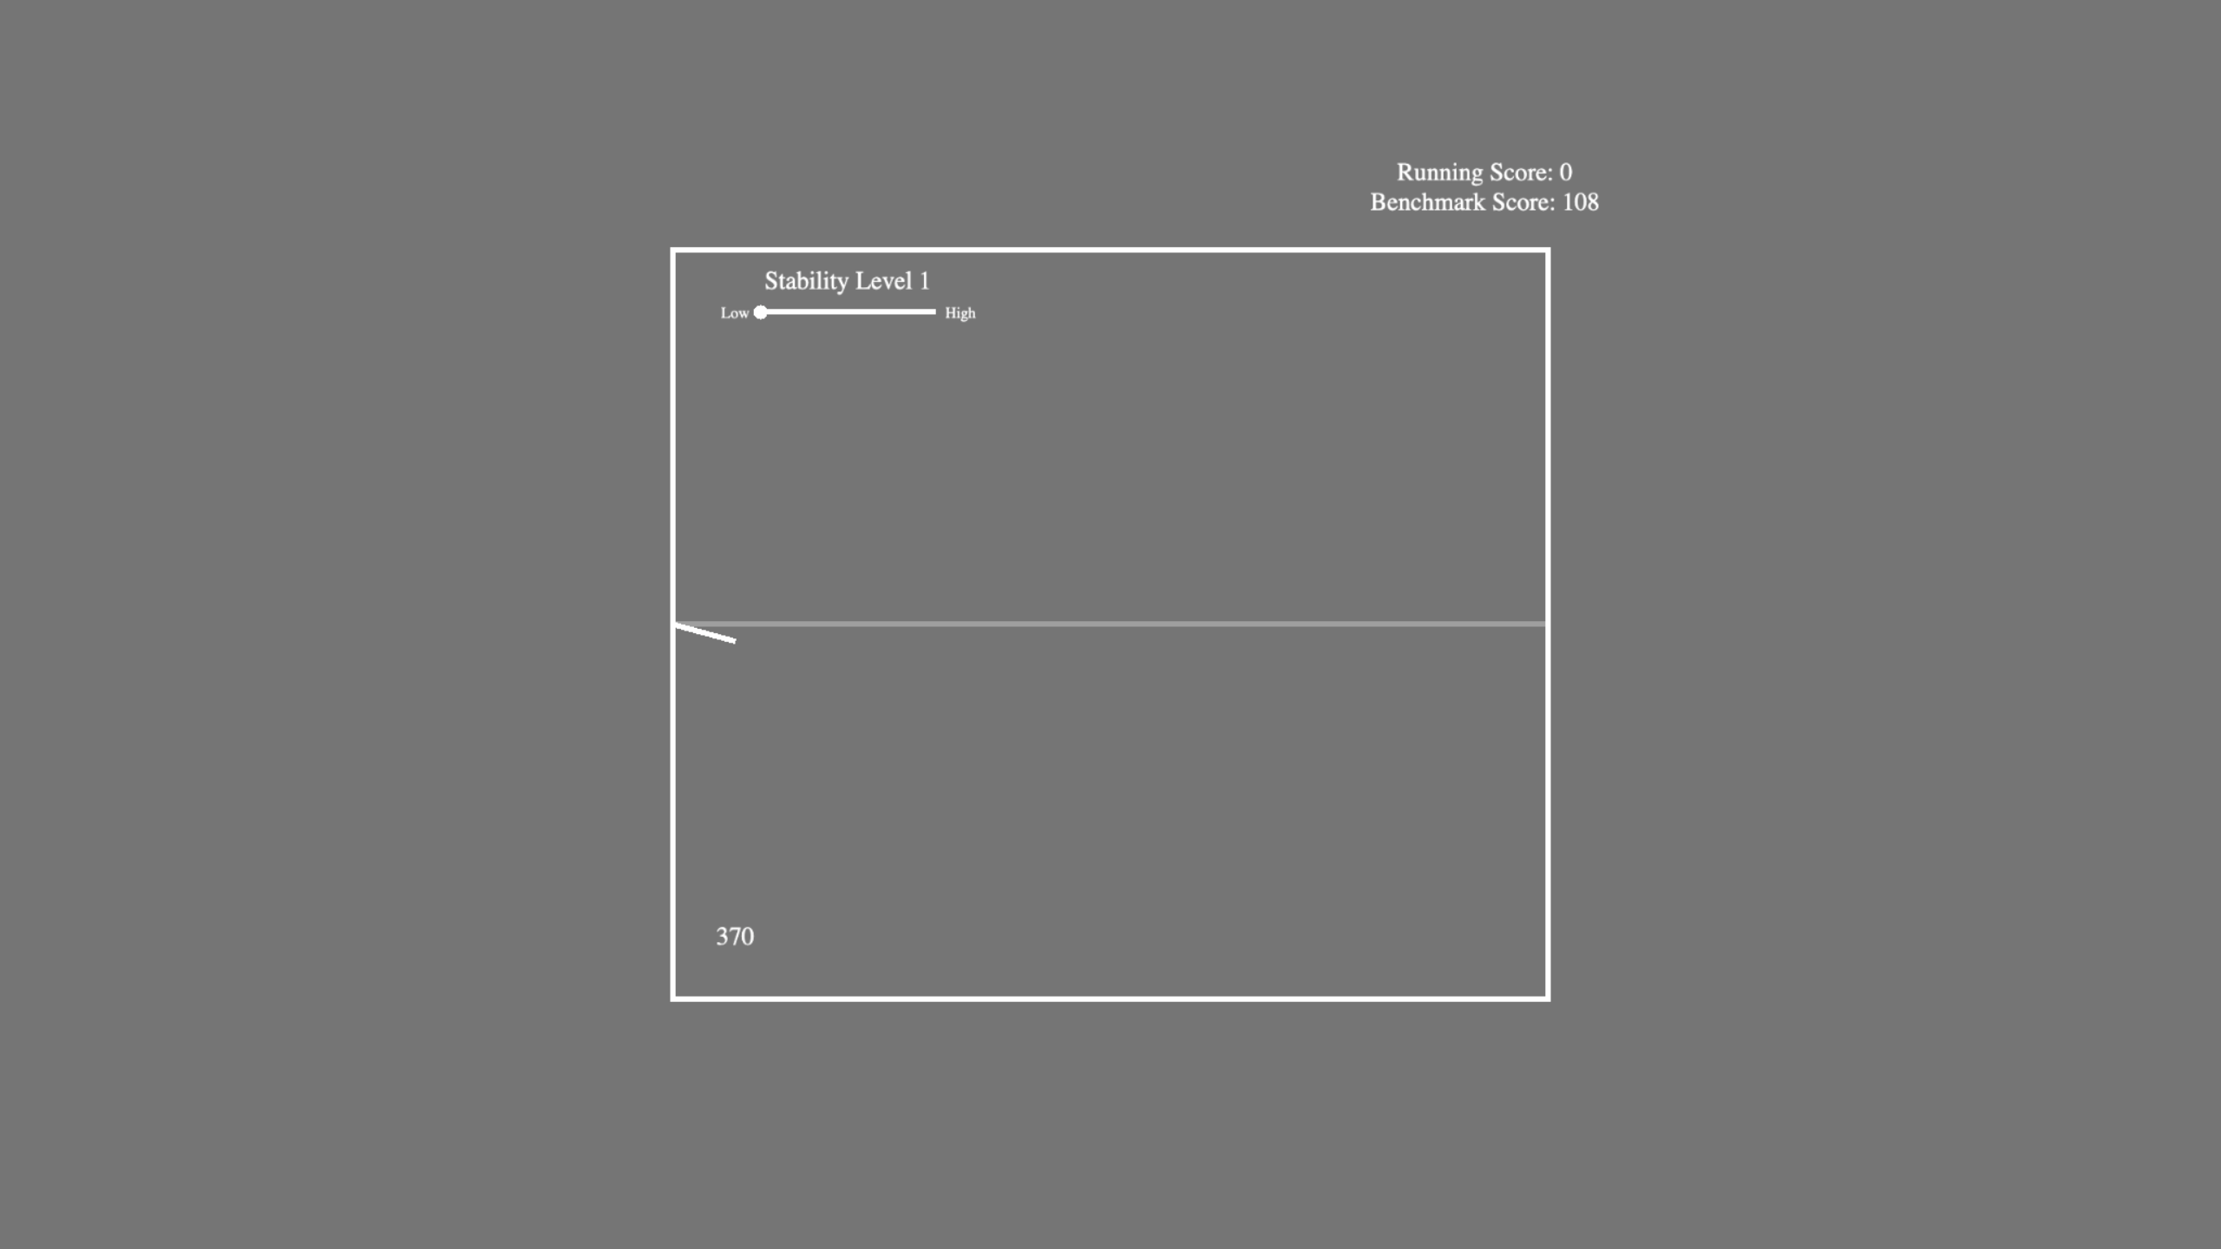
Stability level: In this example, you are in a relatively low stability environment. This means the correct final state will switch frequently between UP and DOWN.
Your current running score, displayed above a benchmark score for the experiment. If you exceed the benchmark by the end of the experiment, you will be rewarded.
Press UP if you think this white line will end ABOVE the gray reference line.
Press DOWN if you think this white line will end BELOW the gray reference line.
Press RIGHT if you want to see where the price is after another step. This may help you choose the correct answer.
Reference line for starting price
GOAL: predict where the stock price will be above (UP) or below (DOWN) the reference line once it reaches here.
The number of steps left in the block; this decreases every time you make an action (RIGHT, UP, DOWN)
Press SPACE to BEGIN the task.

Slide 2
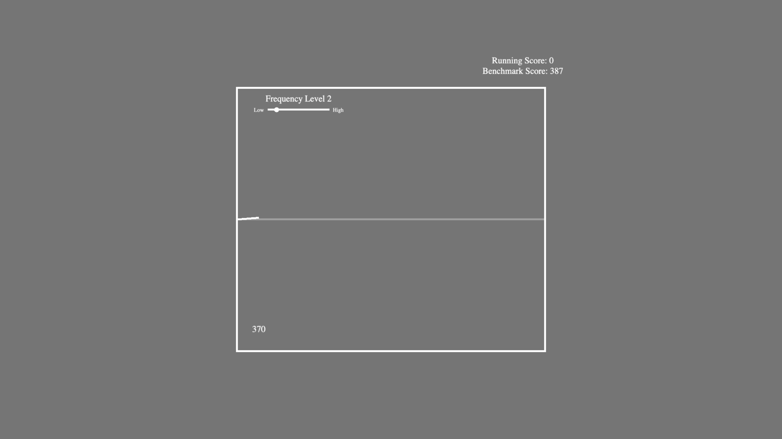
Frequency level: In this example, you are in a relatively low frequency environment. This means you will tend to NOT receive feedback after each trial about whether your choice was correct or not.
Your current running score, displayed above a benchmark score for the experiment. If you exceed the benchmark by the end of the experiment, you will be rewarded.
Press UP if you think this white line will end ABOVE the gray reference line.
Press DOWN if you think this white line will end BELOW the gray reference line.
Press RIGHT if you want to see where the price is after another step. This may help you choose the correct answer.
Reference line for starting price
GOAL: predict where the stock price will be above (UP) or below (DOWN) the reference line once it reaches here.
The number of steps left in the block; this decreases every time you make an action (RIGHT, UP, DOWN)
Press SPACE to BEGIN the task.

