Slide 1
PearScale
By David Kalcic and Zach Kauffman

Slide 2
What is PearScale?
The world’s first social media platform for rating photos of pears
Functionality
Any page visitor can view Fresh (newest) or Ripe (top rated) pears on the homepage
A user may create an account
Registered users may post a photo of a pear with a title, description, and tags
Registered users can rate other users’ pear pics
A user may delete a pear they have posted
Any page visitor can submit a report on a pear if they feel like it.
Any page visitor can search for pears by title, description, author, rating, or tags
Business Rules
ABSOLUTELY NO NON-PEAR PHOTOS PERMITTED
Pears are ranked on a scale of 1-15
Only one rating per user per pear is allowed

Slide 3
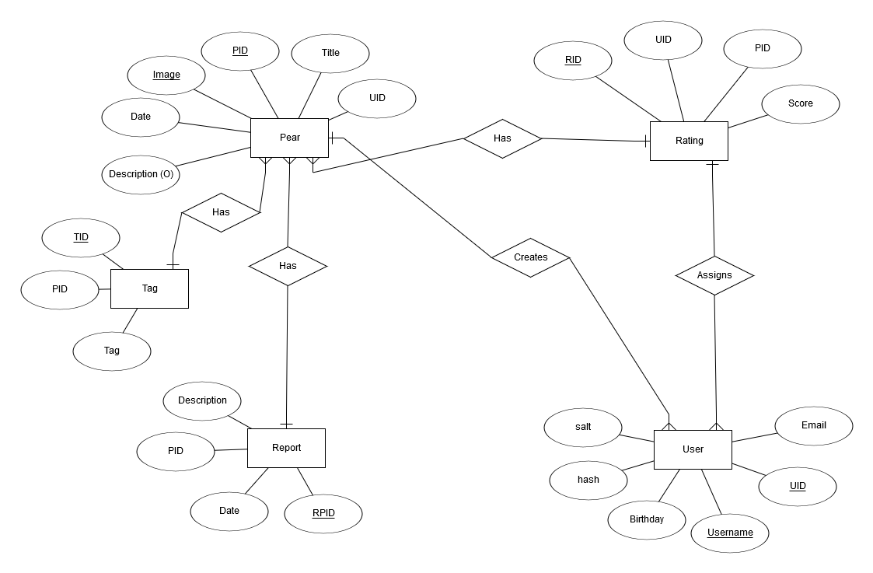
Database Design: ER Diagram

Slide 4
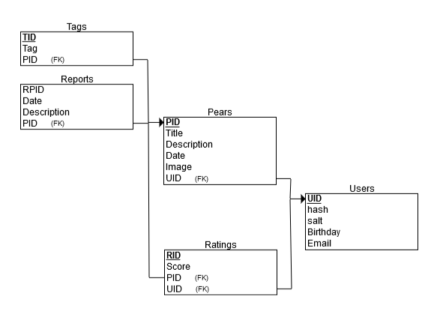
Database Design: Relational Schema

Slide 5
Website Layout
Home page
Fresh
Ripe
Pear pages
User pages

Slide 6
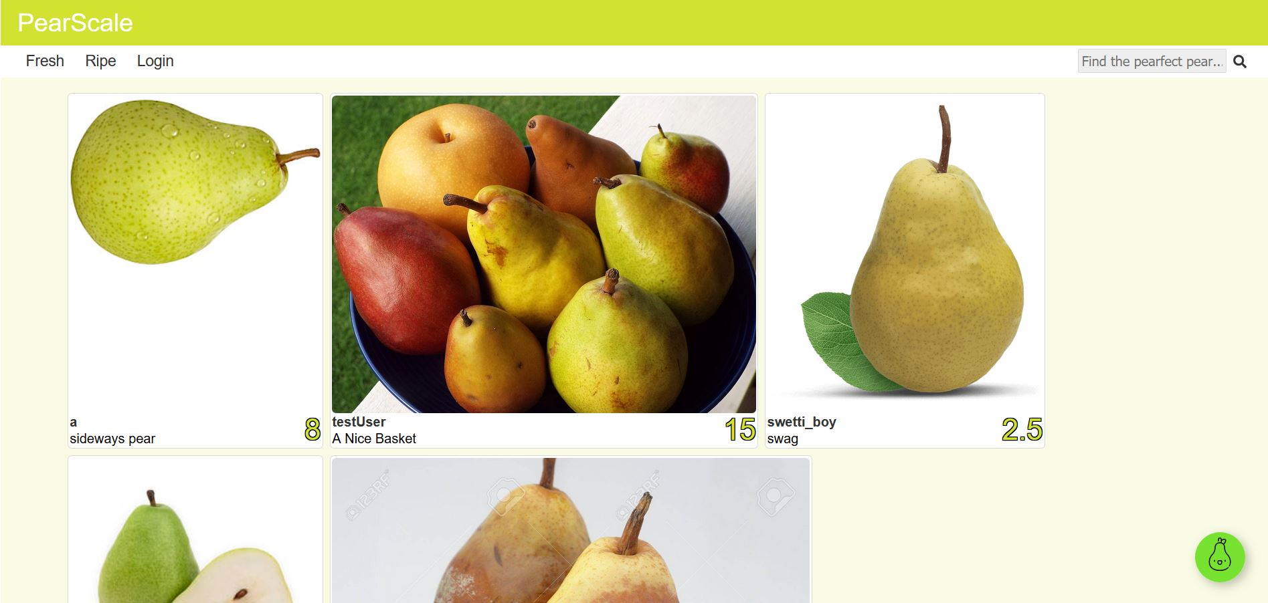
Home Page

Slide 7
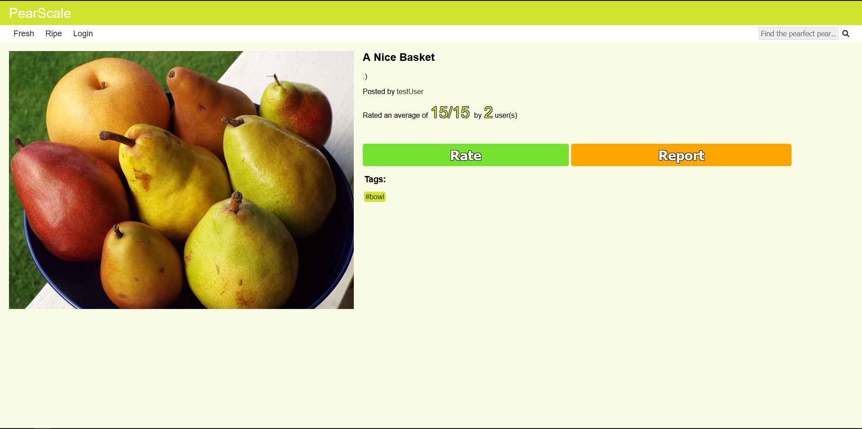
Pear Page

Slide 8
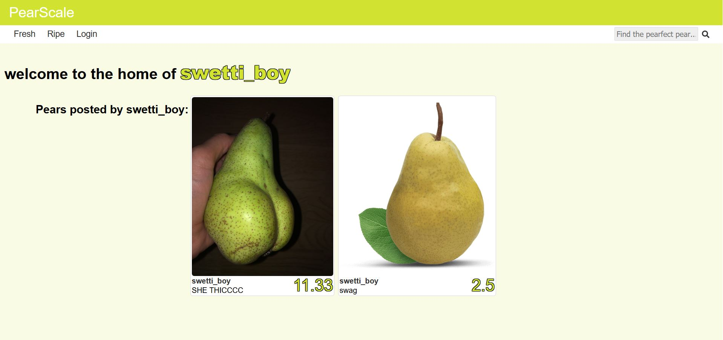
User Page

Slide 9
Implementation
DAO (Data Access Object)
Acts as interface between database and server
Handles all SQL queries to database and returns queried data
getPearByPID(), postRating(), etc.
Server
Node.js Express routing
Express sessions for session management
Handles user authentication & password hashing
Calls DAO functions when endpoint is requested by client
Client
Pages templated by Handlebars
Queries server endpoints
Handles/displays responses from server

Slide 10
Demo

