Slide 1
Variational Quantum Eigen-solver
Kalyan Dasgupta
IBM

Slide 2
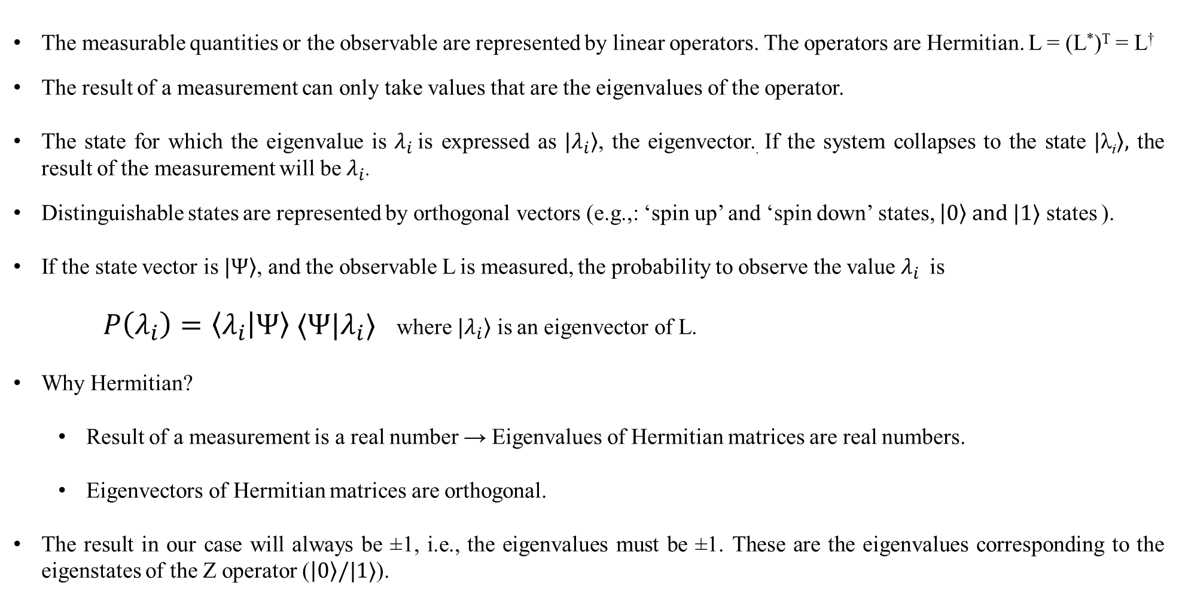
Fundamental Principles
The measurable quantities or the observable are represented by linear operators. The operators are Hermitian. L = (L*)^{T} = L†
The result of a measurement can only take values that are the eigenvalues of the operator.
The state for which the eigenvalue is $λ_{i}$ is expressed as $|\left.λ_{i}\right\rangle$, the eigenvector.. If the system collapses to the state $|\left.\text{λ}\text{i}\right\rangle ,$ the result of the measurement will be $λ_{i}$.
Distinguishable states are represented by orthogonal vectors (e.g.,: ‘spin up’ and ‘spin down’ states, $\left|0\right\rangle and |1⟩$ states ).
If the state vector is $|\left.Ψ\right\rangle$, and the observable L is measured, the probability to observe the value $λ_{i}$ is
$P\left(λ_{i}\right)=\left\langle λ_{i} | Ψ\right\rangle ⟨Ψ|λ_{i}⟩$ where $|\left.λ_{i}\right\rangle$ is an eigenvector of L.
Why Hermitian?
Result of a measurement is a real number → Eigenvalues of Hermitian matrices are real numbers.
Eigenvectors of Hermitian matrices are orthogonal.
The result in our case will always be ±1, i.e., the eigenvalues must be ±1. These are the eigenvalues corresponding to the eigenstates of the Z operator ($\left|0\right\rangle /|1⟩$).

Slide 3
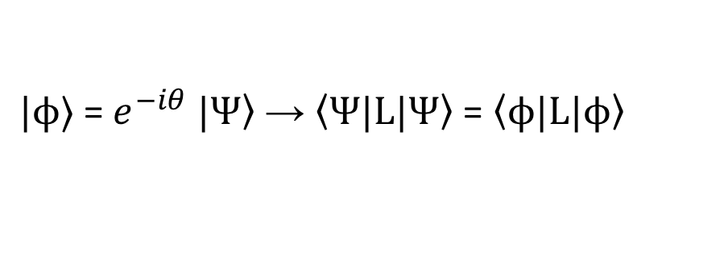

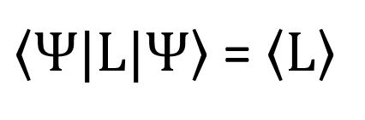
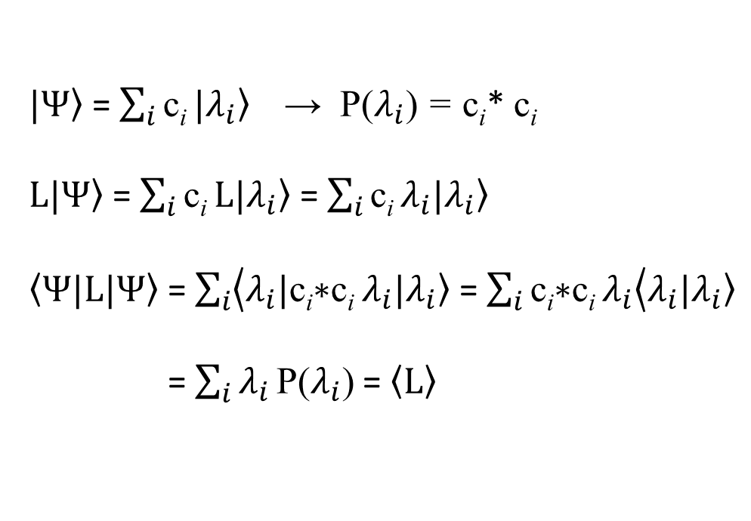
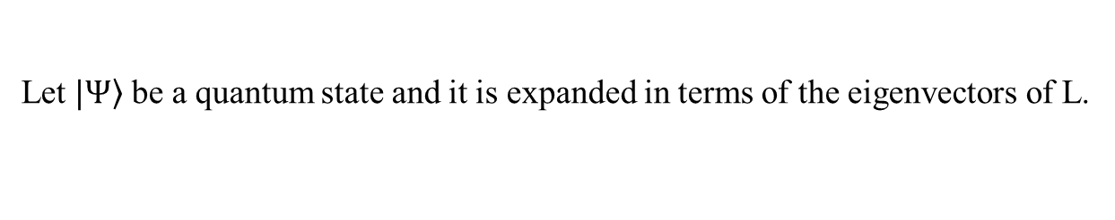
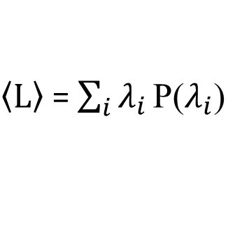
Expectation value of a measurement outcome
Let L be an observable. P($λ_{i}$) is the probability of having outcome $λ_{i}$.
$$\left\langle L\right\rangle$$
- Expectation of the observable.
$\left\langle L\right\rangle$ = $\sum_{i}{λ_{i}}\text{P}\text{(}λ_{i}\text{)}$
Let $|\left.Ψ\right\rangle$ be a quantum state and it is expanded in terms of the eigenvectors of L.
Observable
$|\left.Ψ\right\rangle$ = $\sum_{i}{\text{c}\text{i}}|\left.λ_{i}\right\rangle$ → $\text{P}\text{(}λ_{i}\text{)}$ = $\text{c}\text{i}$* $\text{c}\text{i}$
$L|\left.Ψ\right\rangle$ = $\sum_{i}{\text{c}\text{i}}L|\left.λ_{i}\right\rangle$ = $\sum_{i}{\text{c}\text{i}}λ_{i}|\left.λ_{i}\right\rangle$
$\left\langle Ψ\right.|L|\left.Ψ\right\rangle$ = $\sum_{i}{\left\langle λ_{i}\right.|\text{c}\text{i}\text{∗}\text{c}\text{i}}λ_{i}|\left.λ_{i}\right\rangle$ = $\sum_{i}{\text{c}\text{i}\text{∗}\text{c}\text{i}}λ_{i}\left\langle λ_{i}\right.|\left.λ_{i}\right\rangle$
= $\sum_{i}{λ_{i}}\text{P}\text{(}λ_{i}\text{)}$ = $\left\langle L\right\rangle$
$\left\langle Ψ\right.|L|\left.Ψ\right\rangle$ = $\left\langle L\right\rangle$
Given state
$|ϕ$⟩ = $e^{−iθ}$ $|\left.Ψ\right\rangle$ → $\left\langle Ψ\right.|L|\left.Ψ\right\rangle$ = $\left\langle ϕ\right.|L|\left.ϕ\right\rangle$
Global phase change in a state does not alter the expectation.

Slide 4

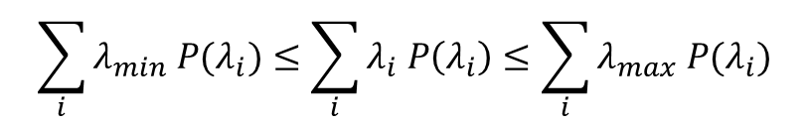

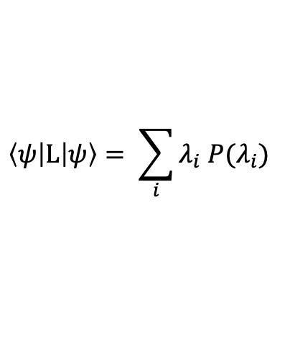

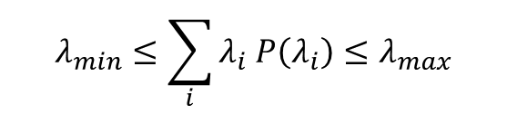
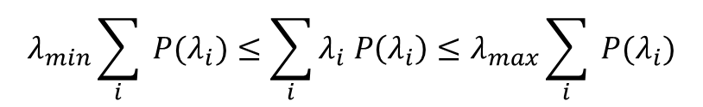
Variational principle
We have seen
$$\left\langle ψ\left|L\right|ψ\right\rangle = \sum_{i}{λ_{i} P(λ_{i})}$$
for any eigenvalue $λ_{i}$
$${λmin≤λ}_{i }≤λmax$$
Now,
$$\sum_{i}{λ_{min} P(λ_{i})}≤\sum_{i}{λ_{i} P\left(λ_{i}\right)}≤\sum_{i}{λ_{max} P(λ_{i})}$$
$$λ_{min}\sum_{i}{ P(λ_{i})}≤\sum_{i}{λ_{i} P\left(λ_{i}\right)}≤λ_{max}\sum_{i}{ P(λ_{i})}$$
$$λ_{min}≤\sum_{i}{λ_{i} P\left(λ_{i}\right)}≤λ_{max}$$
For any given parameterized ansatz
$λ_{min}≤$ $\left\langle ψ(θ)\left|L\right|ψ(θ)\right\rangle ≤λmax$

Slide 5










VQA layout
Quantum
Classical
$${\left|0\right\rangle }^{⊗n}$$
$${|φ}_{ref}⟩$$
$$θ±Δθ$$
$$|ψ⟩$$
$$|0⟩$$
Encoding
Strategy
Ansatz Prep
Classical optimizer
$$\left\langle \hat{H}\right\rangle$$
$$\left\langle \hat{H}\right\rangle$$
$$|0⟩$$
$$|ψ⟩=U(θ){|φ}_{ref}⟩$$
Optimizer
Gradient based
Non-gradient based
Encoding strategy
Occupation number basis
One hot encoding
Amplitude Encoding
Phase encoding
Ansatz
Domain inspired
Hardware Efficient
QAOA
IBM Quantum © 2024 IBM Corporation

Slide 6
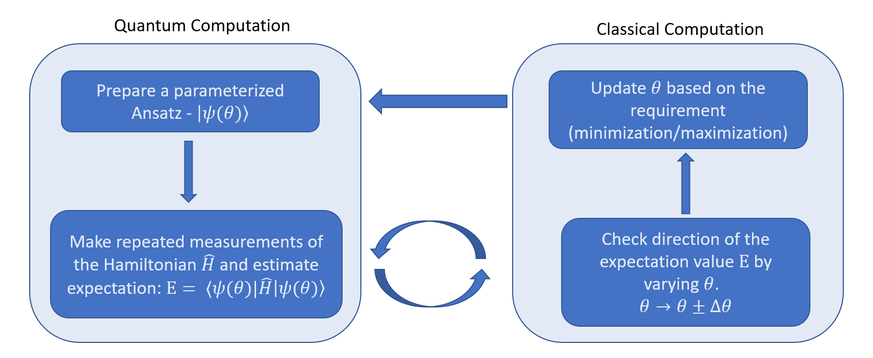
Variational Quantum Eigen-solver

Slide 7
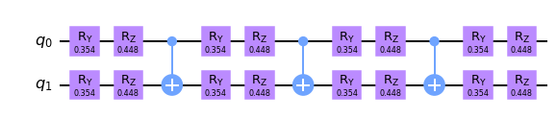
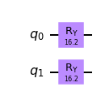
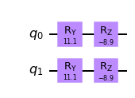
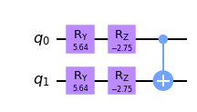
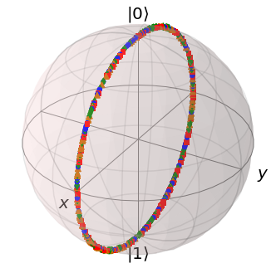
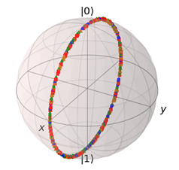
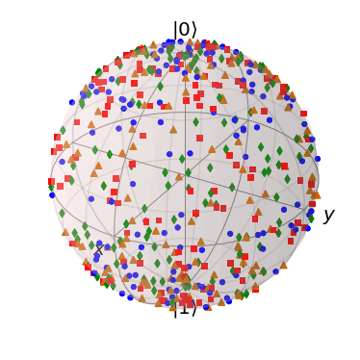
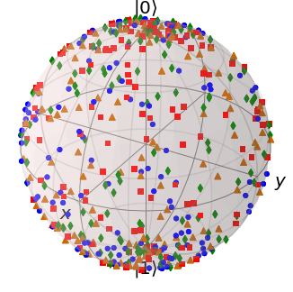
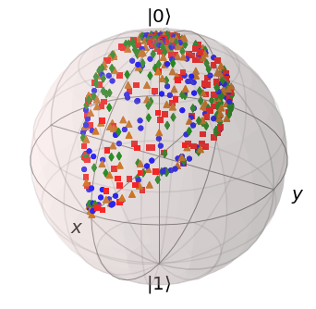
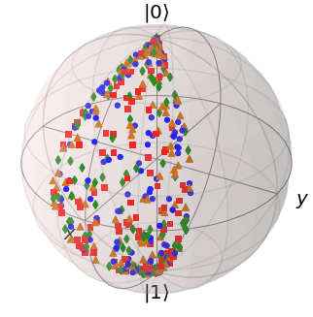
Ansatz Preparation
1 layer
Single qubit rotations
Entanglers

Slide 8



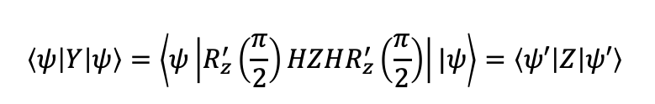









Hamiltonian (Observable/Operator)
$$\hat{H}= \sum_{j=1}^{m}{{\hat{H}}_{j}}=\sum_{j=1}^{m}{c_{j}}\prod_{i=1}^{n}{P_{ji}} P_{ji}∈\left\{X, Y, Z, I\right\}$$
$$\left\langle \hat{H}\right\rangle = \sum_{j=1}^{m}{{⟨\hat{H}}_{j}}⟩$$
For the purpose of measurement all the Pauli terms are transformed to $±Z$ computational basis.
$$|ψ⟩=U{|φ}_{ref}⟩$$
$$|ψ⟩=U{|φ}_{ref}⟩$$
Ansatz Prep
Ansatz Prep
$${|φ}_{ref}⟩$$
$$|ψ⟩$$
$${|φ}_{ref}⟩$$
$$R_{z}′\left(\frac{π}{2}\right)$$
ZZ measurement
XY measurement
$$\left\langle ψ\left|X\right|ψ\right\rangle =\left\langle ψ\left|HZH\right|ψ\right\rangle =\left\langle ψ′\left|Z\right|ψ′\right\rangle$$
$$\left|ψ^{′}\right\rangle =H\left|ψ\right\rangle$$
$$\left\langle ψ\left|Y\right|ψ\right\rangle =\left\langle ψ\left|R_{z}^{′}\left(\frac{π}{2}\right)HZHR_{z}^{′}\left(\frac{π}{2}\right)\right||ψ\right\rangle =\left\langle ψ′\left|Z\right|ψ′\right\rangle$$
$$\left|ψ^{′}\right\rangle \text{ = }HR_{z}^{′}\left(\frac{π}{2}\right)|ψ⟩$$

Slide 9
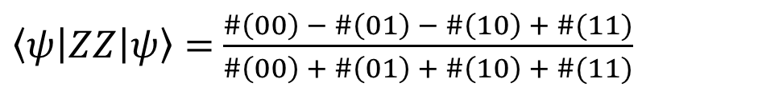
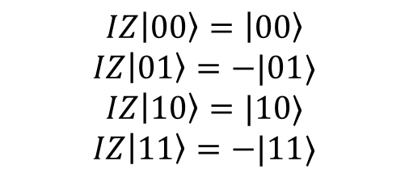




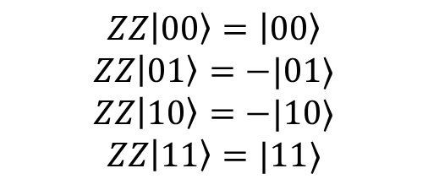
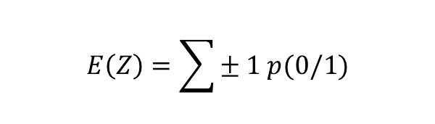



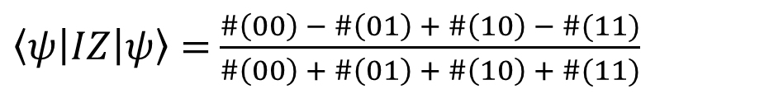
Count statistics and Expectation
$$E\left(Z\right)=\sum{± 1 p(0/1)}$$
$⟨Z⟩$
$$E\left[𝒳\right]=\sum{x p(x)}$$
$\left|ψ\right\rangle =c_{1}\left|0\right\rangle +c_{2}|1⟩$
$p\left(0\right)= \frac{\#0}{\#0 + \#1}$ $p\left(1\right)= \frac{\#1}{\#0 + \#1}$
$$E\left(Z\right)=\left\langle ψ\left|Z\right|ψ\right\rangle =c_{1}^{2}.1+c_{2}^{2}. \left(−1\right)=c_{1}^{2} −c_{2}^{2}$$
$$\left\langle ψ\left|Z\right|ψ\right\rangle =p\left(0\right)−p(1)$$
$⟨ZZ⟩$
$⟨IZ⟩$
$$ZZ\left|00\right\rangle =\left|00\right\rangle$$
$$ZZ\left|01\right\rangle =−|01⟩$$
$$ZZ\left|10\right\rangle =−|10⟩$$
$$ZZ\left|11\right\rangle =|11⟩$$
$$IZ\left|00\right\rangle =\left|00\right\rangle$$
$$IZ\left|01\right\rangle =−|01⟩$$
$$IZ\left|10\right\rangle =|10⟩$$
$$IZ\left|11\right\rangle =−|11⟩$$
$\left\langle ψ\left|ZZ\right|ψ\right\rangle =$ $\frac{\#\left(00\right) − \#\left(01\right) − \#\left(10\right) + \#(11)}{\#\left(00\right) + \#\left(01\right) + \#\left(10\right) + \#(11)}$
$\left\langle ψ\left|IZ\right|ψ\right\rangle =$ $\frac{\#\left(00\right) − \#\left(01\right) + \#\left(10\right) − \#(11)}{\#\left(00\right) + \#\left(01\right) + \#\left(10\right) + \#(11)}$

Slide 10
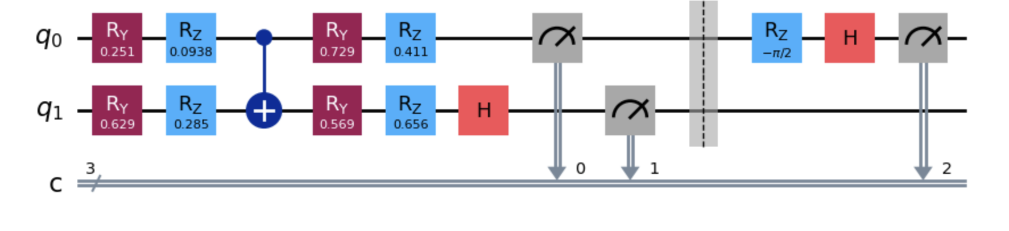
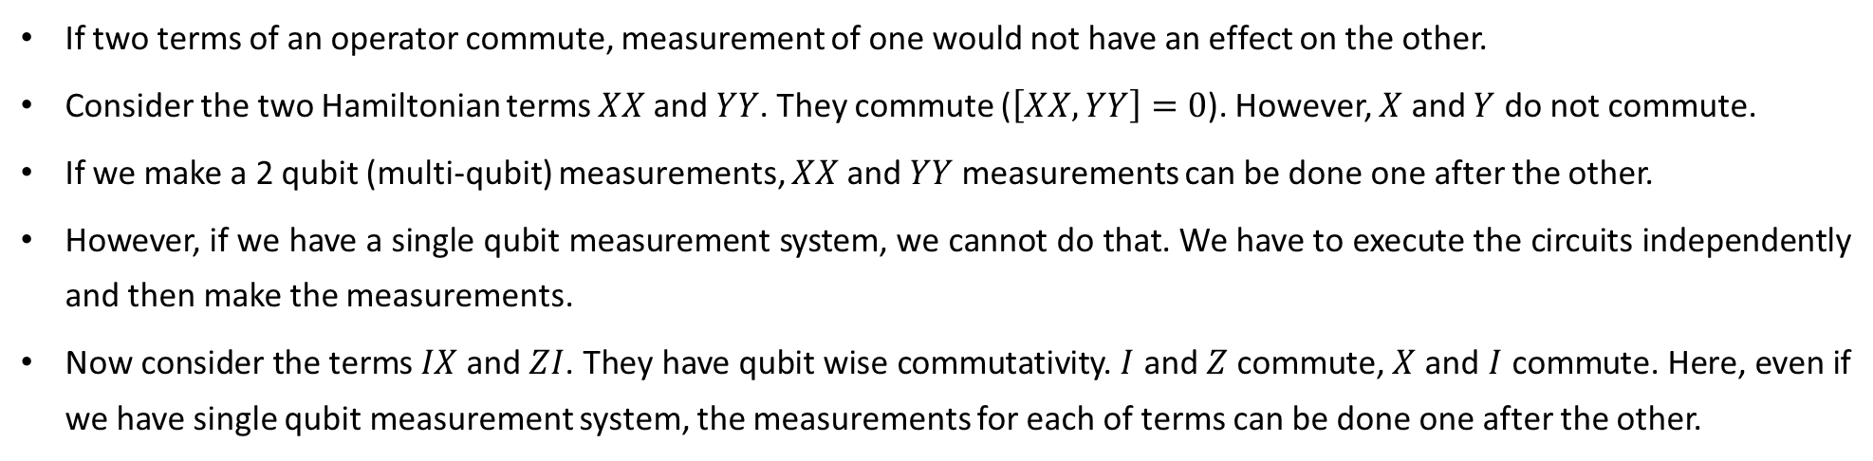



When to measure?
If two terms of an operator commute, measurement of one would not have an effect on the other.
Consider the two Hamiltonian terms $XX$ and $YY$. They commute ($\left[XX, YY\right]=0$). However, $X$ and $Y$ do not commute.
If we make a 2 qubit (multi-qubit) measurements, $XX$ and $YY$ measurements can be done one after the other.
However, if we have a single qubit measurement system, we cannot do that. We have to execute the circuits independently and then make the measurements.
Now consider the terms $IX$ and $ZI$. They have qubit wise commutativity. $I$ and $Z$ commute, $X$ and $I$ commute. Here, even if we have single qubit measurement system, the measurements for each of terms can be done one after the other.
$$H=α_{1} XI+α_{2} IY$$
$$XI$$
$$IY$$
Ansatz

