Slide 1

TASK MANAGEMENT APP

Slide 2
Welcome to Task Management App
Designed to help users track tasks and manage time effectively.
Provides powerful insights into productivity patterns.
Combines task management and advanced analysis into one seamless experience.

Slide 3
Features
Time Entry Recording
Querying Time Entries
Report Generation
Priority Command

Slide 4
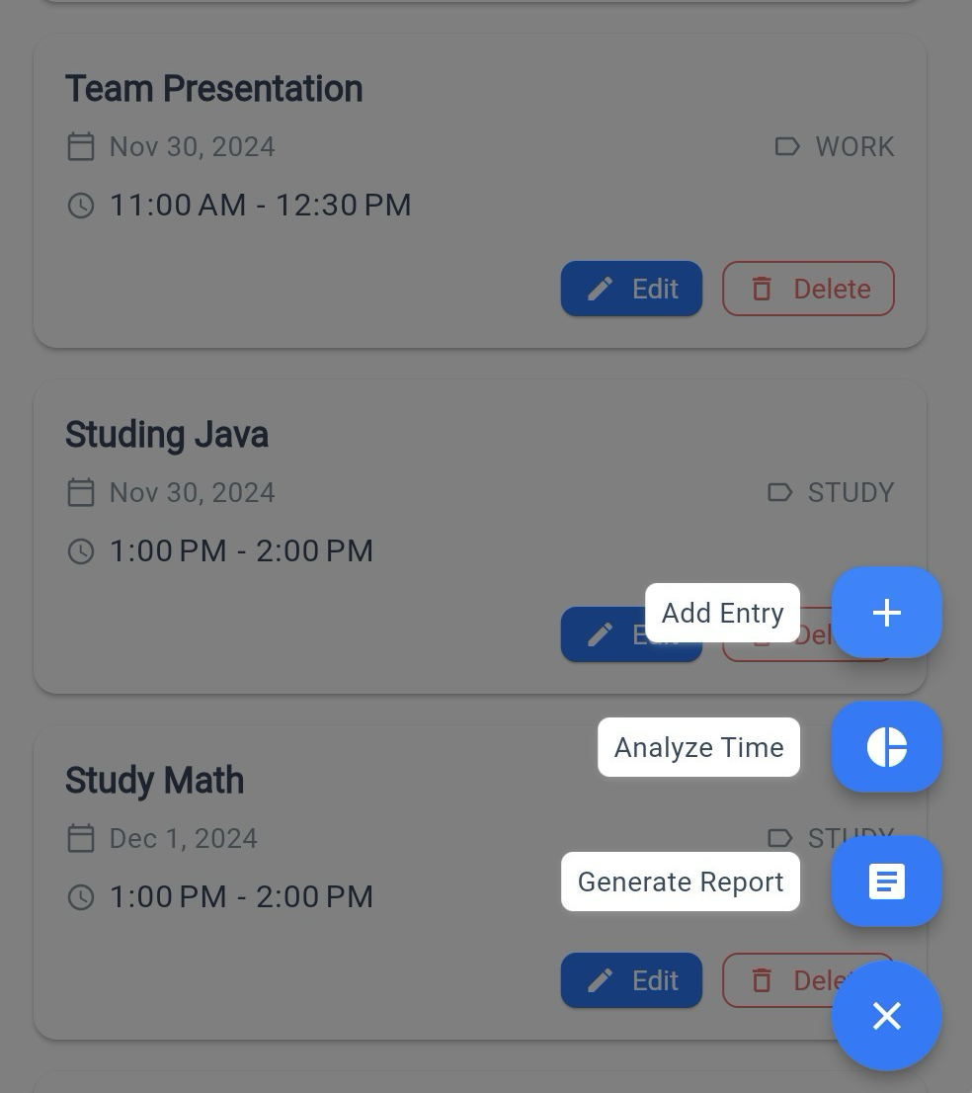
Time Entry Recording
Add tasks with details such as name, time and tags
Modify or remove existing entries.

Slide 5
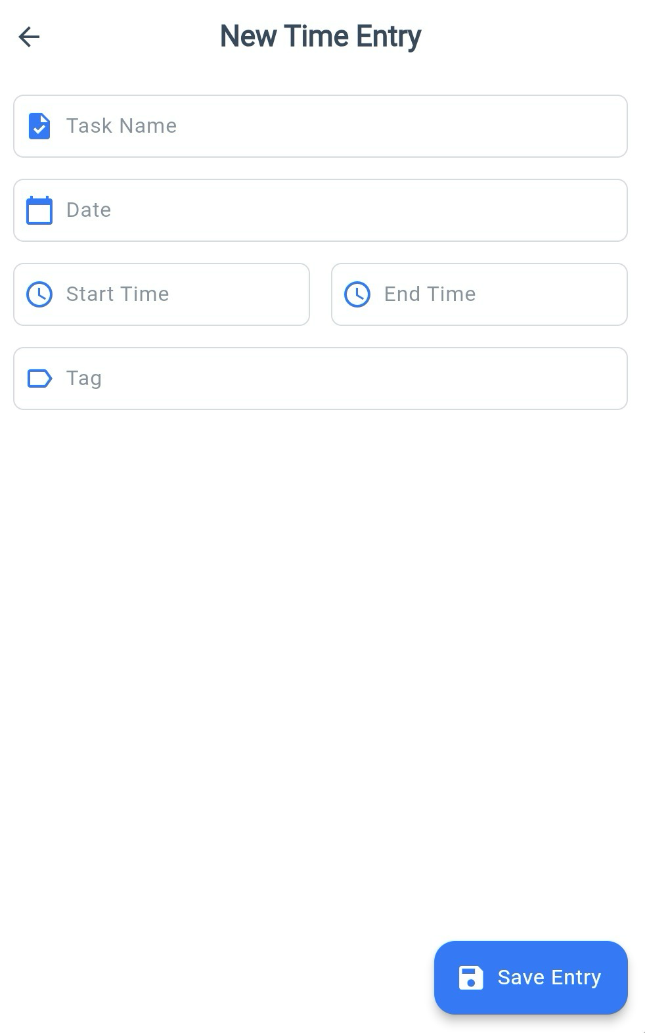
Time Entry Recording
Add tasks with details such as name, time and tags
Modify or remove existing entries.

Slide 6
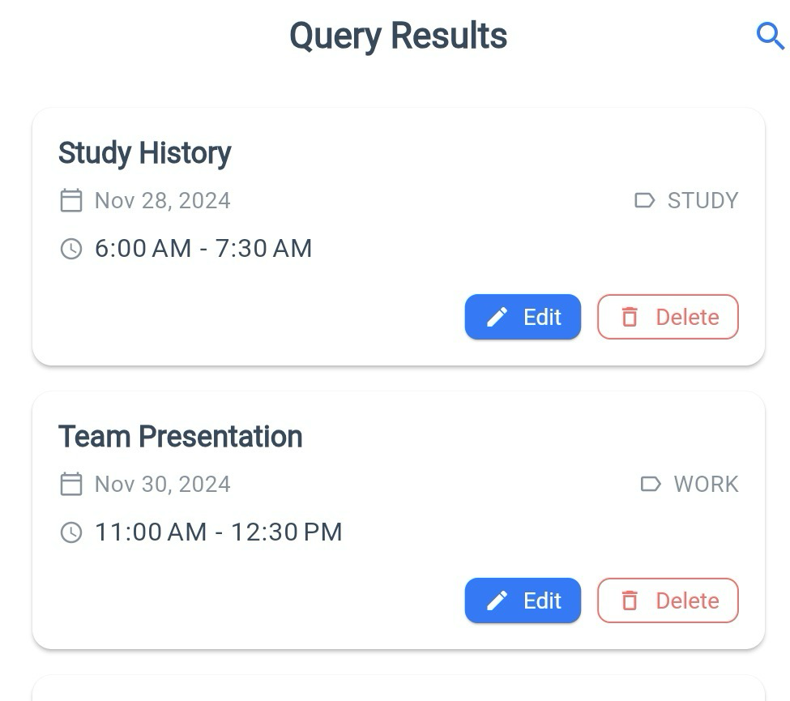
Time Entry Recording
Add tasks with details such as name, time and tags
Modify or remove existing entries.

Slide 7
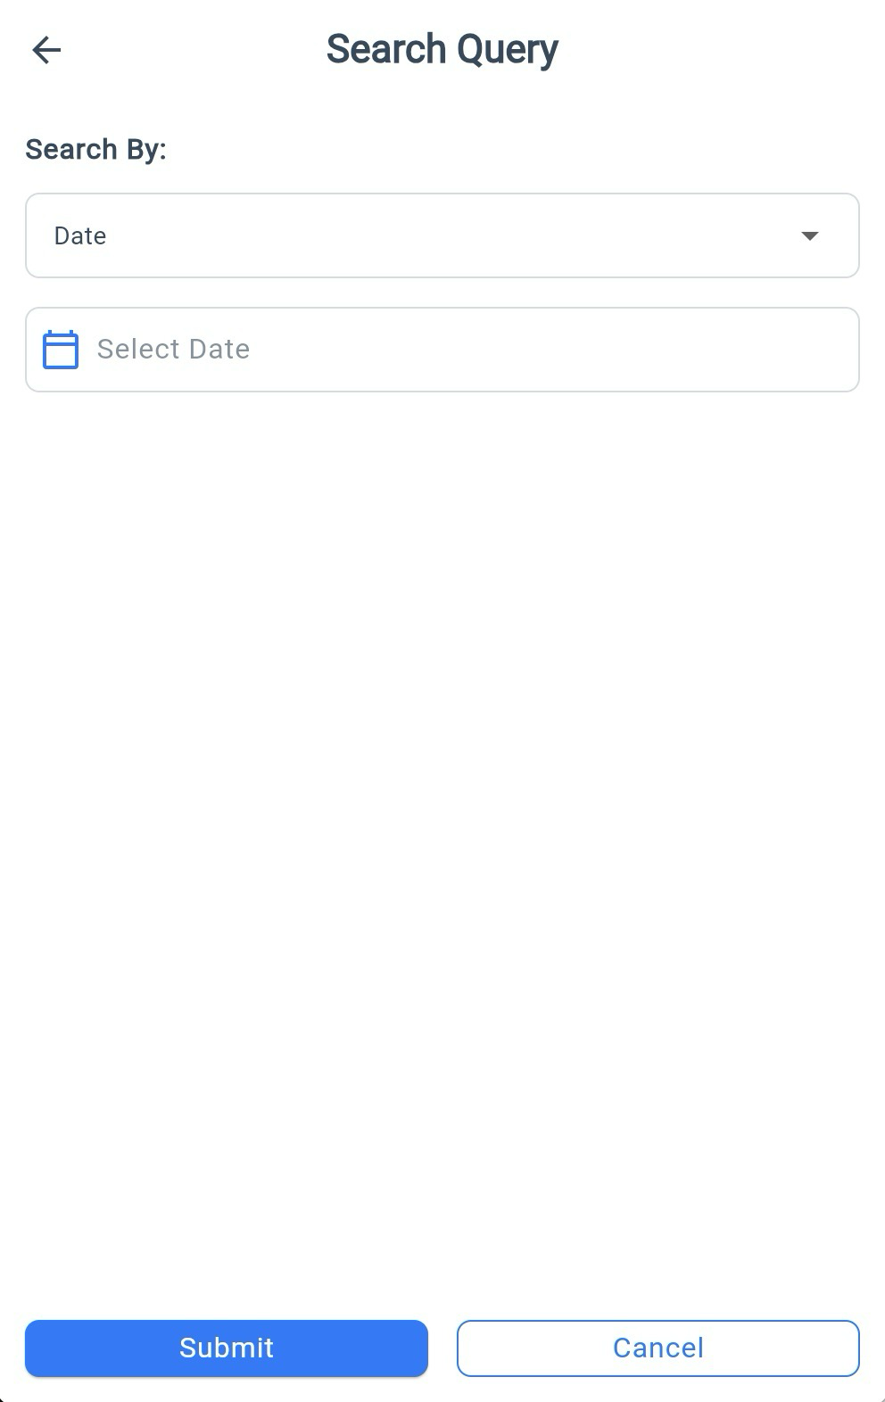
Querying Time Entries
Search for tasks by date, name, or tag.

Slide 8
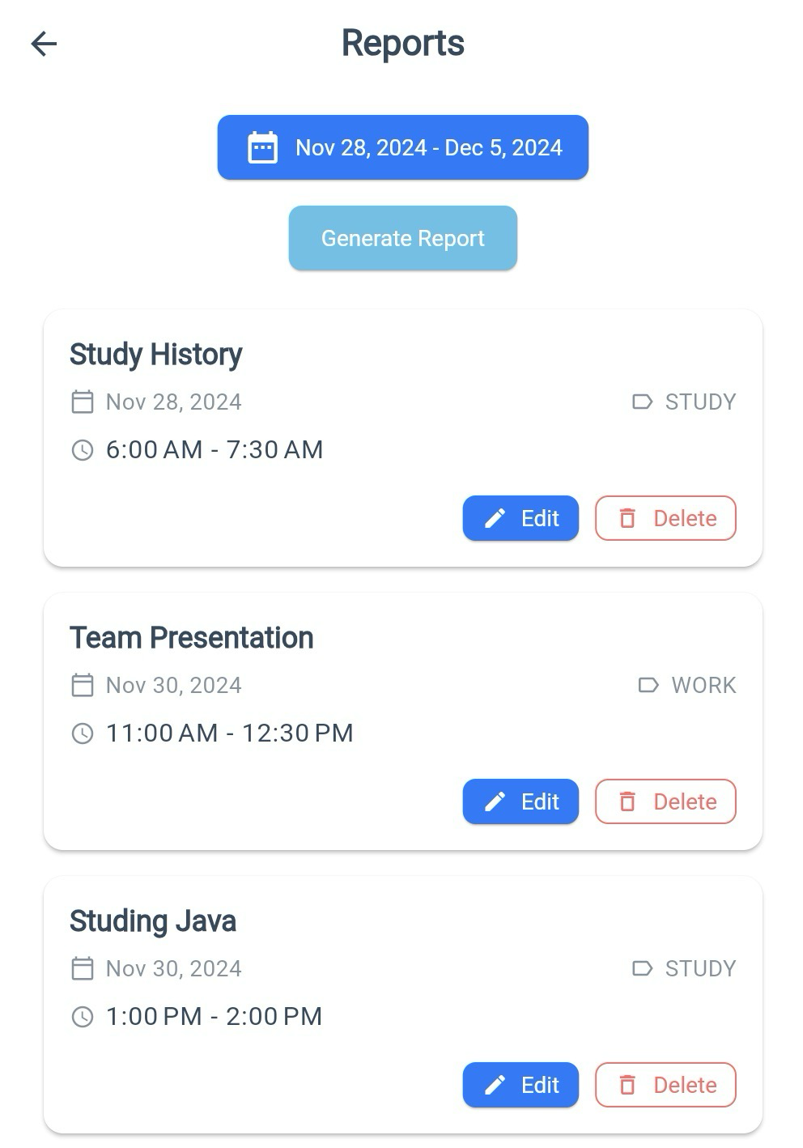
Report Generation
View entries between a range of dates.

Slide 9
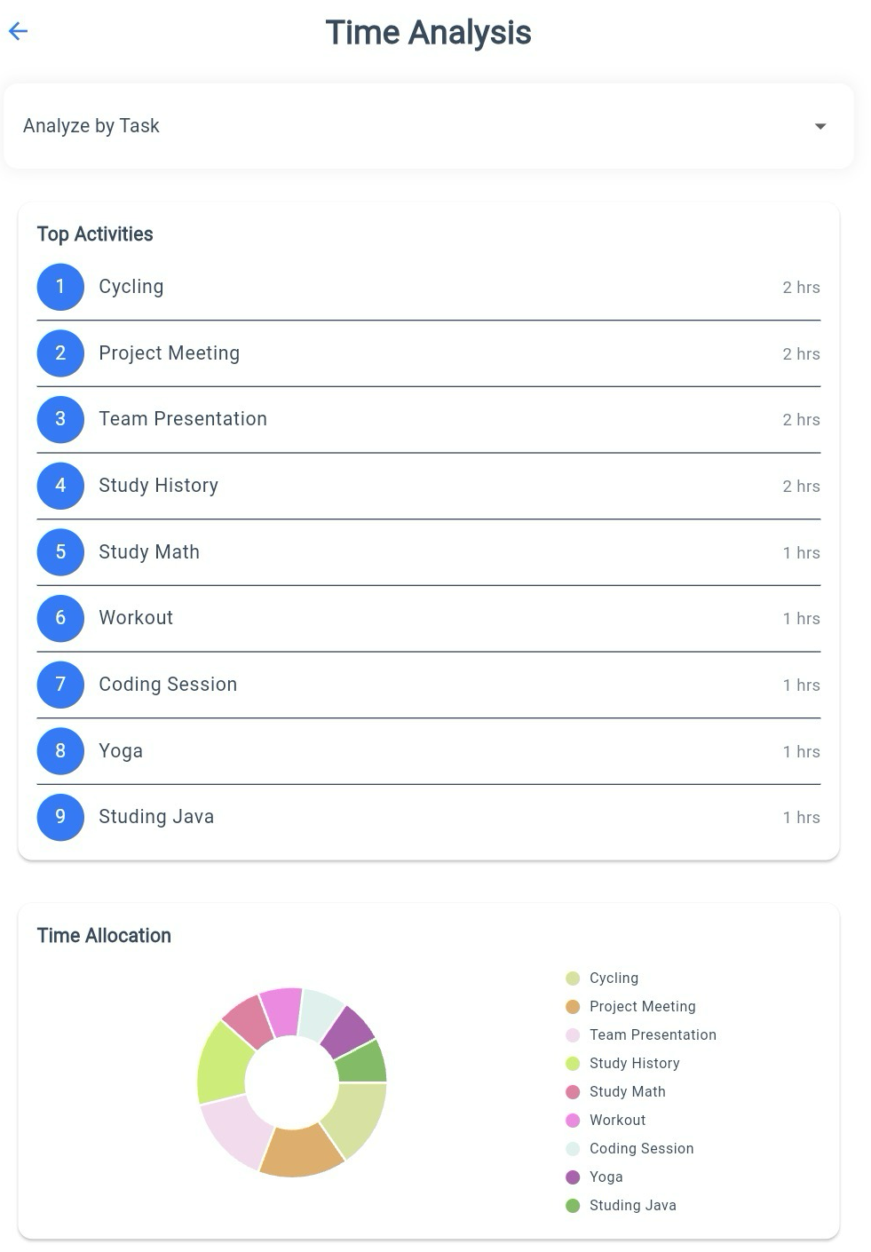
Priority Command
Summarized statistics, such as total time tracked and task count.
Visualize time spent by task or tag with ranked lists and pie charts.

Slide 10
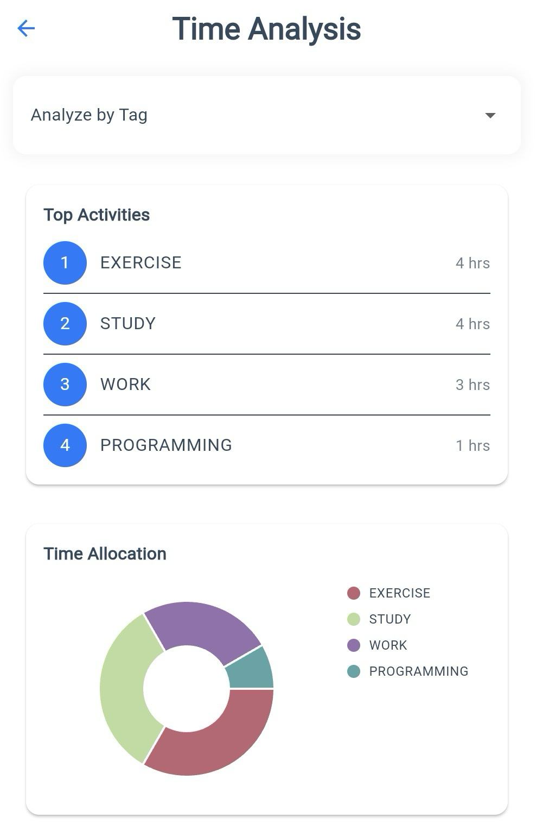
Priority Command
Summarized statistics, such as total time tracked and task count.
Visualize time spent by task or tag with ranked lists and pie charts.

