Slide 1

OwnTheBlock
Own the homes
on your block
Neighbors pool $10 at a time to buy, fix and own local homes, with the rules run on the blockchain.
Kaleb Conway · Own Your Future Challenge · Nov 10, 2026
Notes:
TIMING: about 5:00 across 16 slides, so most slides are 15–25 seconds. Spend the most time on slides 6–7 (blockchain) and 13–14 (plan and budget). The app demo images at the end are for Q&A.
SAY: "Walk two blocks from A&T and count how many homes are owned by people who live there. I'm Kaleb, and this is OwnTheBlock."

Slide 2




Problem
Black homeownership is 45%, vs 74% for white households.
Empty houses sit for years: heirs live away and banks won't lend on them.
Outside investors buy them, and the rent leaves the neighborhood.
Source: U.S. Census Bureau, Housing Vacancies and Homeownership Survey (rounded).
Notes:
SAY: "Meet Ms. Jenkins: forty years on the same block in East Greensboro. The house next door is boarded up; the heirs live out of state and no bank will lend on it. Then the cash offers start. Black homeownership is 45%, white is 74%, and homes are how families build wealth. Her neighbors would chip in, but there's no way to turn $10 here and $50 there into owning a house."
Rubric: Problem Articulation (5): who, root cause, impact.

Slide 3



Why now
For the first time, the tools exist to make this legal and cheap.
Anyone can invest small amounts in a local deal (SEC Regulation Crowdfunding).
Blockchain payments on Base cost less than 1¢.
Digital dollars (USDC) are now federally regulated (GENIUS Act, 2025).
Notes:
SAY: "Why now? Three things changed. Crowdfunding rules let everyday people invest small amounts in a local deal. Blockchain payments on Base cost less than a cent. And digital dollars are now federally regulated. Ten years ago this wasn't possible."

Slide 4


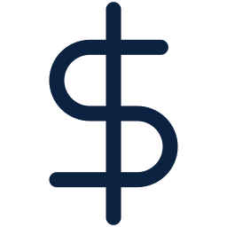
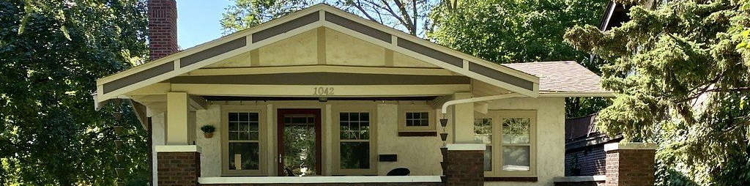
Solution
Neighbors buy the house together, on their phones.
Pool $10 at a time. Residents get first access.
Each $10 token is one piece of the LLC that owns the house.
Get paid rent every month and vote on the rules.
Notes:
SAY: "OwnTheBlock lets about 1,250 neighbors, students, alumni and churches put in $10 to $2,000 each to raise $144,000: enough to buy and fix one house. Each $10 token is one unit of an LLC that owns the deed. A local family rents it, every owner gets paid monthly and votes on the rules, and the tenant can buy the home."
If asked why an LLC: people can't legally own 1/14,400th of a house, but an LLC can own the house and have thousands of members.

Slide 5

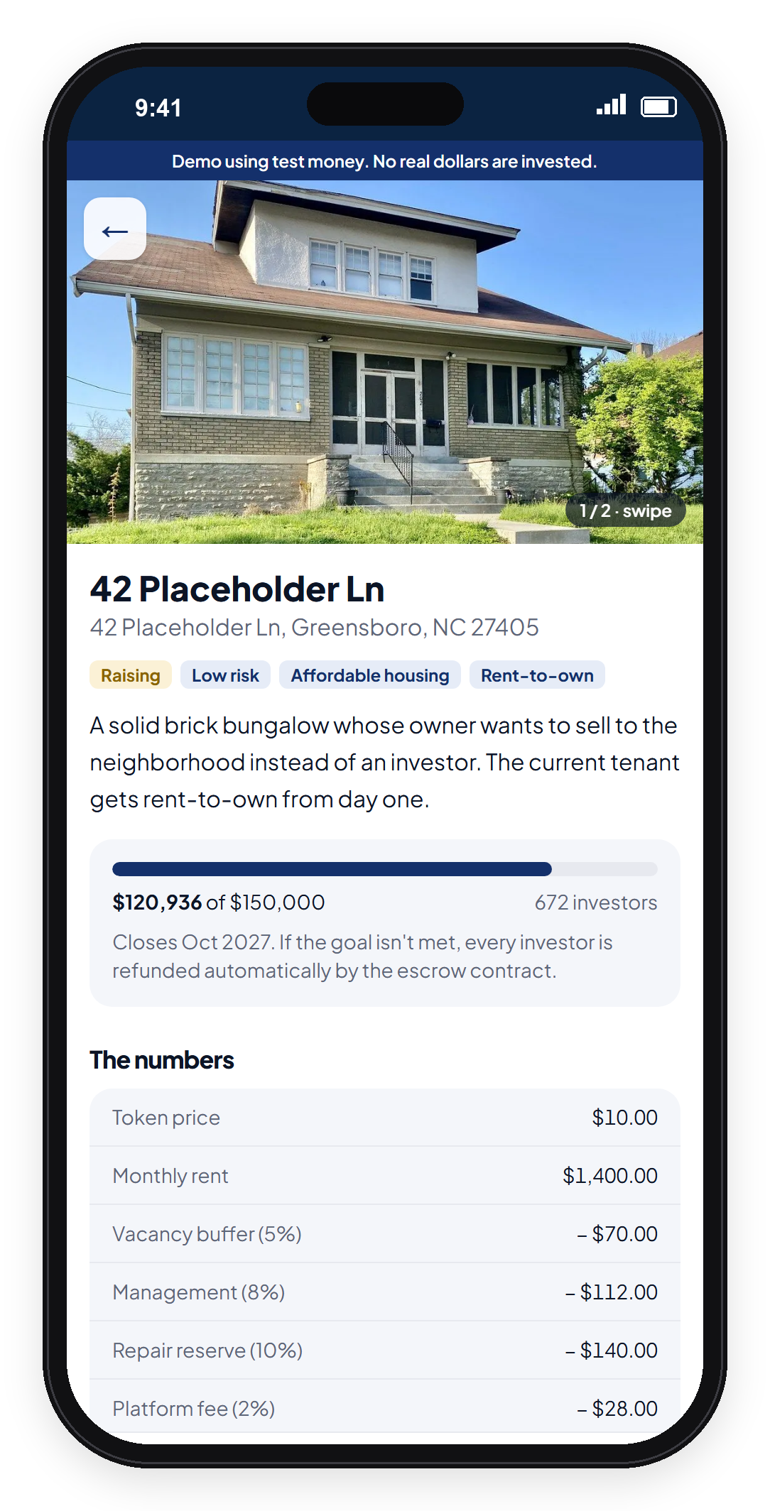
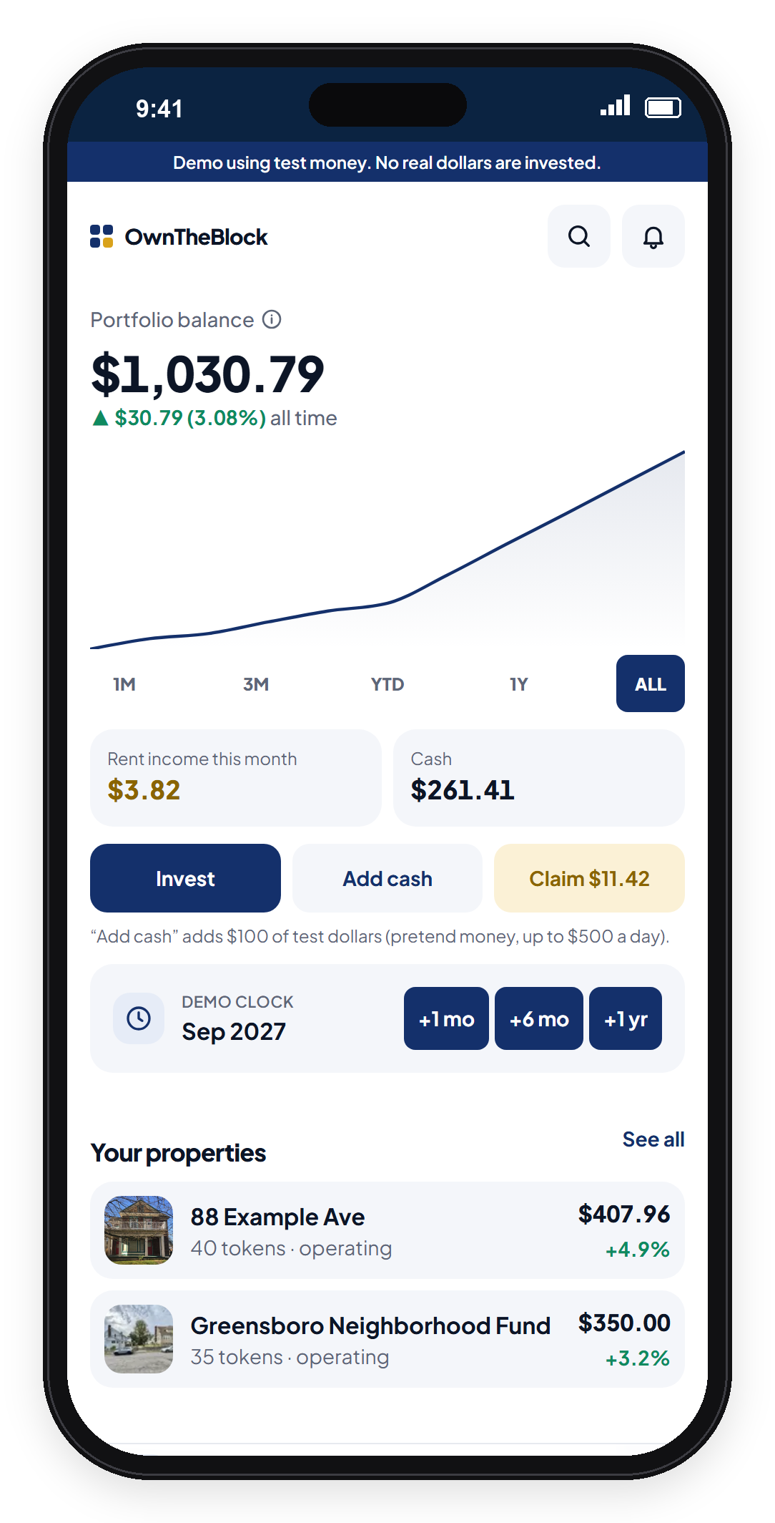

How it works
Pick a home on your block.
Invest from $10. Refunded if the raise misses.
Local contractors fix it; a local family rents it.
Get paid rent monthly. The tenant can buy it in years 3–7.
Notes:
SAY: "Here's the app. You pick a home, invest from $10, and if the raise doesn't hit its goal everyone is refunded automatically. Local contractors fix it, a local family rents it, and you get your share of the rent every month."

Slide 6
Why blockchain: payments
Paying 1,440 owners their share of $700 rent, every month.
Bank transfers
OwnTheBlock on Base
~$500
~$14
a month in fees. Most of each $0.49 payout is gone.
a month. One deposit pays everyone; under 1¢ per owner.
Bank: ~$0.20–$0.50 per payment (midpoint). Base: measured gas per claim at typical Base fees.
Notes:
WORTH 20 POINTS (with the next slide). Slow down.
SAY: "Why does this need a blockchain? Reason one: the payments. A $100 owner earns 49 cents a month. Paying 1,440 owners by bank transfer costs about $500 a month in fees, which eats the payout. On Base, the manager makes one deposit and the contract splits it for everyone, for about $14 total."

Slide 7
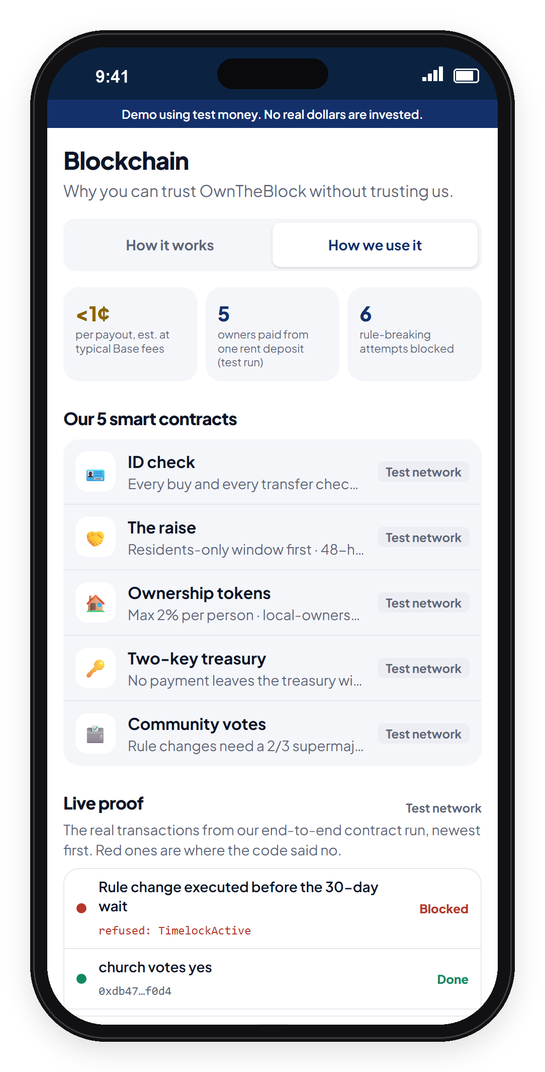

Why blockchain: trust
The rules live in code, not in our database.
Rent can only rise 3% a year. The code won't allow more.
Changing a rule takes a 2/3 owner vote and a 30-day wait.
Every payment is public. Anyone can check where the money went.
Notes:
SAY: "Reason two: trust. In a normal company, whoever runs the database can change the rules. Here the rent cap, ownership limits and local share are written into smart contracts. Changing them takes a two-thirds vote of owners and a 30-day wait, and every payment is public. For a neighborhood that's been burned before, that's the whole point."
IF ASKED 'Why not a database?': "A database can store the list. It can't make tiny payments cheap, and it can't stop its own operator from changing the rules."

Slide 8
It's already built
A working app and smart contracts, tested end to end.
5
22
38
6
smart contracts
tests passing
test-run transactions
rule-breaks blocked
Blocked by the code: an early sale, a 10% rent hike, and a rushed rule change.
Run on a local test blockchain. Base Sepolia deployment next; independent security audit before any real money.
Notes:
SAY: "This isn't just an idea. The app works, we wrote five smart contracts with 22 automated tests passing, and we ran Ms. Jenkins' whole story on a test blockchain. The code refused an early sale, a 10% rent hike and a rushed rule change. Nobody, including us, can override it."
If you have any interest data (survey responses, sign-ups), say it here: that's the 'traction' investors look for.

Slide 9
Market opportunity
Start with one house in Greensboro. Grow through HBCU communities.
1 home
25 homes
500 homes
Greensboro pilot
(first 18 months)
5 cities
(years 2–3)
100 HBCU communities
× 5 homes
At 500 homes: $72M of homes owned by their neighborhoods, and $4.2M a year of rent staying local.
500 × $144,000 = $72M; 500 × $700 × 12 = $4.2M. Targets, not forecasts.
Notes:
SAY: "We start with one house in Greensboro, grow to 25 homes in five cities, and the goal is 100 HBCU communities with five homes each. That's $72 million of homes owned by the people who live around them, and $4.2 million a year in rent staying in those neighborhoods."
Rubric: Benefits (15): scalability.

Slide 10
Competition
Others do pieces. No one does all four.
 | Invest from $10 | Locals first | Rules in code | Tenant can buy
Fundrise, Arrived | ● | ○ | ○ | ○
RealT, Lofty | ● | ○ | ◐ | ○
Community land trusts | ○ | ● | ◐ | ◐
OwnTheBlock | ● | ● | ● | ●
● yes ◐ partly ○ no
Based on each company's public descriptions.
Notes:
SAY: "Others do pieces of this. Fundrise and Arrived let you invest small amounts, but from anywhere into homes anywhere. RealT and Lofty put homes on a blockchain, but the owners are global. Land trusts keep homes affordable, but residents can't invest small amounts. Nobody keeps ownership local, puts the rules in code, and gives the tenant a path to own."
Rubric: Innovation (15). Don't say 'no one has ever done this'; say 'no one combines these four.'

Slide 11


How we make money
Small fees per house, then licensing the platform.
2% of each raise
($2,880 per house)
2% of monthly rent
(~$336 per house a year)
License the platform to land trusts, nonprofits and cities
Investors' money for the house never pays for the company.
Notes:
SAY: "We earn 2% of each raise and 2% of rent. Fees alone need a few hundred homes to cover a team, so the scale plan is licensing the platform to land trusts, community development nonprofits and cities that already own properties."

Slide 12
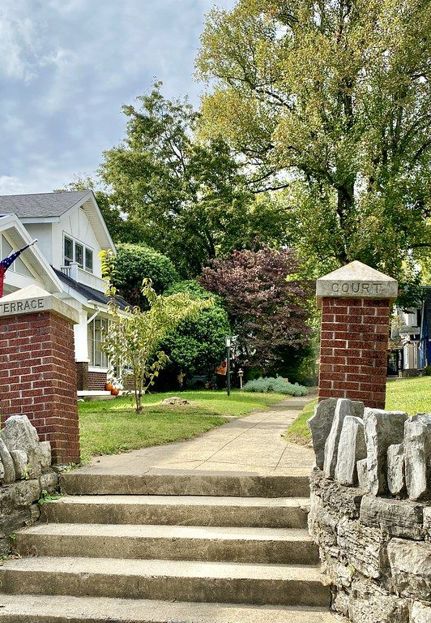


Who wins
Residents become owners of their own block.
The tenant gets capped rent and a path to buy the home.
Students make a first investment and learn how ownership works.
Coinbase's mission: increase economic freedom. Ours starts on your block.
Notes:
SAY: "Who wins? Residents become owners. The tenant gets capped rent and a path to buy the home. Students make their first investment and learn how ownership works. And the heirs get a fair price. It fits Coinbase's mission to increase economic freedom, starting on your own block."
Rubric: Benefits (15): social impact + Coinbase mission.

Slide 13





Why us
Built by an HBCU student, for HBCU neighborhoods.
Partners we're lining up
A community steward (church, association or land trust)
Kaleb Conway
City & county surplus homes
Founder · Finance student
Built the financial model, the smart contracts and the app
A CDFI or bank to cover early losses
Base grants and mentorship
Partners are targets, not yet signed. Advisors to recruit: securities attorney, Greensboro broker, CPA.
Notes:
FILL IN: add your school, year, and any teammates or advisors. One line of credibility each.
SAY: "I'm a finance student at an HBCU. I built the financial model, the smart contracts and the app myself. To launch, we're lining up a community steward, the city's surplus-home program, a CDFI to cover early losses, and Base for grants and mentorship."
Be honest that partners are targets.

Slide 14
The plan
Prove one house end to end in 18 months.
✓
1
2
3
DONE
MONTHS 0–3
MONTHS 3–9
MONTHS 9–18
Prototype
Set up
First raise
First payouts
App + tested contracts
Lawyer, security audit, steward
Find the house, raise $144K
Rent it; start 2 more
Real money only moves after a lawyer signs off and the code passes an independent audit.
Notes:
SAY: "The plan proves one house in 18 months. First three months: securities attorney, independent security audit, and sign a community steward. Months three to nine: get a house from city surplus or an heirs'-property family and run the raise. Months nine to eighteen: renovate, lease, start monthly payouts, then houses two and three."
Rubric: Action Plan (20): objectives + timeline.

Slide 15
Budget: $180,000
What the 18-month pilot costs, and who funds it.
Funded by
$50K
grants & competitions
$50K
a CDFI or bank program
$80K
impact angels
Each house is paid for by its own $144K raise, never this budget.
Notes:
SAY: "The pilot costs $180,000, mostly the team, the securities lawyer and the security audit. It's funded by grants like Base Builder grants, a CDFI or bank community program, and impact angels. The houses themselves are paid for by their own raises."
Rubric: Action Plan (20): resources + budget. Ranges if asked: Reg CF counsel $20–50K; audit $15–50K.

Slide 16
Risks we've planned for
Can't fill the raise → refunds if it misses; residents, students, alumni and churches all invest
Securities law → registered crowdfunding portal, one LLC per house
Code bug or hack → independent audit before any real money
Repairs or vacancies → 15% repair cushion and a 10% reserve
Estimates, not guarantees: investors can lose money, and the app shows the downside as clearly as the upside.
Notes:
SAY: "We've planned for the hard parts. If a raise doesn't fill, everyone is refunded. We use a registered crowdfunding portal and one LLC per house. No real money moves before an independent security audit. And every house keeps a repair cushion and a reserve."
Rubric: Feasibility (15).
If asked 'what if home values fall?': bought below repaired value, no mortgage, and a first-loss partner covers the first 10%.

Slide 17
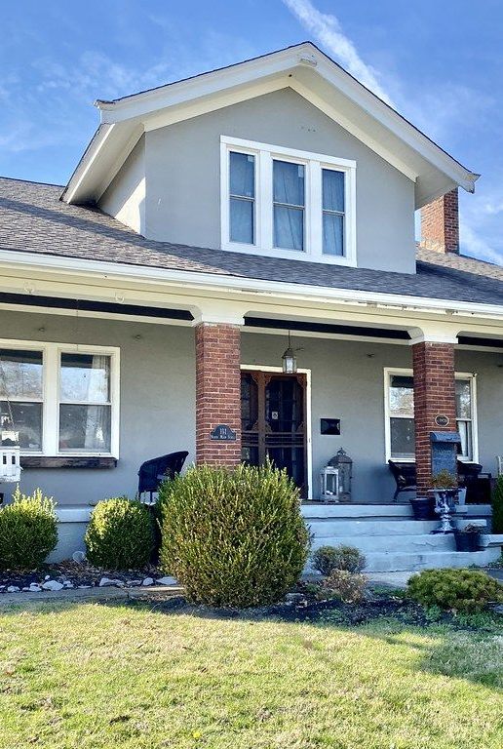
Our ask
1
A steward partner
and a first house in Greensboro
2
$180,000
for the 18-month pilot
3
Mentorship from Base
for the audit and launch
Fix the block. Own the block.
Notes:
SAY: "Our ask: a steward partner and a first house in Greensboro, $180,000 for the pilot, and mentorship from Base for the audit and launch. Ms. Jenkins doesn't have to leave. Fix the block. Own the block. Thank you."
Q&A one-liners:
- Legal? Each house's LLC raises under Reg CF via a registered portal; 12-month lockup in code.
- 49 cents is nothing? The impact is the house, its rent and its rising value staying in the neighborhood, and a tenant becoming an owner.
- Fill $144K? 300 residents × $50, 400 students × $25, 540 alumni × $150, 19 churches/orgs × $2,000.
- Gentrification? Residents buy first, rent is capped at 3%/yr in code, and the tenant can buy the home.
- Home values fall? Bought below repaired value, no mortgage, a first-loss partner covers the first 10%.
The next slides are the app demo: use them in Q&A ("Here's what it looks like on your phone").

Slide 18
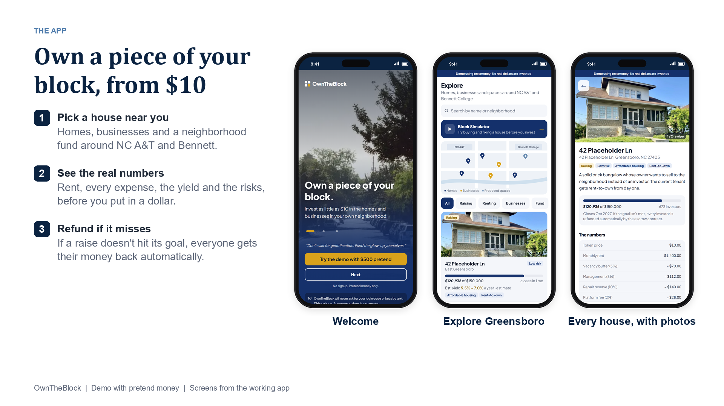
Notes:
APP DEMO (screens from the working app, pretend money).
SAY: Welcome, Explore and a property page. Every house shows its photos, the real numbers and the risks before anyone invests.

Slide 19
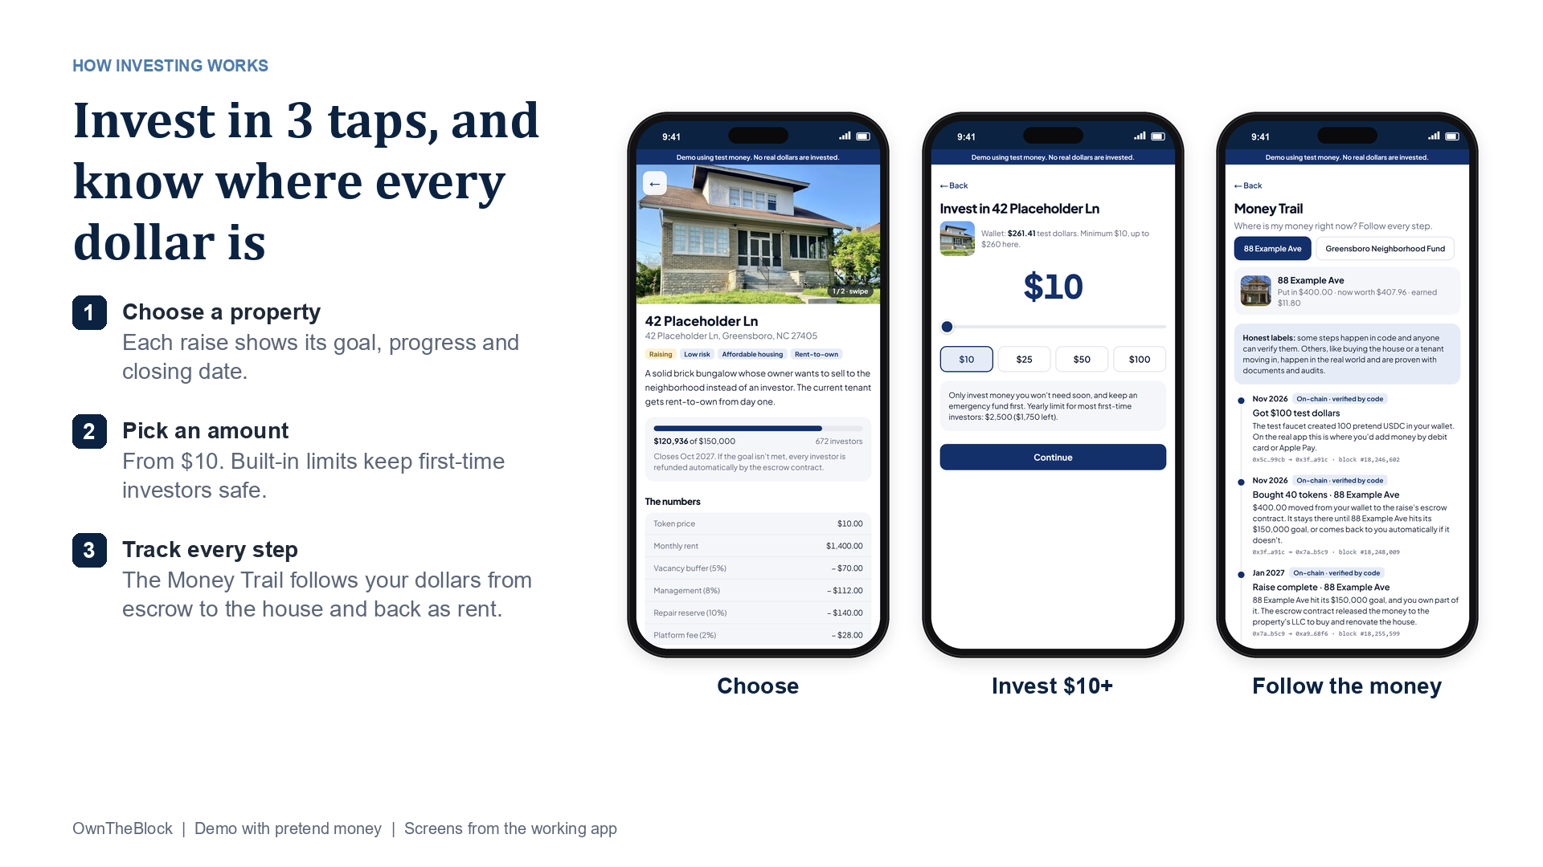
Notes:
APP DEMO (screens from the working app, pretend money).
SAY: Choose a property, pick an amount from $10, then follow every dollar on the Money Trail.

Slide 20
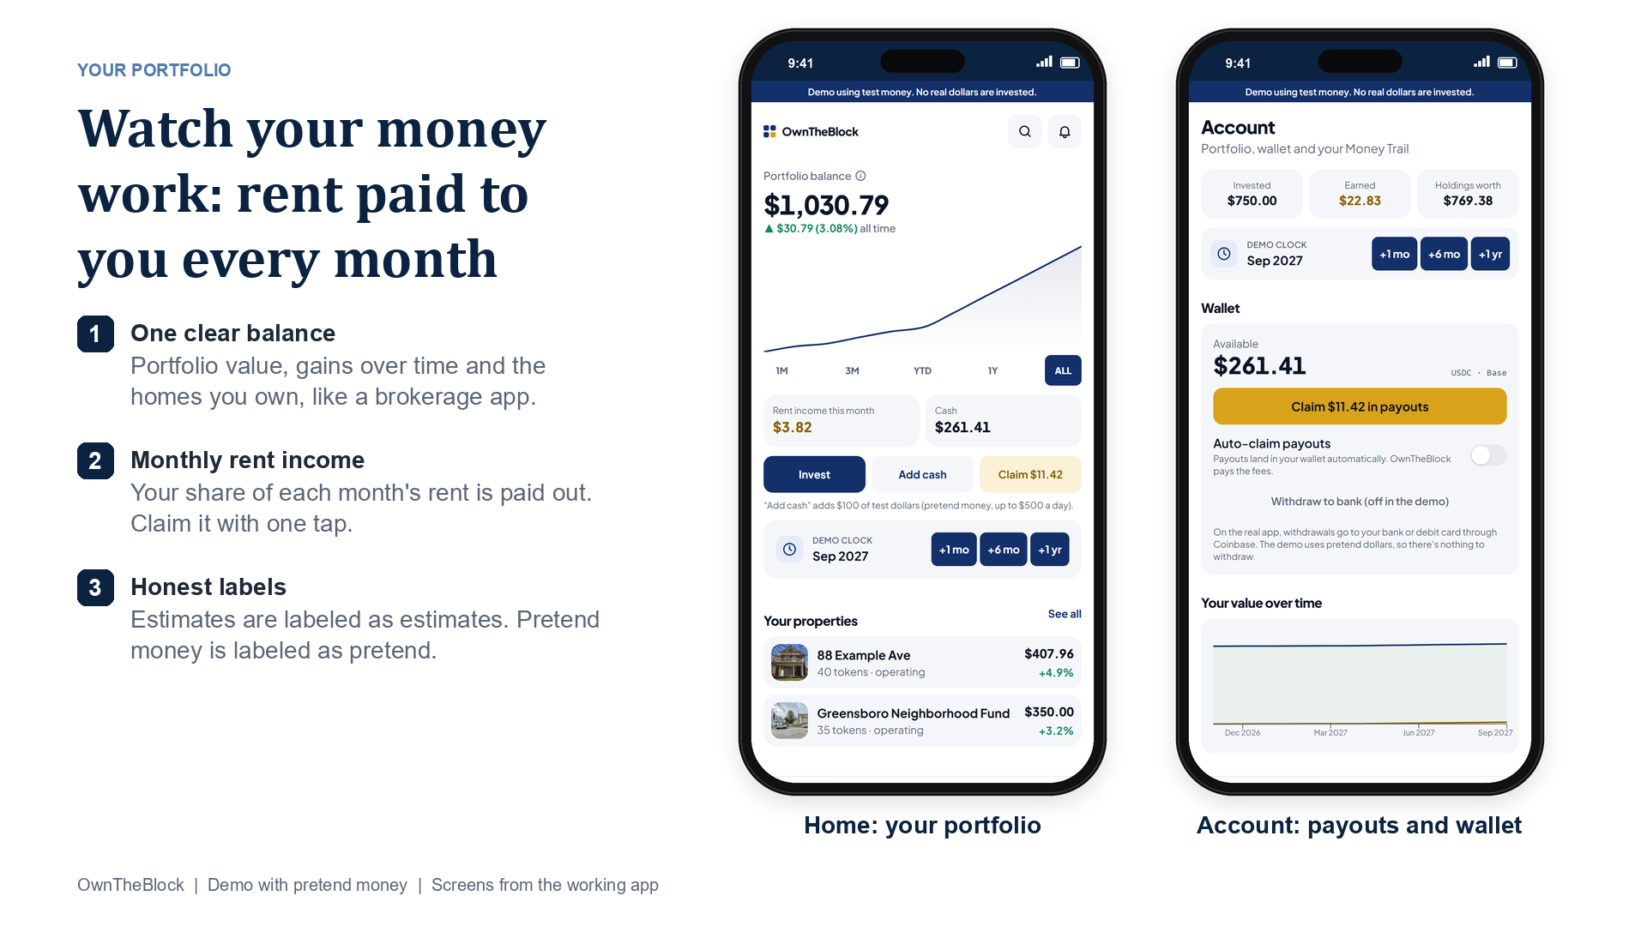
Notes:
APP DEMO (screens from the working app, pretend money).
SAY: Home works like a brokerage app: balance, gains over time, the homes you own, and rent income you claim with one tap.

Slide 21
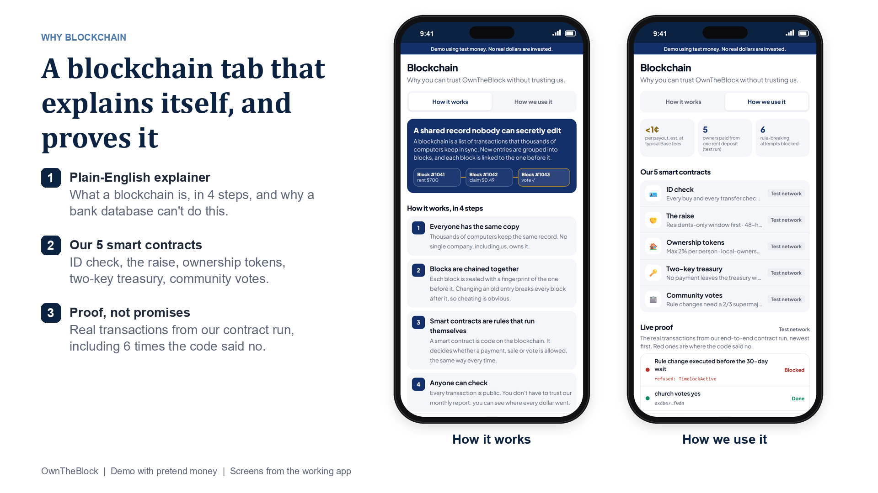
Notes:
APP DEMO (screens from the working app, pretend money).
SAY: The Blockchain tab explains blockchain in plain English, then shows our 5 contracts and the real test-run transactions, including the 6 the code blocked.

Slide 22
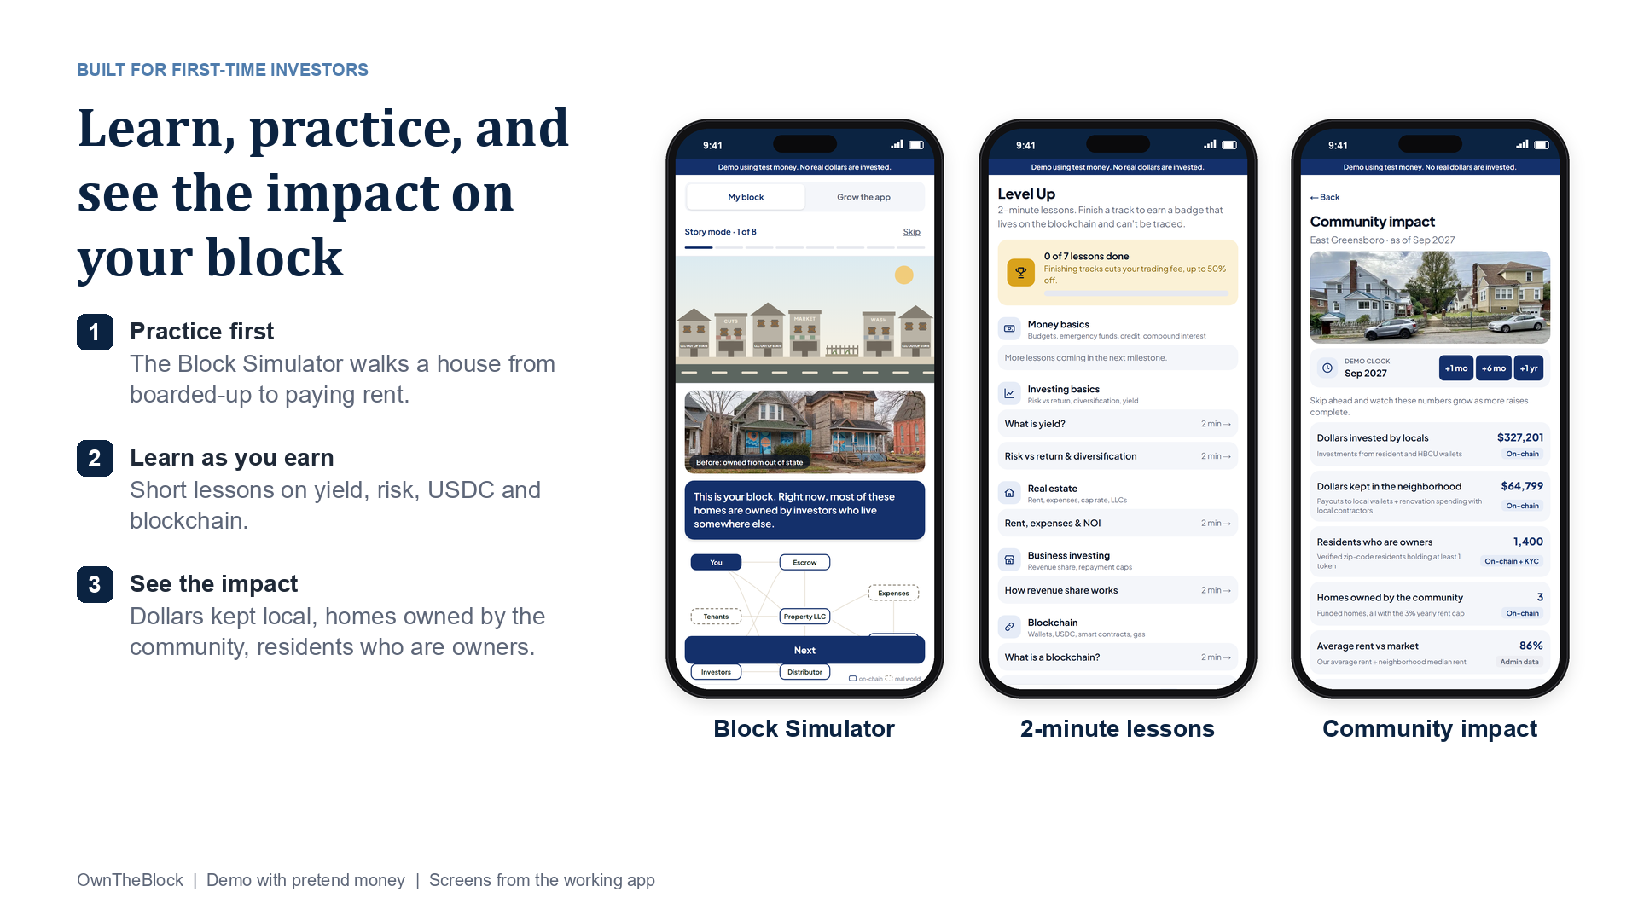
Notes:
APP DEMO (screens from the working app, pretend money).
SAY: Built for first-time investors: practice in the Block Simulator, take 2-minute lessons, and see the impact on the neighborhood.

