Slide 1

OwnTheBlock
Fix the block. Own the block.
Neighbors pooling $10 at a time to own the homes and businesses on their street
Case competition · Greensboro, NC pilot
Notes:
OPEN WITH THE HOOK (30 seconds). Don't explain the app yet.
Say: "Walk two blocks from A&T and count how many homes are owned by people who actually live there." Pause.
Then: "Today I'm going to tell you a story about one of those blocks, and then show you exactly how OwnTheBlock changes the ending."
What OwnTheBlock is in one sentence (if asked): a phone app that lets neighbors pool small amounts, starting at $10, to buy, fix and own the homes and businesses on their own block, with the rules and payouts run by smart contracts on the blockchain.

Slide 2
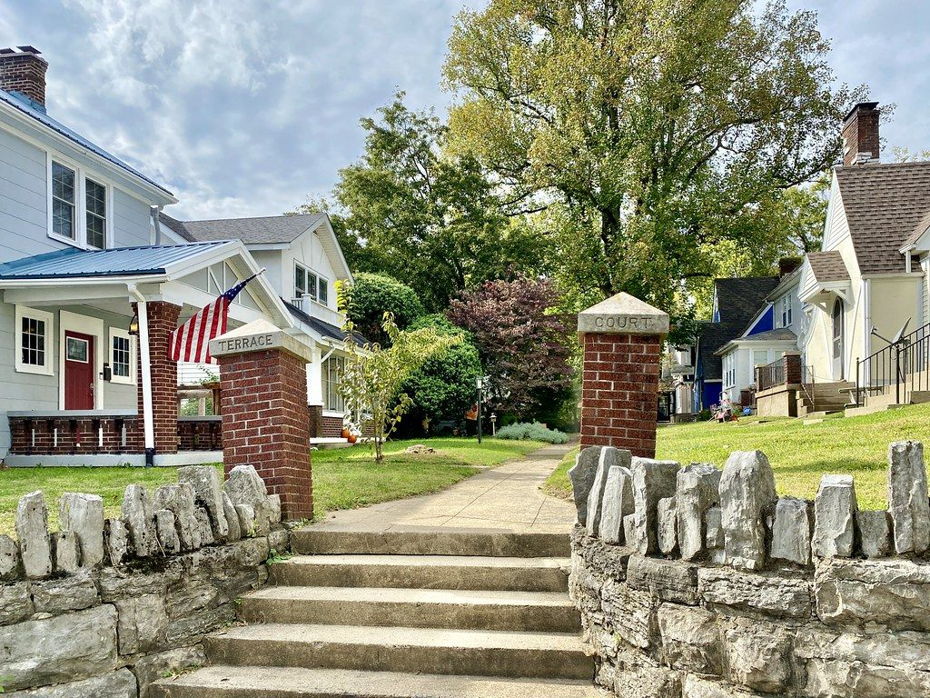
Meet Ms. Jenkins
Forty years on the same block in East Greensboro.
She raised her kids here, paid her taxes every year, and knows every neighbor by name.
She has no plans to leave. But the block around her is changing.
Ms. Jenkins is a composite character based on common situations, not a real person.
Notes:
Tell this like a story, slowly. Make the judges picture her.
Key point: she's the kind of person who built the neighborhood's value over decades but has no say in what happens to it.
If asked: she's a composite, built from situations that are common in historically Black neighborhoods near HBCUs. Being upfront about that builds trust.

Slide 3

The house next door
Her neighbor passed away. The heirs live out of state.
They can't afford repairs, and no bank will lend on a boarded-up house.
So it sits empty. Every home on the block loses value, including hers.
Notes:
This is the problem in one picture: the eyesore.
Facts to know: this is often called heirs' property: the owner died and several family members inherit it together, often without a will or probate. Every heir has to agree before it can be sold or fixed, which is why these houses sit for years.
A vacant, decaying house drags down the value of nearby homes and can attract crime and code violations. The neighbors want it fixed but have no way to pool money into one house.

Slide 4
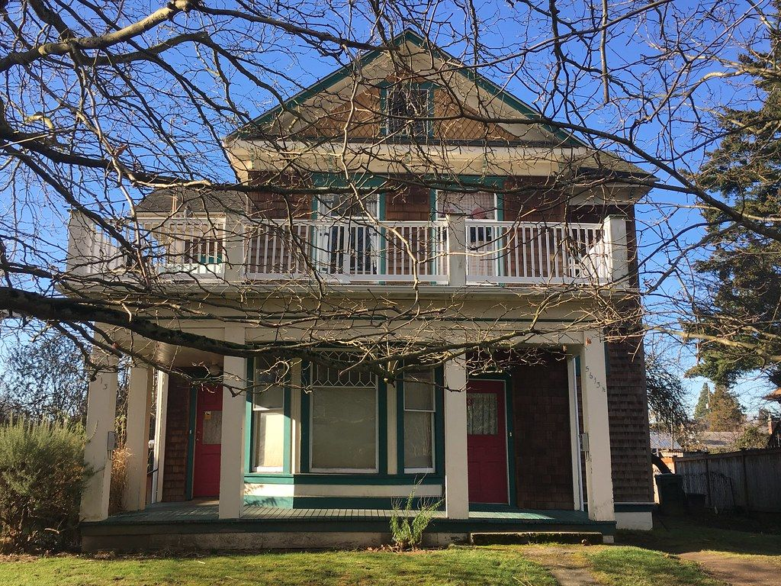
Then the cash offers start
An investor from out of town offers the family cash.
If the investor buys it, rents go up and the profit leaves with every rent check.
The only person with a seat at the table has never lived on this street.
Notes:
This is the villain of the story: not a person, but a pattern. Outside capital decides the neighborhood's future.
Line to use: "Why should a developer who lives in another city have more say than the woman who has paid taxes here for 40 years?"
Context: neighborhoods around HBCUs are increasingly bought by outside investors. Rents rise, and the value the neighborhood creates leaves with the rent check. Communities wait for gentrification to 'improve' the block, then get priced out when it does.

Slide 5




Real estate builds wealth, and most of the block is locked out
Down payments
45%
74%
Thousands of dollars up front before you can own anything.
Credit history
of Black households own their home
of white households own their home
No credit or thin credit means no loan, or a bad one.
Investing rules and know-how
For most American families, a home is the biggest source of wealth. A 29-point gap in ownership becomes a gap in wealth that's passed down for generations.
Real estate deals are built for wealthy, experienced investors.
Predatory business loans
Local Black-owned businesses often get only expensive capital.
U.S. homeownership rates, approximate. Cite the latest Census figure on the day.
Notes:
Zoom out from Ms. Jenkins to the whole country.
Roughly 45% of Black households own their home versus about 74% of white households (national figures; check the latest Census Bureau number before presenting). Homes are the main way American families build wealth, so the ownership gap drives the wealth gap.
The four barriers on the right are exactly what OwnTheBlock removes: no down payment ($10 minimum), no credit check to invest, rules and education built in, and fair capital for local businesses.

Slide 6



Why traditional finance can't fix the house next door
Banks
Investment groups
Neighbors
Want a down payment, good credit and a house in good condition. The heirs have none of those.
Real estate partnerships are built for wealthy members writing big checks.
Plenty of people would chip in $10 to $500. Splitting one house among 1,000 owners used to be a legal and accounting nightmare.
Traditional finance asks for a down payment. We ask what you can put up.
Notes:
The point: the money exists in the neighborhood, but in small amounts, and nothing lets small amounts combine into ownership.
Banks won't lend on a boarded-up house to heirs without cash. Investment groups and real estate syndicates are for accredited (wealthy) investors. Neighbors could pool money, but tracking 1,000 tiny owners, paying them each month and letting them vote was too expensive and complicated.
That last column is what blockchain changes. Transition: "So what if the neighbors could buy it together?"

Slide 7
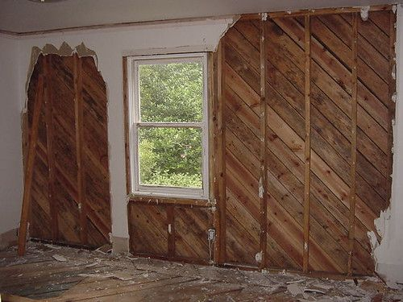
What if the neighbors bought it together?
Ms. Jenkins puts in $50. A student at A&T puts in $10. An alumna in Atlanta puts in $2,500.
About 1,000 neighbors, alumni and supporters raise $144,000 on their phones.
The family is paid a fair price, local contractors fix the house, and a local family moves in.
Notes:
This is the turning point of the story.
The $144,000 covers everything: buying the house at its appraised as-is value ($90,000), repairs ($35,000) plus a 15% safety cushion, closing costs, a reserve for future repairs, and the legal and platform costs of raising the money. Details are on the 'numbers' slide later.
About 1,000 people averaging around $150 each funds one house. Neighbors who live in the zip code get first access for 7 days, then students and alumni, then everyone else.

Slide 8
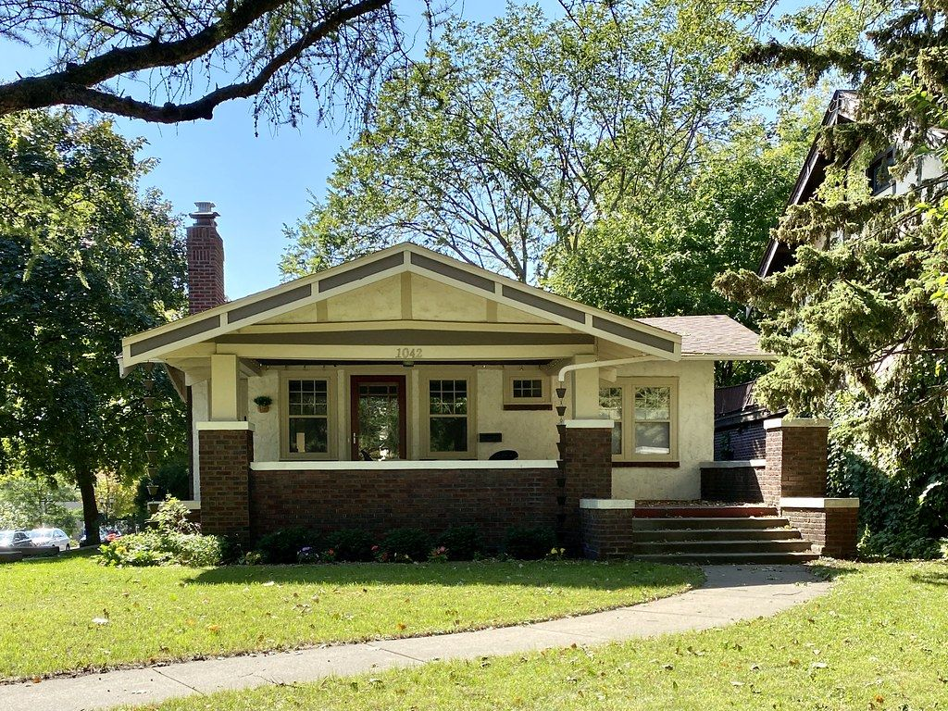
One year later
The family got cash at the appraised price, with the option to buy the house back.
A local family rents it, with a real path to buying it.
Every neighbor who chipped in owns a piece and gets paid every month.
Ms. Jenkins doesn't have to leave. The block is theirs.
Don't wait for gentrification. Fund the glow-up yourselves.
Notes:
End the story here. Let it land, then say: "Now let me show you exactly how this works, step by step."
Everyone wins: the heirs get paid fairly and can keep a buy-back right; the tenant gets capped rent and a lease-purchase path; neighbors become owners and earn income; the block's value goes up for everyone; and a public body or neighborhood group can keep control instead of selling to a developer.

Slide 9
How it actually works
The structure, the steps, the blockchain, the money and the people
Notes:
Transition slide. From here, you're explaining. Take your time; this is where you show you understand every piece.

Slide 10





You can't own part of a house, but you can own part of the LLC that owns it
Neighbors
The house's LLC
The house
Buy tokens from $10.
Each token = 1 unit of the LLC.
Legally owns the house.
Managed by OwnTheBlock.
A local steward holds a seat.
Deed recorded in the LLC's name at the county.
1 token = 1 LLC unit = $10
Tokens are recorded on the Base blockchain
The law already recognizes LLC ownership
Notes:
THIS IS THE CORE IDEA. Make sure you can explain it without the slide.
People can't legally own 1/14,400th of a house. But a house can be owned by an LLC (limited liability company), and an LLC can have thousands of members. The tokens are membership units of that LLC.
OwnTheBlock is the LLC's manager (handles the day-to-day work). A steward, meaning a trusted local group like a neighborhood association, church, land trust or the city, holds a governance seat and a veto over changes to the affordability rules.
Why it's legally solid: LLC ownership is standard U.S. law. The operating agreement says the official member list is kept by a registered transfer agent, which mirrors the token records on the blockchain. Limited liability means investors can't lose more than they put in.
Recommended upgrade: one 'Block Fund LLC' per neighborhood that owns several homes directly. It means one tax form per investor, lower admin costs, and spreads the risk.

Slide 11
The life of one house, in ten steps
1
Find
2
Vet
3
Set up
4
Raise
5
Close
Neighbors flag an eyesore; stewards bring properties
Title search, appraisal, inspection, two repair bids
Form the LLC, adopt the Charter, sign the purchase deal
Offering goes live; residents get first access
Escrow releases funds; deed recorded to the LLC
Week 0
Weeks 1–8
Weeks 6–10
Weeks 10–20
Weeks 20–24
6
Renovate
7
Rent
8
Pay
9
Govern
10
Exit
Local contractors, paid in stages after inspections
Licensed manager leases to a local family
Net rent paid out to token holders every month
Owners vote; reports published every quarter
Tenant buys, community holds, or mission sale
Months 6–9
Month 9
Month 10 →
Ongoing
Years 3–10
Notes:
Walk through these in order. Roughly 9–10 months from flagging a house to the first payout.
1 FIND: neighbors tap 'Flag an eyesore' with a photo and address, or a steward (city, land bank, church) brings a property. Staff pull public records: owner, back taxes, liens, code violations.
2 VET: a title company checks who legally owns it; a licensed appraiser sets the value (rule: never pay above the as-is appraisal); an inspector checks condition; two licensed contractors bid on repairs. All documents go in the project's document room.
3 SET UP: form the LLC, attach the neighborhood's Charter (the rules), sign a purchase agreement that depends on the raise succeeding.
4 RAISE: an attorney files Form C with the SEC. The offering goes live on a registered crowdfunding portal and in the app. Days 1–7 zip-code residents, days 8–14 students and alumni, day 15+ any verified U.S. investor. Investors can cancel up to 48 hours before the deadline.
5 CLOSE: if the goal is met, the escrow bank releases the money and tokens are created for every investor. If not, everyone is refunded automatically. NC uses attorneys for closings; the deed is recorded in the LLC's name.
6 RENOVATE: contractors are paid in 3–4 stages, each needing an invoice, inspection photos and two signatures (manager plus steward). A 15% contingency covers surprises.
7 RENT: a licensed property manager picks the tenant under fair-housing law. Investors never pick tenants.
8 PAY: each month, rent minus expenses goes to token holders.
9 GOVERN: owners vote on big decisions; quarterly public reports.
10 EXIT: preferred is the tenant buying the home; or hold long-term; or sell to a land trust; open-market sale only by a 2/3 vote.

Slide 12


How the house gets bought: the family chooses
A
Sell
B
Sell with buy-back
C
Trade the house for shares
Cash at the appraised value. Back taxes and liens are paid off at closing.
Cash now, plus the right to buy the house back within 5 years at a preset price.
No cash needed. The family keeps about half the tokens and shares future rent or sale.
Best when: Heirs live far away and want out
Best when: The family wants to keep its tie to the house
Best when: Heirs lack cash but want to stay owners
Other ways a house comes in
Paid-off owner sells to neighbors
Mortgage is paid off at closing
Bought from the bank after foreclosure
City or land bank property
Notes:
The family is never forced. Staff present all three options side by side, and nothing happens without the heirs' agreement.
Example (Option A): appraised as-is at $90,000. The family gets $90,000 minus any back taxes and liens paid at closing. Repairs cost about $35,000, and the fixed-up house is worth about $150,000.
Fairness question you'll get: 'If you buy at $90k and it's worth $150k, did you take the family's money?' Answer: most of the gap is the $35–40k of repairs plus the risk of fixing it. The family gets the full as-is value, and if they want a share of the upside they can choose B (buy-back) or C (keep shares).
Hurdles to be honest about: every heir must sign (often the slowest step), back taxes reduce the family's cash, vacant-house insurance is expensive, and repairs can run over budget. No raise opens until the title is clear.
Other sources: a paid-off owner who'd rather sell to neighbors than an investor (simplest case); a mortgaged house (the attorney pays off the loan at closing, the seller keeps the rest); a bank-owned foreclosure (needs a fast 'bridge' fund since banks want quick closings); city or land bank properties, which are the best pipeline for growth.

Slide 13

Where the blockchain fits, and where it doesn't
On the blockchain (proven by code)
In the real world (proven by documents)
Who passed the ID check (no personal data)
Every commitment to a raise, and the tokens
Every repair payment (steward must co-sign)
Monthly payouts, split automatically
Votes and community rules (rent cap, reserve)
Tenant's on-time rent record and lesson badges
Buying the house and recording the deed
Investor dollars held by the escrow bank
Collecting rent from the tenant
Repairs actually getting done
Choosing the tenant (licensed manager)
Every real-world document gets a digital fingerprint on the blockchain, so nobody can quietly swap it later.
Notes:
Being honest about what blockchain can't do is a strength, not a weakness. Say it before a judge asks.
WHY BLOCKCHAIN AT ALL? Four reasons: (1) thousands of tiny owners tracked and paid for almost nothing; payouts cost the same whether there are 10 owners or 10,000; (2) a public record anyone can check: where every dollar went; (3) rules no single party can quietly change, because the rent cap and reserve can only change by a 2/3 vote plus a 30-day wait, enforced by code; (4) caps and local-first rules checked automatically on every transfer.
The smart contracts: IdentityRegistry (who passed KYC), AssetToken (the LLC units; transfers only between verified people), Raise (commitments, refunds), Treasury (repair money; steward co-signs), Distributor (monthly payouts), RulesRegistry and CommunityGovernor (rules and votes), Badges (lessons). All on Base, a low-cost network built by Coinbase that settles to Ethereum.
Users never see crypto: balances show in dollars, there's no seed phrase (Face ID/passkey wallet), and OwnTheBlock pays the network fees.
WHAT IT CAN'T DO: code can't prove a house exists or make a tenant pay rent. Those are proven by the recorded deed, the manager's monthly report and audits, and each document's fingerprint (hash) is stored on-chain.
Legal note: under crowdfunding rules, investor dollars must sit with a bank or broker-dealer escrow until the raise closes. The blockchain records the commitments and creates the tokens at closing.

Slide 14




Follow the money
Buying and fixing the house
+
Investors
Escrow bank
House's LLC
Seller
Contractors
$10 and up
Holds money until the goal is met
Gets the money, mints tokens
Paid at closing
Paid in stages
Every month after
Tenant
Property manager
Bills first
Payout contract
Investors
Pays $1,400 rent
Collects rent, sends report
Taxes, insurance, repairs, reserve
Splits by tokens
Claim to wallet or bank
Notes:
TOP ROW (one time): investors commit money; it sits at a regulated escrow bank; if the goal is met it goes to the LLC, which pays the seller at closing and pays contractors in stages after each inspection. If the goal is missed, everyone gets refunded.
BOTTOM ROW (every month): the tenant pays rent in dollars to the licensed property manager. Bills come first: property taxes and insurance, management (8%), a repair reserve (10%) and a vacancy cushion (5%), admin and a 2% platform fee. What's left is converted to USDC (a digital dollar) and sent to the payout contract with a fingerprint of the expense report. The contract splits it by tokens, and investors claim it to their wallet or cash out to their bank.
This is the 'Money Trail' in the app: any investor can trace their exact dollars at every step.

Slide 15
Follow one person: Jasmine's $100
Dec
Jan
Mar
Apr
May–Jul
Aug
Sep
Year 5
Signs up with Face ID, takes the safety and money lessons
Puts in $100 = 10 tokens
Raise hits its goal; her tokens are created
LLC buys the house
Repairs in three inspected stages
A family moves in
First payout: $0.49
Exit: tenant buys or community sells
$0.49
~$145
~8.7%
a month in payouts
back after 5 years
a year, estimated
Estimates, not guarantees. You can lose some or all of your investment.
Notes:
Jasmine is a 20-year-old A&T sophomore with about $40 a month to spare who has never invested and is scared of crypto scams.
Her $100 buys 10 of the house's 14,400 tokens (0.069% ownership). After bills, about $700 a month goes to investors. $700 / 14,400 = about 4.9 cents per token per month, so Jasmine gets about $0.49 a month, or $5.83 a year.
At year 5, if the house has grown 3% a year, each token is worth about $11.56 after selling costs. Jasmine gets about $115.60 from the sale plus about $29 in payouts = about $145 total, roughly 8.7% a year.
If she also auto-invests $40 a month at that rate, she'd have about $3,100 after 5 years from $2,500 put in.
Downside: if the house is worth 10% less than expected, prices stay flat and there are two vacant months, she'd get back about $117. A 25% drop in value is about break-even, and bigger shocks mean a loss. Always show the downside next to the base case.
On the blockchain: her ID check, her commitment, her tokens being created, each repair payment, each monthly payout and her claim are all recorded and visible in her Money Trail.

Slide 16
The numbers for one house
Where the $144,000 goes | Amount
Buy the house (appraised as-is) | $90,000
Repairs (local contractors) | $35,000
Repair safety cushion (15%) | $5,250
Closing costs (attorney, title, recording) | $2,000
Starting repair reserve | $3,110
Legal, accountant and crowdfunding portal | $5,760
OwnTheBlock raise fee (2%) | $2,880
Total raised = 14,400 tokens at $10 | $144,000
Worth after repairs
$150,000
Value behind each $10 token on day one
$10.63
Buying below value means investors start ahead, even after every cost is paid.
Notes:
This is the honest budget. Every real cost is included, which is what judges with finance backgrounds will check.
The house is bought at its appraised as-is value (never above), fixed up, and worth about $150,000 afterwards. The fixed-up house plus the reserve, divided by 14,400 tokens, is about $10.63 per token on day one.
WHY THIS MATTERS (know this cold): the original plan bought a $132,000 house at full price. Once you add closing costs, legal, the accountant, the portal fee and the platform fee, the raise grows to $175,500 and each $10 token is backed by only about $8.55 on day one. The yearly return falls to about 3.5%, less than a savings account. That's why OwnTheBlock focuses on rescuing distressed houses: the mission and the math point the same way.
Cost notes: legal, CPA review and portal fees are pooled across a neighborhood fund to keep them near 4%. The CPA review is required for crowdfunding raises above roughly $124,000 (verify the current threshold).

Slide 17



Where each month's $1,400 rent goes
$700
a month to investors = 4.9¢ per token, about 5.8% a year in cash
Bills are always paid first; investors get what's left
The reserve covers roofs, water heaters and empty months
The rest of the return comes when the house is sold or the tenant buys it
Notes:
Formula from the spec: money to investors = rent minus (vacancy + management + reserve + platform fee) x rent, minus taxes and insurance, minus admin.
$1,400 - $70 vacancy - $112 management - $140 reserve - $28 fee - $270 taxes and insurance - $80 admin = $700.
$700 x 12 = $8,400 a year / $144,000 raised = 5.8% cash yield.
Verify the tax and insurance estimate for Guilford County before presenting. The admin line assumes a pooled neighborhood fund; a separate LLC for every single house would cost about $250 a month and cut the payout to about $530.
When something goes wrong (a tenant moves out, the roof leaks), the reserve pays first, and payouts dip until it refills. The simulator in the app shows this honestly.

Slide 18
Why we rescue eyesores instead of buying at full price
Full price
$175,500 raise for a $147,000 house. Each $10 token starts at about $8.55 of value.
Distressed
$144,000 raise for a house worth $150,000 once fixed. Each token starts at about $10.63.
Fixing the eyesore is where the value is created. The mission and the math point the same way.
Notes:
This is the most important financial insight in the whole plan.
Buying a normal house at market price means paying the full price plus all the costs of the raise. Investors start behind and only earn about 3.5% a year over 7 years, below a savings account.
Buying a boarded-up house at its as-is value and fixing it creates value: the repairs add more to the house's worth than they cost. Investors start ahead and earn about 8.5% a year over 7 years (about 8.7% over 5 years).
So 'Rescue the Eyesore' isn't a side feature. It's the business model. Assumptions: 3% yearly home-price growth and 6% selling costs. At 2% growth, the distressed case drops by about 1 point.

Slide 19


What $100 could become in 5 years
Monthly cash
About 6% a year, paid monthly
Most comes back at the exit
Usually years 3–7, when the tenant buys or the house is sold
Not instant cash
Locked for 12 months by law, then limited resale
What an index fund can't give you
Ownership on your own block, a vote, and a neighbor who becomes a homeowner
Notes:
Be honest here; it builds credibility.
Cash under the mattress loses value to inflation (about $86 in today's dollars after 5 years at 3% inflation). A high-yield savings account at 4% grows to about $122 with almost no risk. An index fund has historically averaged roughly 7–10% a year but swings a lot; $150 is a rough midpoint, not a promise. OwnTheBlock's estimate is about $145.
So on pure return, OwnTheBlock is similar to an index fund, but with less flexibility: federal crowdfunding rules lock it for 12 months, and resale after that is limited.
The real advantages are local ownership, a voice in what happens on your block, a path to homeownership for the tenant, and money that stays in the neighborhood.
If asked 'Isn't $0.68 a year too small?': it's the starting point. Wealth comes from stacking: $10 a month, reinvesting, the exit, credit-building and education.

Slide 20
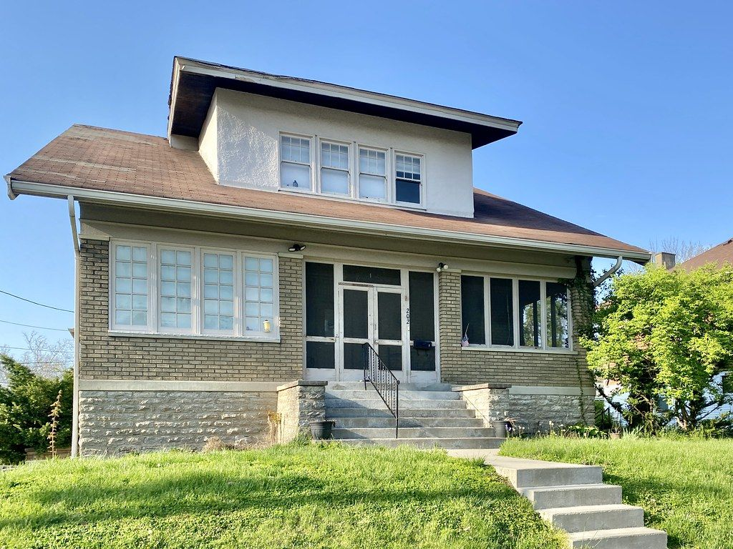
Tasha: from renter to homeowner
Moves in
Gets an option to buy the house at a price set on day one (appraisal + 3% a year).
$100 of rent each month is credited
It builds into a down-payment credit: about $6,000 by year 5.
On-time rent builds credit
Payments are reported to credit bureaus and recorded on-chain as a record she owns.
Years 3–5: buys the home
Credit + NC down-payment help + a mortgage. Investors are paid out.
Notes:
Tasha is a 31-year-old single mom renting an OwnTheBlock home and building credit.
HOW IT WORKS: when she moves in, she gets a lease-purchase option. She can buy the house in years 3–7 at a price set the day she moves in (the appraisal plus 3% a year). $100 of each month's rent goes into a down-payment credit: $100 x 60 months = $6,000 by year 5. Combined with NC down-payment assistance programs and her improved credit, she can get a mortgage and buy the house.
WHY IT'S GOOD FOR EVERYONE: Tasha becomes a homeowner, and her purchase is the investors' exit; they get paid out at the preset price. The home stays local instead of going to a developer.
COST: the $100 credit reduces investor payouts by about 0.8 percentage points a year. That's a deliberate choice; it's part of the social return.
Why this replaced the original idea: the first plan gave tenants tokens worth 2% of rent ($28 a month). That would have taken about 88 years to reach a down payment, and it used up the entire platform fee.
Also: rent caps (3% a year max) protect her, and eviction is a last resort after a hardship fund, a payment plan and mediation.

Slide 21
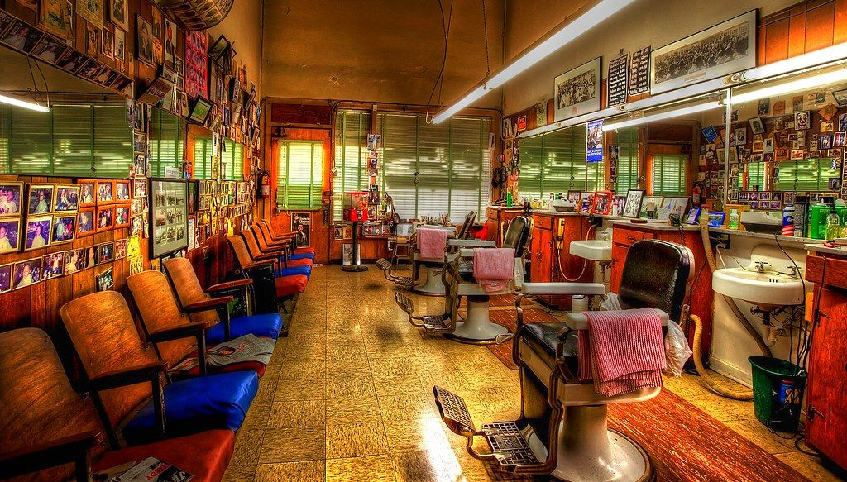


Marcus: growing a barbershop without a predatory loan
Typical cash advance
OwnTheBlock revenue share
Often far above 40% APR
Fixed daily payments, even in slow weeks
Can require personal guarantees
Raise $25,000 from neighbors
Pay 4% of sales ($667/mo) until investors get 1.25× back
About 12% APR; payments shrink in slow months
Marcus keeps 100% ownership
Notes:
Marcus owns a barbershop near campus and needs $25,000 to expand.
REVENUE SHARE: instead of a loan, investors get a percentage of the shop's monthly sales until they've received a set multiple of what they put in (the 'cap'). With $200,000 a year in sales, 4% = about $667 a month. The cap is 1.25 x $25,000 = $31,250, reached in about 47 months. If sales drop, payments drop too, and it just takes longer.
IMPORTANT CHANGE: the original plan used 5% of sales with a 1.4x cap. That works out to about 20% APR, which is hard to defend as 'not predatory.' 4% with a 1.25x cap is about 12% APR.
THE RIGHT COMPARISON: businesses that banks turn down often use merchant cash advances, which commonly cost far more than 40% APR with fixed daily payments (find a specific source before presenting). Against an SBA microloan (often around 8–13%), it's similar, but needs no collateral.
HOW REVENUE IS VERIFIED (barbershops take cash): funding requires a connected card terminal (Square, Stripe or Clover) plus monthly bank deposit statements. Payments are based on verified deposits, not self-reported numbers.
IF THE BUSINESS CLOSES: investors lose the unpaid part. A first-loss partner (a bank, foundation or city fund) covers the first 10% of losses, and the neighborhood fund spreads the risk across many deals.

Slide 22


The community writes the rules, and the code enforces them
Who can invest
Per-person cap
Local-share floor
Anyone, residents first, or residents only
e.g. no one person holds more than 2%
e.g. 51% of tokens must stay local
Resident votes count 1.5×
Rent cap
Changes need 2/3 + 30 days
Among owners of the property
Max 3% a year, between tenants too
No sudden takeover can rewrite the rules
A steward (neighborhood association, church, land trust or city) co-signs every repair payment and can veto changes to affordability rules.
Notes:
This answers the question every judge asks: 'What stops a rich outsider or a developer from buying everything?'
Answer: each neighborhood writes its own Charter: who may invest, how much one person can hold, how much must stay local, how votes work, the rent cap and the reserve. The token contract rejects any transfer that would break those rules. Caps apply per verified person, not per wallet, so splitting money across wallets doesn't get around them.
Three starter presets: Open Block (anyone verified, per-person cap); Neighbors First (default: local windows first, resident vote bonus, rent cap); Resident Owned (residents and local business owners only, 51% local floor).
Who votes: binding votes on a property are by its token holders, with verified residents counting 1.5x. Big money decisions (sell or refinance) can use 'quadratic' weighting, where votes = the square root of tokens held, so large holders can't dominate.
The steward is required on every spend from the house's account, so OwnTheBlock and the property manager can't move money alone.
Legal guardrail: rules can favor residents or years of local presence, never race or any protected class. An attorney reviews every preset.
The rules aren't meant to shut people out: a community can welcome a trusted outside investor on whatever terms it chooses. The point is that residents hold the pen.

Slide 23



Everyone it takes to make one house work
Neighbors and alumni
Tenant
Seller or heirs
Local business
Invest, vote, propose projects
Rents, builds credit, can buy
Sell, keep a buy-back, or trade for shares
Raises capital, keeps ownership
Steward
OwnTheBlock
Crowdfunding portal
Escrow bank
Governance seat, co-signs spending
App, vetting, manages the LLC
SEC-registered; hosts the offering
Holds money until the goal is met
Transfer agent
Closing attorney
Property manager
First-loss partner
Official owner list, mirrors the chain
Title, closing, records the deed
Leasing, rent, repairs, reports
Bank, foundation or city; absorbs first losses
The community
Licensed professionals and partners
Notes:
Green = the community. Brown = the regulated professionals who make it legal and safe.
The professionals are the same people involved in any normal home sale or securities offering. OwnTheBlock doesn't replace them; it connects them to a neighborhood.
Crowdfunding portal: under Regulation Crowdfunding, offerings must run through an SEC-registered funding portal or broker-dealer. OwnTheBlock partners with one in the pilot.
Transfer agent: a registered company that keeps the official list of owners; it mirrors the token records on the blockchain.
First-loss partner: banks get credit under the Community Reinvestment Act for investing in low- and moderate-income communities, so a bank absorbing the first 10% of losses is realistic.
How residents get involved: block captains, sign-up nights at churches, barbershops and the A&T student union, free lessons before investing, pitch nights for new project ideas, and $10-a-month auto-invest.

Slide 24



How OwnTheBlock pays for itself
2% raise fee
2% of rent
About $2,880 per house, once
About $336 per house, per year
Software licensing
Grants and impact investors
Land trusts, community developers and cities use the platform for their own properties
Fund the lean pilot years
Fees alone need a few hundred homes to support a team. Licensing grows through partners without charging residents more.
Notes:
Judges will ask how the company itself makes money. Be honest.
Deal fees are small: 2% of a $144,000 raise is $2,880 once, and 2% of $1,400 rent is $28 a month per house. The app's own growth model showed fees alone take about 10 years and roughly $5 million of funding to break even.
So the plan: run the pilot lean (about $10,000 a month) on grants, competition winnings and impact investors. Long term, the main revenue is software licensing: land trusts, community development corporations and city vacant-property programs already hold properties but have no way to take $10 investments from residents. OwnTheBlock becomes their engine for a monthly fee, which scales without charging residents more.
Option on the table: a 1% yearly asset fee is standard in real estate crowdfunding, but it would cut investor returns by about a point, a trade-off to decide carefully.

Slide 25
Honest about risk
What could go wrong | How it's handled
Tenant moves out | 5% vacancy cushion and a repair reserve keep bills paid
Repairs cost more than planned | 15% safety cushion, staged payments, community vote beyond that
A business closes | First-loss partner covers the first 10%; the fund spreads the risk
Home values fall | No borrowing on the house, long holding period, tenant purchase option
You need your money back fast | 12-month legal lockup is shown upfront; buyback windows later
A hack or a coding bug | Professional audit before real money; pausing never blocks refunds or payouts
Heirs can't agree on a sale | No raise opens until the title is clear; legal aid partners help
Estimates, not guarantees. You can lose some or all of your investment, and the app shows the losses as clearly as the gains.
Notes:
Never promise returns. Every projection in the app is labeled as an estimate, and the simulator lets anyone trigger bad events (tenant leaves, roof repair, slow winter, business closes) and watch payouts drop.
Extra protections for users: a $10 minimum; a 24-hour cooling-off period on a first investment over $100, with a reminder to keep an emergency fund; a check-in if someone invests more than 10% of their monthly income; the federal yearly investment limit (about $2,500 for most people with lower incomes); no borrowing to invest; and lessons never pay cash rewards.
Recovery: if someone loses their phone, passkeys back up to iCloud or Google; if that fails, identity-verified recovery lets the transfer agent reissue their tokens. Investors can name a beneficiary.
Digital-dollar risk: USDC is only used for payouts and held briefly. The house, not the token, is the real asset.

Slide 26
Built to work inside today's rules
Regulation Crowdfunding
Bank escrow
Offerings run through an SEC-registered portal. Up to $5M a year per issuer; yearly limits protect smaller investors.
Investor dollars sit with a regulated escrow bank until the goal is met.
An LLC behind every house
Identity checks on everyone
Ownership is standard U.S. law. A transfer agent keeps the official list, mirroring the chain.
ID + selfie verification and sanctions screening. No personal data on the blockchain.
Fair housing
12-month lockup
Rules can favor local residents, never race or any protected class. Attorneys review every rule set.
Required by law and enforced in the token contract.
Notes:
Keep regulation to about 20% of your talk. State it, show you've thought about it, move on.
Suggested wording: "OwnTheBlock is a tool. Wide use will take regulatory oversight at the federal, state and local levels, just like selling a home already involves regulated parties who verify ownership and protect buyers' money. Our pilot starts inside existing rules: Regulation Crowdfunding through a registered portal, an LLC for each property, a regulated escrow bank, and identity checks on every investor."
Details if pressed: securities can't generally be resold for 12 months; after that, resale must go through a registered trading platform, so there's no do-it-yourself marketplace in the pilot. Crowdfunding raises above roughly $124,000 need accountant-reviewed financials (verify). Investors get a tax form each year (a K-1 from the LLC, or possibly a simpler 1099 if the fund is structured as a REIT; ask a CPA). A securities attorney reviews everything before any real money moves. Stablecoins like USDC are now federally regulated under the GENIUS Act (2025).

Slide 27
Where we are and what comes next
Today
Next 6 weeks
12–18 months
Then
Working demo app
Real blockchain
Greensboro pilot
100+ HBCU communities
Block Simulator with honest risk events
Pretend-money invest, payouts and Money Trail
43 automated tests on every formula
Smart contracts on Base's test network
Face ID wallet, no fees for users
Live buys, payouts and votes
2–3 homes and 1 business
500+ investors near A&T and Bennett
Every investor completes the money lessons
Grow through stewards: cities, land banks, HBCU foundations
Same contracts and Charter templates
Notes:
Be honest about where the project is: today it's a working simulator and demo with pretend money. The blockchain contracts are the next build step (if you finish them before the competition, change this slide to say so and show a live transaction).
Next 6 weeks: smart contracts deployed to Base Sepolia (Base's free test network) with test dollars; a Face ID smart wallet; OwnTheBlock pays all network fees; real transactions for buying, payouts and voting that anyone can check on the block explorer.
Pilot: form the company, sign with a crowdfunding portal and transfer agent, recruit a steward, survey residents, find the first distressed house through a city program or an heirs' family, file the offering, close, renovate and pay out. Goal: 2–3 homes, 1 business, 500+ investors.
Scale: deal supply limits growth, not money. So growth comes through partners who already have properties, using the same contracts and Charter templates.

Slide 28
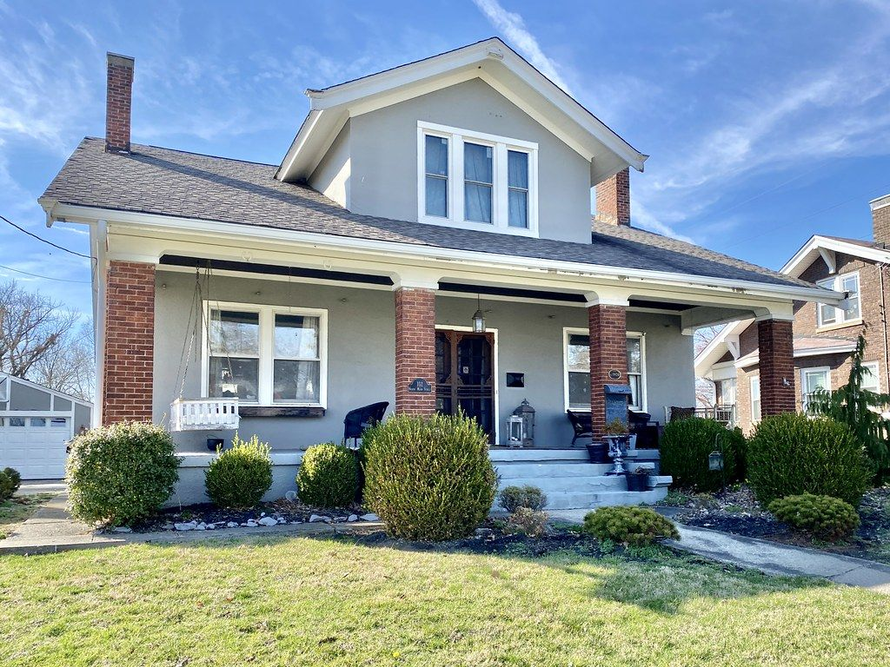
We didn't build a crypto product.
We built a way for a neighborhood to own itself.
Ms. Jenkins doesn't have to leave. Her neighbors become owners. The block is theirs.
Thank you · Questions
Notes:
Return to the story. End on Ms. Jenkins, not on technology.
Say: "We didn't build a crypto product. We built a way for a neighborhood to own itself." Pause. "Thank you."
Be ready for these questions (full answers are in the playbook PDF, section 11): Where's the blockchain? Why not a regular database? Is this legal? How do you stop outsiders taking over? Isn't $0.68 a year too small? How does OwnTheBlock make money? What if a business fails? Isn't this just gentrification with extra steps?

Slide 29
Notes and photo credits
All projects, people and numbers in this deck are illustrative. Ms. Jenkins, Jasmine, Tasha and Marcus are composite characters, not real people. Financial figures are estimates for discussion, not investment advice, and should be verified with a securities attorney and a CPA.
Neighborhood street: "Santamonica Street" by Jay Mantri, CC0 (StockSnap)
Porch: "Terrace Court, Danville, KY" by w_lemay, CC BY-SA 2.0 (Flickr)
Boarded houses: "Boarded up houses on North Huron Street" by chris.rycroft, CC BY 2.0 (Flickr)
Duplex: "Duplex in Seattle's West Woodland neighborhood" by Sightline Institute, CC BY 2.0 (Flickr)
Renovation: "House Renovation 051" by shister, CC BY 2.0 (Flickr)
Restored house: "John McAnulty House, Summit Avenue, Saint Paul, MN" by w_lemay, CC BY-SA 2.0 (Flickr)
Bungalow: "Doctor Fenton Adams House, Latonia, Covington, KY" by w_lemay, CC BY-SA 2.0 (Flickr)
Barbershop: "Barbershop" by billackerman1, CC BY 2.0 (Flickr)
Closing photo: "C. Scott Chambers House, Walton, KY" by w_lemay, CC BY-SA 2.0 (Flickr)
Notes:
Photos are openly licensed stand-ins, not real OwnTheBlock properties. Swap in real Greensboro photos (with permission) when you have them, and keep the credits for any photos you keep.

