Slide 1

OwnTheBlock
Own the homes
on your block
Neighbors pool $10 at a time to buy, fix and own local homes, with the rules run on the blockchain.
Kaleb Conway · Own Your Future Challenge · Nov 10, 2026
Notes:
TIMING: 12 slides in about 4:45. Spend the most time on slides 4-6 (blockchain, 20 points) and 9-10 (plan and budget, 20 points). Everything after slide 12 is backup for Q&A.
SAY: "I grew up watching communities that were once wealthy Black neighborhoods change. Now the windows are boarded up, the houses sit vacant, and the people who live there just watch, because they can't do anything about it. It doesn't have to be this way. A century ago, Greenwood in Tulsa, Black Wall Street, showed what a community can build when it owns and reinvests in itself."
IF ASKED about Greenwood: a prosperous Black business district attacked May 31 to June 1, 1921; 35 city blocks were destroyed. Keep it to one sentence.

Slide 2




What I grew up watching
Once-wealthy Black neighborhoods now have vacant, boarded-up homes.
Outside buyers take them, and neighbors can't pool small amounts to buy in.
Black homeownership is 45%, vs 74% for white households.
Source: U.S. Census Bureau, Housing Vacancies and Homeownership Survey (rounded).
Notes:
SAY: "Around our HBCUs I see the same boarded-up houses. Outside buyers pick them up, and the rent leaves the neighborhood. Black homeownership is 45 percent, versus 74 percent for white households, and homes are how families build wealth. Neighbors would chip in, but there's no way to turn ten dollars here and fifty there into owning a house."
Rubric: Problem Articulation (5). Verify the 45% / 74% Census figures before Nov 8.

Slide 3

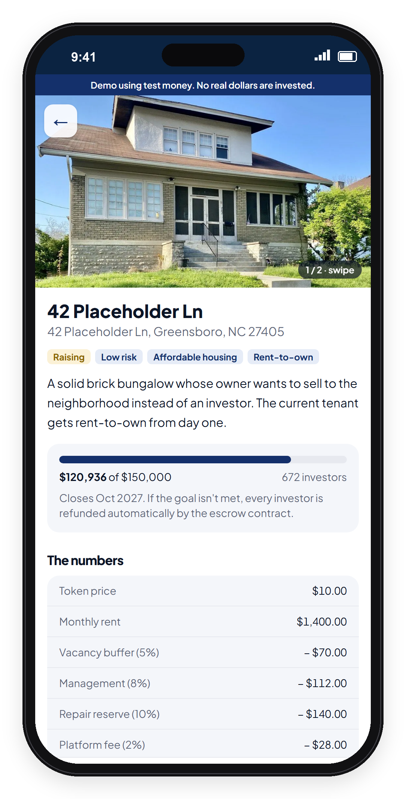
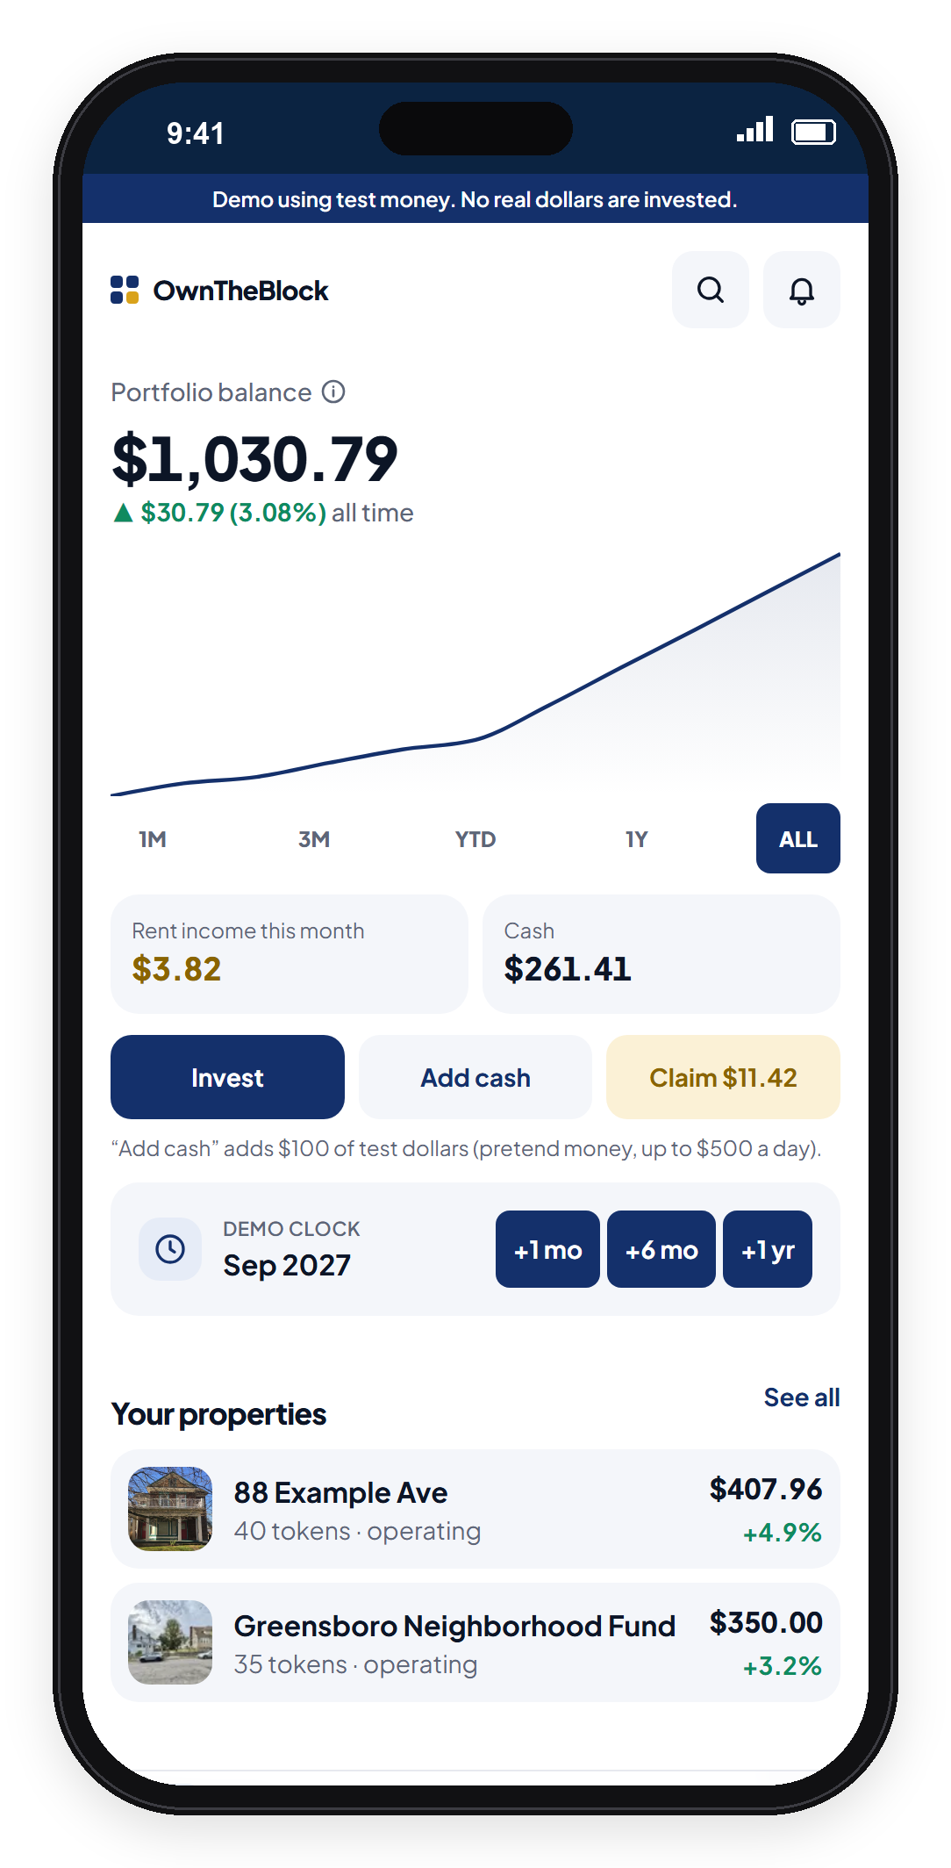
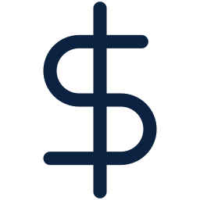

Solution
Pick a home on your block. Residents get the first 7 days.
Invest from $10. Each token is a share of the LLC that owns the house.
Local contractors fix it; a local family rents it.
Get paid rent monthly and vote on the rules. The tenant can buy in years 3–7.
Notes:
SAY: "OwnTheBlock fixes that. On the app I built, neighbors, students and alumni put in as little as ten dollars each, $144,000 together, enough to buy and fix one house. Each token is a share of an LLC that owns the deed. Residents get the first seven days, and no one can own more than 2 percent. A local family rents it, owners get paid monthly and vote, and the tenant can buy the home."
IF ASKED why an LLC: people can't legally own 1/14,400th of a house, but an LLC can own the house and have thousands of members.
IF ASKED who owns the LLC: the token holders. OwnTheBlock manages it, and a community steward co-signs every payment.

Slide 4
Why blockchain: payments
Paying 1,440 owners their share of $700 rent, every month.
Bank transfers
OwnTheBlock on Base
~$500
~$14
a month in fees. Most of each $0.49 payout is gone.
a month. One deposit pays everyone; under 1¢ per owner.
Bank: ~$0.20–$0.50 per payment (midpoint). Base: measured gas per claim at typical Base fees.
Notes:
WORTH 20 POINTS with the next two slides. Slow down.
SAY: "Why blockchain? First, the payments. A $100 owner earns 49 cents a month. Paying 1,440 owners by bank transfer costs about $500 a month in fees, most of the payout. On Base, the manager makes one deposit, the contract splits it, and each claim costs under a cent."
IF ASKED 'banks can batch payments': "Even at 25 cents, a 49-cent payout loses half. And fees are only half my case. The other half is trust." Get one real bank quote before Nov 8.

Slide 5
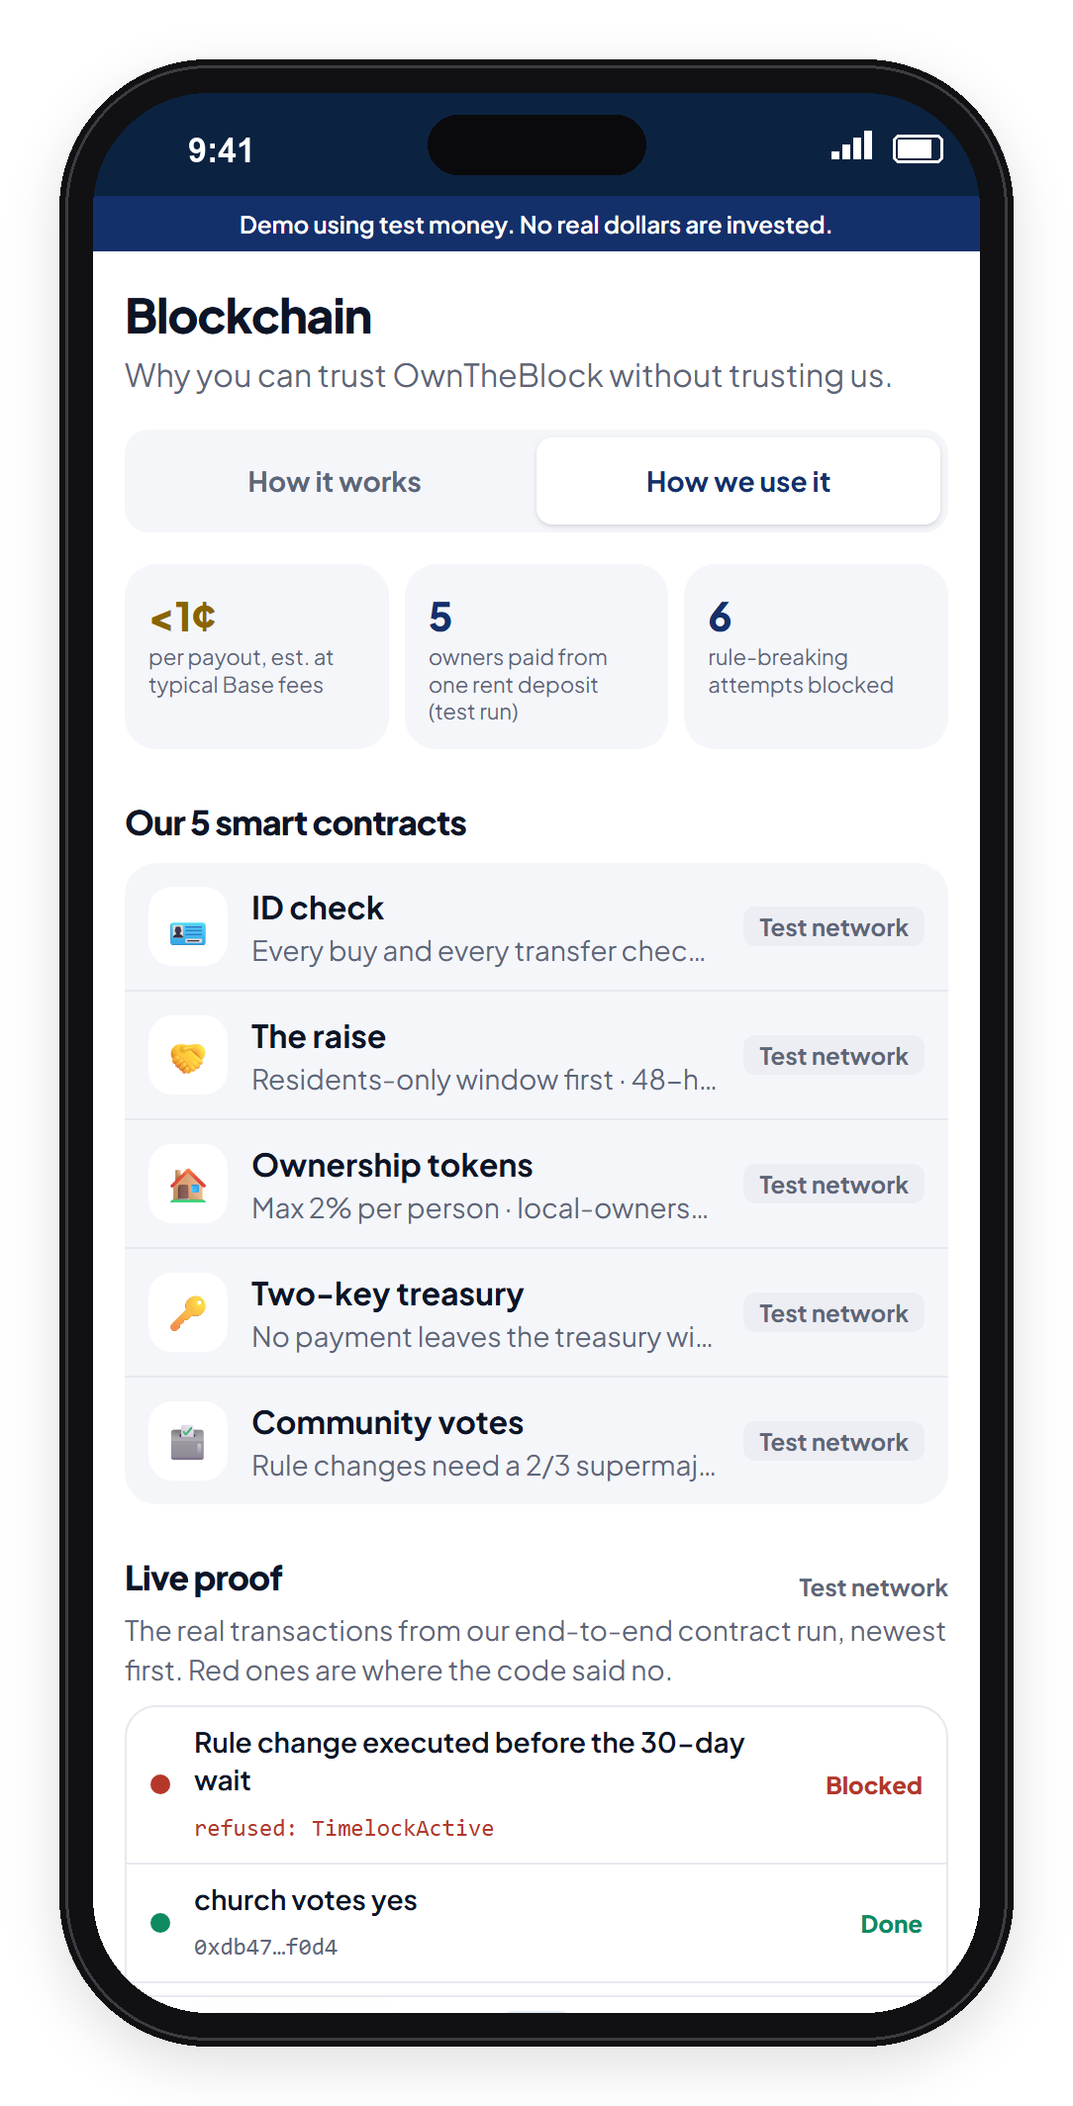


Why blockchain: trust
The rules live in code, not in a database I control.
Rent can only rise 3% a year. The code won't allow more.
Changing a rule takes a 2/3 owner vote and a 30-day wait.
Every payment is public. Anyone can check where the money went.
Notes:
SAY: "Second, and more important, trust. A payment processor works if you trust whoever runs it. Here the rent cap, the 2 percent limit and the local share are written into the contract, so even I can't change them without a two-thirds owner vote and a 30-day wait. A community steward co-signs every payment, and the trail is public. A spreadsheet can't promise that, because I control the spreadsheet."
IF ASKED how code enforces the rent cap: "Code can't control what a tenant pays in dollars, so the cap works three ways: it's in the lease, the manager reports rent to the contract and isn't paid if it breaks the cap, and the steward co-signs every payment. Blockchain enforces what's recorded; the lease and the steward cover the rest."
IF ASKED 'Why not a database?': "A database can store the list. It can't make tiny payments cheap, and it can't stop its own operator from changing the rules."

Slide 6
It's already built
A working app and smart contracts, tested end to end.
5
22
38
6
smart contracts
tests passing
test-run transactions
rule-breaks blocked
Blocked by the code: an early sale, a 10% rent hike, and a rushed rule change.
Run on a local test blockchain. Base Sepolia deployment next; independent security audit before any real money.
Notes:
SAY: "This isn't just an idea. I built the app and five smart contracts, with 22 automated tests passing, and ran a full neighborhood story on a test blockchain. The code refused an early sale, a 10 percent rent hike and a rushed rule change. Not even I can override it."
CHECK before Nov 8: confirm the '6 rule-breaks blocked' count against the demo output. Say 'test blockchain', not 'live on Base', unless you deploy to Base Sepolia first.

Slide 7
Competition
Other platforms cover parts of this. None combine all four.
 | Invest from $10 | Locals first | Rules in code | Tenant can buy
Fundrise, Arrived | ● | ○ | ○ | ○
RealT, Lofty | ● | ○ | ◐ | ○
Community land trusts | ○ | ● | ◐ | ◐
OwnTheBlock | ● | ● | ● | ●
● yes ◐ partly ○ no
Based on each company's public descriptions.
Notes:
SAY: "Others cover parts of this. Fundrise and Arrived take small amounts, but from anywhere into homes anywhere. RealT and Lofty put homes on a blockchain, but the owners are global. Land trusts keep homes affordable, but residents can't invest. None keep ownership local, put the rules in code, and give the tenant a path to own."
Rubric: Innovation (15). Say 'none combine all four', never 'no one has ever done this'. Verify competitors' current features.

Slide 8
Impact at scale
Start with one house in Greensboro, then grow through HBCU communities.
1 home
25 homes
500 homes
Greensboro pilot
(first 18 months)
5 cities
(years 2–3)
100 HBCU communities
× 5 homes
At 500 homes: $72M of homes owned by their neighborhoods and $4.2M a year of rent kept local.
Who wins: residents own their block, tenants get a path to buy, students make a first investment.
500 × $144,000 = $72M; 500 × $700 × 12 = $4.2M. Targets, not forecasts.
Notes:
SAY: "I start with one house in Greensboro, grow to 25 homes in five cities, then 100 HBCU communities with five homes each. That's $72 million of homes owned by the people around them, and $4.2 million a year in rent staying local. Residents become owners, tenants get a path to buy, and students make a first investment. That's Coinbase's mission, economic freedom, starting on your block."
Rubric: Benefits (15): social impact, scalability, Coinbase mission. Targets, not forecasts.

Slide 9
The plan
Prove one house end to end in 18 months.
✓
1
2
3
DONE
MONTHS 0–3
MONTHS 3–9
MONTHS 9–18
Prototype
Set up
First raise
First payouts
Built by me: app, model, tested contracts
Lawyer, security audit, steward
Find the house, raise $144K
Rent it; start 2 more
Real money only moves after a lawyer signs off and the code passes an independent audit.
Notes:
SAY: "The plan proves one house in 18 months. Months zero to three: a securities attorney, an independent security audit, and a signed community steward. Months three to nine: get a house from city surplus or an heirs'-property family and run the raise. Months nine to eighteen: renovate, lease, start payouts, then houses two and three."
Rubric: Action Plan (20): objectives and timeline. The 'Built by me' line covers who is doing this; you are a solo founder.

Slide 10
Budget: $70,000
A lean 18-month pilot: no salaries, only what protects investors.
Funded by
$40K
grants & competitions
$30K
a CDFI or bank program
Each house is paid for by its own $144K raise, never this budget.
Notes:
SAY: "I've kept the pilot lean: $70,000 over 18 months. I'm not taking a salary, and I built the prototype myself with AI tools. The money goes to the two things you can't shortcut, a securities attorney and an independent security audit, plus compliance and outreach. It's funded by grants like Base Builder grants and a bank or CDFI community program. Each house is paid for by its own raise, never this budget."
IF ASKED for the breakdown: securities attorney $25K (low end of the $20-50K range, through a law clinic or startup legal program), security audit $15K (narrow scope: OpenZeppelin base code, scanned with automated and AI tools first), compliance $15K (CPA, portal and transfer agent, insurance, about $5K each), outreach and app $8K (AI-drafted lessons, Coinbase Verifications for ID checks), contingency $7K.
IF ASKED 'is that realistic?': these are planning estimates at the low end, not quotes yet. The trade-off is time: solo and unpaid, the timeline may stretch. Funding sources are targets, not commitments.

Slide 11



Risks I've planned for
Can't fill the raise → refunds if it misses; residents, students, alumni and churches all invest
Securities law → registered crowdfunding portal, one LLC per house
Code bug or hack → independent audit before any real money
Repairs or vacancies → 15% repair cushion and a 10% reserve
A seller won't wait for the raise → start with city surplus and heirs' property; a bridge loan, repaid by the raise, for fast closes
Estimates, not guarantees: investors can lose money, and the app shows the downside as clearly as the upside.
Notes:
SAY: "I've planned for the hard parts. If a raise misses, everyone is refunded. I use a registered crowdfunding portal and one LLC per house. No real money moves before an independent audit. Every house keeps a repair cushion and a reserve. And when a seller can't wait, I plan to use a bridge loan from a community lender, repaid by the raise."
IF ASKED 'what if the raise misses after a bridge loan?': only use a bridge once a raise shows strong demand, with the lender or first-loss partner in the plan.
IF ASKED 'what if home values fall?': bought below repaired value, no mortgage, and a first-loss partner (being pursued) covers the first 10%.

Slide 12
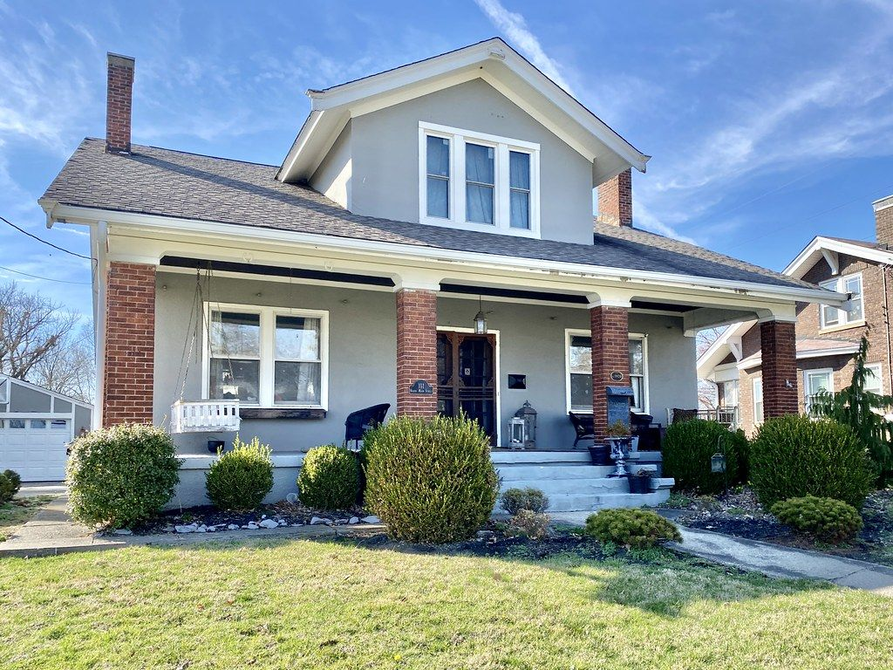
My ask
1
A steward partner
and a first house in Greensboro
2
$70,000
for the 18-month pilot
3
Mentorship from Base
for the audit and launch
Fix the block. Own the block.
Notes:
SAY: "My ask: a steward partner and a first house in Greensboro, $70,000 for the pilot, and mentorship from Base for the audit and launch. Neighbors shouldn't have to watch anymore. Fix the block. Own the block. Thank you."
Q&A one-liners:
- Legal? Each house's LLC raises under Reg CF through a registered portal, with a 12-month lockup in code.
- 49 cents is nothing? The impact is the house, its rent and its rising value staying in the neighborhood, and a tenant becoming an owner.
- Fill $144K? 300 residents x $50, 400 students x $25, 540 alumni x $150, 19 churches and organizations x $2,000.
- Gentrification? Residents buy first, rent is capped at 3% a year, and the tenant can buy the home.
- Sell my tokens? Not for 12 months. Then through a registered trading platform. The main exit is the tenant buying or a sale to a land trust, years 3-7.
- You're one person? I built the prototype myself; the budget covers a securities attorney and an independent auditor, and I'm recruiting advisors.
The slides after this one are backup for Q&A.

Slide 13
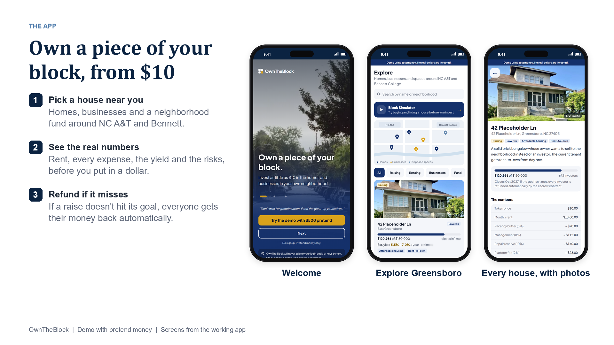
Notes:
BACKUP: use only if a judge asks.
APP DEMO (screens from the working app, pretend money).
SAY: Welcome, Explore and a property page. Every house shows its photos, the real numbers and the risks before anyone invests.

Slide 14
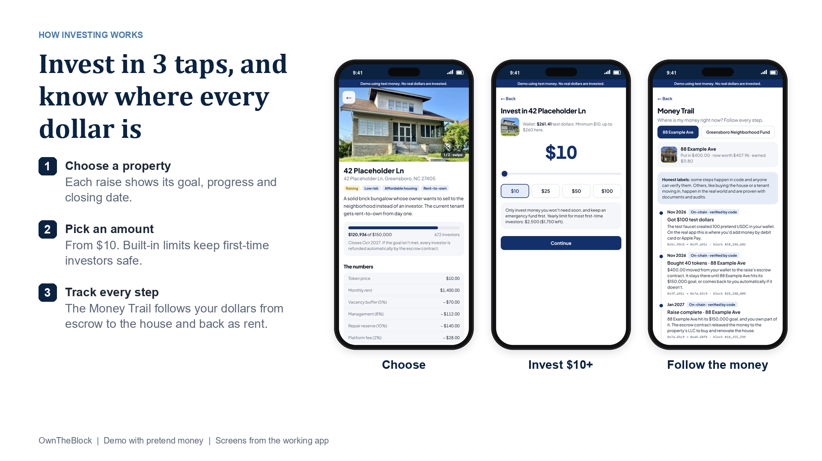
Notes:
BACKUP: use only if a judge asks.
APP DEMO (screens from the working app, pretend money).
SAY: Choose a property, pick an amount from $10, then follow every dollar on the Money Trail.

Slide 15
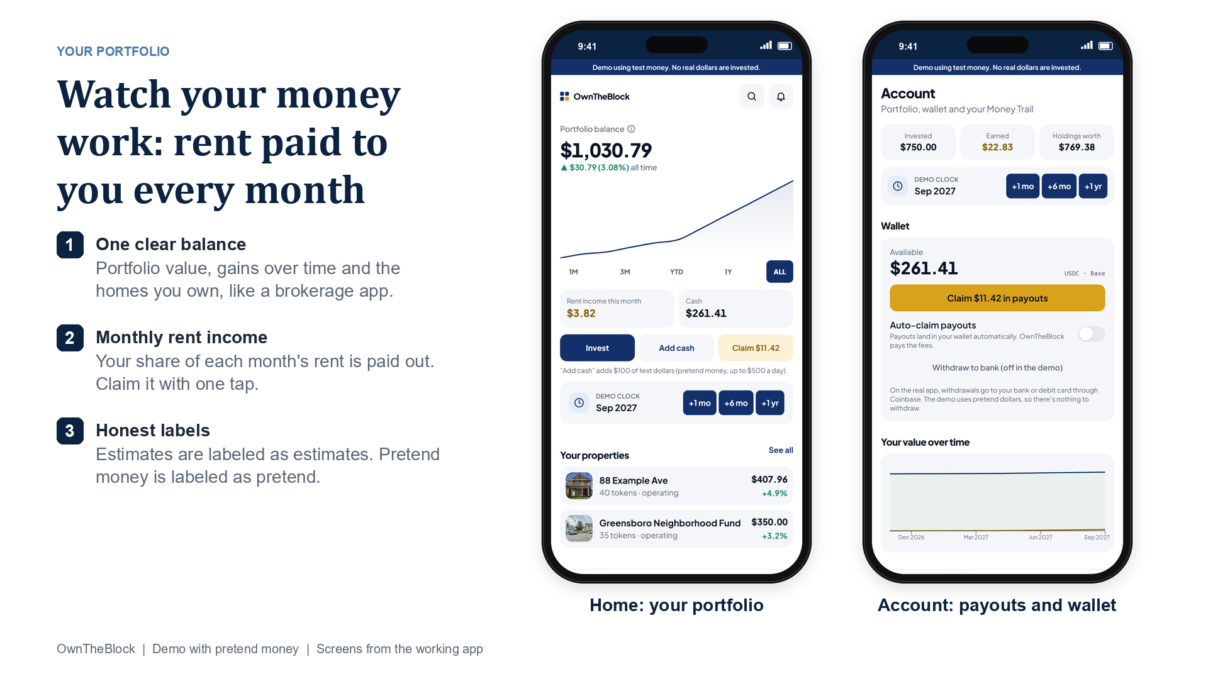
Notes:
BACKUP: use only if a judge asks.
APP DEMO (screens from the working app, pretend money).
SAY: Home works like a brokerage app: balance, gains over time, the homes you own, and rent income you claim with one tap.

Slide 16
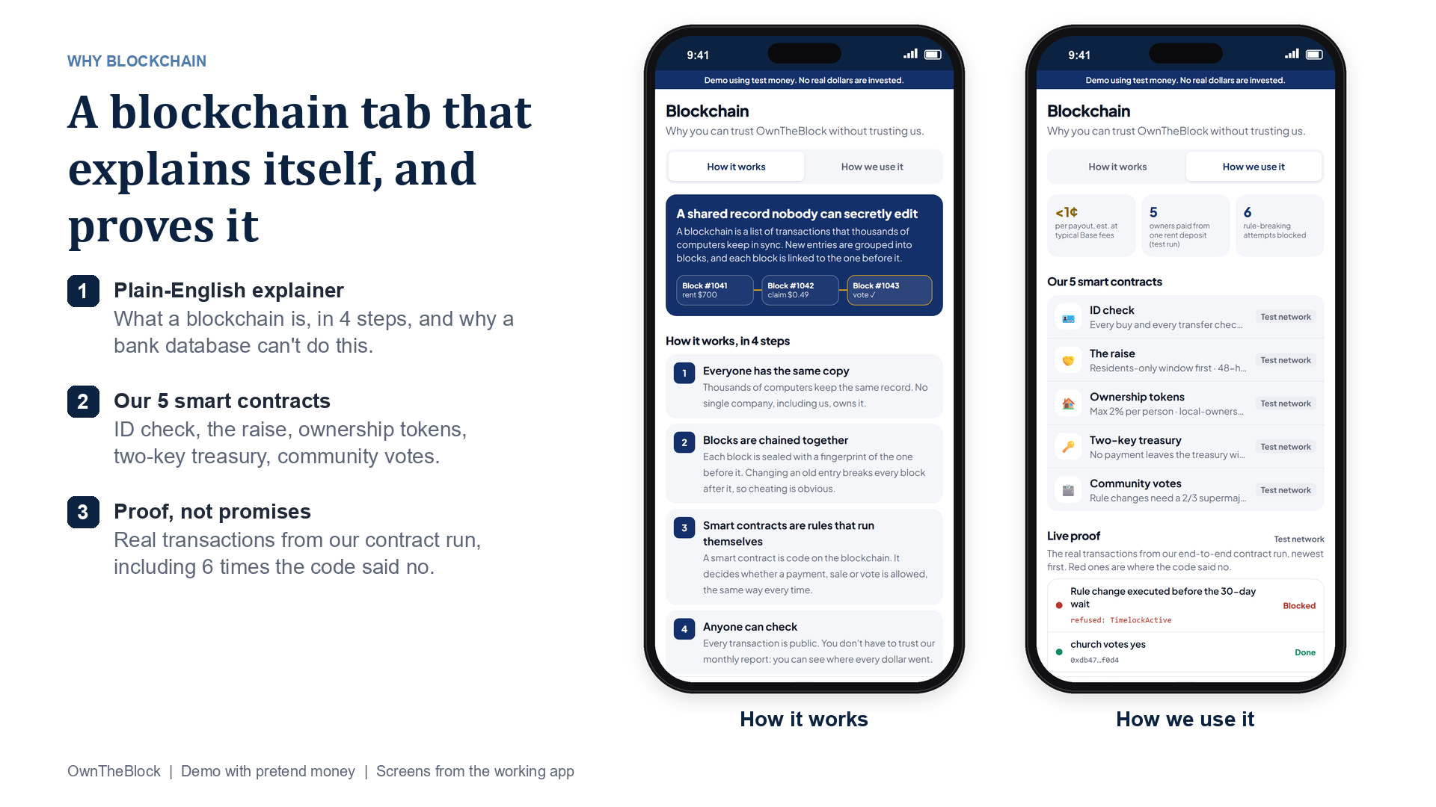
Notes:
BACKUP: use only if a judge asks.
APP DEMO (screens from the working app, pretend money).
SAY: The Blockchain tab explains blockchain in plain English, then shows the 5 contracts and the real test-run transactions, including the 6 the code blocked.

Slide 17
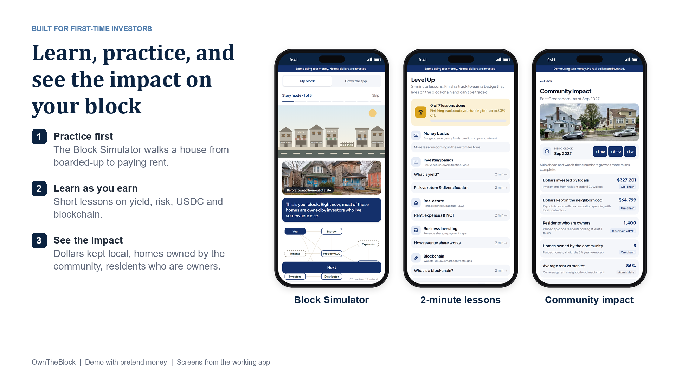
Notes:
BACKUP: use only if a judge asks.
APP DEMO (screens from the working app, pretend money).
SAY: Built for first-time investors: practice in the Block Simulator, take 2-minute lessons, and see the impact on the neighborhood.

Slide 18

Why now
For the first time, the tools exist to make this legal and cheap.
Anyone can invest small amounts in a local deal (SEC Regulation Crowdfunding).
Blockchain payments on Base cost less than 1¢.
Digital dollars (USDC) are now federally regulated (GENIUS Act, 2025).
Notes:
BACKUP: use only if a judge asks.
SAY: "Why now? Three things changed. Crowdfunding rules let everyday people invest small amounts in a local deal. Blockchain payments on Base cost less than a cent. And digital dollars are now federally regulated. Ten years ago this wasn't possible."

Slide 19
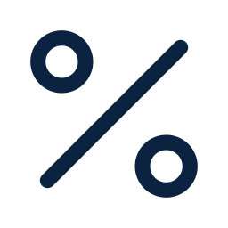

How OwnTheBlock makes money
Small fees per house, then licensing the platform.
2% of each raise
($2,880 per house)
2% of monthly rent
(~$336 per house a year)
License the platform to land trusts, nonprofits and cities
Investors' money for the house never pays for the company.
Notes:
BACKUP: use only if a judge asks.
SAY: "OwnTheBlock earns 2% of each raise and 2% of rent. Fees alone need a few hundred homes to cover a team, so the scale plan is licensing the platform to land trusts, community development nonprofits and cities that already own properties."

Slide 20
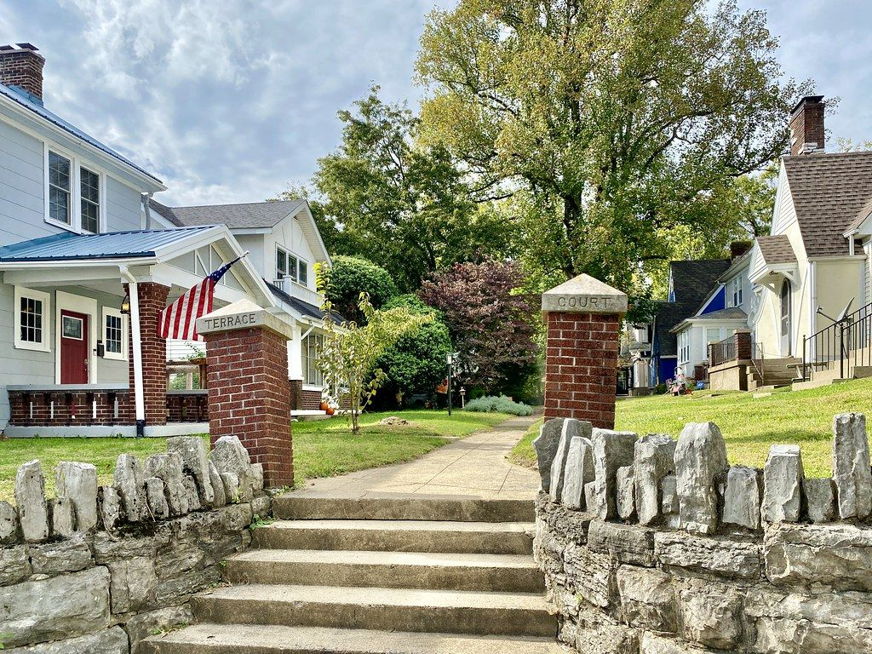


Who wins
Residents become owners of their own block.
The tenant gets capped rent and a path to buy the home.
Students make a first investment and learn how ownership works.
Coinbase's mission: increase economic freedom. Ours starts on your block.
Notes:
BACKUP: use only if a judge asks.
SAY: "Who wins? Residents become owners. The tenant gets capped rent and a path to buy the home. Students make their first investment and learn how ownership works. And the heirs get a fair price. It fits Coinbase's mission to increase economic freedom, starting on your own block."
Rubric: Benefits (15): social impact + Coinbase mission.

