Slide 1

STARFLEET
PADAWAN ACADEMY
AT SPACEX

Slide 2
THE VISION
"The purpose of SpaceX is that we want to make Star Trek real.
We want to make Starfleet Academy real, so that it's not always science fiction."
— Elon Musk
Eureka realized. The ships are coming. The people who will fly them must be forged now.

Slide 3



THE SYNTHESIS
Three worlds. One destiny.
STARFLEET
PADAWAN
SPACEX
Exploration. Command. Science. The Prime Directive. Boldly going where the math says we can — and the heart says we must.
Apprenticeship. Precision. Resilience. The Living Force. Inner discipline that survives when the hull breaches and comms go dark.
First principles. Rapid iteration. Hardware reality. Starship-scale ambition. Making life multi-planetary in our lifetime.

Slide 4

THE CAMPUS
Starbase, Texas — Where the temple meets the launch pad

Slide 5
THE PROGRAM
4 Years Core + Padawan Apprenticeship
YEAR 1
Awakening
All pillars foundation. The Forge. First 72-hour Lost Ship sim.
YEAR 2
Refinement
Specialization tracks. Real mission contributions. Cross-training.
YEAR 3
Command
Lead teams. Multi-week habitat mission. Select Master for apprenticeship.
YEAR 4
Synthesis
Capstone project. Public defense before mixed Council board.
PADAWAN
Apprenticeship
1-2 years embedded. Starship crew, Starbase ops, forward missions. Knighting.

Slide 6
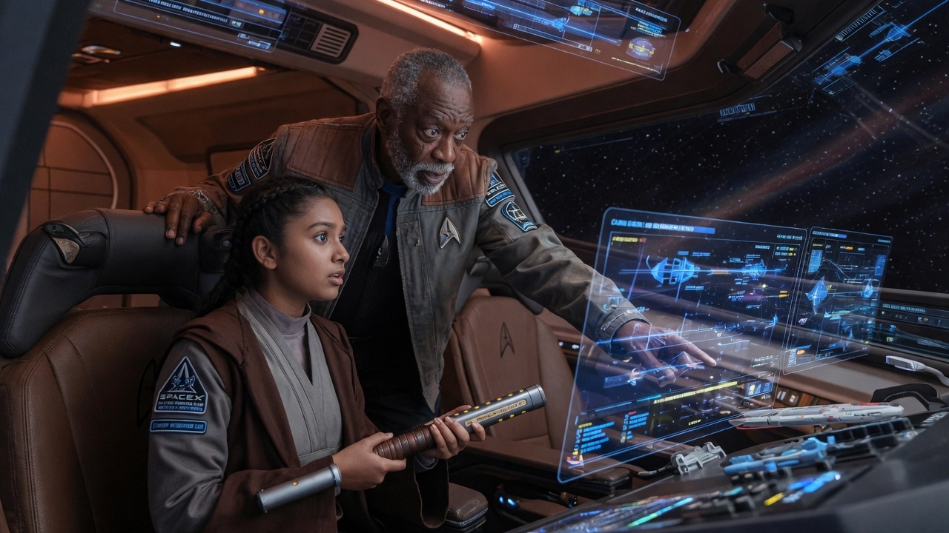
THE FORGE + THE PATH
Precision engineering meets lightsaber discipline — on the actual launch pad

Slide 7
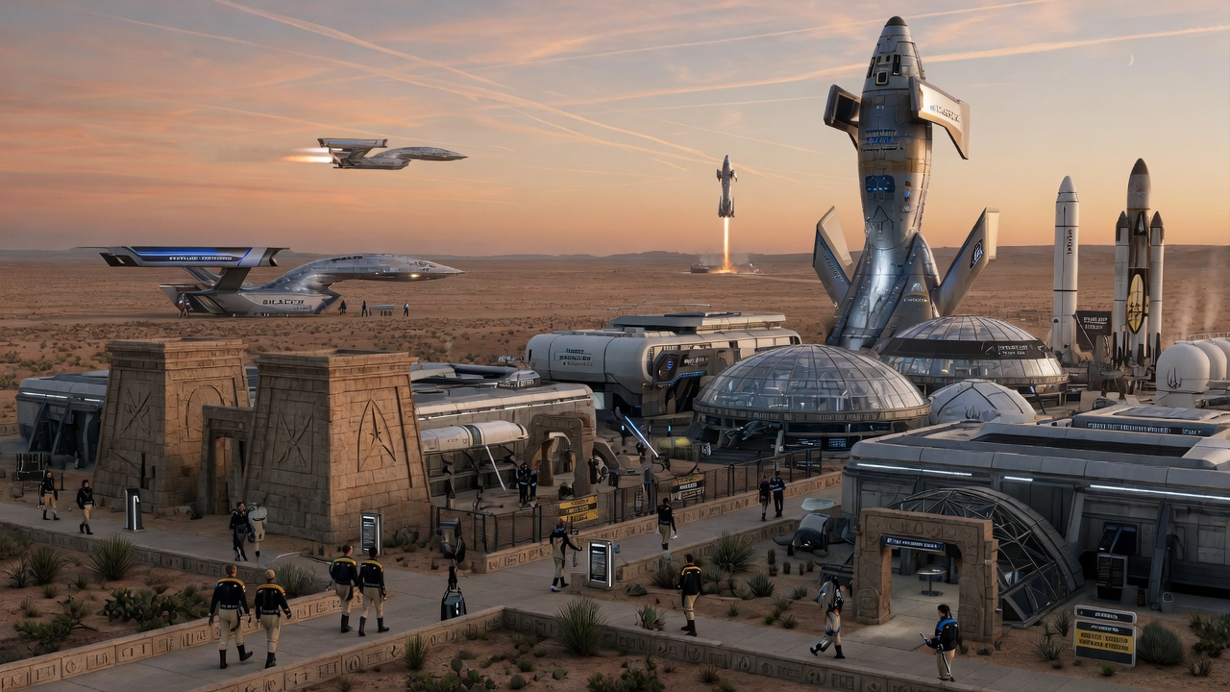

THE MASTER & THE PADAWAN
Apprenticeship is the soul of the Academy.
Every cadet is paired with a living Master during apprenticeship
Masters are active operators: chief engineers, flight directors, Starship captains
The relationship is lifelong — the chain of knowledge and character
Graduation is not a degree. It is a knighting.

Slide 8
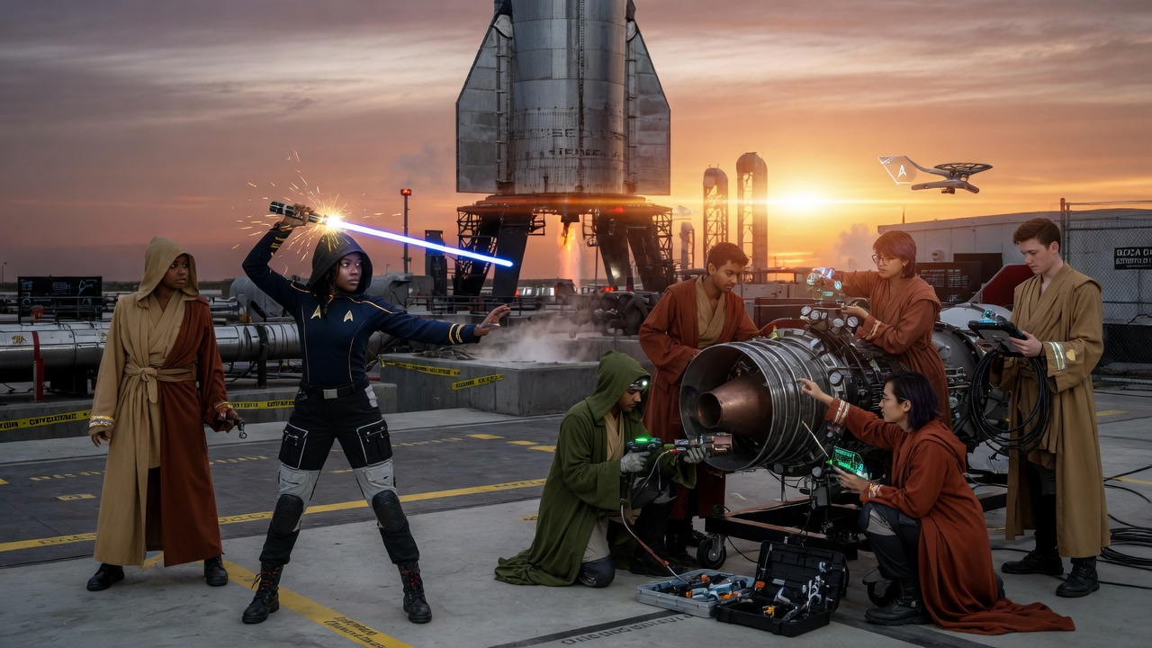
THE FIRST GRADUATES
Ensign-Knights ready to crew the fleet that makes the future real

Slide 9
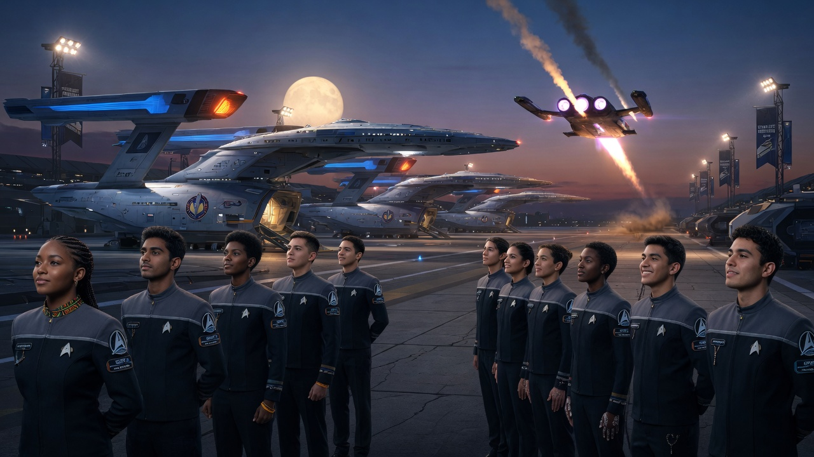
THE LONG ASCENT
The ships will come. The question is whether we will be ready — in mind, hand, and spirit.

Slide 10

BUILD THE ACADEMY
This is more than a concept. It is the logical next step in making Star Trek real.
→ Recruit the first cohort of Padawans who have already built something real
→ Stand up the Forge at Starbase alongside existing training infrastructure
→ Identify the first Masters willing to take on apprentices for the long voyage
→ Begin the conversation that turns vision into policy, budget, and flight manifest
May the Force be with the boosters — and the people who fly them.

