Slide 1
Ticket Management System
Luis Lua, Kaleb Shah

Slide 2
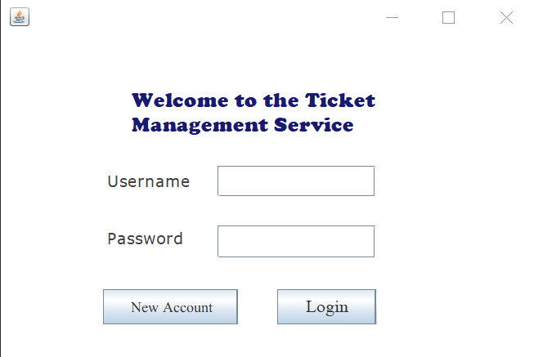
Introduction
Create Ticket Management System (TMS) to track productivity within a team
Divide tasks
Organize work
Login page to allow secure access as well as tracking progress on who does what
Simple Interface for anyone to use

Slide 3
Algorithm
Ticket
Create a User and Ticket class
Every Ticket is created by the User
Save Progress:
Sign Out - Save Tickets and users in their corresponding files
Open App – Read files and store data in the program
Interface to show tickets and interact with them
User
Database

Slide 4
Packages: WindowBuilder
Used WindowBuilder for the GUI of the application:
JTextPane for text, like “Username:”
JTextField for user input, like “Details:”
Jbutton to move between windows
Jlist to store and show tickets

Slide 5
Runtime Example
1
Example slides including all the windows

Slide 6

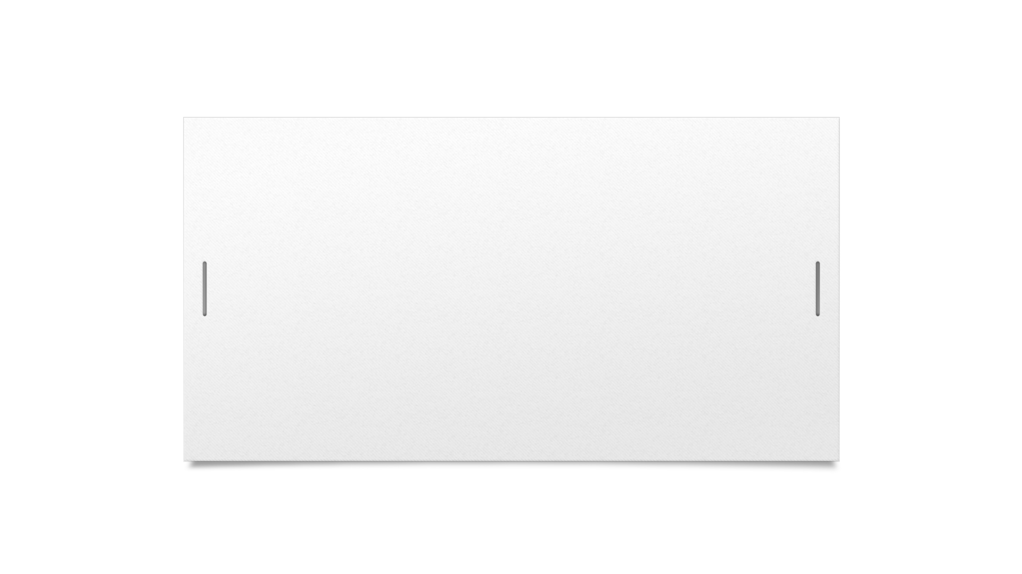

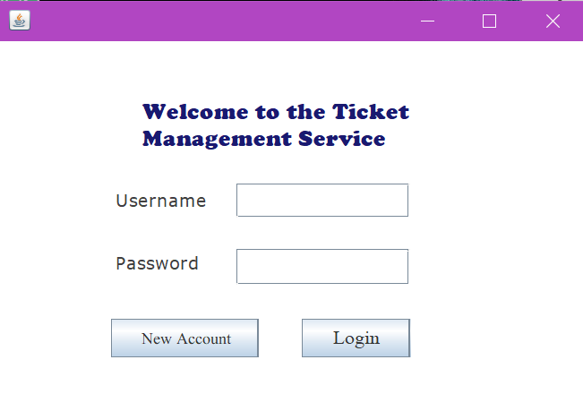


Login

Slide 7
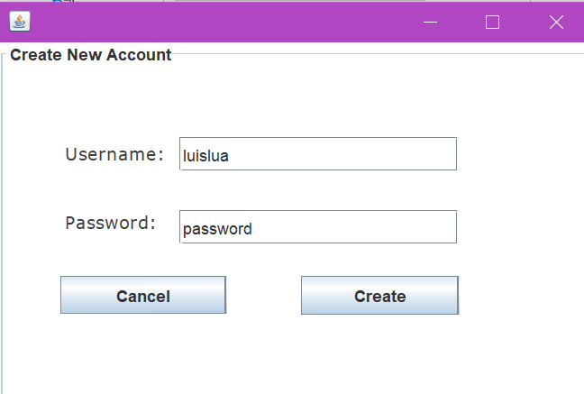
Create New Account

Slide 8
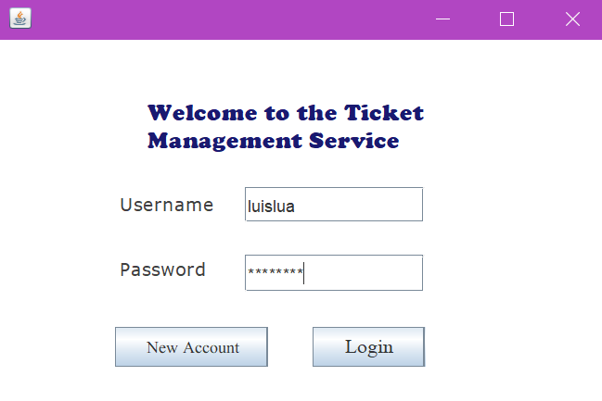
Login (filled)

Slide 9
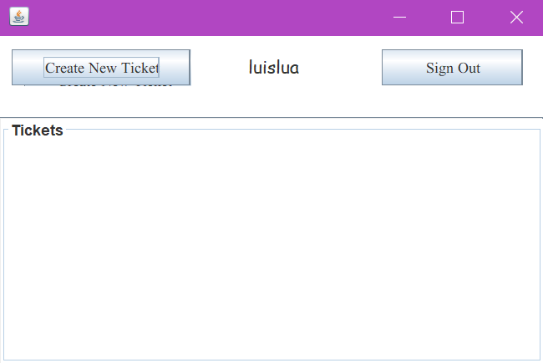
View Tickets

Slide 10
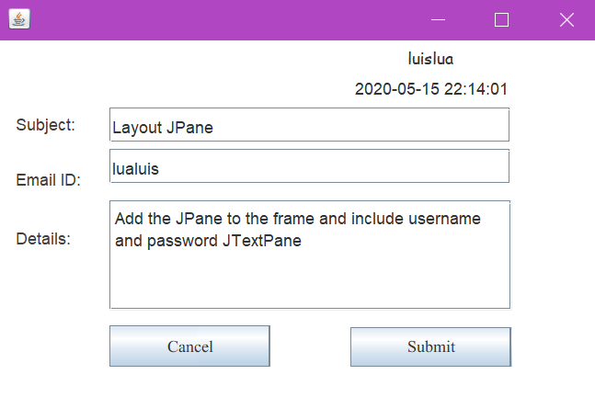
Create New Ticket

Slide 11
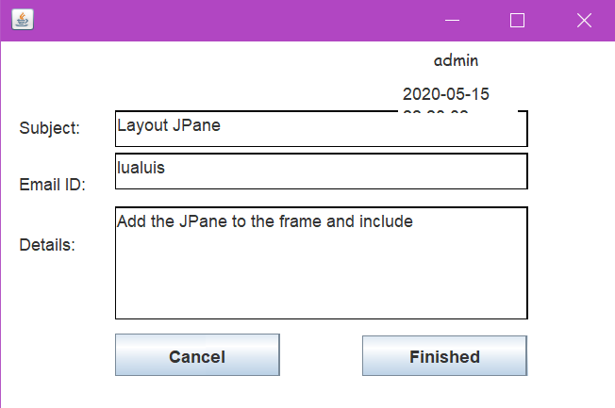
View Ticket

Slide 12
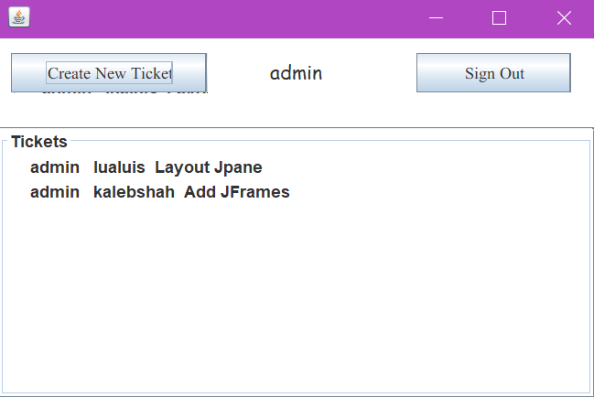
View Tickets

Slide 13
Discussion
Users and Tickets are personalized to the computer of every user
Ticket system can be useful to create own app
Future:
Add a server

