Slide 1
IBM UNIVERSITY ENGAGEMENT PROJECT SUBMISSION
“Exploring the Power of Agentic AI with IBM Granite and IBM Bob”
AI-Powered Nutrition Agent
Multi-Agent Agentic AI for Personalized Nutrition & Preventive Healthcare Guidance
Student: MOHAMMAD KALEEM SHAIKH
AICTE – 2026 | IBM SkillsBuild for University Engagements | Edunet Foundation
Domain: Healthcare / Nutrition / Preventive Wellness

Slide 2
Student Details
Student Name | Recent Passport Photo | Email ID | Mobile Number
MOHAMMAD KALEEM SHAIKH | [ Photo to be added by student ] | [ Email to be added by student ] | [ Mobile / WhatsApp to be added ]
Project Domain
Institution Context
Healthcare / Nutrition / Preventive Wellness
Project Title: AI-Powered Nutrition Agent
Theme: Exploring the Power of Agentic AI with IBM Granite and IBM Bob
AICTE – 2026, Problem Statement No. 8 (Nutrition Agent)
IBM SkillsBuild for University Engagements
Edunet Foundation Program
Note: Fields not supplied by the student are marked as placeholders and must be completed before final submission.
2

Slide 3
Problem Statement
AICTE Problem Statement No. 8 — Nutrition Agent
The Challenge
Real-World Pain Points
In an era of growing health awareness, individuals increasingly seek personalized nutrition guidance. Most existing tools provide generic diet plans, lack real-time adaptability, and fail to consider a person's holistic lifestyle, cultural preferences, allergies, and evolving health conditions. Dieticians and nutritionists also face limits in scaling personalized consultations due to time and resource constraints. Generative AI presents an opportunity to build an intelligent, interactive, adaptive virtual nutrition assistant.
Difficulty in day-to-day diet planning and portion control
Nutritional tracking is manual, tedious and error-prone
Nutrition information is scattered across unreliable sources
Lack of personalization for allergies, culture, fitness goals
Preventive healthcare (diabetes, heart health) guidance is hard to access at scale
Nutritionists cannot scale 1:1 consultations to every individual
3

Slide 4
Objective
Personalized Diet Plans
Food Data RAG Retrieval
Diet Tracking & Feedback
Recommend meals based on age, health conditions, allergies, culture and fitness goals.
Fetch and summarize nutritional values (calories, macros, vitamins) from trusted sources.
Let users log meals via text/image/voice and receive instant nutritional analysis.
Preventive Health Focus
Multi-Agent Architecture
Visualization Dashboard
Suggest diets for chronic-disease management, e.g. diabetes-friendly, heart-healthy plans.
Specialized agents for knowledge, recommendation, advisory and food-log feedback.
Show daily/weekly nutrient intake, deficiencies and progress toward health goals.
4

Slide 5
Proposed Solution
A multi-agent AI-powered Nutrition Agent built around IBM Bob orchestration, IBM Granite models, and IBM watsonx.ai, delivering personalized, real-time dietary guidance. A Retrieval-Augmented Generation (RAG) pipeline grounds every answer in trusted nutrition datasets, while four specialized agents divide the work: retrieving knowledge, recommending diets, giving preventive health advice, and analyzing food logs. A dashboard visualizes progress so users can see their nutrition story unfold day by day.
1
2
3
4
Nutrition Knowledge Agent
Diet Recommendation Agent
Health Advisory Agent
Food Log & Feedback Agent
Retrieves & summarizes nutrition facts via RAG
Builds personalized meal plans from user profile
Preventive, disease-specific dietary suggestions
Analyzes logged meals, flags nutritional gaps
IBM Bob orchestrates the four agents; Granite drives language understanding & personalization; watsonx.ai handles deployment, embeddings and governance.
5

Slide 6
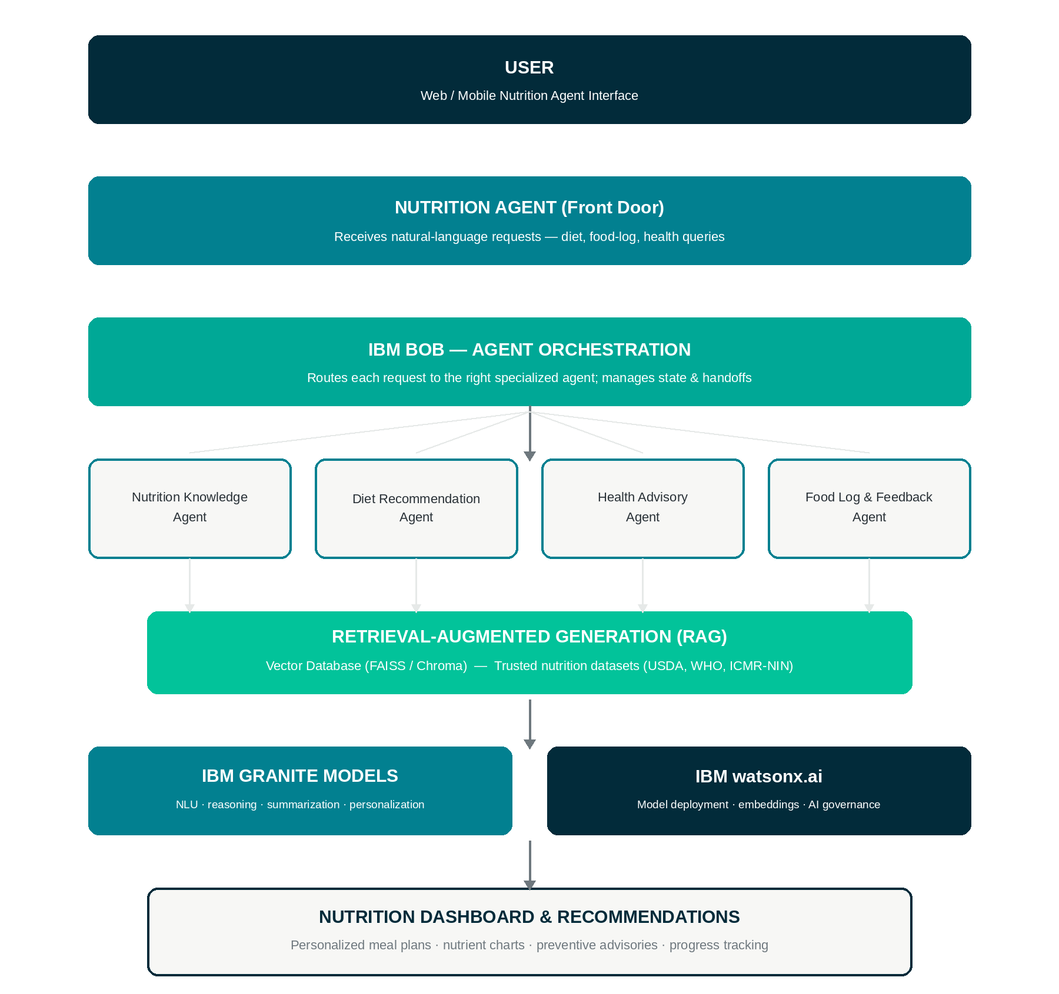
Solution Architecture
6

Slide 7
Technology Used
IBM Bob
IBM Granite Models
IBM watsonx.ai
IBM Cloud (Lite)
Visually designs & orchestrates the multi-agent workflow
e.g. ibm-granite-3-2-8b — NLU, reasoning, personalization
Model deployment, embeddings, AI governance
Infrastructure to build, deploy & scale the agent
RAG Pipeline
Vector Database
Python
Streamlit / React
Retrieves trusted data first, then generates grounded answers
FAISS / Chroma for nutrition-data retrieval
Agent logic, data processing, RAG pipeline
Nutrition dashboard & chat interface
7

Slide 8
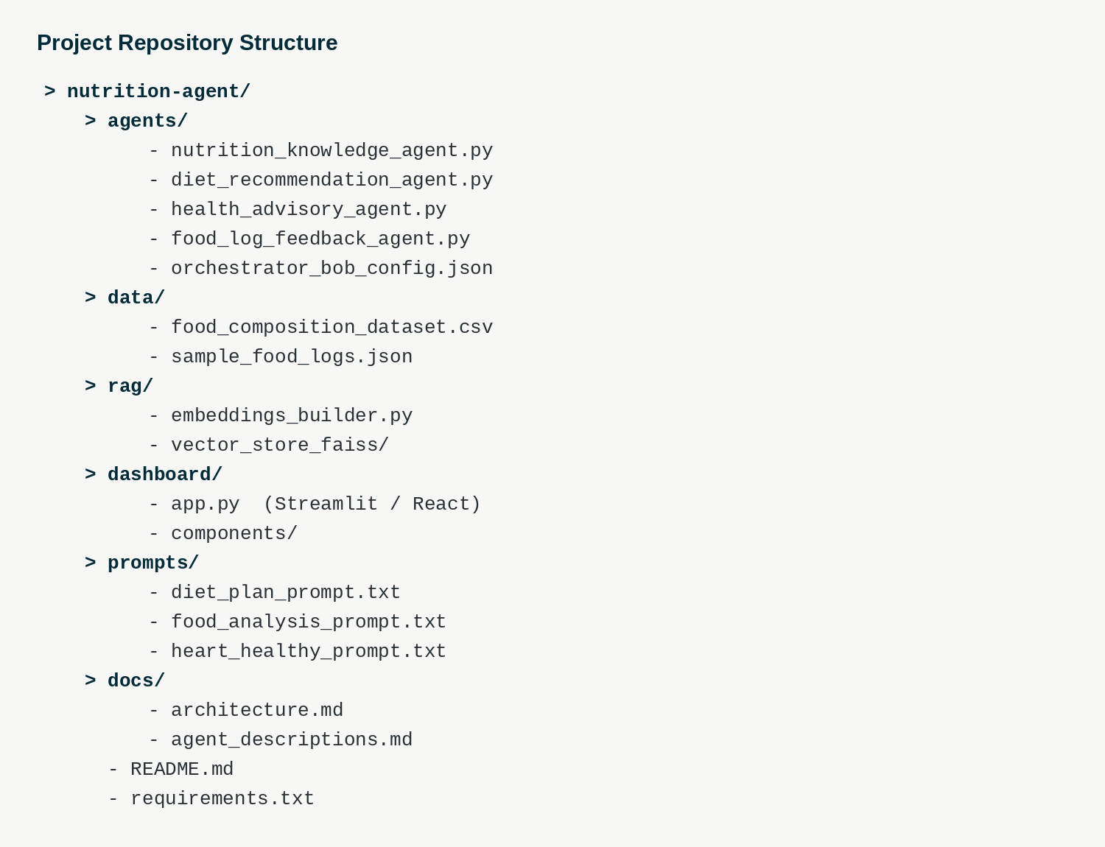
Required Files
Project repository structure prepared for IBM Bob / GitHub submission
8

Slide 9
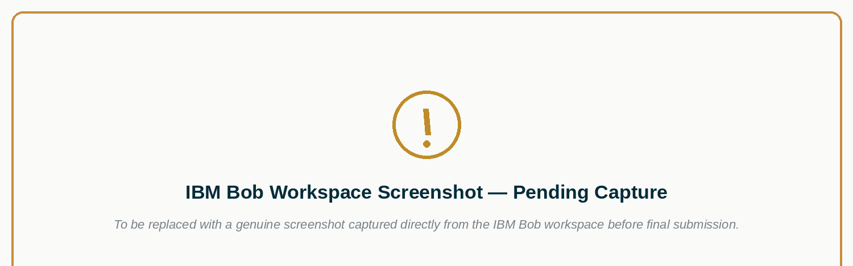
IBM Bob — Development Workflow Evidence
Insert: project workspace, agent configuration screens, files panel, and prompt history captured from the student's own IBM Bob session.
9

Slide 10
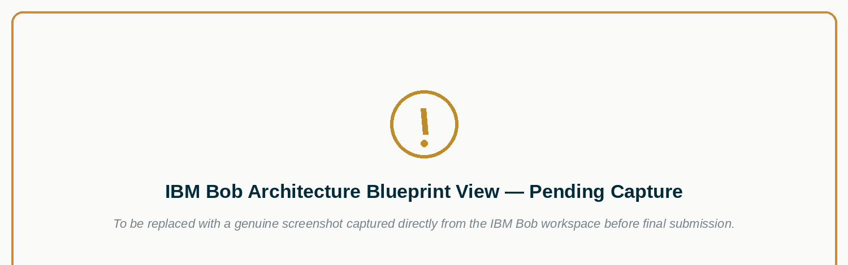
IBM Bob — Architecture Blueprint View
Insert: the multi-agent blueprint / canvas view as rendered inside IBM Bob for this project.
10

Slide 11
Role of Agentic AI in the Solution
Agentic AI lets the Nutrition Agent behave as an intelligent, autonomous system rather than a single-turn chatbot. Powered by IBM watsonx.ai and IBM Granite models, it coordinates multiple specialized agents — each responsible for one part of the nutrition journey — while IBM Bob manages hand-offs between them.
Chatbot vs. Agentic AI
Simple Chatbot
Single response per prompt, no memory of goals
Context-awareness: understands age, health conditions and goals
Real-time adaptation: updates guidance as new meals are logged
Inter-agent communication: agents hand off context, not just text
Goal-driven behaviour: proactively tracks progress, not just replies
Agentic Nutrition System
Multiple agents collaborate, retain context, and act toward a health goal over time
11

Slide 12
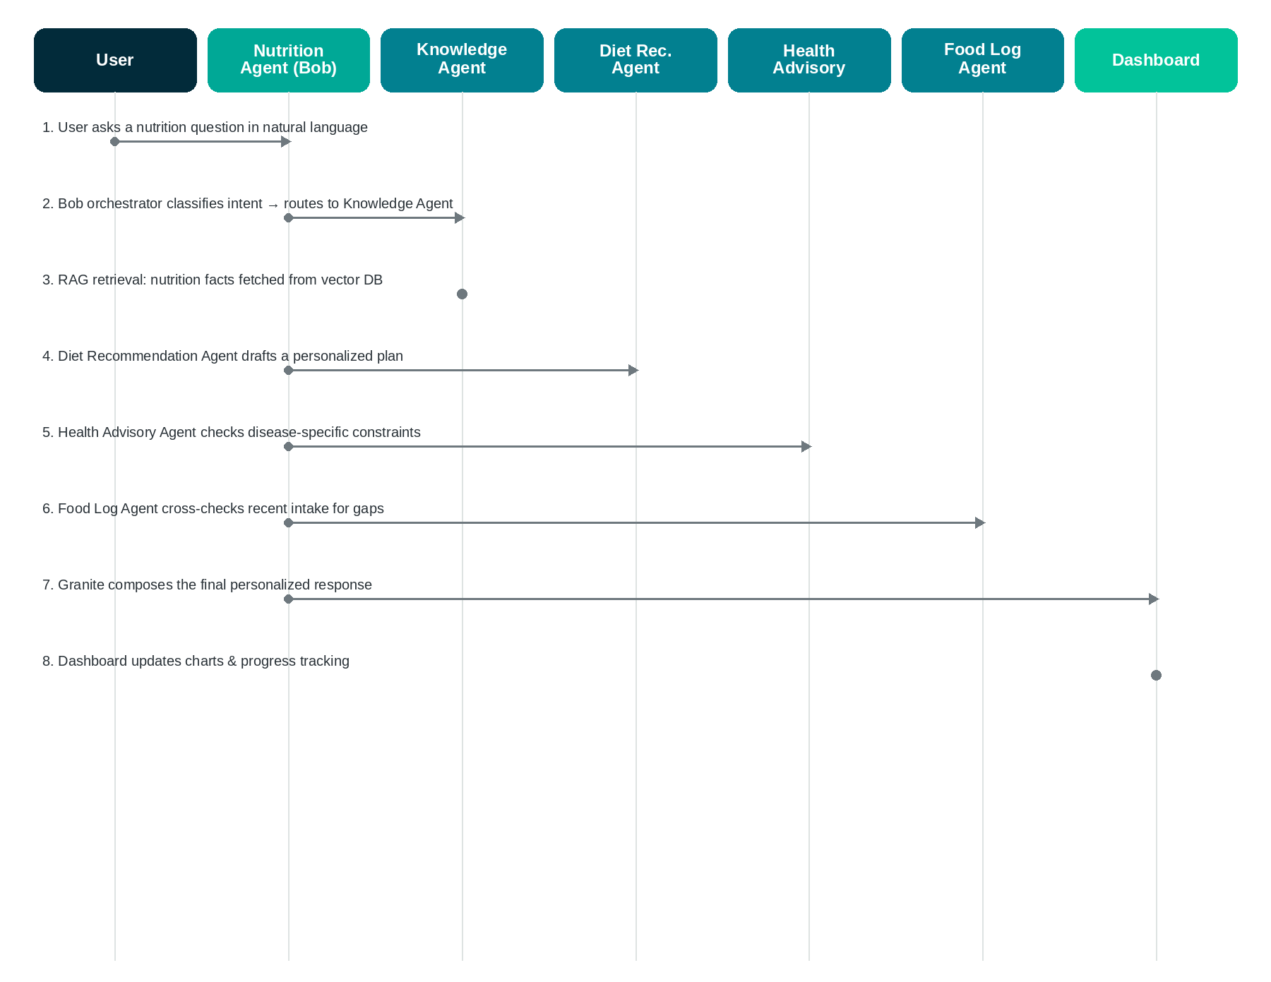
Multi-Agent Workflow
Conceptual sequence — how a single user request flows through the system
12

Slide 13
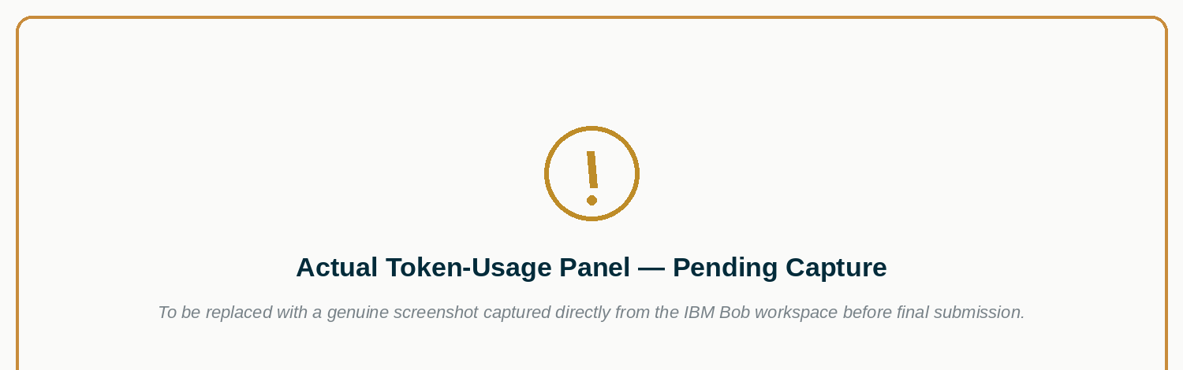
Token Usage
Academic-honesty note: token-usage figures are reported only when genuinely available from the IBM Bob / watsonx.ai session. No token counts are invented for this submission.
13

Slide 14
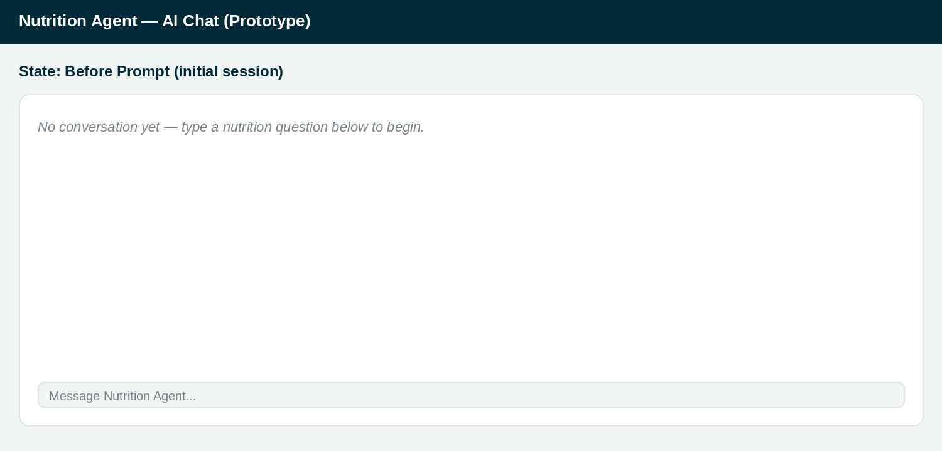
Before Prompt
Prototype demo interface — initial state
14

Slide 15
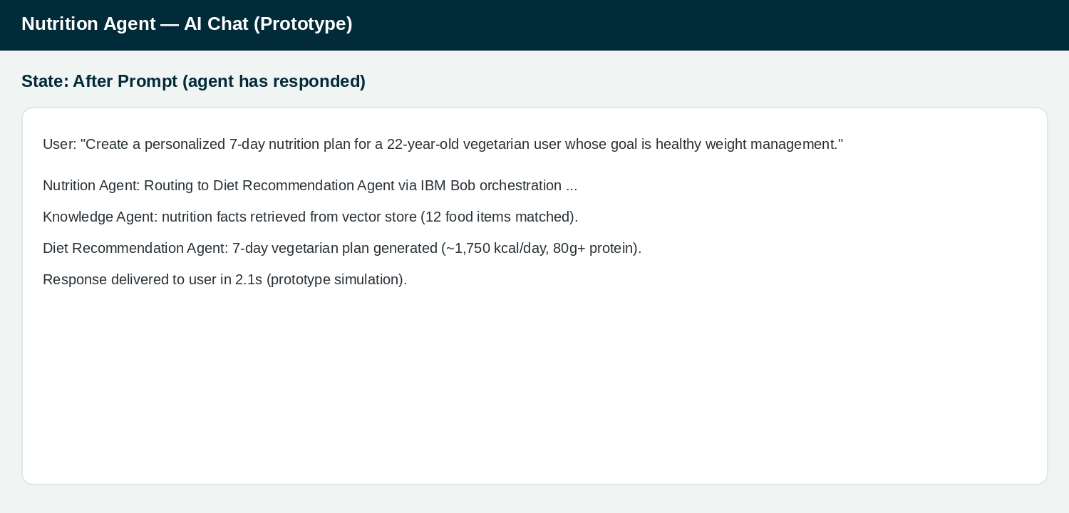
After Prompt
Prototype demo interface — after the agent responds
15

Slide 16
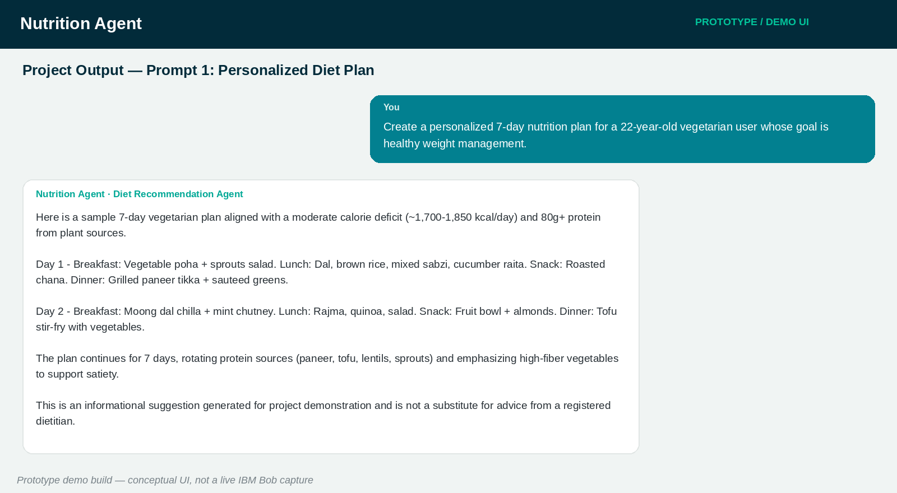
Project Output — Prompt 1
Prototype demo output (conceptual UI, not a live IBM Bob capture)
16

Slide 17
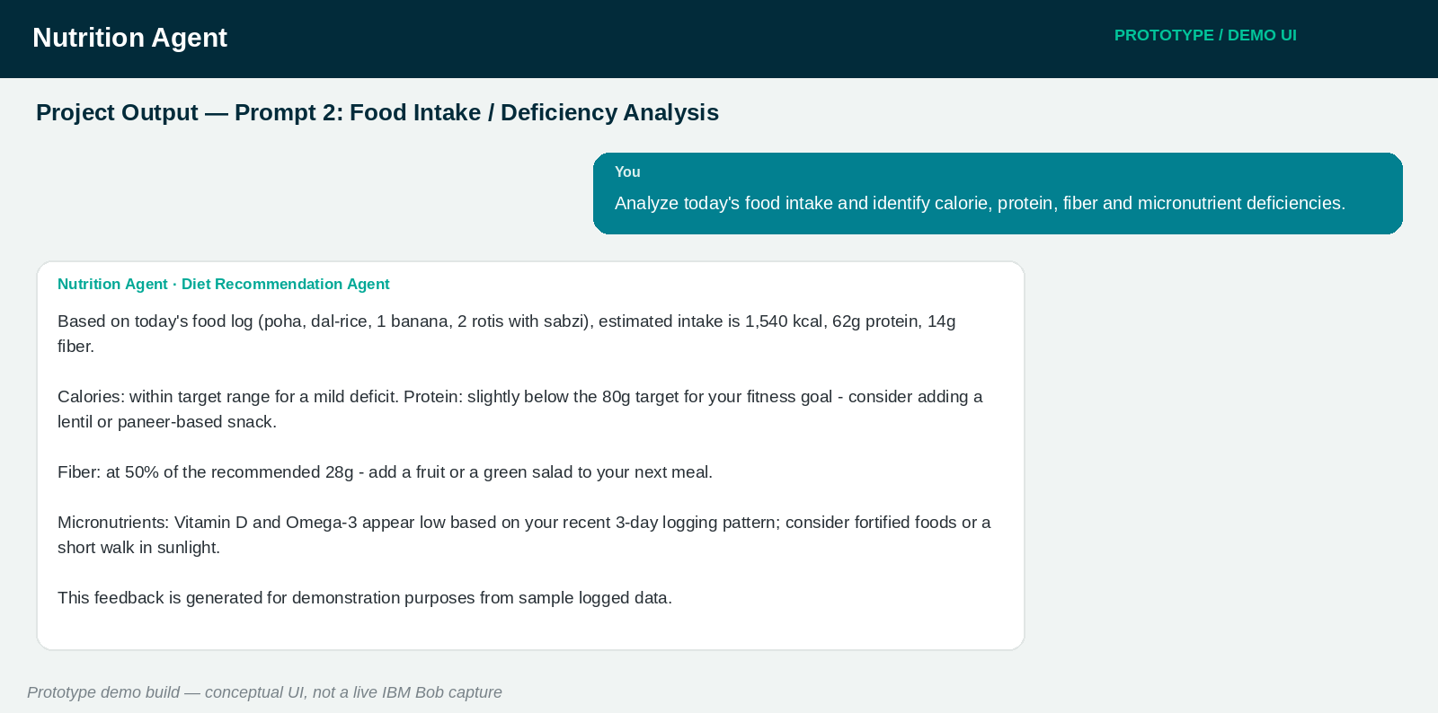
Project Output — Prompt 2
Prototype demo output (conceptual UI, not a live IBM Bob capture)
17

Slide 18
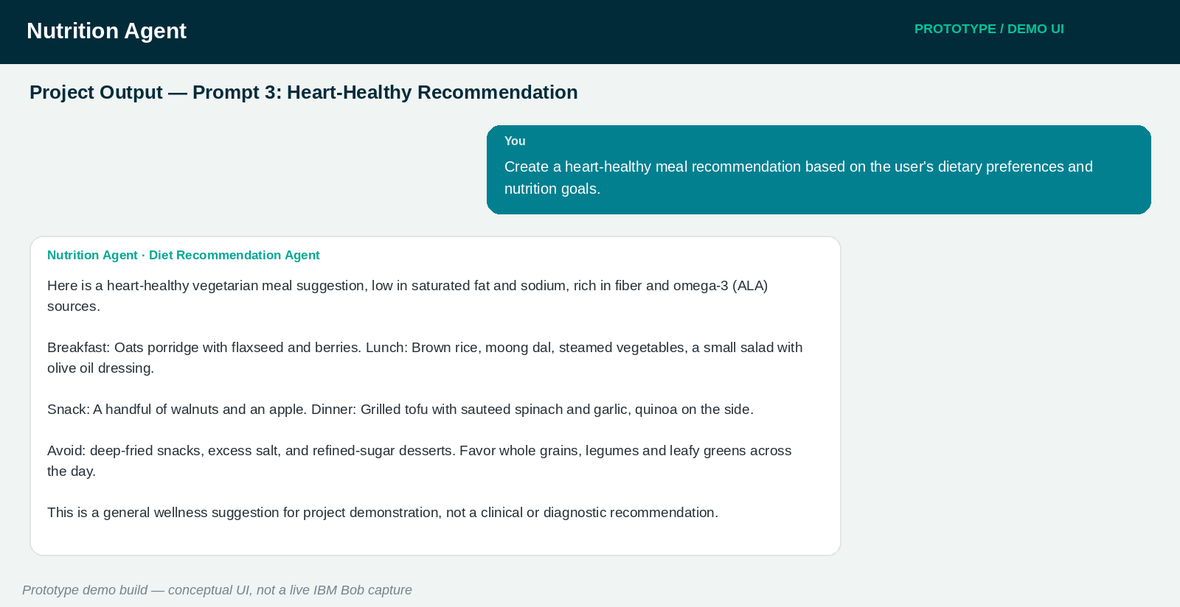
Project Output — Prompt 3
Prototype demo output (conceptual UI, not a live IBM Bob capture)
18

Slide 19
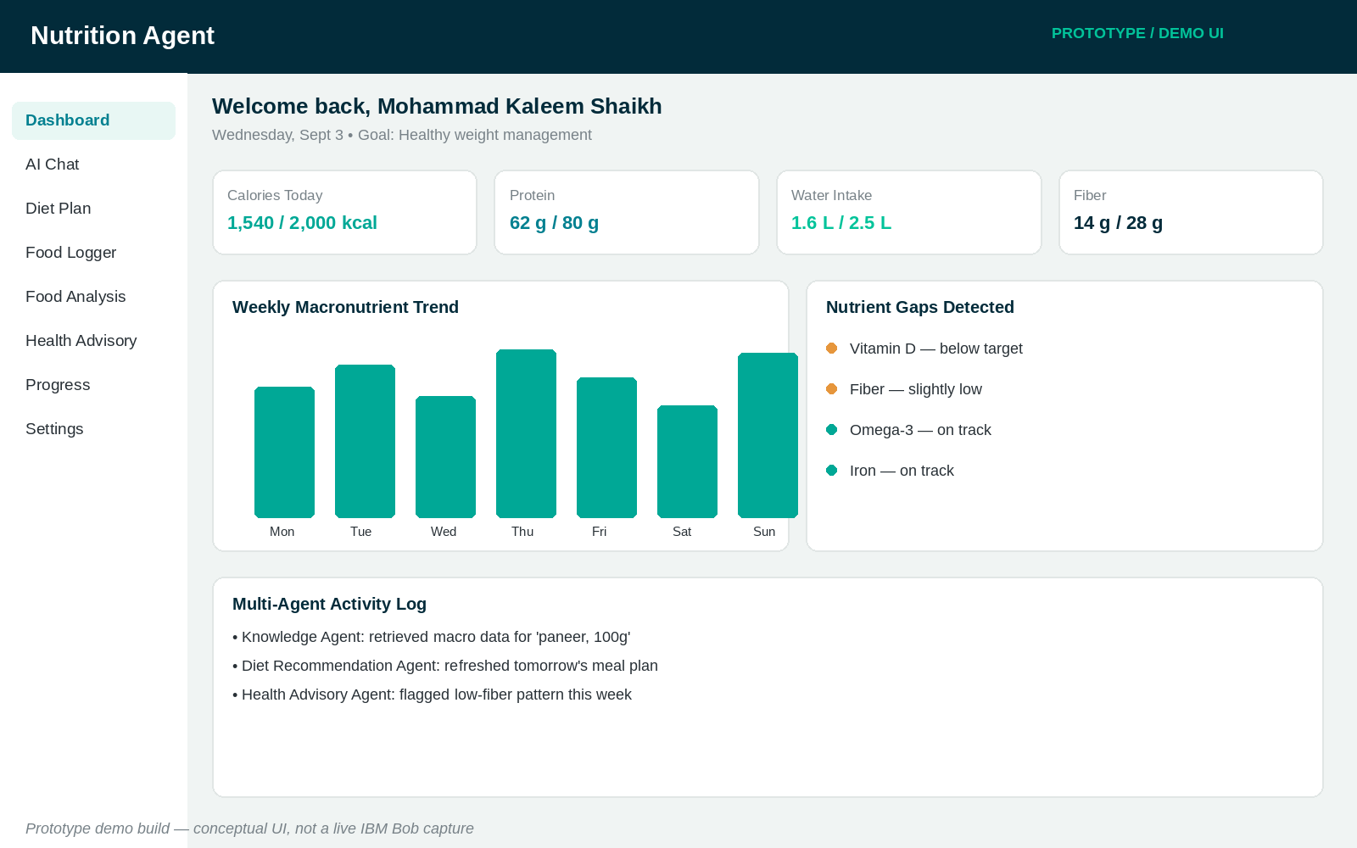
Nutrition Dashboard Output
Prototype demo dashboard — daily/weekly nutrition visualization
19

Slide 20
Novelty and Uniqueness
Multi-Agent Intelligence
RAG-Based Accuracy
Hyper-Personalization
Real-Time Feedback Loop
Specialized agents collaborate instead of one monolithic chatbot
Grounds answers in real nutrition data, reducing misinformation
Tailors plans to health conditions, culture & fitness goals
Continuously adapts as new food logs arrive
Multimodal Input
Preventive Healthcare Focus
Scalable & Enterprise-Ready
Supports text, voice and image-based meal tracking
Goes beyond diet planning to disease-specific advice
Built on watsonx.ai and Granite for reliability & governance
20

Slide 21
Project Impact
1
2
3
4
Individuals
Families
Health-Conscious Users
Nutrition Professionals
Everyday, judgement-free access to personalized nutrition guidance
Shared meal planning that accounts for each member's needs
Data-driven visibility into daily nutrient intake and gaps
A scalable first line of support that frees up time for complex cases
21

Slide 22
GitHub Repository
Repository Status
Suggested repository name
GitHub repository to be added after upload.
ai-powered-nutrition-agent
Create a public repository with README enabled
Upload all IBM Cloud / agent-related project files
Upload the problem-statement PDF
Upload this project presentation (.pptx)
Paste the tested, working repository URL here once created
No fabricated or placeholder GitHub URL is included in this submission — in line with academic-honesty requirements.
22

Slide 23
Future Scope
Wearable & Smartwatch Integration
Voice Assistant & Multilingual Support
Real-time steps, heart rate & sleep data for dynamic recommendations
Natural interaction in the user's preferred language
Image-Based Food Recognition
Advanced Predictive Analytics
Log meals instantly from a photo of the plate
Anticipate nutrient deficiencies before they occur
Health-Device Integration
Deeper Personalization
Sync with glucometers, BP monitors for chronic-care support
Cultural cuisine libraries and regional food databases
23

Slide 24
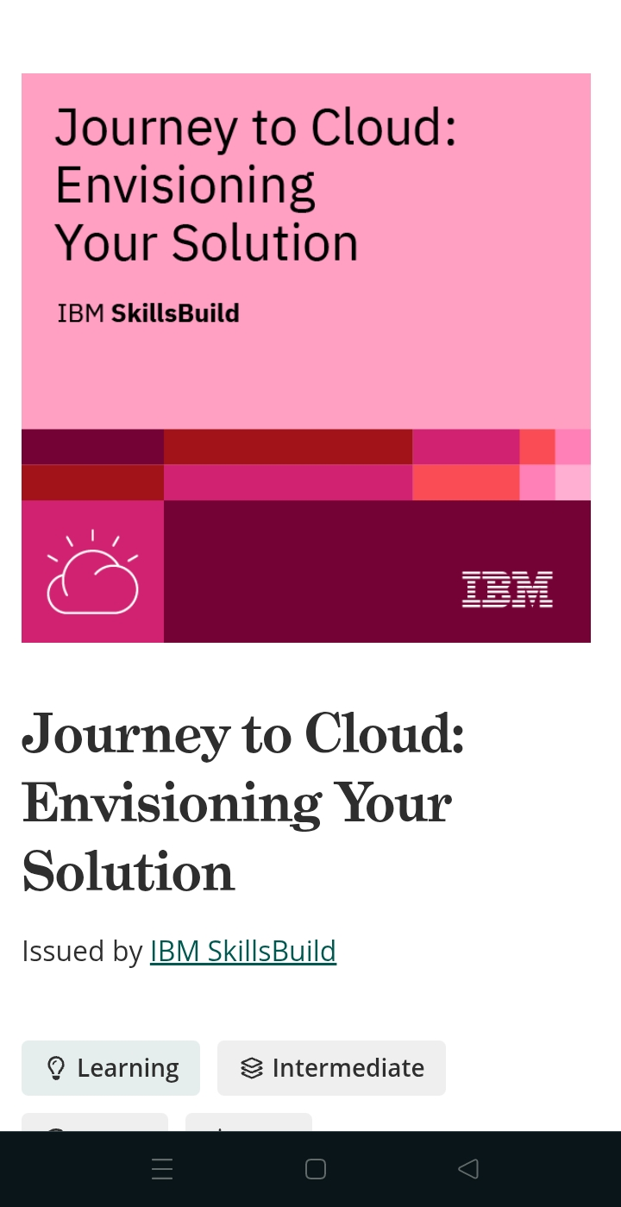
Certificates Earned
IBM SkillsBuild — Journey to Cloud: Envisioning Your Solution
24

Slide 25
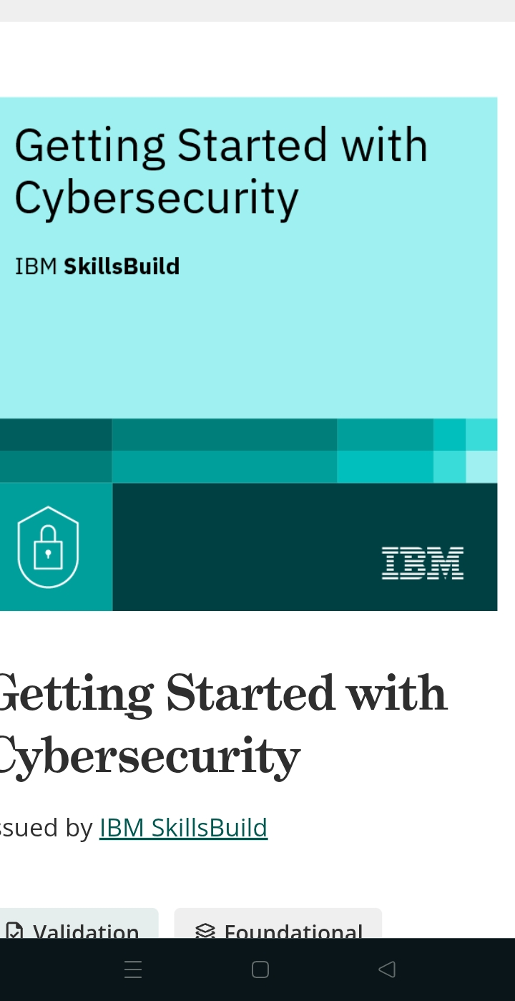
Certificates Earned
IBM SkillsBuild — Getting Started with Cybersecurity
25

Slide 26
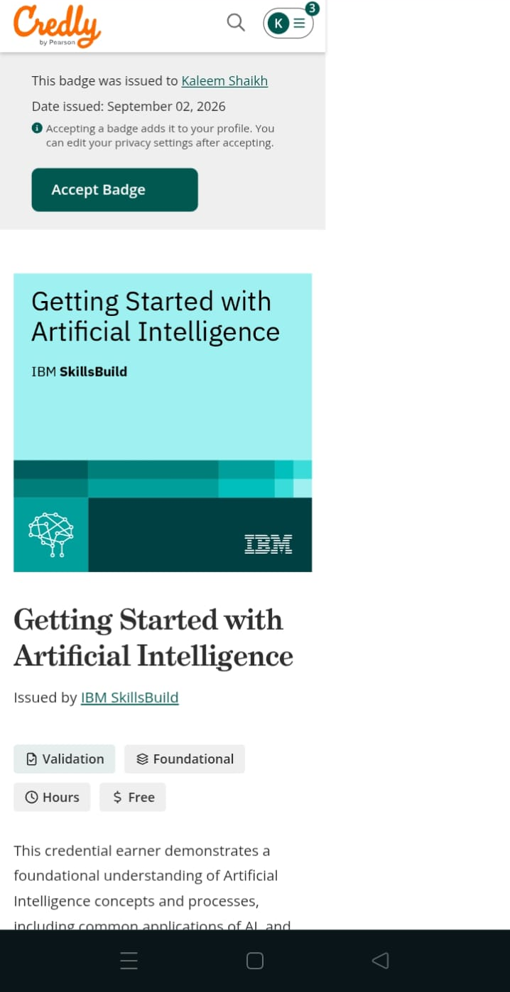
Certificates Earned
IBM SkillsBuild — Getting Started with Artificial Intelligence
26

Slide 27
Final Project Summary
The AI-Powered Nutrition Agent demonstrates how Agentic AI, orchestrated through IBM Bob and powered by IBM Granite and IBM watsonx.ai, can turn scattered nutrition data into personalized, trustworthy, and preventive guidance. Four specialized agents — Knowledge, Diet Recommendation, Health Advisory and Food Log & Feedback — work together under a RAG pipeline to deliver context-aware support, while a live dashboard keeps users engaged with their own progress. Built for accessibility and grounded in academic honesty, this project is ready for extension into wearables, voice, and multilingual support as outlined in the future scope.
Submitted by MOHAMMAD KALEEM SHAIKH — AICTE 2026 — IBM SkillsBuild for University Engagements

