Slide 1
AI BASED LEAF DISEASE IDENTIFICATION AND CLASSIFICATION SYSTEM USING DEEP LEARNING
GUIDED BY,
Mr. V. Solai Raja
Team Members,
V Arun
M Ganeshpandiyan
V Kaleeswaran
P Ramkumar

Slide 2
INTRODUCTION
Generally, a plant gets diseased when it is continually disrupted by a certain causal agent, resulting in a physiological process anomaly which disrupts the normal structure of the plant’s function, growth, among other activities. Pathological conditions and symptoms result from the disruption of one or more of a plant’s critical biochemical and physiological systems.
The occurrence and prevalence of crop diseases vary seasonally, depending on the prevalence of a pathogen, conditions of the environment, and the crops and varieties are grown. Some plant varieties are more prone to outbreaks of plant diseases than others.

Slide 3
OBJECTIVE
To find the interactions between the disease causing agents and host plant in
relation to overall environment.
To identify various diseases in plants.
To implement a method for preventing the diseases and providing management for
reducing the losses/damages caused by diseases

Slide 4
LITERATURE REVIEW - 1
Title | Author | Year | Description
Crop Leaf Disease Image Super-Resolution and Identification With Dual Attention and Topology Fusion Generative Adversarial Network | QIANG DAI 1 , XI CHENG 2 , YAN QIAO 1 , AND YOUHUA ZHANG | VOL. 8, 2020 | In this paper, they propose a generative adversarial network with dual-attention and topology-fusion mechanisms called DATFGAN. This network can effectively transform unclear images into clear and high-resolution images. Additionally, the weight sharing scheme in our proposed network can significantly reduce the number of parameters. Experimental results demonstrate that DATFGAN yields more visually pleasing results than state-of-the-art methods. Additionally, treated images are evaluated based on identification tasks

Slide 5
LITERATURE REVIEW - 2
Title | Author | Year | Description
Plant Disease Recognition: A Large-Scale Benchmark Dataset and a Visual Region and Loss Reweighting Approach | Xinda Liu, Weiqing Min , Member, IEEE, Shuhuan Mei, Lili Wang, Member, IEEE, and Shuqiang Jiang , Senior Member, IEEE | VOL. 30, 2021 | In this paper they first compute the weights of all the divided patches from each image based on the cluster distribution of these patches to indicate the discriminative level of each patch. Then they allocate the weight to each loss for each patch-label pair during weakly-supervised training to enable discriminative disease part learning. We finally extract patch features from the network trained with loss reweighting, and utilize the LSTM network to encode the weighed patch feature sequence into a comprehensive feature representation

Slide 6
LITERATURE REVIEW - 3
Title | Author | Year | Description
Tomato Leaf Disease Identification by Restructured Deep Residual Dense Network | CHANGJIAN ZHOU 1 , SIHAN ZHOU2 , JINGE XING1 , AND JIA SONG3 | VOL. 9, 2021 | In this paper, a restructured residual dense network was proposed for tomato leaf disease identification; this hybrid deep learning model combines the advantages of deep residual networks and dense networks, which can reduce the number of training process parameters to improve calculation accuracy as well as enhance the flow of information and gradients. The original RDN model was first used in image super resolution, so we need to restructure the network architecture for classification tasks through adjusted input image features and hyper parameters.

Slide 7
LITERATURE REVIEW - 4
Title | Author | Year | Description
AI based hybrid CNN-LSTM model for crop disease prediction: An ML advent for rice crop | Sonal Jain, Dharavath Ramesh | 2021 | Plant disease is an extreme challenge in gaining appropriate yield and crop quality. Therefore, a pest forewarning system is advantageous in early disease prediction and controlling it by practicing suitable measures. This paper presents a pest prediction and classification model for yellow stem border (YSB) disease in rice plants. An Artificial Intelligent based prediction model developed considering historical pest and weather data of various regions of India. The proposed model is named as hybrid CNN-LSTM that combines the advantage of convolution neural network (CNN) and long short term memory network (LSTM). It is a region-specific prediction model that predicts one-month pest data based on past three-months weather and pest data. The performance of the proposed model is compared with CNN and LSTM networks. This shows the enhancement in performance while using hybrid CNN-LSTM. On the other hand, this paper also presents a generalized classification model by combining the datasets of all regions. The model predicts the disease severity for the next day based on weather and preceding day pest data. The error correcting output code (ECOC) method with SVM classifier is used for the classification of disease severity.

Slide 8
LITERATURE REVIEW - 5
Title | Author | Year | Description
A Multi-Crop Disease Detection and Classification Approach using CNN | Zubair Saeed, Ali Raza, Ans H. Qureshi, Muhammad Haroon Yousaf | 2021 | Being an agricultural country, the well-being of plants plays a vital role in the agricultural yield. Various diseases and disorders affect the quality and quantity of the production, thus the intelligent methods for disease detection in crops is the need of hour. We have proposed a robust and generalized approach that detects diseases in multiple crops by utilizing the baselines of existing CNN models. We have proposed the variants of ResNet-152 and Inception-v3 for detection of diseases in essential crops like rice and corn. We have used publicly available datasets having three different diseases in rice and both infected and healthy leaves of corn. The proposed method has achieved accuracy of 97.81% and 97.48% by employing variants of InceptionV3 and ResNet152 respectively for corn crop. To understand the diversity of diseases, we categorize the rice disease images into major and minor subsets. The proposed ResNet152 variant has achieved accuracy of 99.10% and 82.20% for the major and minor disease subsets respectively. Experimental results of proposed approach indicate robustness in disease detection for multiple crops.

Slide 9
EXISTING SYSTEM
In the existing systems they have proposed a robust and generalized approach that detects diseases in multiple crops by utilizing the baselines of existing CNN models.
That method has achieved accuracy of 97.81% and 97.48%.
Experimental results of existing approach indicate robustness in disease detection for multiple crops.

Slide 10
PROPOSED SYSTEM
In the Proposed system we used a deep Learning Algorithm called Hybrid ensemble deep Learning Technique to predict the crop disease.
So that we can able to get the accuracy above 98%

Slide 11
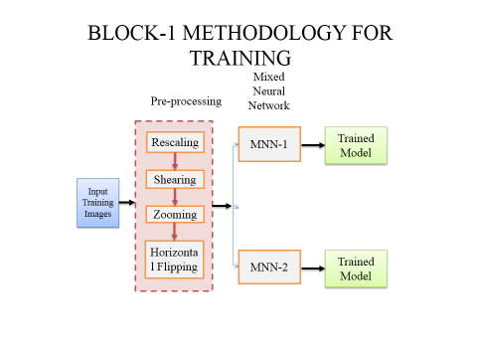

Slide 12
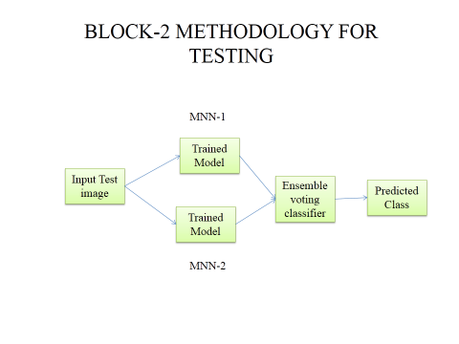

Slide 13
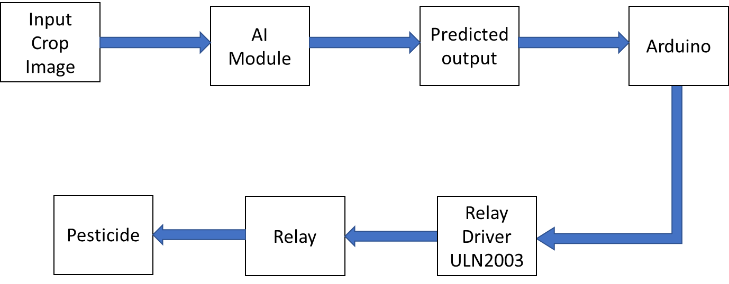
Block-3 AI with Embedded System

Slide 14
REFERENCE
Umit Atilaa, Murat Uçarb, Kemal Akyolc, and Emine Uçar, "Plant leaf disease classification using EfficientNet deep learning model," Ecological Informatics, vol.61, Article 101182, March 2021
M.Akila and P.Deepan, "Detection and Classification of Plant Leaf Diseases by using Deep Learning Algorithm," International Journal of Engineering Research & Technology (IJERT), SSN: 2278-0181, 2018
Srdjan Sladojevic, Marko Arsenovic, Andras Anderla, Dubravko Culibrk, and Darko Stefanovic, "Deep Neural Networks Based Recognition of Plant Diseases by Leaf Image Classification," Hindawi Publishing Corporation Computational Intelligence and Neuroscience, vol. 2016, Article ID 3289801, 2016
S. B. Patil and S. K. Bodhe, “Leaf disease severity measurement using image processing,” International Journal of Engineering and Technology, vol.3, no.5, pp.297–301, 2011.
P. Revathi and M. Hemalatha, “Identification of cotton diseases based on cross information gain deep forward neural network classifier with PSO feature selection,” International Journal of Engineering and Technology, vol.5, no.6, pp.4637–4642, 2014

Slide 15
CONCLUSION
In this project, a Hybrid Ensemble deep learning technique based architecture has been proposed for robust detection leaf disease. This architecture adopts an enhanced mixed neural network that is interconnected with series of skip pathway. The multi-stage approach overcomes the limitation of some deep convolutional networks in producing coarsely segmented outputs when processing challenging crop images. In this approach, the whole network is divided two MNN (mixed neural network) architectures for training,. A new method is devised to classify leaf diseases based on the results from the ensemble voting classifier. It also aims at developing an efficient system that can meet up with real time leaf disease diagnosis task.

