Slide 1
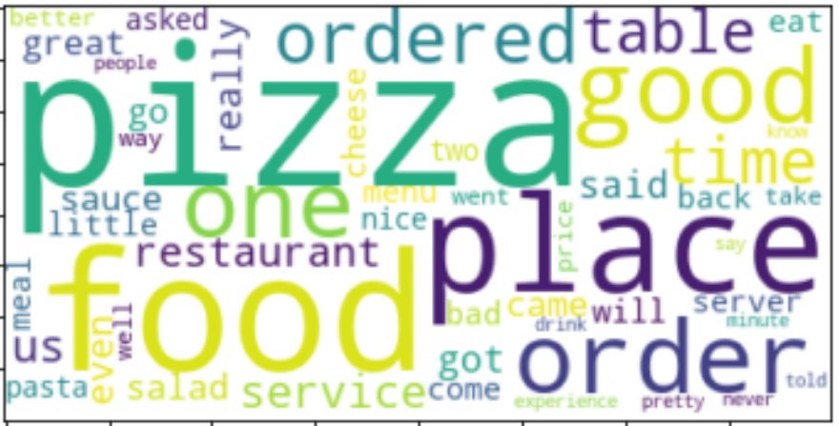
YELP MARKETING ANALYSIS ON RESTAURENT CATEGORIES

Slide 2
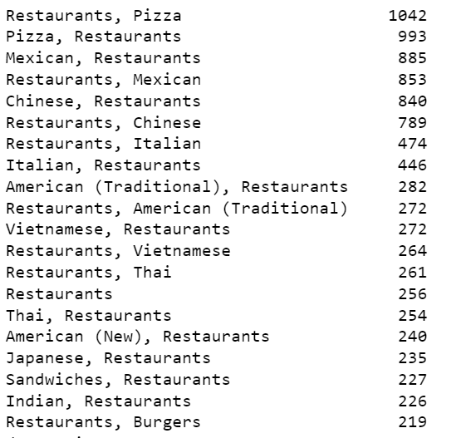
Various Categories Inspected (w.r.t Reviews count)

Slide 3
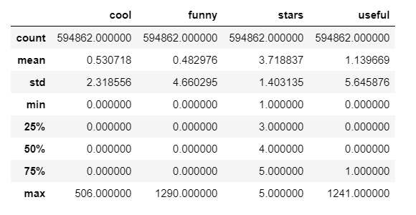
Percentage of Reviews received for Restaurants

Slide 4
ANALYSIS ON THE RESTAURENT CATEGORIES AND THEIR RATINGS
From the above analysis, we could assume that the Good reviews could be considered on 5 Star rating,
whereas the Poor rating could be the rating bellow 4 stars
From the analysis, its proved that 5 most preferred category of Restaurant cuisine are;
Pizza (1993 Reviews)
Mexican (1790 Reviews)
Chinese (1600 Reviews)
Italian (900 Reviews)
American (500 Reviews)
As Most reviews are centered to Pizza, lets restrict our Analysis to Pizza Restaurants and find the Wordlist for it…

Slide 5
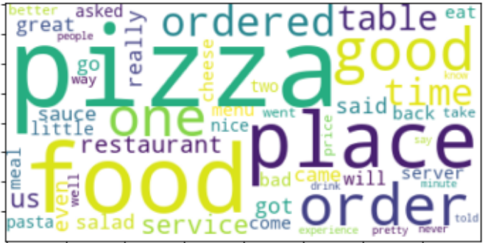
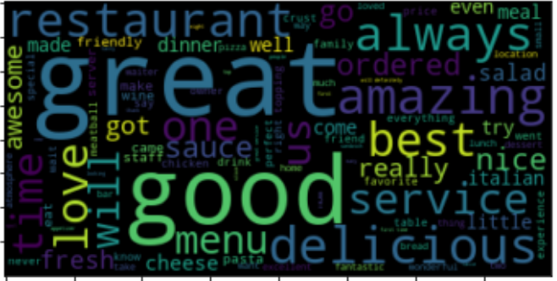
MOST FREQUENTLY USED WORDS IN REVIEWS ARE

