Slide 1
Control Structure

Slide 2
Introduction
Control structure statements specify the order in which tasks are executed in a programming language
Control structures are constructs or statements that determines the flow or order of execution of a program.

Slide 3
Types of control structure
Sequential Structure
Selection Structure
They are:
If statements
Single statement or option
Double statements or option (IF...ELSE)
Nested-If
Compound IF or if...else...if
Switch-Case
Iterative/Repititive/Loop
Pre-condition
For...loop
While...loop
Post-condition
Do...while

Slide 4
If statement
The if statement is executed when its condition evaluates to be true, otherwise it is ignored.
Syntax:
if (condition)
{
statement1;
statement2;
}
or
if (condition)
statement;

Slide 5
if else statement
This statement is used for deciding statement to execute between two sequences of statements.
Syntax
For multiple option
if (condition)
statement1;
else
statement2;

Slide 6
if else statement
Syntax:
or
if (condition)
{
statementa1;
statementan;
}
else
{
statementb1;
statementbm;
}

Slide 7
Example
Write a C++ program that determines the maximum number between two integers input by the user.

Slide 8
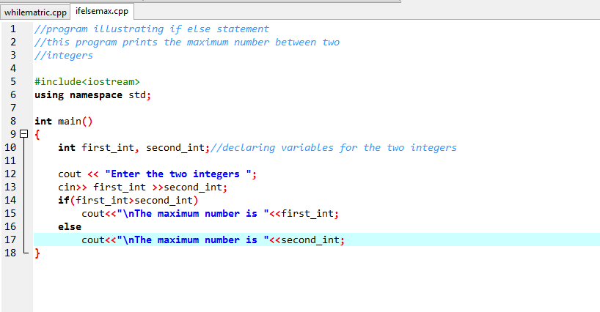
Example

Slide 9
if else if statement OR compound if
This is for deciding between two or more blocks based on multiple conditions.
Syntax
if (condition)
{
statementa1
statementa2
}
else if (condition)
{
statementb1
statementb2
}
else if (condition)
{
statementc1
statementc2
}

Slide 10
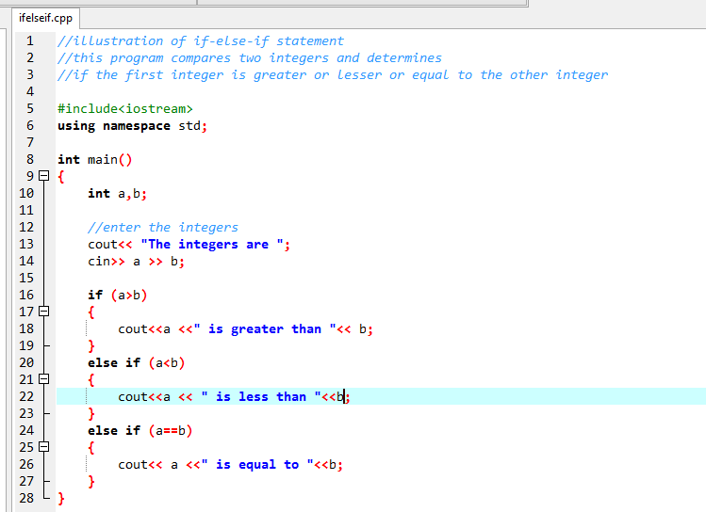
Example on if else if

Slide 11
Classwork/assignment
Write a C++ program that determines the maximum number among three integers.
Write a C++ program that determines the maximum number among five integers.

Slide 12
switch-case
The switch statement allows for multiple branching, based on the test of an expression against a list of constants
The format is shown below:
switch (expression) { case const-expr:
statements;
break; case const-expr:
statements;
break;

Slide 13
Switch-case
Switch-case is a cleaner way of expressing an if-else-if statement.
break is used to get out of the switch statement.
If break is omitted, program execution falls-through from one block to the next.

Slide 14
Loop
Loop executes certain statements while certain conditions are satisfied.

Slide 15
while loop
The while loop executes certain statements as long as the condition is met.
Syntax:
initialize the condition variable
while (condition)
{
statement1;
statementn;
incrementization_statement;
}
Note that the curly braces are not needed if there is only a single statement.
Note that the variable used for the condition will be initialized before the while statement.

Slide 16
Example
Write a C++ program to print out only even matric numbers of students offering COSC112. (Hint there are 100 students offering COSC112)

Slide 17
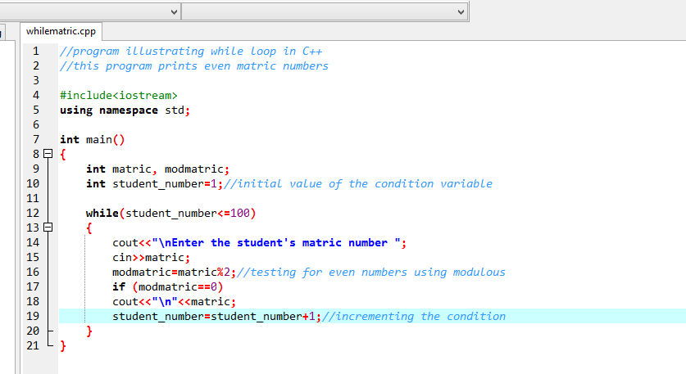
Example

Slide 18
Using a Sentinel Value
The user can be allowed to keep entering the loop until he enters a special value that signals that he’s done.
This special signal value is called a sentinel value.
It is also known as flag or signal value.
Its for indicating the end of data entry.
It can also be used when the user does not know the number of variables to be entered. This means when the repetition is indefinite.
The sentinel value must not be a legal value for the problem at hand. For example, we can’t use 0 (zero) as the sentinel value for an exam score.

Slide 19
Lab/Classwork
Write a C++ program to calculate the average grade of 30 students in a course.
Write a C++ program to calculate the average grade of students in offering COSC112.

Slide 20
do…while loop
Irrespective of the condition, the statements are executed in the first iteration.
Before the second iteration the condition will be evaluated, if it is true the statements will be executed the second time.
If not it will get out of the loop.

Slide 21
do…while loop
Syntax:
initialize the condition variable
do
{
statement1
statementn
} while (condition);
Note that the statements will always be in curly braces even if it is a single statement.
In addition, the while ends with a semicolon, unlike the while loop.
Note that the variable used for the condition will be initialized before the do…while statement.

Slide 22
for loop
It is a specialized version of WHILE.
Its for repeating execution of statements a specific number of times.
Syntax:
for(initialization; condition; incrementation)
{
statement1
statement2
}
Note that the for statement, like while tests the condition before the first iteration.

Slide 23
Example
Write a C++ program that outputs “Hello World” n number of times using the for loop.

Slide 24
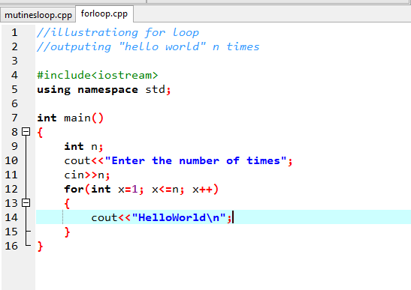
Example

Slide 25
Class/Labwork
Write two C++ programs with one using for loop and the other while loop to print odd numbers between 500 and 10000.

Slide 26
Nested control structure
Nested control structure involves placing if…else statement inside another if…else statement or placing loop inside another loop. This allows more complicated program behaviours.

Slide 27
Nested if statement
This is a multiple selection structure using dependent conditions.
An application that will educate secondary school students on admission process
WAEC
jambScore
Post UTME
Age
NESTED IF statement: this is when there is an IF … ELSE statement inside an IF statement or an IF THEN statement.

Slide 28

An application that will educate secondary school students on admission process
WAEC
jambScore
Post UTME
Age

Slide 29
Nested loop statement
As it is possible to place ifs inside of ifs, loops can also be placed inside of loops by simply placing these structures inside the statement blocks.

Slide 30
Example of Nested loop
Write a C++ program showing multiplication tables from 1 to12

Slide 31
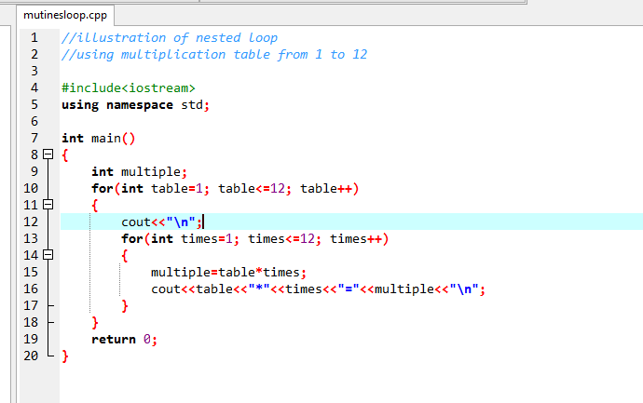
Example

Slide 32
Class/Labwork
Write a C++ program showing multiplication tables specified by the user.

Slide 33
Assignment
Write a C++ program that outputs “Hello World” n number of times using
while…loop
do…while
Write a C++ program that computes factorial of any number.

