Slide 2
Lecture 9
Software Defined Networks

Slide 3
OUTLINE
What is Computer Network
What is Computer Software
Background to Software Defined Network
Introduction to Software Defined Network
What is Software Defined Network
Principles of SDN
Advantages of SDN
How SDN Function

Slide 4
Computer Networks
Computer network, two or more computers that are connected with one another for the purpose of communicating data electronically and sharing of resources with each other.

Slide 5
Computer Software
Software is a set of instructions, data or programs used to operate computers and execute specific tasks. It is the opposite of hardware, which describes the physical aspects of a computer. Software is a generic term used to refer to applications, characters (scripts) and programs that run on a device. It can be thought of as the variable (adjustable) part of a computer, while hardware is the invariable part.

Slide 6
Background to Software Defined Networks
Traditional Networking uses hardware and software to direct traffic across a series of routers and switches to transmit data over a network. Software Defined Networks was originally designed to virtualize the network by separating the control plane that manages the network from traffic plane which the data flows.

Slide 7
Software Defined Networks Introduced
SDN changes how a networking is fundamentally done. Instead of having a network intelligence, in every router and switches, SDN centralizes the brain (the command and control) into a central node. This will be distributed into a central control and forwarding plane.

Slide 8
The forwarding plane, forwards the packets from one device to another, while the control plane routes the data to the correct traffic. These routing decisions are taken on basis of the routes configured on the router and also the routes learned from the adjacent nodes or adjacent routers.

Slide 9
What is SDN
It is a network architecture approach that enables the network to be intelligently and centrally controlled, or 'programmed,' using software applications.
SDN enables consistent management of the network, which may be made up of complex technology parts.

Slide 10
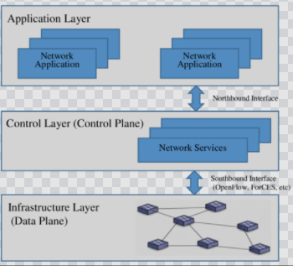
Figure 1. An overview of SDN Architecture. Source: www.google.csearch

Slide 11
Note that traditional network connect different networks using routers, it defines the best path to route data from computer A to computer B. They follow Open Shorter Path First (OSPF) protocol method. They also follow the actual data packet to the next device based on the address of the destination machine, this function is performed by the data plane.

Slide 12
SDN separates the functions of the control plane and the data plane. The data plane is managed by forwarding Packets to the next layer, while the control plane is managed by the controller.
SDN identifies the routes, using open flow Application Programing Interface (API).
Developer write an application that control the traffic for both audio and video apps, which enables it to run on any system or machine.
SDN abstracts the lower layer network from the upper layer network (Application Layer)

Slide 13
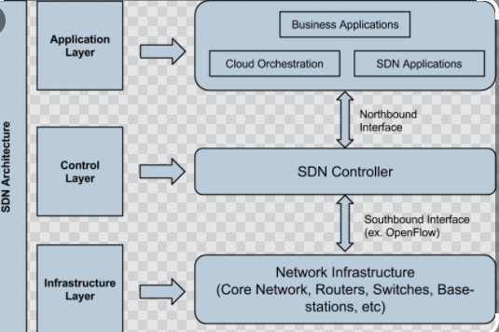
Figure 2. Expanded SDN Architecture showing How SDN will change the future NW

Slide 14
Principles of SDN
It makes the networking & IP Routing flexible
Decoupling control & Data Plane: It enables packets to reach its destination, It does same with helping software & dynamic algorithms with full flexibility and Agility instead of wasting many days in performing its function
Offloads brain to centralized controller
Central View of Resources: Used in resource allocation and keeping of end to end eye on network services.
Programmable network are centrally managed: The true power of SDN is Abstraction, the whole logic flow is so automated that network applications can make requests to SDN controller which in turn will adjust the network resources, change the configurations all in a one network.

Slide 15
Advantages:
More dynamic Network
Centralized network provisioning
Consistent and timely content delivery.
Holistic enterprise management.
For better security.
Hardware savings and reduced capital expenditures.
Lower operating costs.

Slide 16
Disadvantage:
Complete Network Short down: Since Networks are centrally managed, If there is a fault from the central point of connection, the entire network will be down.

Slide 17
SDN is making IP network much more programmable so that packets routing is possible with lots of flexibility and agile. It is based on concept of programmatic and dynamic control of Network. SDN is a powerful tool for customizing network to the next level.

Slide 18
Through SDN new bandwidth and defined traffic flow just like never before. SDN is about networking control function for routing policy definition through automation. With SDN IP & Networking reachability is going to happen well on time. SDN provides a new level of programmability and abstraction to Network layer which is a phenomenal role in automating the networks.

Slide 19
How does SDN work and how it is helping?
For network to reach its destination, we need multiple things such as the IP allocation, Bandwidth allocation, Policy opening, routing changes and end to end reachability. All these take a lot of time. Preparing, designing, executing the changes we need to do in each router and switches are not easy. They are prone to mistakes and take days even weeks, to avoid these challenges SDN is needed.

Slide 20
SDN changes how a networking is fundamentally done. Instead of having a network intelligence, in every router and switches, SDN centralizes the brain (the command and control) into a central node. This will be distributed into a central control and forwarding plane.

Slide 21
The forwarding plane forward the packets from one device to another, while the control plane routes the data to the correct traffic. These routing decisions are taken on basis of the routes configured in the router and also the routes learned from the adjacent nodes or adjacent routers.

Slide 22
Difference between Control Plane & Data Plane
S.N | CONTROL PLANE | DATA PLANE
01. | Control plane refers to the all functions and processes that determine which path to use to send the packet or frame. | Data plane refers to all the functions and processes that forward packets/frames from one interface to another based on control plane logic.
02. | It is responsible for building and maintaining the IP routing table. | It is responsible for forwarding actual IP packet.
03. | Control plane responsible about how packets should be forwarded. | Data plane responsible for moving packets from source to destination.
04. | Control plane performs its task independently. | Data plane performs its task depending on Control plane.
05. | In general we can say in control plane it is learned what and how it can be done. | In general we can say in data plane the actual task is performed based on what is learned.

Slide 23
Difference between Control Plane & Data Plane
S/N | CONTROL PLANE | DATA PLANE
06. | Control plane packets are processed by router to update the routing table. | The forwarding plane/data plane forwards the packets based on the built logic of control plane.
07. | It includes Spanning Tree Protocol (STP) Address Resolution Protocol (ARP) Routing Information Protocol (RIP), Dynamic Host Configuration Protocol (DHCP)etc. | It includes decrementing Time To Live (TTL), recomputing IP header checksum etc.
08. | Control plane packets are locally originated by the router itself. | Data plane packets go through the router.
09. | Control plane acts as a decision maker in data forwarding. | Data plane acts as a decision implementer in data forwarding.
10. | Routing is performed in the control plane. | Switching is performed in the data plane.

Slide 24
Discussion Questions
What is your understanding about Software Defined Network (SDN)?
What are the functions of the Control Plane (CP) and Data Plane (DP) in SDN?
How is SDN different from a normal network?
What on four (4) advantages of SDN
What is the likely drawback of SDN?

Slide 25
THE END

