Slide 1
DATA COMMUNICATION AND COMPUTER NETWORKS
Lecture 1
Course Lecturer: Dr Alao O.D
Email adr: jimialao@hotmail.com

Slide 2
QUIZ
1. What is the rationale for networking a set of
PC .
2. Mention and describe five standards
organizations in the field of computer
networking .

Slide 3
Course Description and Rationale
This module assumes no prior knowledge of networks although it is possible that some students may have some basic understanding.
The module starts from initial principles and network types and then develops greater understanding of computer networks.

Slide 4
Learning Outcomes: Upon completion of
this module, students should be able to:
Have a comprehensive description on computer networks, from underlying physical layer up to application layer and today’s most popular network applications.
Identify and use internetworking, broadband, electrical interface, and data transmission concepts

Slide 5
Course Requirements
Regular class attendance and active participation in class
Assignment requiring students to study and produce a simple documented write-up on a particular area of the subject coverage.
Design Project
Quizzes
Mid-semester examination
Final Semester examination
Recommended Textbook
Grading
The following assessments and grading system as prescribed by the University will
apply:
Attendance =5%
Assignments =10%
Quizzes =10%
Mid-Semester Exam =15%
Final Exam = 60%

Slide 6
Tentative Teaching Schedule
(Scheduled topics are subject to changes to enhance understanding and more effective course delivery)
PART 1
Topic 1: Network Fundamentals, Network Requirements and Concepts
Topic 2: Network Topologies
Topic 3: Networking Technologies: Ethernet, Token Ring
Topic 4: Connectivity Devices :Hubs, Switches, routers and Brigdes
Topic 5: Transmission Mediums
Topic 6: OSI Model ,TCP/IP Architecture
Topic 7: IP addressing
Topic 8: Network protocols standards
Topic 9: Network Security
PART 2
Telecomunication

Slide 7
Recommended Textbook
Introduction to Computer Networks and Telecommunications
By
Alao Olujimi
Jonah V Joshua
Ibironke A Ajayi

Slide 8
TOPIC 1: Network Fundamentals
Networking like any other technical
discipline has a language of its own.
To master any technology, the
language used to describe that
technology needs to be understood

Slide 9
1.0 Networking Terminology
Packets
A packet is a unit of data sent across a network
Size : ranges from 1,000 to 1,500 bytes.
also known as a datagram
contains addressing and handling information on how data should be sent over the network
contents of a packet depend on the network protocol used.

Slide 10

Figure 1-1: A data packet carries information.

Slide 11
What is a computer network?
A group of computers that are connected together to communicate and share resources such as files, printers, and email.
include
network media such as a cable to carry network data,
network adapter to translate data between a computer and the
network media,
network operating system to enable a computer to recognize
the network,
network protocol to control the network communications.

Slide 12
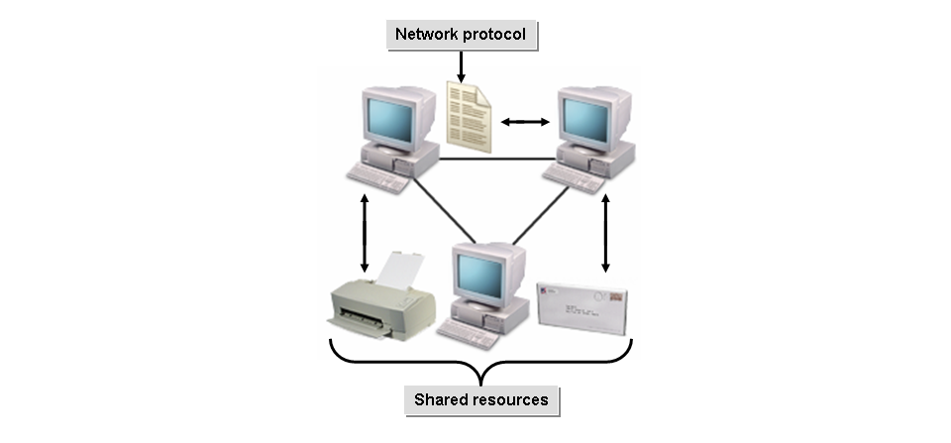
Figure 1-2: A network of various resources.

Slide 13
Servers
A server is a network computer that shares resources with and responds to requests from other network computers, including other servers.
provide centralized access and storage for resources.
provide specialized services such as email.
can be optimized and dedicated to one specific function, or it
can serve general needs.
Multiple servers can exist on a single network.

Slide 14
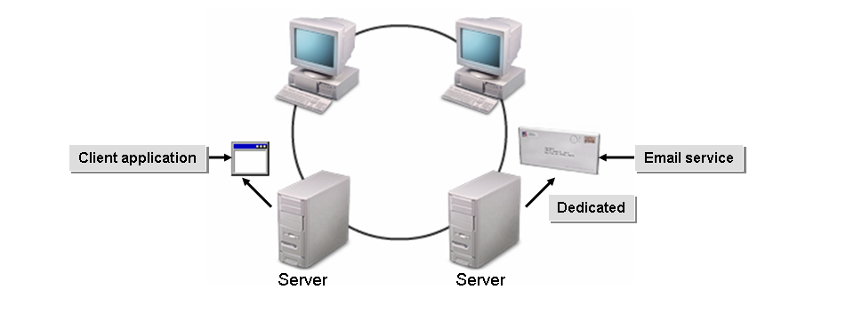
Figure 1-3: Servers provide various services to other resources.

Slide 15
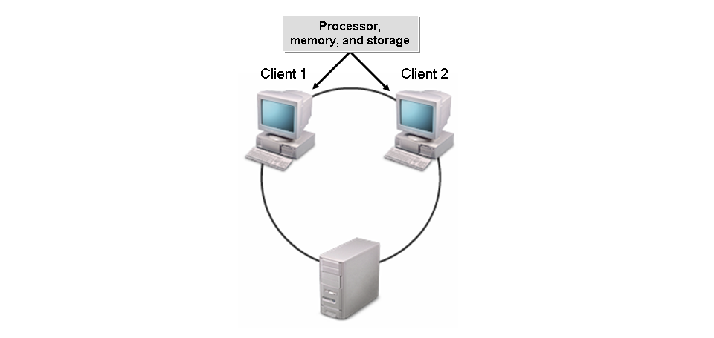
Clients
A client is a network computer that utilizes the resources of other
network computers, including other clients.
It has its own processor, memory, and storage.
It can maintain some of its own resources and perform its own
tasks and processing.

Slide 16
Server Categories
Servers can be categorized into many types based on their
functionality.
Web server
A web server is a server computer on the Internet that stores
and distributes web content and other resources to web
clients.
File server
A file server stores programs and data files shared by users.

Slide 17
Print server
A print server enables many network users to share printers. It
can either be part of the network operating system (NOS) or
an add-on utility that stores the print-image output from
users’ machines and feeds it to the printer, one job at a time.
Mail server
A mail server provides “post office” facilities by storing
incoming mail for distribution to users and forwards outgoing
mail

Slide 18
Fax server
A fax server provides a bank of fax modems. It may be a
dedicated machine or implemented on a file server that
provides other services.
Application server
An application server performs data processing in a
client/server environment. The difference between a file
server and an application server is that the file server stores
the programs and data, while the application server runs the
programs and processes data.

Slide 19
Database server
A database server holds the Database Management System
(DBMS) and databases. It is dedicated to data storage and
retrieval and is a key component in a client/server
environment.

Slide 20
Peers
A peer is a self-sufficient computer that acts both as a server and a client to other similar computers on the network. Peer computing is often used on smaller networks with no dedicated central server.
Host Computers
A host computer is a powerful, centralized computer system, such as a mainframe computer, that performs data storage and processing tasks on behalf of clients and other network devices. On a host-based network, the host computer does all the computing tasks and returns the resultant data to the end user's computer.

Slide 21
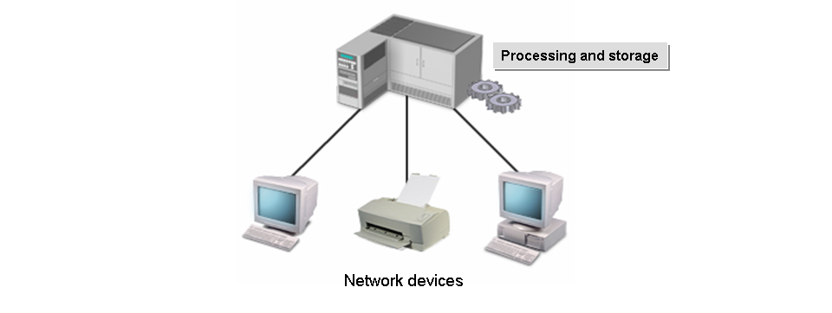
Figure 1-6: A host computer performs tasks for other resources.

Slide 22
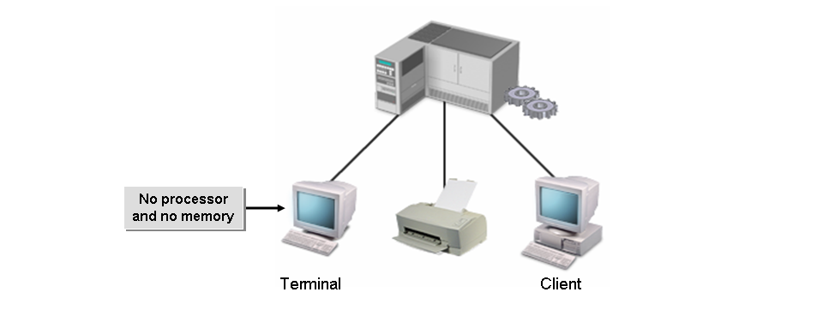
Terminals
A terminal is a specialized network device on a host-based network that transmits data entered by a user to the host for processing and displays the results. Terminals are often called “dumb” because they have no processor or memory of their own.
Figure 1-7: A terminal on a network.

Slide 23
Network Operating Systems
A network operating system (NOS) is the software that controls a network, allows multiple users to access files, and performs important operations such as securing and connecting computers and devices to the network.
Common Network Operating Systems
Windows Server 2008: Microsoft's Windows Server 2008 is built on the Windows NT 6.0 and is the successor to Windows Server 2003.
UNIX: UNIX is a trademark for a family of operating systems originally developed in the early 1960s at Bell Laboratories.
Linux: Linux is an open-standard UNIX derivative originally developed and released by Linus Torvalds, a Finnish computer science student.

Slide 24
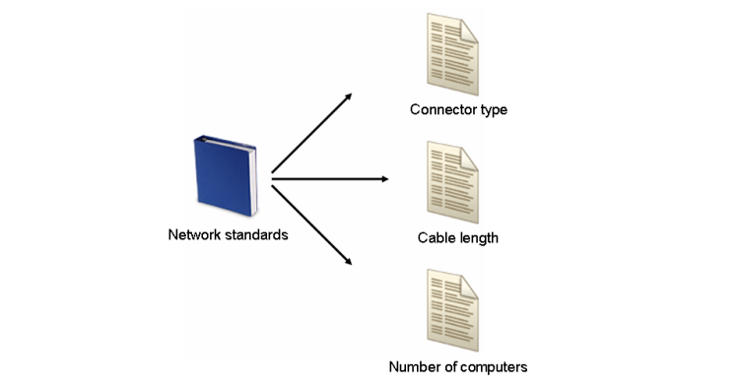
Networking Standards
A networking standard is a set of specifications, guidelines, or characteristics applied to network components to ensure interoperability and consistency among the components. Networking standards determine everything from the size, shape, and type of connectors on network cables to the number of computers that can be attached to a network.
Figure 1-9: Network standards specify the characteristics of network
components.

Slide 25
Standards Organizations
International Organization for Standardization (ISO):The largest standards development body in the world, comprising the national standards institutes of 148 countries
Institute of Electrical and Electronics Engineers (IEEE):is an organization dedicated to advancing theory, technology, and standards in electrical sciences
American National Standards Institute (ANSI):is the national standards institute of the United States
Telecommunications Industry Association (TIA) and Electronic Industries Alliance (EIA): accredited by ANSI to jointly develop and issue and standards for telecommunications and electronics.
Internet Engineering Task Force (IETF):IETF develops and maintains the Internet standards and contributes to the evolution and smooth operation of the Internet..

Slide 26
Part 2
Network Fundamentals 2

Slide 27
Network Building Blocks
The primary building blocks that are used to construct networks are describe as follows:
Nodes
A node is any network device that can connect to the network and can generate, process, or transfer network data. Every node has at least one unique network address.
Network nodes can either be endpoints or redistribution points. Endpoints are nodes that function as the source or destination of data. Redistribution points are devices, such as network hubs or routers, that are used to transfer data

Slide 28
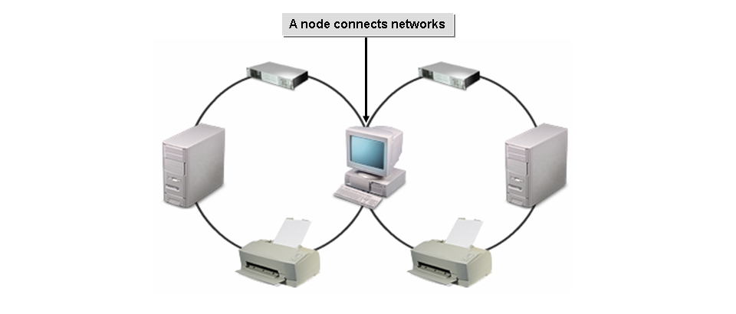
A network with multiple nodes.

Slide 29
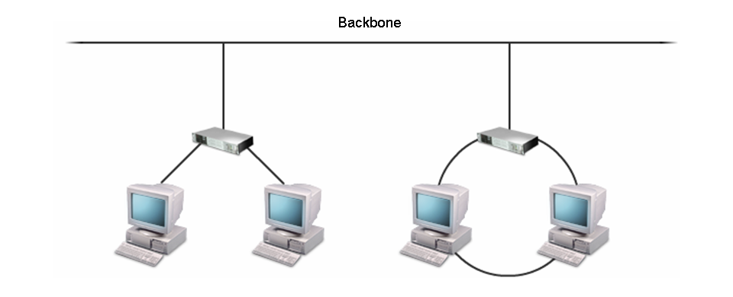
The Network Backbone
The network backbone is the high-speed transmission path that carries majority of the network data. It can connect small networks together or server
nodes to networks.
The backbone carries network data.

Slide 30
Others Network building block components are
Hubs
Switches
Routers
Bridges
N.B : more on this later (Connectivity Devices)

Slide 31
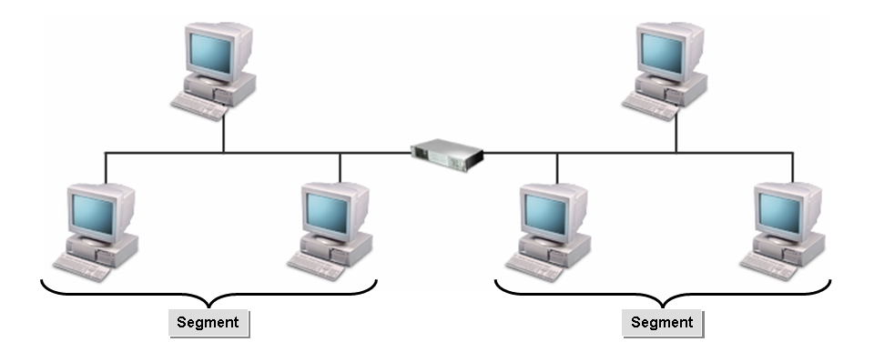
Segments
A segment is any discrete physical subdivision of a network. It is bounded by physical internetworking devices such as hubs, switches, and routers.
Segments on a network.

Slide 32
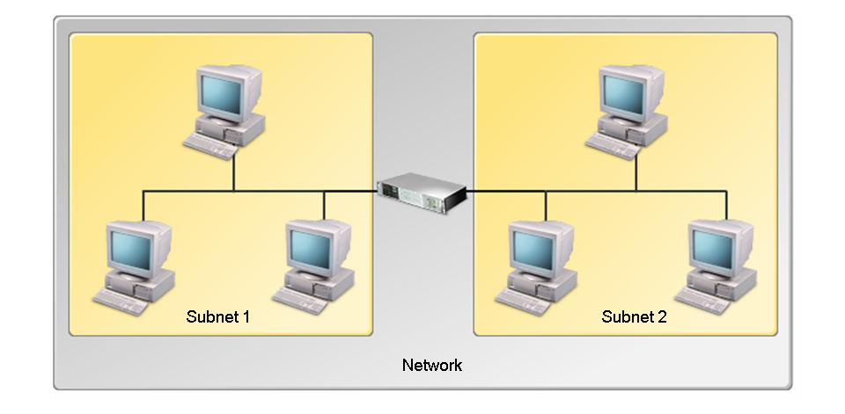
Subnets
A subnet is a portion of a network that shares a common network address. The subnet can be on a separate physical network segment, or it can share segments with other logical subnets.
A network with different subnets.

Slide 33
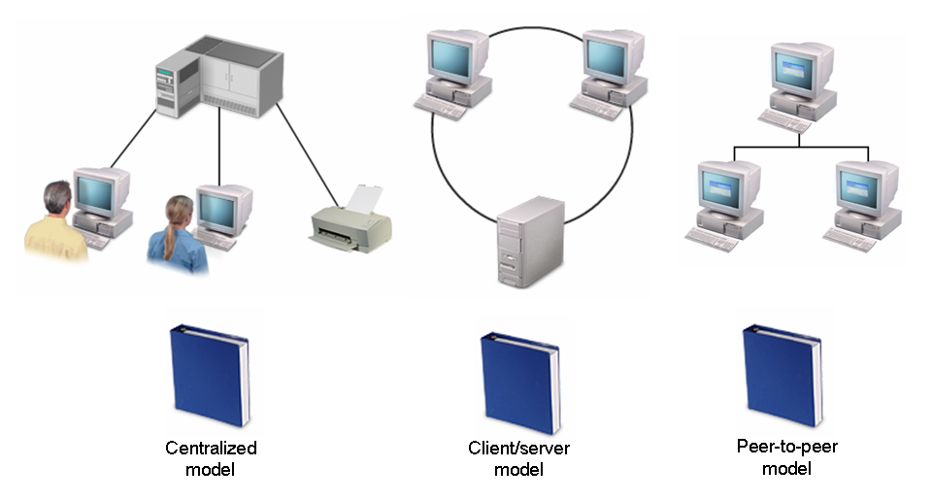
Standard Network Models
A network model is a design specification of how nodes on a network interact and communicate. The network model determines the degree to which communication and processing are centralized or distributed.
Different types of network models.

Slide 34
Centralized Networks
A centralized network is a network in which a central host computer controls the entire network communication and performs data processing and storage on behalf of clients.
Users can connect to the host
Centralized networks provide high performance and centralized management,
they are expensive to implement
Client/Server Networks
A client/server network is a network in which servers provide services to clients
Peer-to-Peer Networks
A peer-to-peer network is a network in which resource sharing, processing, and communication control are completely decentralized.

Slide 35
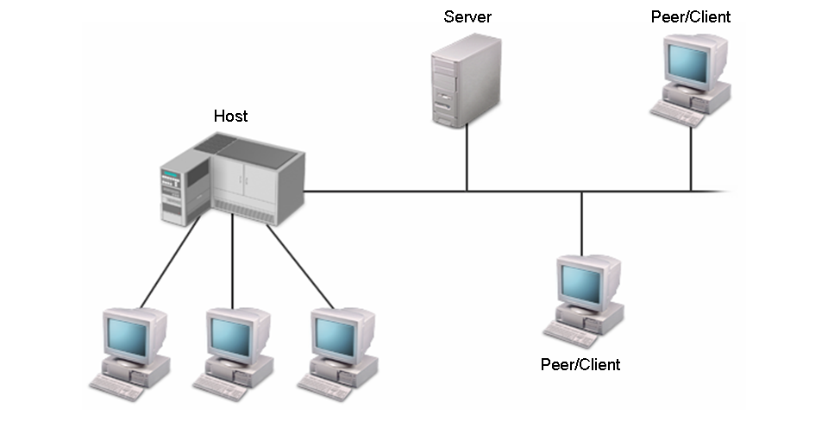
Mixed Mode Networks
A mixed mode network is a network that incorporates elements from more than one of
the three standard network models.
A network containing different models

Slide 36
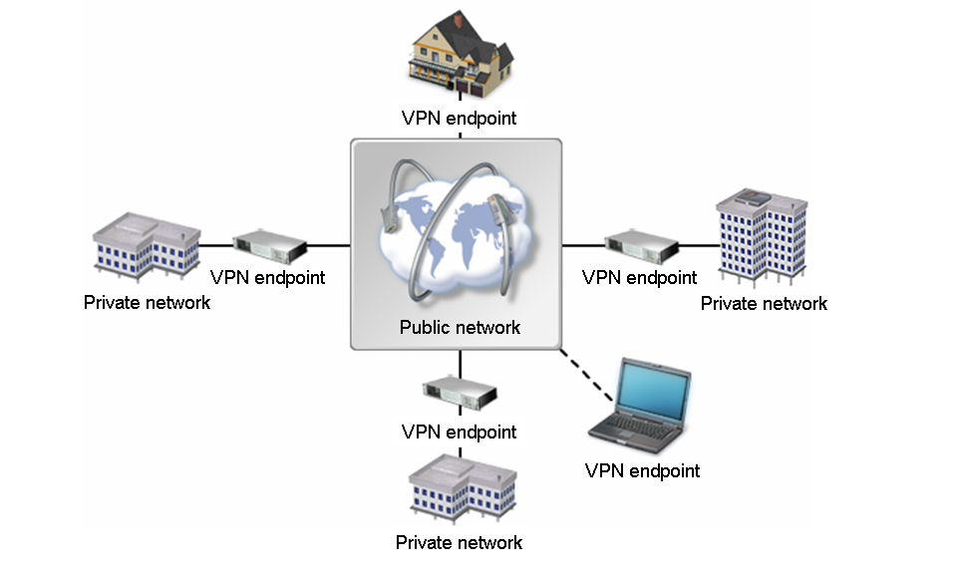
Virtual Private Networks
A Virtual Private Network (VPN) is a private network that is configured
by tunneling through a public network such as the Internet
VPNs provide secure connections among endpoints, such as routers,
clients, or servers, by using tunneling to encapsulate and encrypt data.
Special protocols are required to provide the VPN tunneling, security, and data encryption services
A VPN connects various networks.

Slide 37
What is Tunneling?
Tunneling is a data-transport technique in which a data packet from one
protocol, called the passenger protocol, is transferred inside the frame or
packet of another protocol, called the carrier protocol.
This enables data from one network to pass from one endpoint of a tunnel
to the other through the infrastructure of another network.
VPN Advantages
Most companies implement VPNs because of the cost. The cost to
maintain a VPN is generally lower than that of other remote access
technologies
For instance, if a remote access technology depends on long-distance or
toll-free calls, a company's phone bill can become enormously expensive.

Slide 38
Network Categories
Companies can deploy different categories of networks depending on the
company's size and its need for communication.
The primary categories of networks are as follows:
Local Area Networks
A Local Area Network (LAN) is a self-contained network that spans a
small area such as a single building, a floor, or a room. In a LAN, all
nodes and segments are directly connected with cables or short-range
wireless technologies.

Slide 39
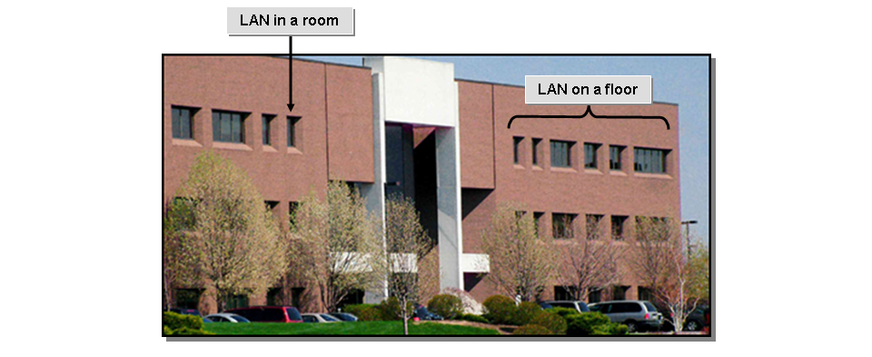
LANs in a building.

Slide 40

Wide Area Networks
A Wide Area Network (WAN) is a network that spans multiple geographic
locations. WANs typically connect multiple LANs using long-range transmission
media. However, a WAN may be built by interconnecting individual users as well.
A WAN containing many LANs.

Slide 41
Metropolitan, Campus, and Other Network Coverage Areas
There are several other network categories named according
to the geographic area they cover.
Network Category Description
MAN Metropolitan Area Network: covers an area equivalent to a city or any other
municipality.
CAN Campus Area Network: covers an area equivalent to an academic campus or a
business park.
A CAN is typically owned or used exclusively by a company, a school, or an
organization.
GAN Global Area Network: any worldwide network. The Internet is a GAN.
WPAN Wireless Personal Area Network: a network that connects wireless devices in very
close proximity, but not through a wireless access point.

Slide 42
Assignment 1 (due next week)
Write briefly on each of the following:
Network Directory
Network Operations Centre
Virtual LAN
Intranet
Extranet
Enterprise Network

Slide 43
THE END

Slide 44
QUIZ
1. What is an NIC use for?
2. List and describe five standards organizations in the field of computer networking
3. What is an application server.

