Slide 1

BOSTON HACKS 2018 Link: https://github.com/kaleketan07/TwiNotify
TwiNotify: A messaging service that broadcasts trending alerts

Slide 2
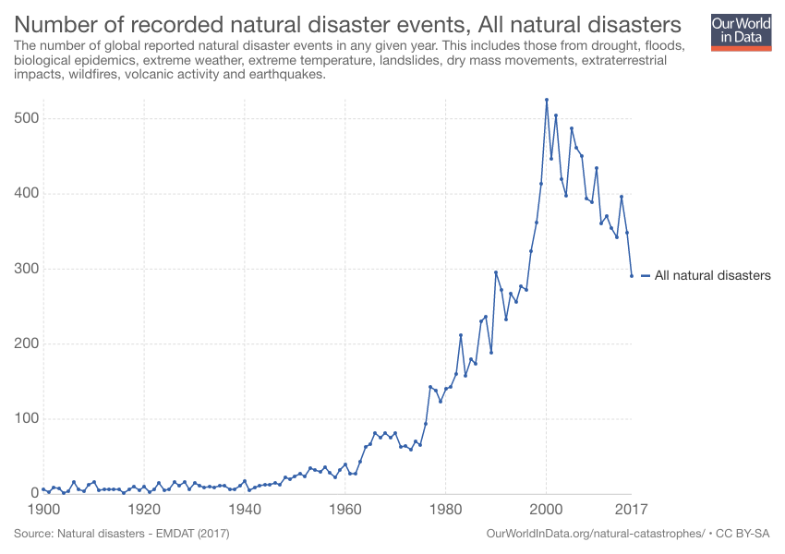
OPPORTUNITY

Slide 3
IMPACT:
Alerts despite of unreliable or poor internet connection
Provides information in a clear and concise manner

Slide 4
PROCESSING
Fetch
Fetch Tweets
Classify
Classify Tweets
Compute
Compute Top Relevant Tweets
Use
Use Twilio to broadcast messages

Slide 5
FETCH TWEETS
Twitter API
Publicaly available external dataset

Slide 6
CLASSIFICATION
1.6 million Tweets
Trained using Logistic Regression
~81% Accuracy

Slide 7
DEMO

Slide 8
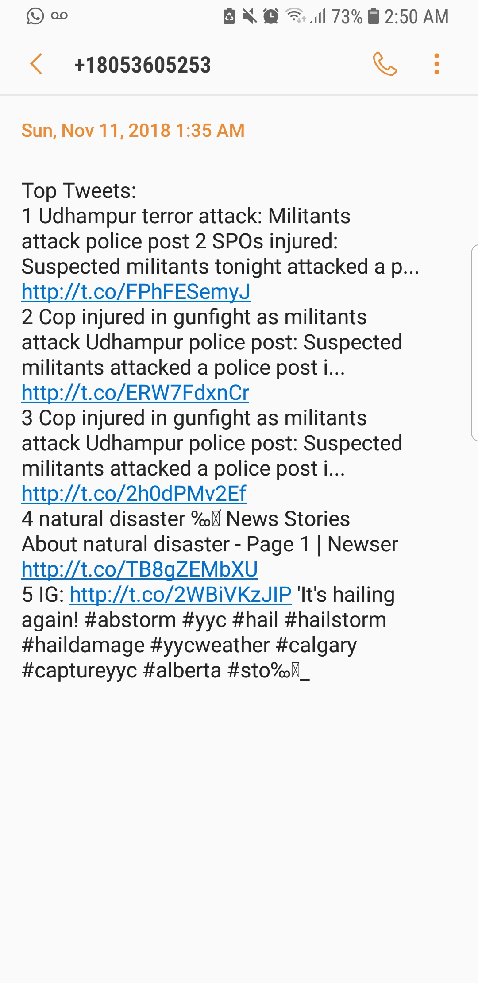
OUTPUT

Slide 9



TECHNOLOGIES

Slide 10
FUTURE SCOPE
Customize Subscription (Start and Stop)
Scope of the project
Geo-location based Subscription

Slide 11

THANK YOU! ANY QUESTIONS?
- Team TwiNotify

