Slide 1

BOSTON HACKS 2018 Link: https://github.com/kaleketan07/TwiNotify
TwiNotify: A messaging service that broadcasts trending alerts

Slide 2
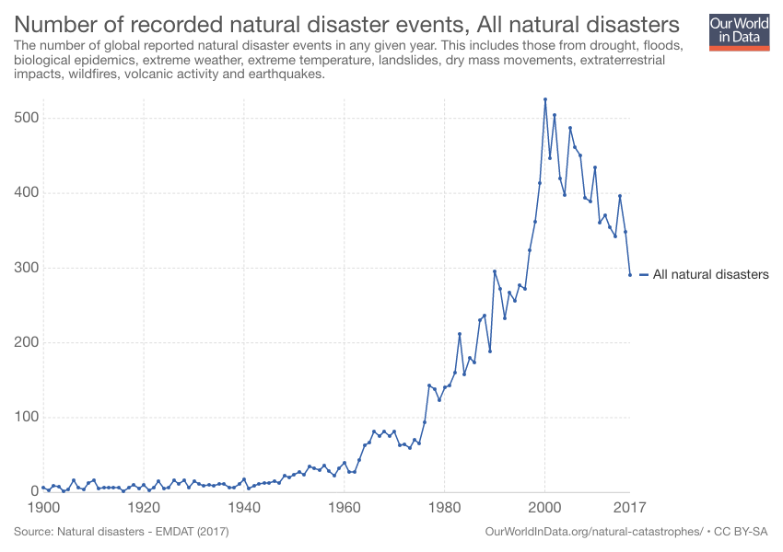
IMPACT

Slide 3
PROCESSING
Fetch
Fetch Tweets
Classify
Classify Tweets
Compute
Compute Top Relevant Tweets
Use
Use Twilio to broadcast messages

Slide 4
FETCH TWEETS
Twitter API
Publicaly available external dataset

Slide 5
CLASSIFICATION
1.6 million Tweets
Trained using Logistic Regression
~81% Accuracy

Slide 6
DEMO

Slide 7
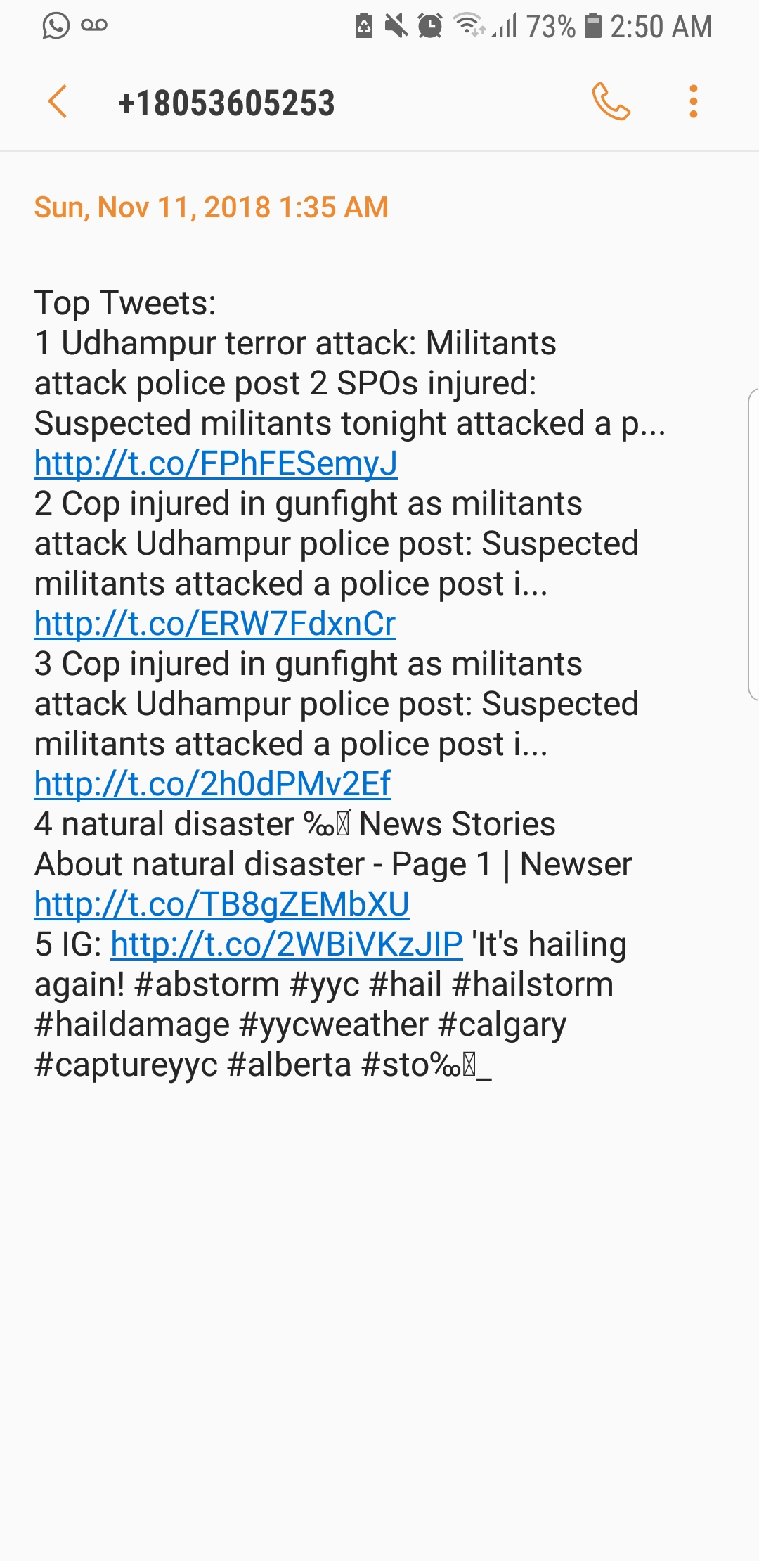
OUTPUT

Slide 8



TECHNOLOGIES

Slide 9
FUTURE SCOPE
Customize Subscription (Start and Stop)
Scope of the project
Geo-location based Subscription

Slide 10

THANK YOU! ANY QUESTIONS?
- Team TwiNotify

