Slide 1
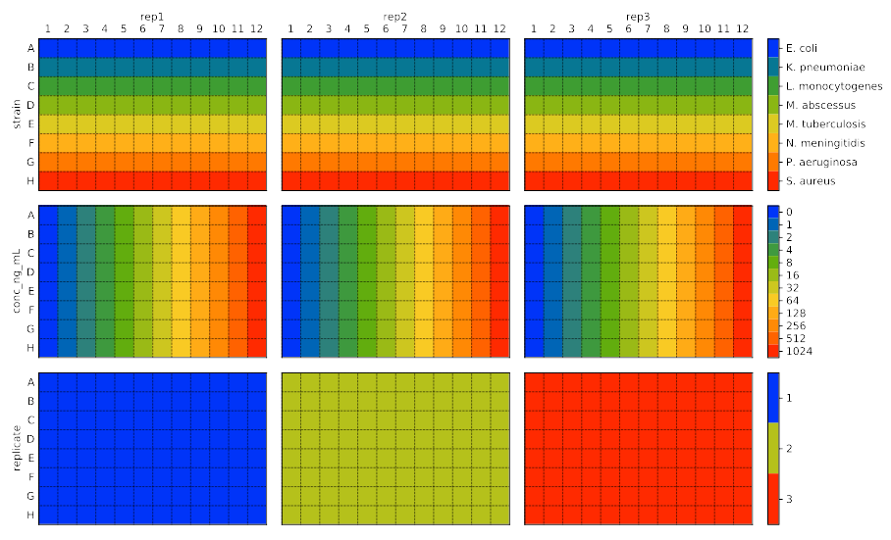
bio96 — File format for 96-well plate layouts

Slide 2
Plates are great for medium-throughput assays.
But it isn’t trivial to keep track of
what was in each well.

Slide 3
A good system should:
• Serve as a record of your experiment.
• Work with your analysis scripts.

Slide 4
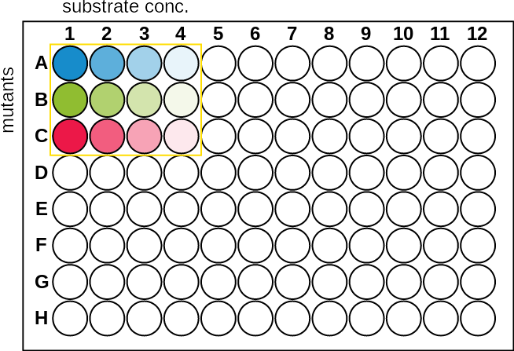
# my_expt.toml
[row.A]
mutant = ‘Y37A’
[row.B]
mutant = ‘E38A’
[row.C]
mutant = ‘T39A’
[col.1]
substrate_uM = 8
[col.2]
substrate_uM = 4
[col.3]
substrate_uM = 2
[col.4]
substrate_uM = 1
#!/usr/bin/env python3
import bio96
df = bio96.load('my_expt.toml')
print(df)
well well0 row col row_i col_j mutant substrate_uM
0 A1 A01 A 1 0 0 Y37A 8
1 A2 A02 A 2 0 1 Y37A 4
2 A3 A03 A 3 0 2 Y37A 2
3 A4 A04 A 4 0 3 Y37A 1
4 B1 B01 B 1 1 0 E38A 8
5 B2 B02 B 2 1 1 E38A 4
6 B3 B03 B 3 1 2 E38A 2
7 B4 B04 B 4 1 3 E38A 1
8 C1 C01 C 1 2 0 T39A 8
9 C2 C02 C 2 2 1 T39A 4
10 C3 C03 C 3 2 2 T39A 2
11 C4 C04 C 4 2 3 T39A 1

Slide 5
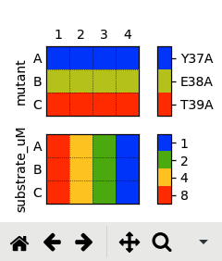
# my_expt.toml
[row.A]
mutant = ‘Y37A’
[row.B]
mutant = ‘E38A’
[row.C]
mutant = ‘T39A’
[col.1]
substrate_uM = 8
[col.2]
substrate_uM = 4
[col.3]
substrate_uM = 2
[col.4]
substrate_uM = 1
$ bio96 my_expt.toml

Slide 6
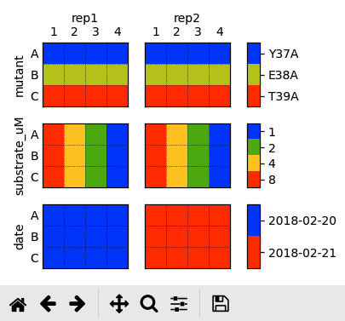
# my_expt.toml
[expt]
enzyme_nM = 100
[plate.rep1]
date = 2018-02-20
[plate.rep2]
date = 2018-02-21
[row.A]
mutant = ‘Y37A’
[row.B]
mutant = ‘E38A’
[row.C]
mutant = ‘T39A’
[col.1]
substrate_uM = 8
[col.2]
substrate_uM = 4
[col.3]
substrate_uM = 2
[col.4]
substrate_uM = 1
$ bio96 my_expt.toml

Slide 7
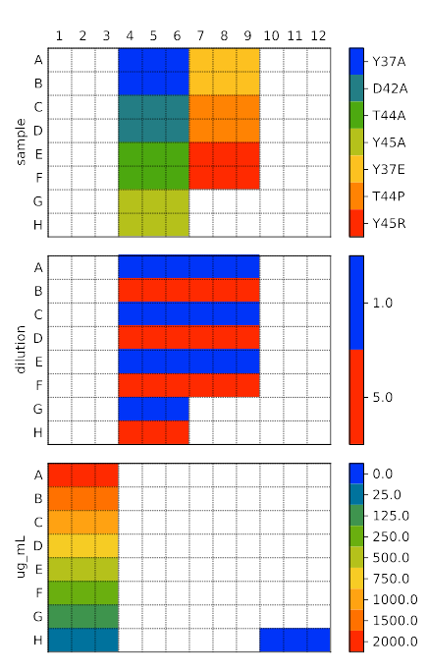
# bradford.toml
[meta]
include = 'standards.toml'
[bradford]
format = 'biotek'
absorbance = '595/450'
[block.3x2.A4]
sample = 'Y37A'
[block.3x2.C4]
sample = 'D42A'
[block.3x2.E4]
sample = 'T44A'
[block.3x2.G4]
sample = 'Y45A'
[block.3x2.A7]
sample = 'Y37E'
[block.3x2.C7]
sample = 'T44P'
[block.3x2.E7]
sample = 'Y45R'
[block.6x1.'A4,C4,...,E4']
dilution = 1
[block.3x1.G4]
dilution = 1
[block.6x1.'B4,D4,...,F4']
dilution = 5
[block.3x1.H4]
dilution = 5
# standards.toml
[block.3x8.A1]
standard = true
# See manual for "Pierce
# BCA Protein Assay Kit"
[block.3x1.A1]
ug_mL = 2000
[block.3x1.B1]
ug_mL = 1500
[block.3x1.C1]
ug_mL = 1000
[block.3x1.D1]
ug_mL = 750
[block.3x1.E1]
ug_mL = 500
[block.3x1.F1]
ug_mL = 250
[block.3x1.G1]
ug_mL = 125
[block.3x1.H1]
ug_mL = 25
[block.3x1.H10]
ug_mL = 0
standard = true

Slide 8
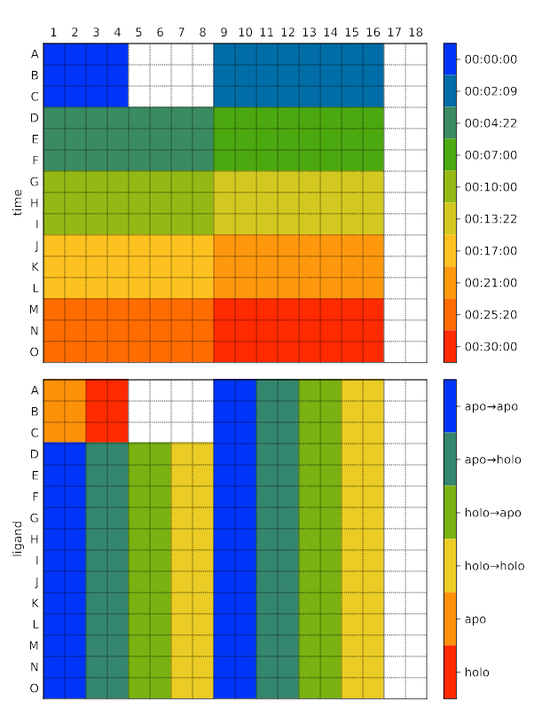
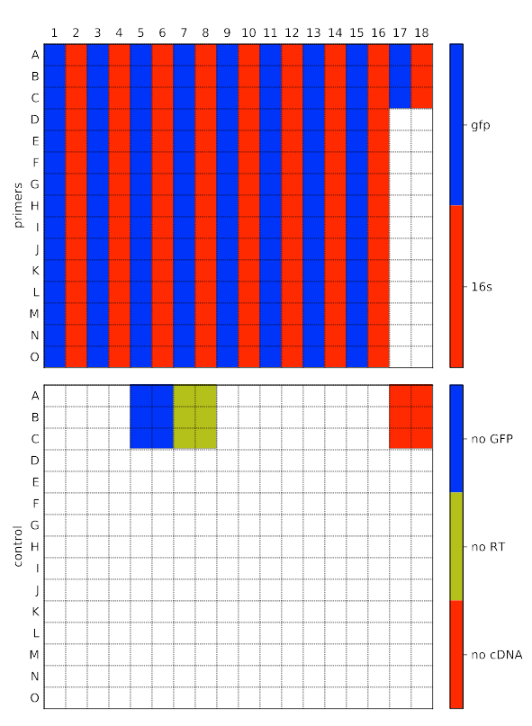

Slide 9
$ pip install bio96

