Slide 1
PROJECT_0118_KZ_LGS_NonCatPartsEntry

Slide 2
Project has two connected robots:
RPA_204_KZ_LGS_NonCatPartsEntryExtraction
RPA_205_KZ_LGS_NonCatPartsEntryProcess

Slide 3
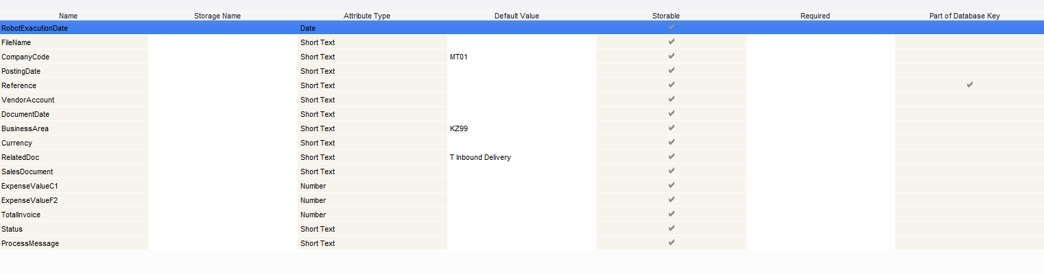
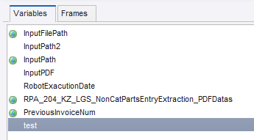
Type RPA_204_KZ_LGS_NonCatPartsEntryExtraction_PDFDatas

Slide 4
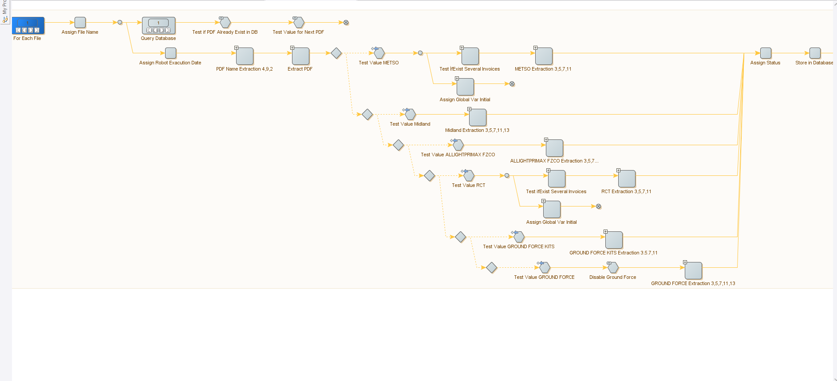
General look to extraction robot

Slide 5
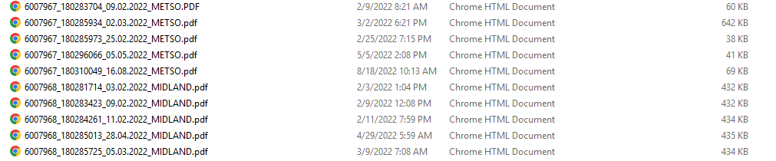
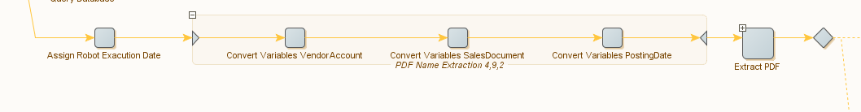
Values taken from PDF name

Slide 6
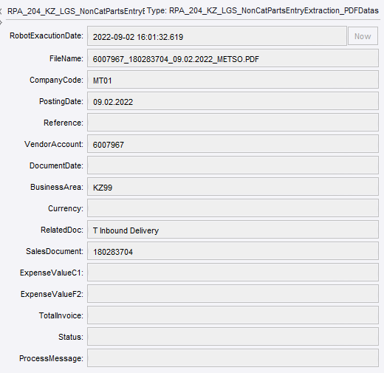
Type status after first extractions

Slide 7
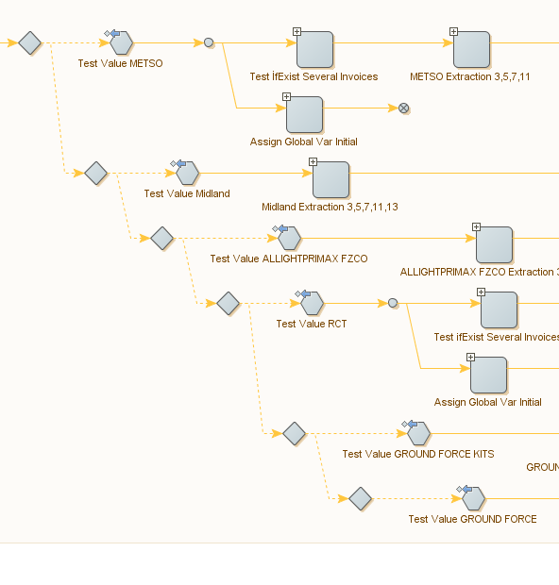
Try Steps to decide which PDF type to extract

Slide 8
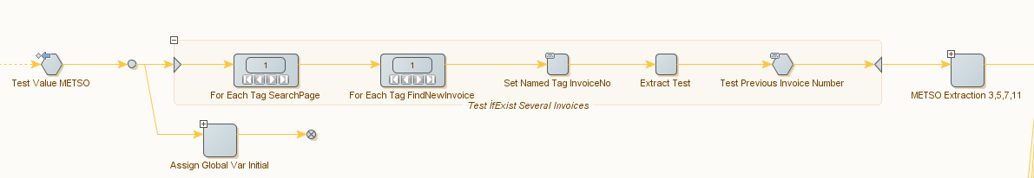
Test if PDF has several invoices in it

Slide 9
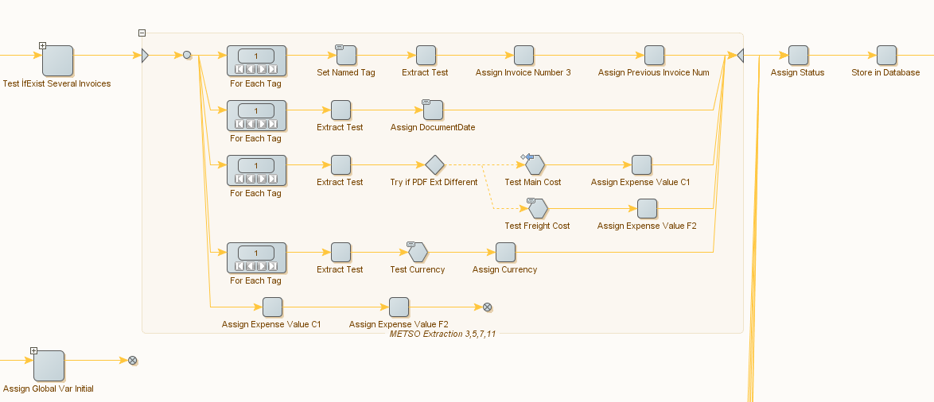
Pdf extraction

Slide 10
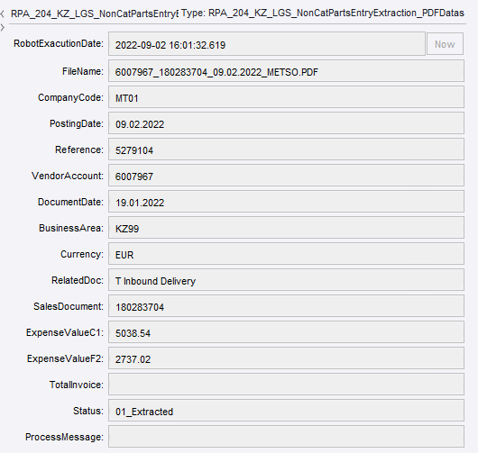
Type status after all extractions

Slide 11
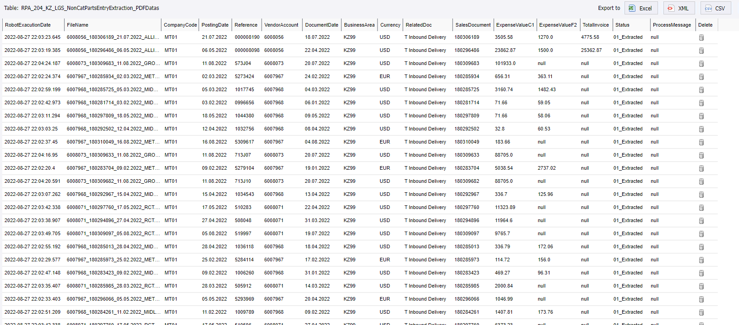
Store in Database

Slide 12
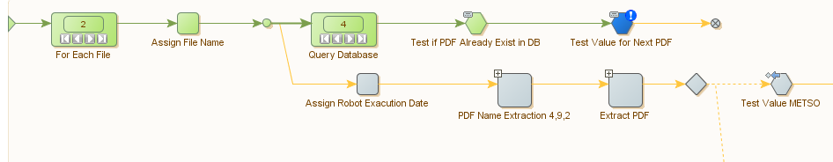
Prevent to extract one PDF multiple times

Slide 13
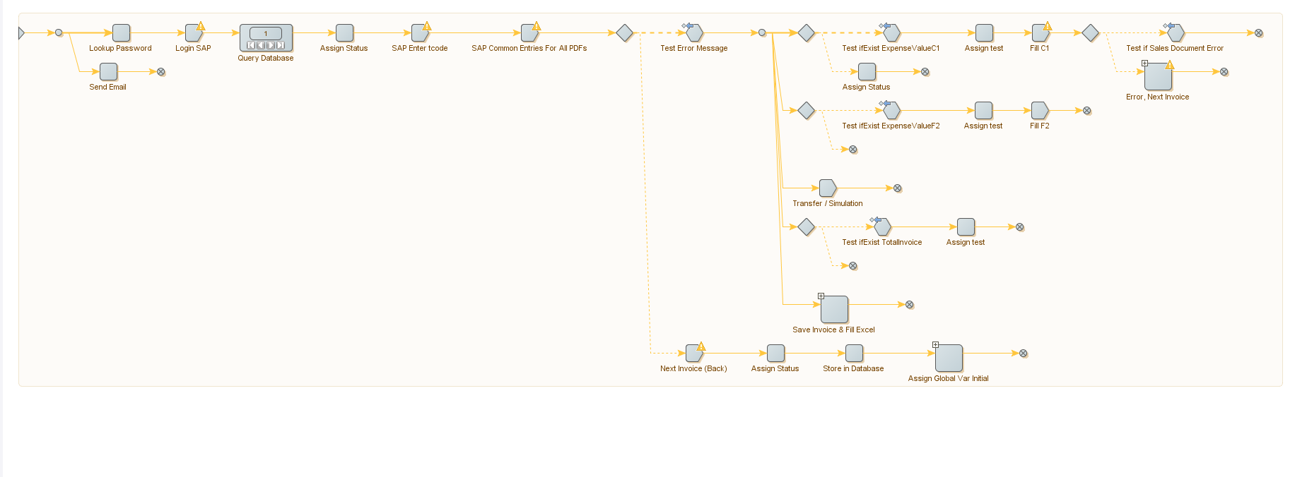
General look to process robot

Slide 14
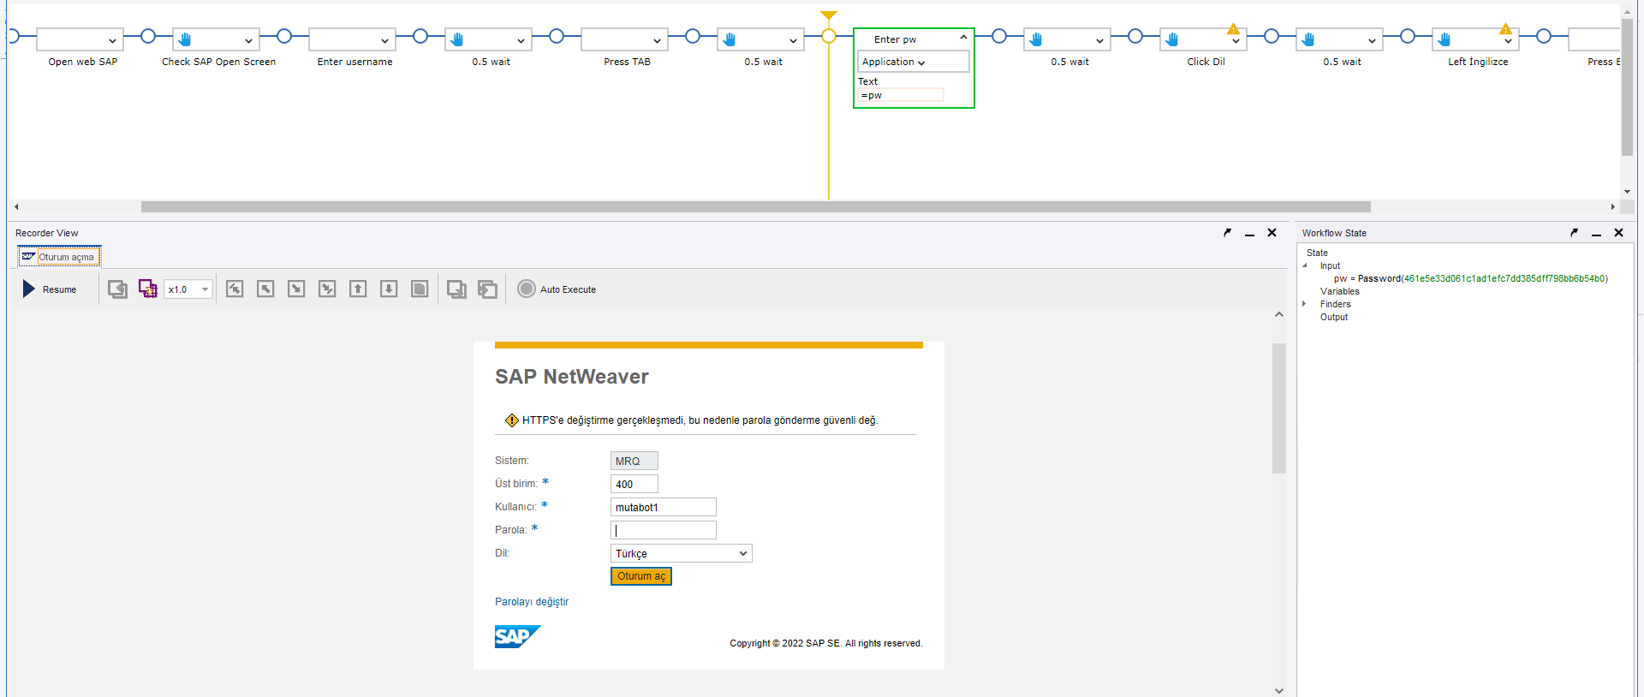
SAP login

Slide 15
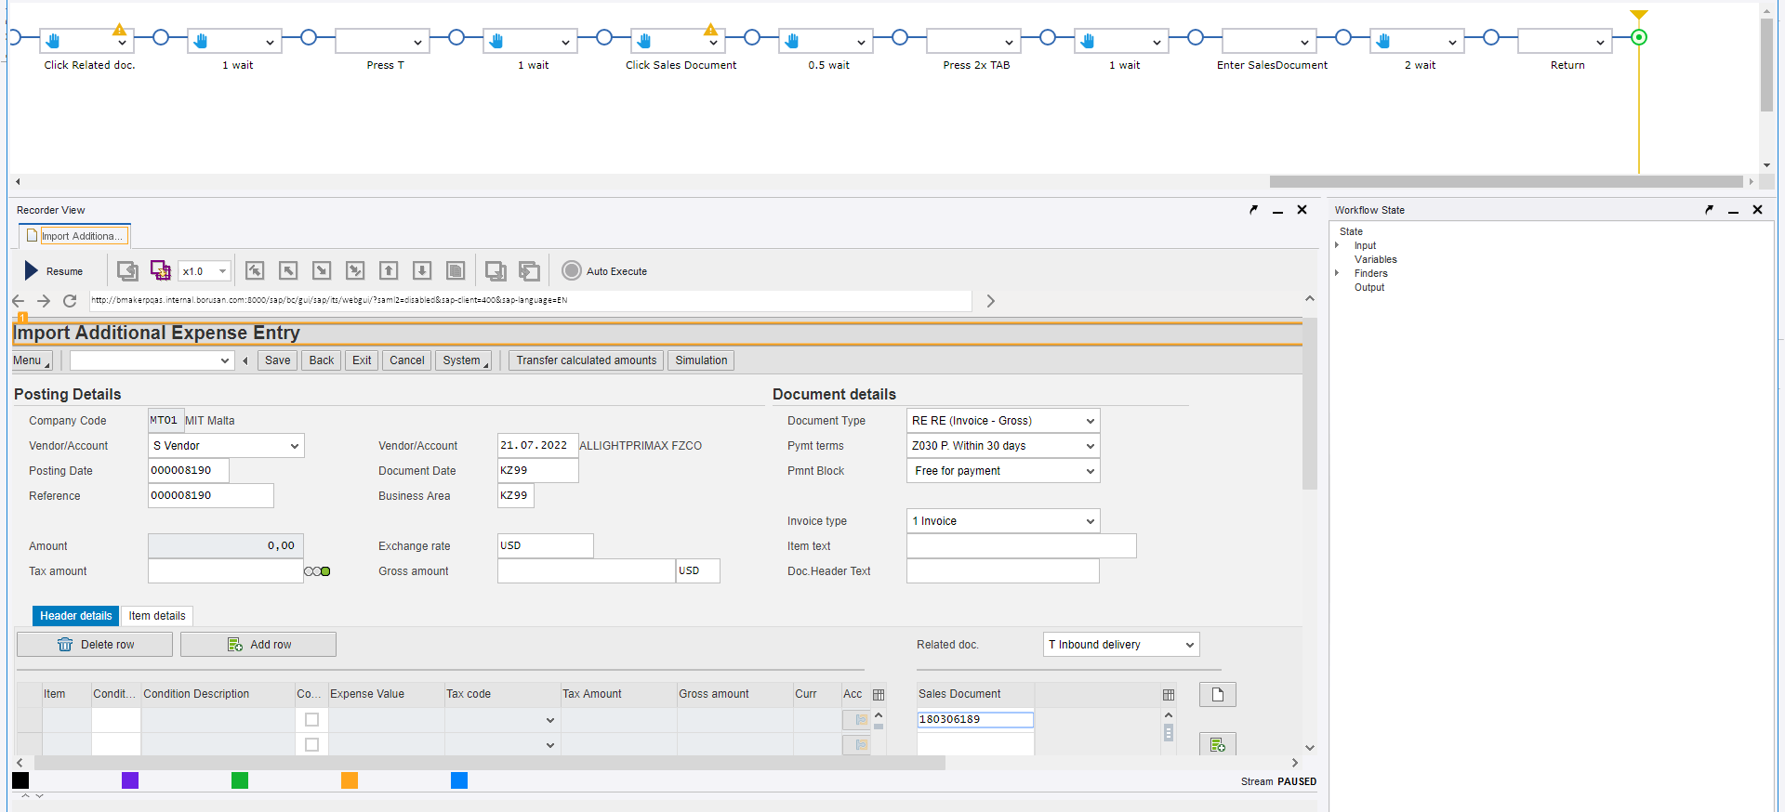
Fill SAP

Slide 16
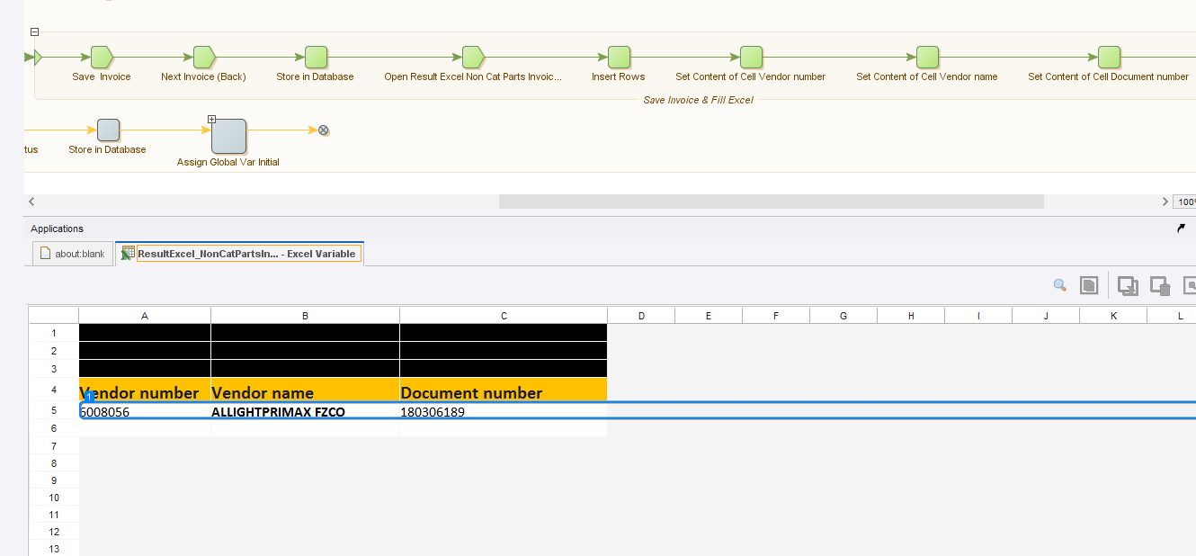
Fill excel & Send email

Slide 17
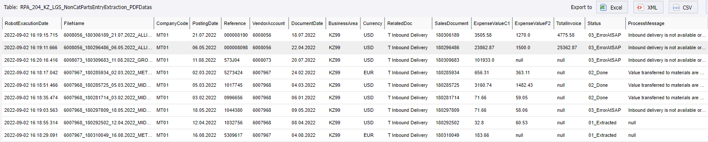
Error & Process message

