Slide 1
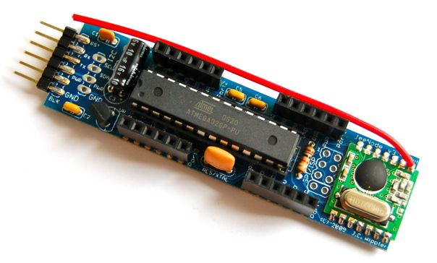
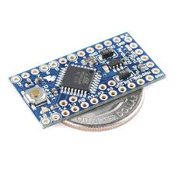
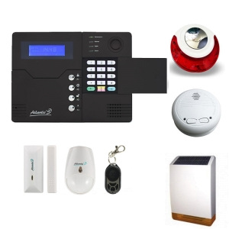
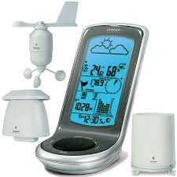

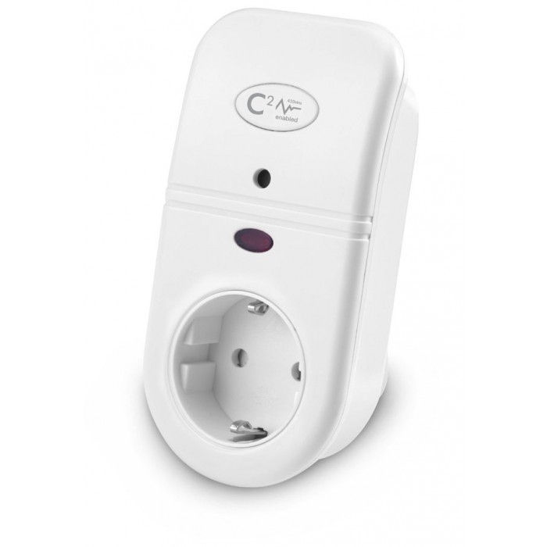
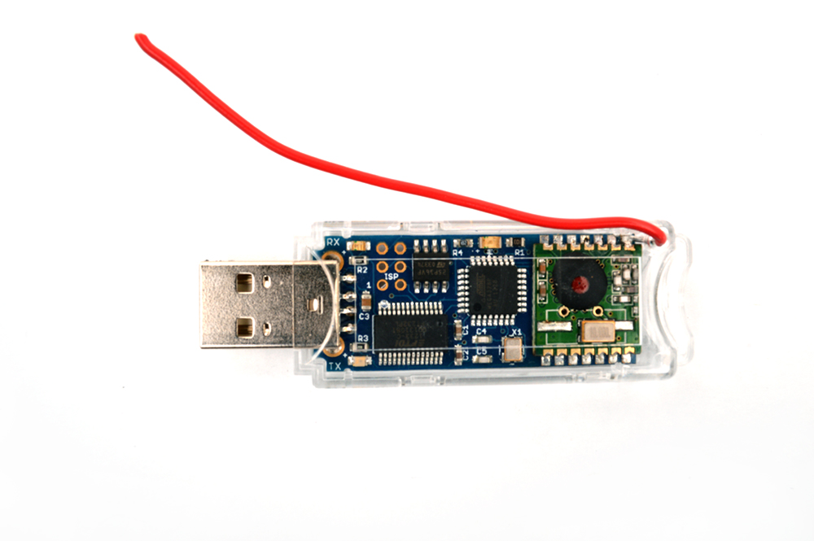

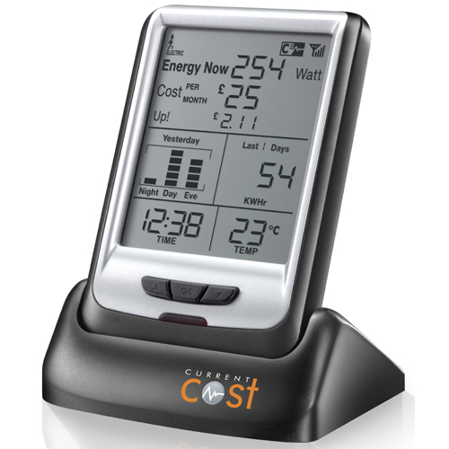
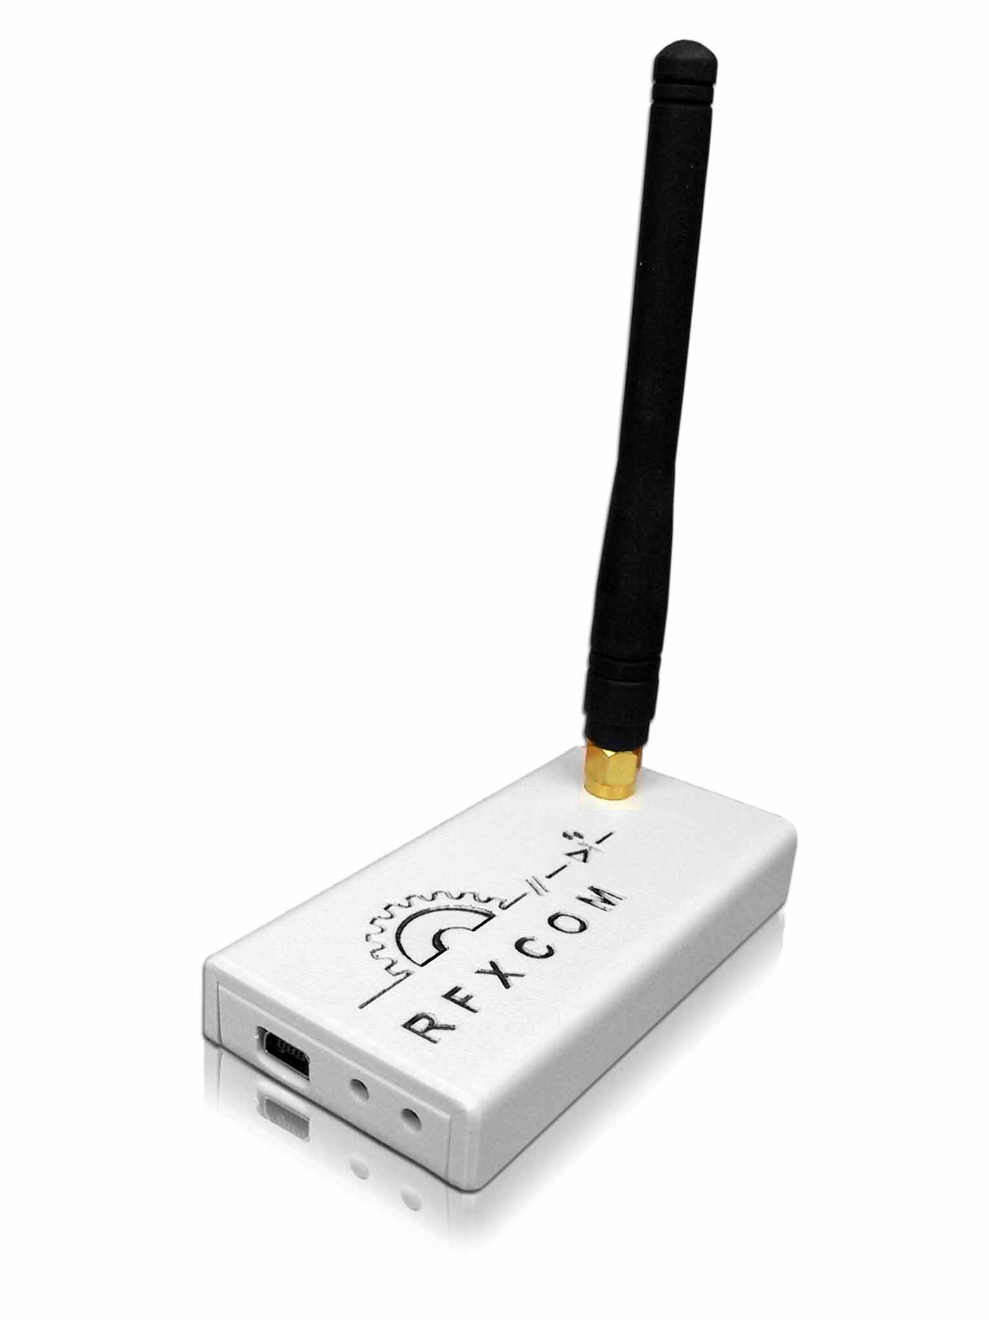


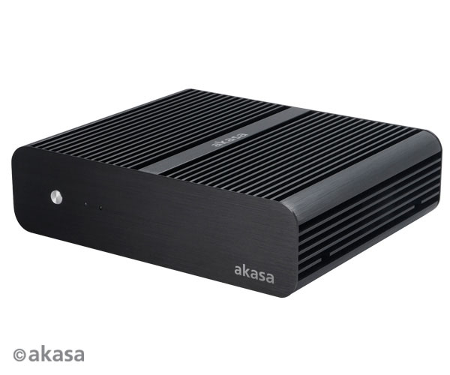


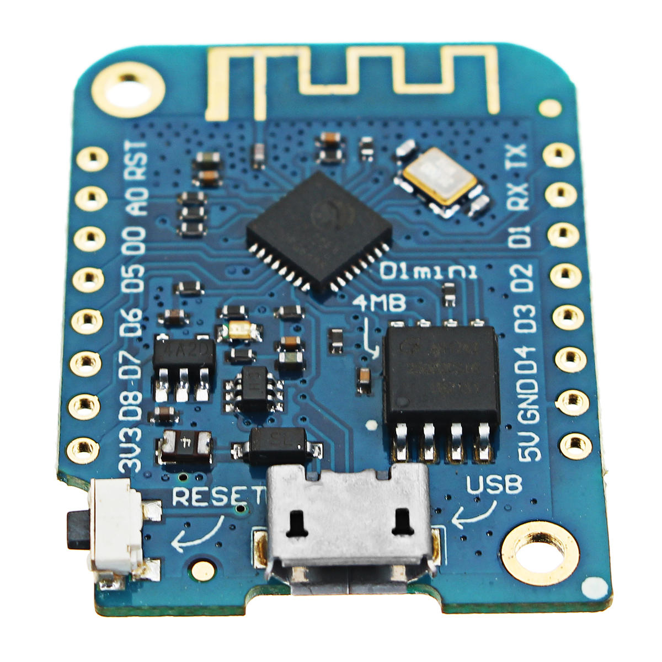



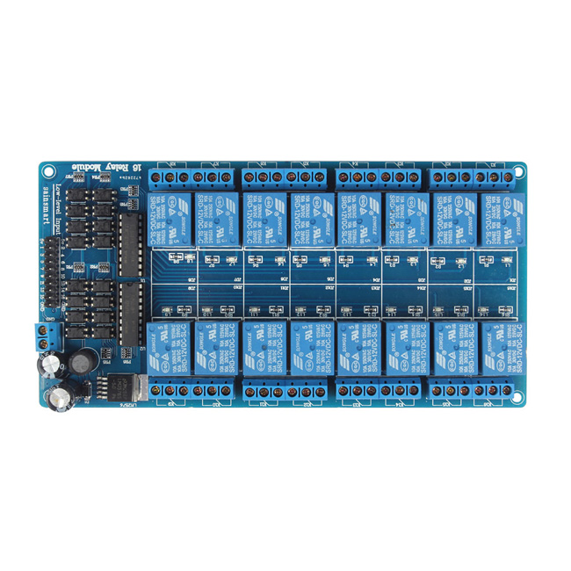




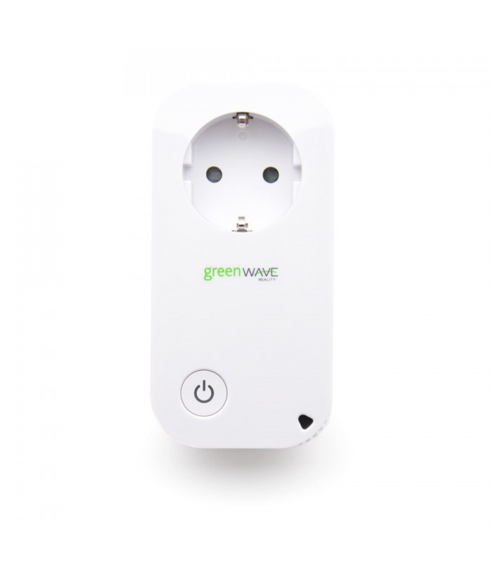

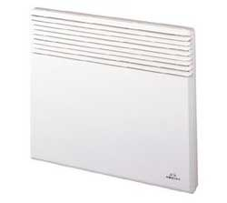
Sensors RF 866Mhz
RFXCom
433Mhz
Current Cost
Web Relays
Passive Server
(<10w – core i3)

Slide 2
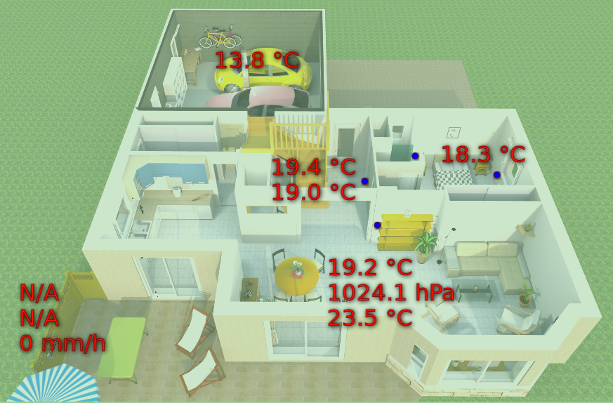
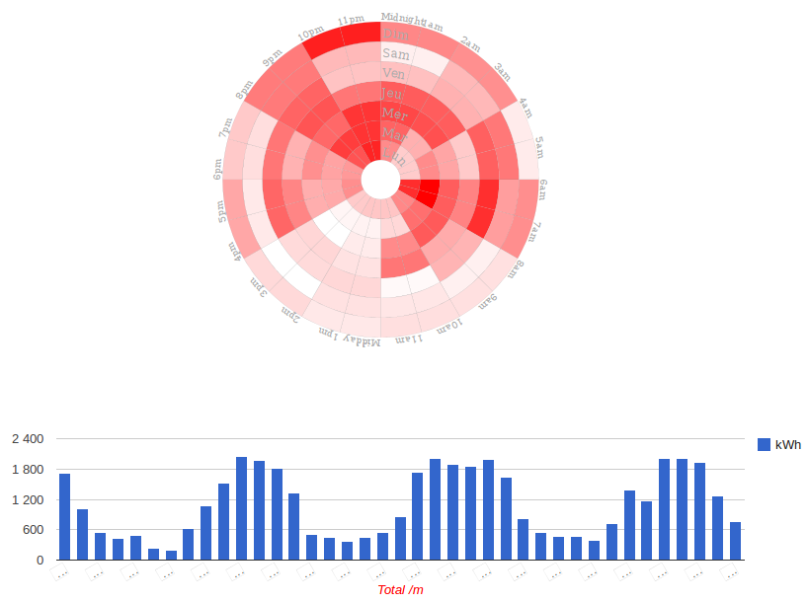

Slide 3
RF 866Mhz
sensors
Receiver
Passive Server
(<10w – core i3)

Slide 4
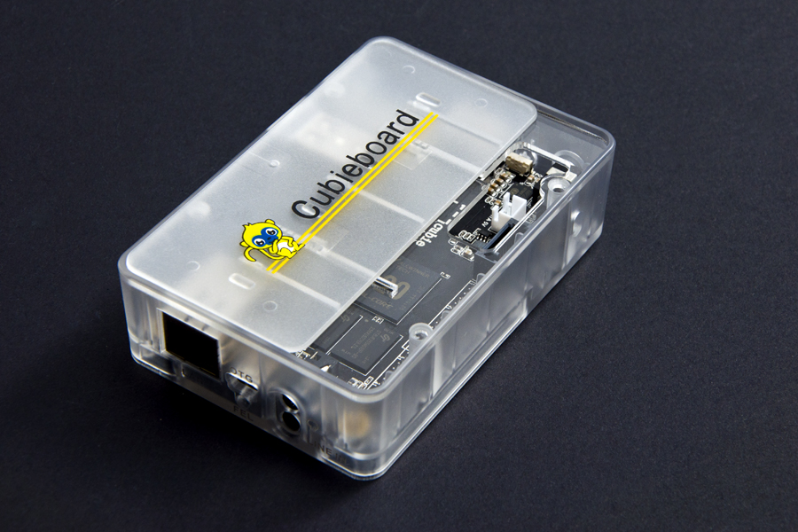
Cubieboard - relays
GET /gpios/status
GET /gpios/:id/set?value=Y

Slide 5
Wemos - relays
GET /gpios/status
GET /gpios/:id/set?value=Y
Wemos ESP8266
12v Relay board (5v data)
Heaters (230v)

Slide 6
Current Cost
Connected to server @57600 baud
NodeJS service running
Push data to MQTT bus
Data can be used listened for :
  Storage for later analysis
  Real-Time monitoring
Example doable graph :
  Week power consumption
  Area consumption real-time
USB

Slide 7
RFXtrx433
Receive/emit data for plenty 433 Mhz devices :
  Meteo sensors
  Alarms
  Switch controllers
  etc
USB

