Slide 1
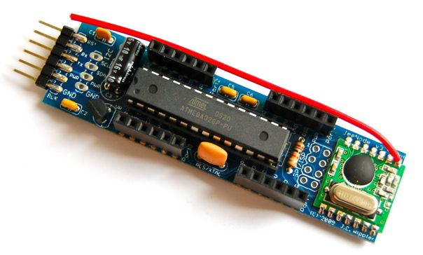
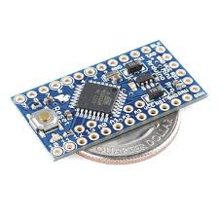
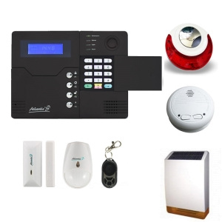


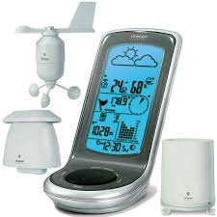
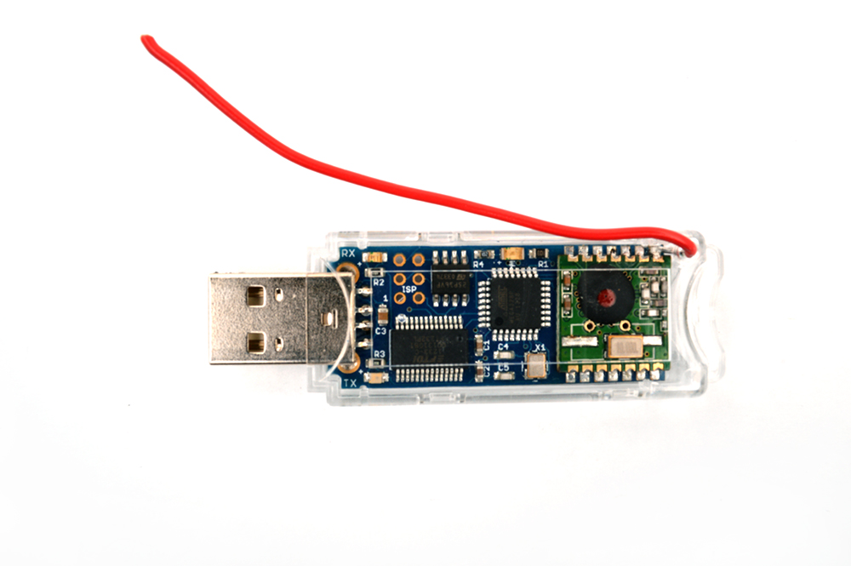


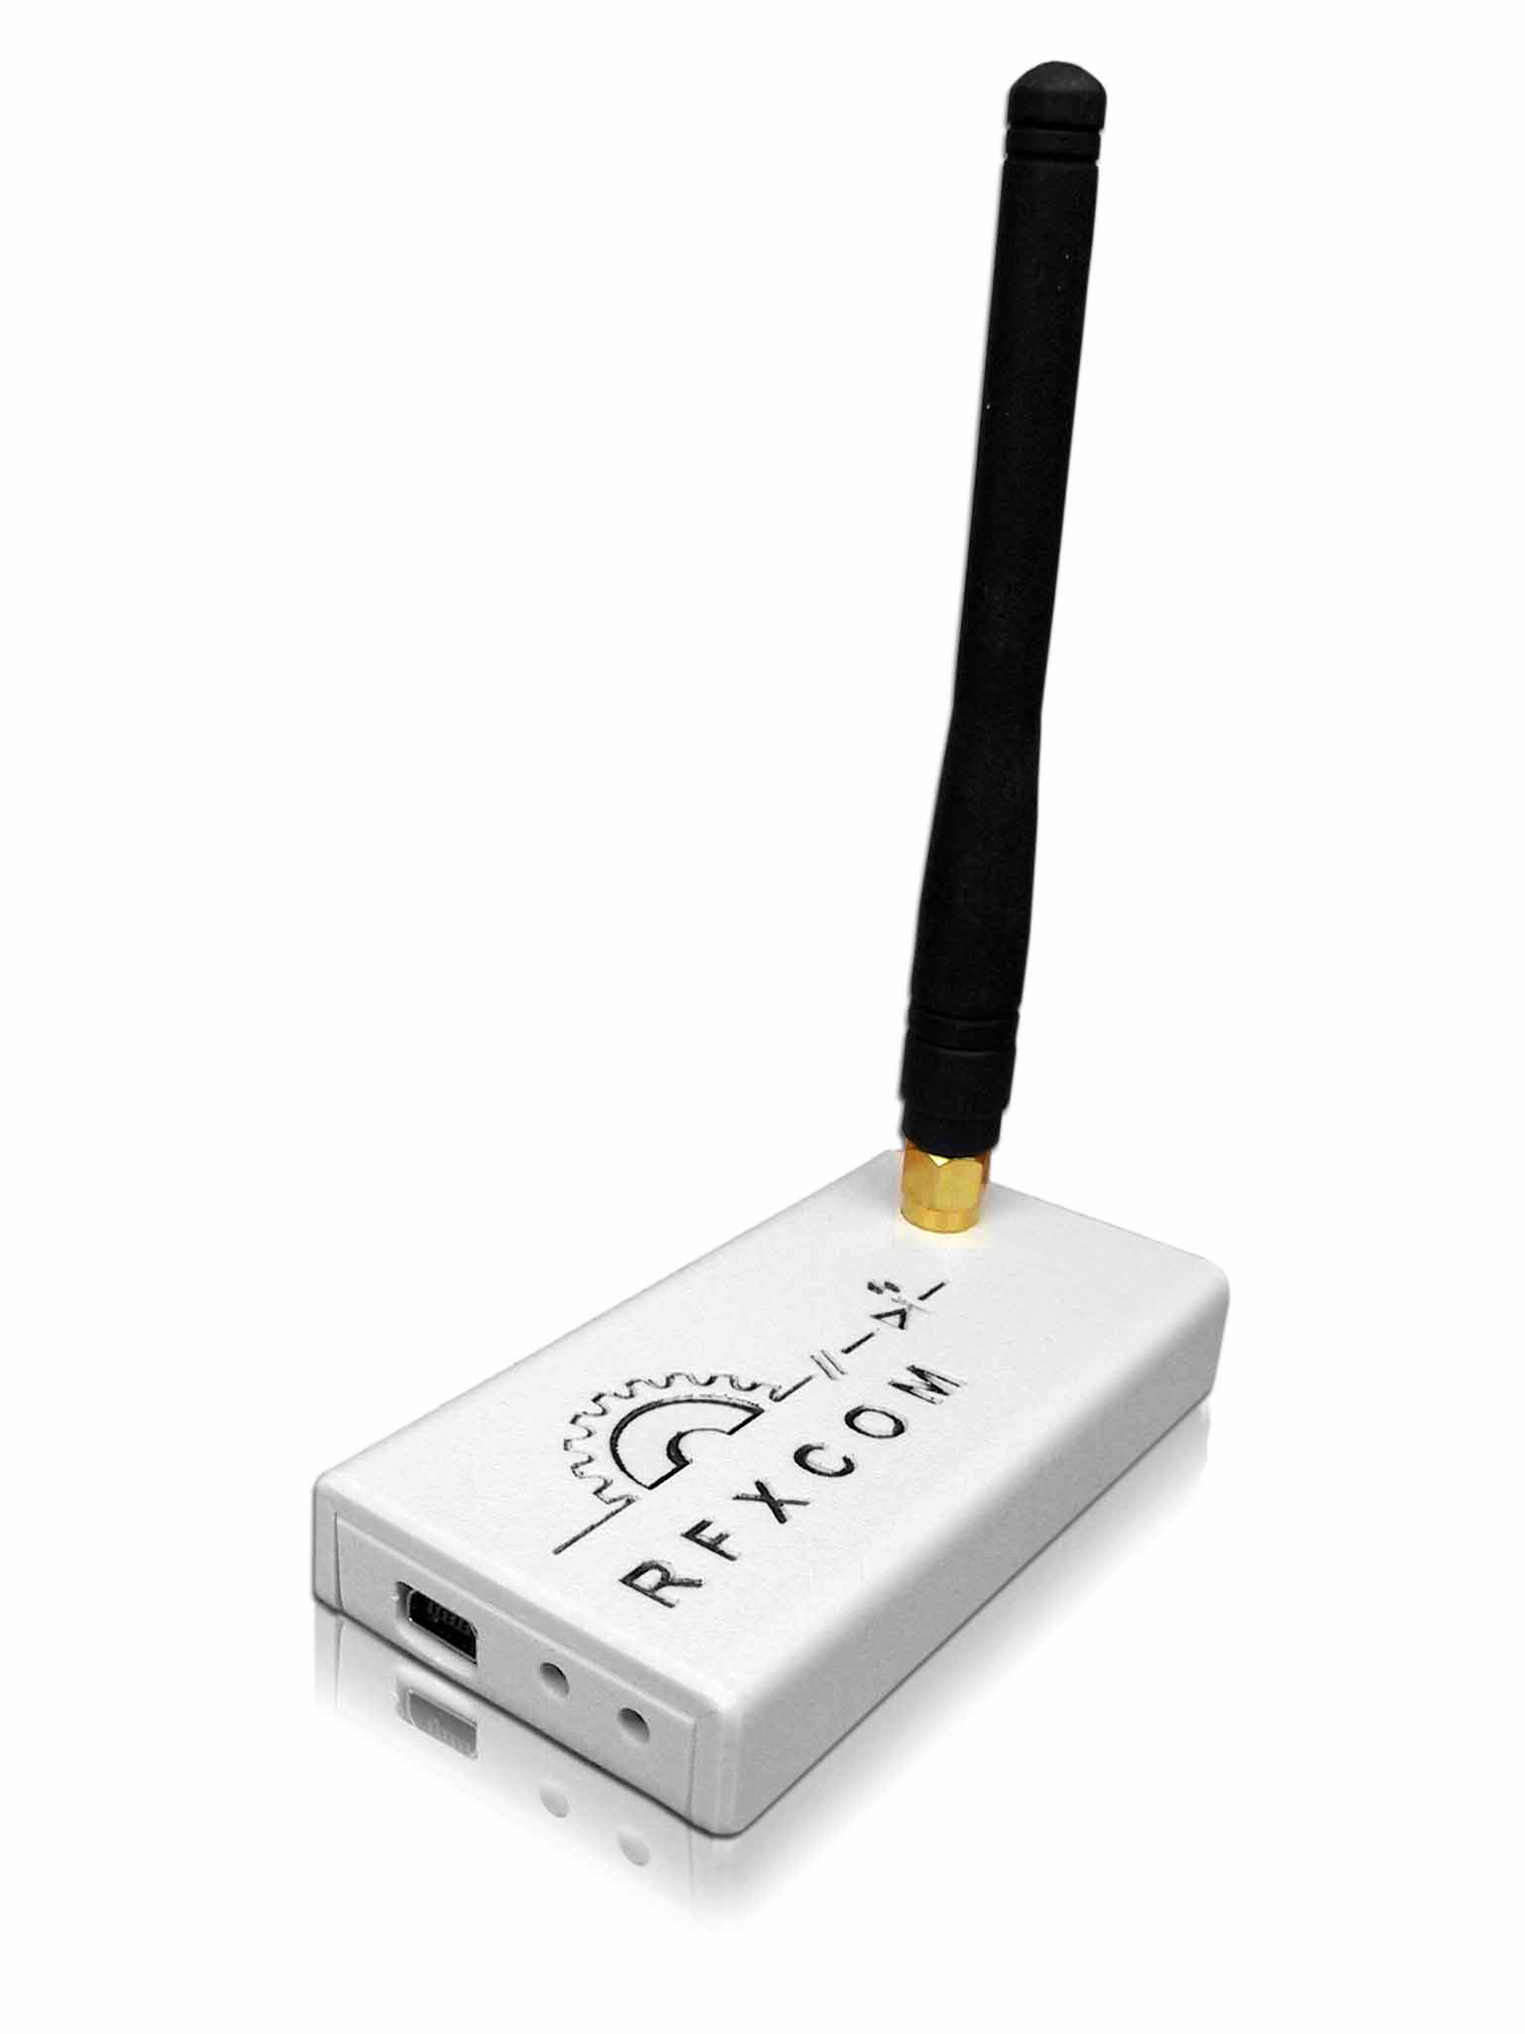
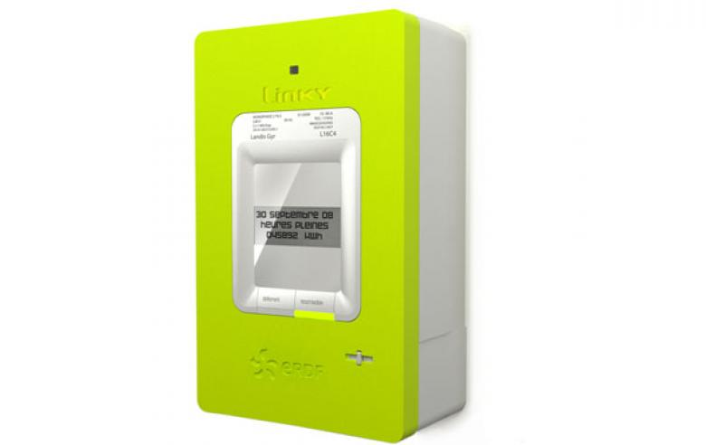



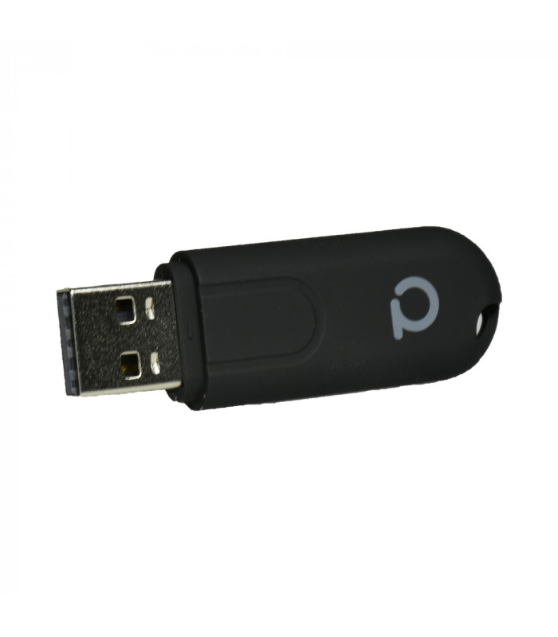
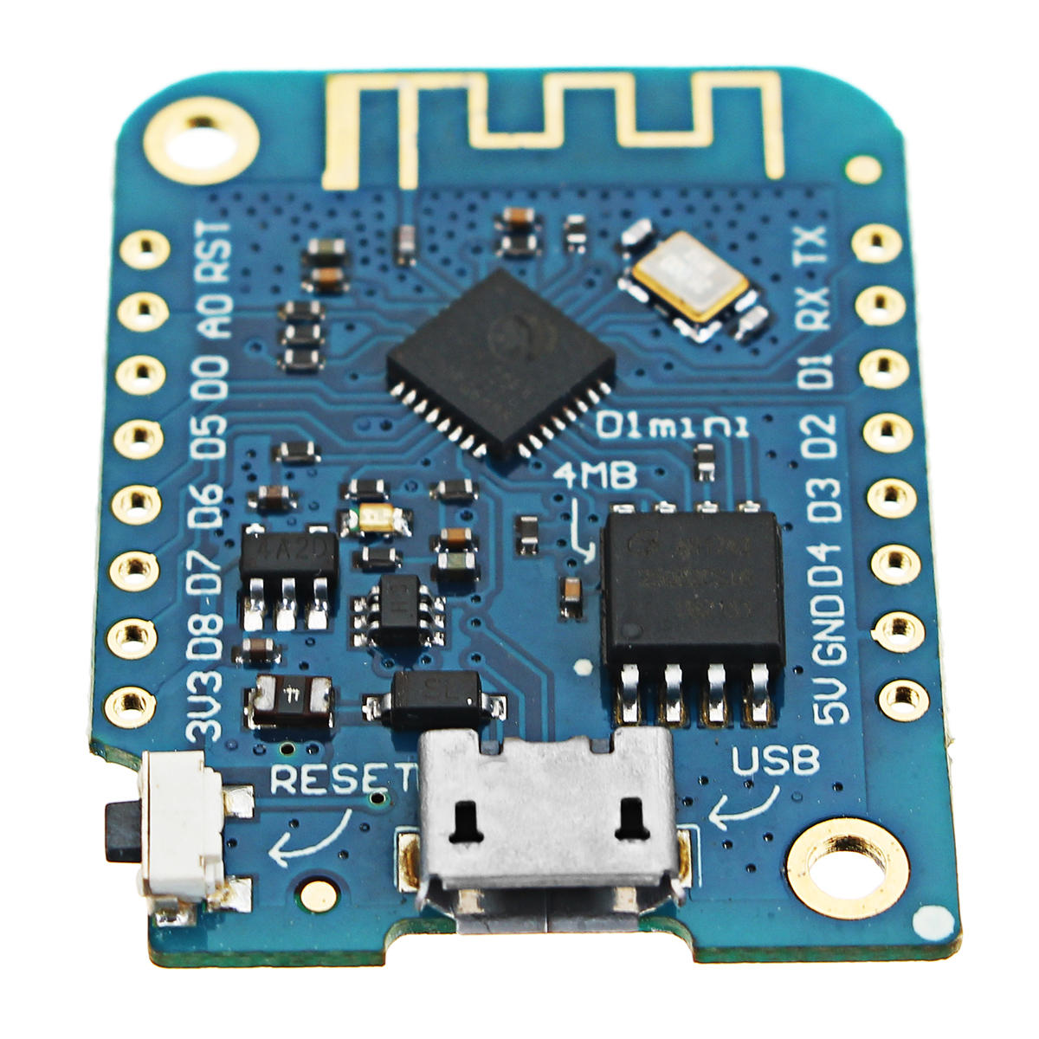
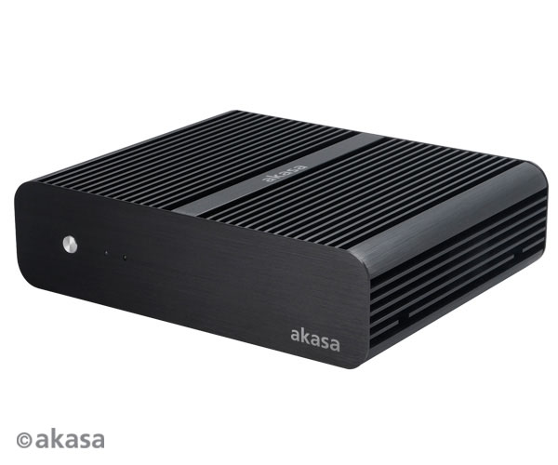
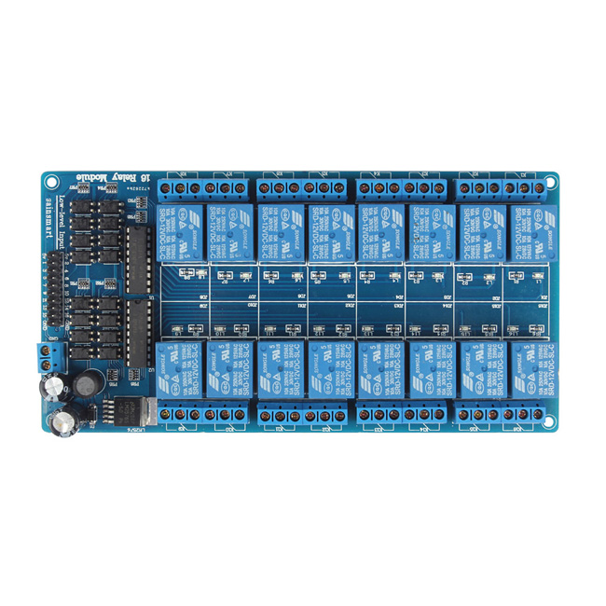












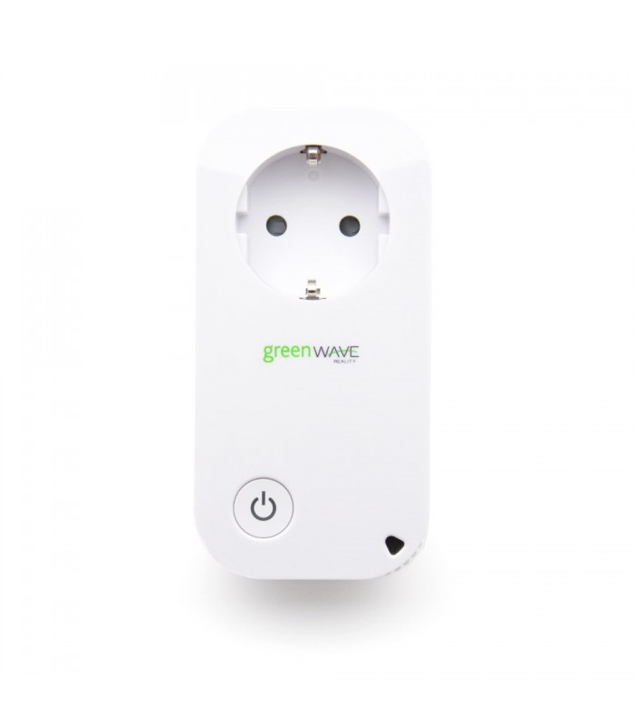


Sensors RF
866Mhz
RFXCom
433Mhz
Current Cost
EDF
Linky
Open to any integrations
e.g. OpenDTU
Passive Server
(<10w – core i3)

Slide 2
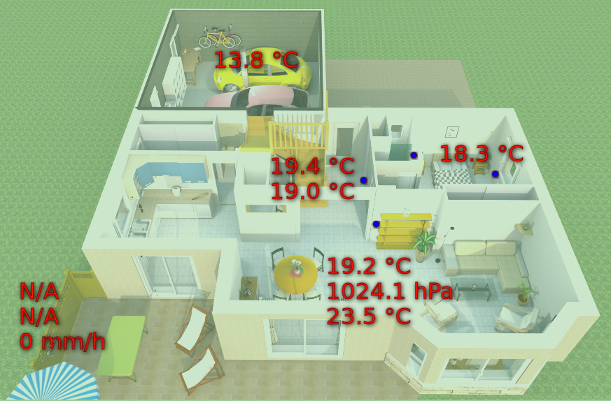
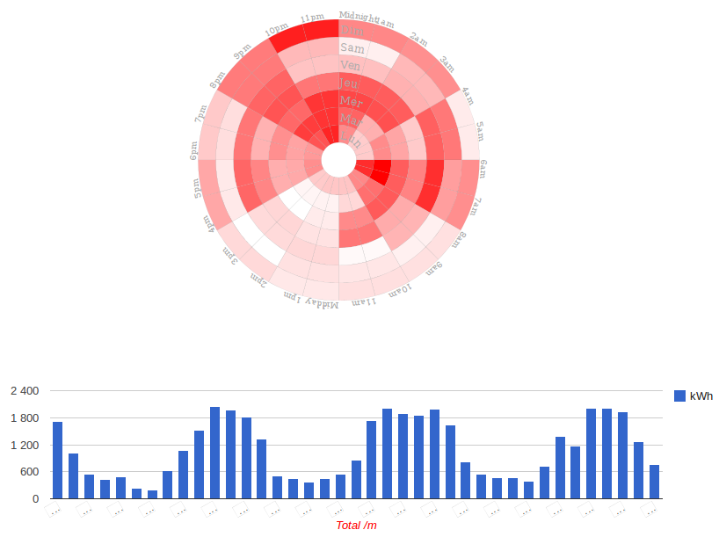

Slide 3
RF 866Mhz
sensors
Receiver
Passive Server
(<10w – core i3)

Slide 4
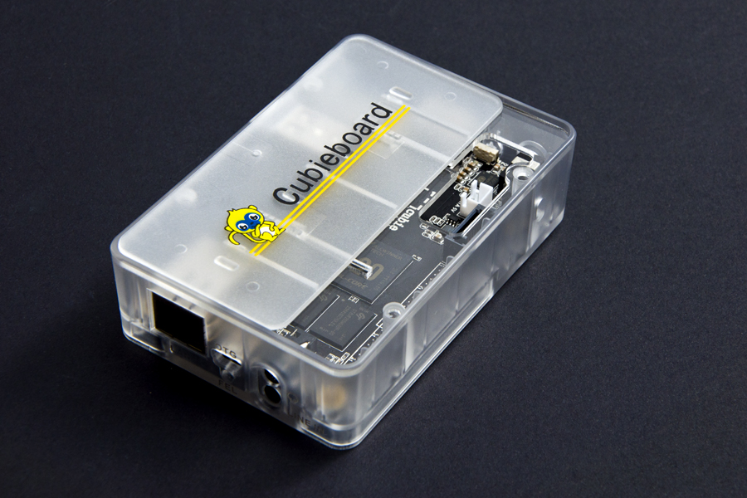
Cubieboard - relays
GET /gpios/status
GET /gpios/:id/set?value=Y

Slide 5
Wemos - relays
GET /gpios/status
GET /gpios/:id/set?value=Y
Wemos ESP8266
ESP32
12v Relay board (5v data)
Heaters (230v)

Slide 6


Relays – Fil Pilote
Linky
Teleinfo
Relay 1 | Relay 2 | Command
OFF | OFF | Confort
ON | ON | Eco
ON | OFF | Hors Gel
OFF | ON | Arrêt

Slide 7
Current Cost
Connected to server @57600 baud
NodeJS service running
Push data to MQTT bus
Data can be used listened for :
  Storage for later analysis
  Real-Time monitoring
Example doable graph :
  Week power consumption
  Area consumption real-time
USB

Slide 8
RFXtrx433
Receive/emit data for plenty 433 Mhz devices :
  Meteo sensors
  Alarms
  Switch controllers
  etc
USB

