Slide 1
Guided Capstone
Big Mountain Resort
Big Mountain Resort has invested in a new chair lift increasing operational costs by $1.54M this season. Each season brings ~350,000 people to Big Mountain Resort. The business profit margin is 9.2%. Big Mountain Resort is looking for a way keep the profit margin at 9.2% with the increased operating costs.
How can Big Mountain Resort maintain the business's profit margin at 9.2% or higher by offsetting the newly incurred operational costs of $1.54M with an adjustment of ticket prices, operational costs, and revenue generation this year?

Slide 2
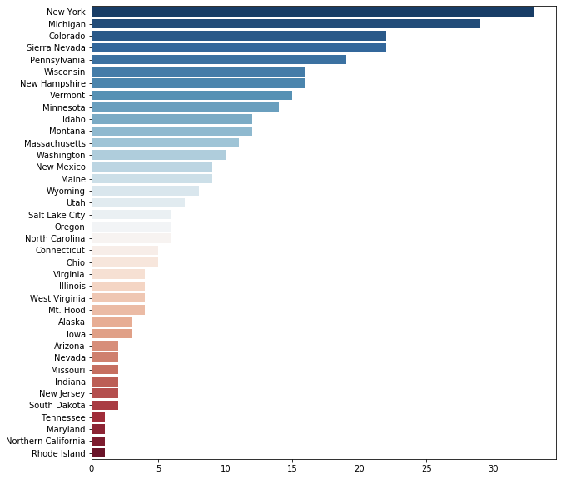
Available Facts and Figures
Big Mountain Resort was not in the data set.
Moving forward, we are working in national resort averages
Regions where the data has come from.

Slide 3
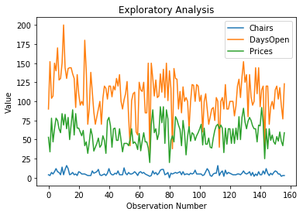
What options are available?
- Searching for correlations
- Raise chairlift ticket prices
- Lower operational costs

Slide 4
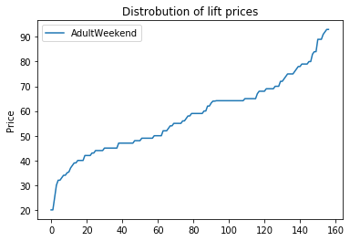
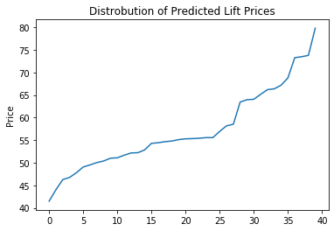
What can we charge?
- The distribution of lift prices will stay almost the same. The average will drop from $57.74 to $52.22 this season.

Slide 5
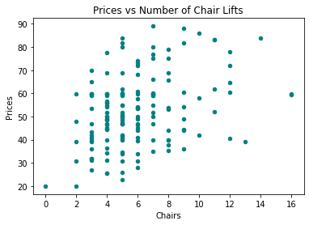
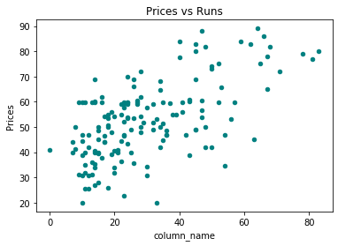
What warrants a higher price?
- From the data, there are two factors that correlate with higher chair lift prices. These are the number of chair lifts, and the number of runs.
- These correlations are weak and will only increase prices marginally.

Slide 6
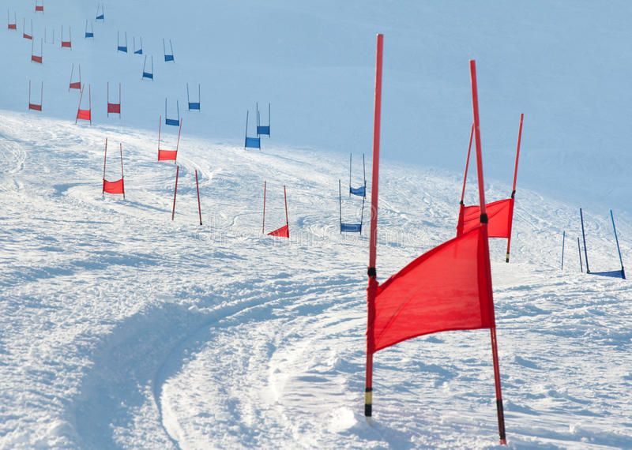
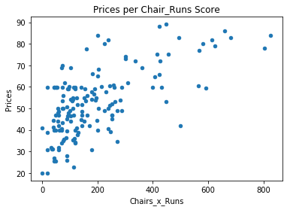
Recommendations
- Segment into parallel ski runs
- Raise prices to the appropriate
Chairs_x_Runs Score
Depending on where Big Mountain Resort’s Chair_x_Runs score falls we can calculate the price we charge for chair lift tickets.
Profit_Margin =
(Tickets_Sold*Price)-Operational_Costs

