Slide 1
[ ] Agree
Term of Agreement.
This Agreement shall become effective as of the date of its execution and shall continue in effect for a period of two years from the date of execution. Thereafter, this Agreement shall continue automatically for successive annual periods, provided such continuance is specifically approved at least annually by (i) the Board or (ii) a vote of a “majority” (as defined in the 1940 Act) of the Portfolio’s outstanding voting securities, provided that in either event the continuance also is approved by a majority of the Board who are not “interested persons” (as defined in the 1940 Act) of any party to this Agreement, by vote cast in person at a meeting called for the purpose of voting on such approval. This Agreement is terminable, without penalty, at any time, by the Manager, by the Board, or by vote of holders of a majority (as defined in the 1940 Act) of the Portfolio’s shares; or on 60 days’ written notice by the Adviser, and will terminate five business days after the Adviser receives written notice of the termination of the Management Agreement between the Trust and the Manager. This Agreement also will terminate automatically in the event of its assignment (as defined in the 1940 Act).
Source: https://www.lawinsider.com/clause/term-of-agreement
Notes:
- How often have you seen this and clicked agree?
- How often have you actually read this?

Slide 2
If search engines have made the encyclopedia extinct, then why do we still have to read:
- Product Documentation
- Legal Documents
- Nutrition Labels?
Notes:
Documentation is becoming a pain point of product usage and lack of understanding results in frustration and support calls.

Slide 3
If search engines have made the encyclopedia extinct, then why do we still have to read:
- Product Documentation
- Legal Documents
- Nutrition Labels?
Data
Notes:
The reason we don’t have a general AI interface for any document is the amount of power and data it would take to accomplish actual machine understanding.

Slide 4
Natural Language Processing
Notes:
Natural language processing or NLP is the Key to machine understanding. NLP is a subset of machine learning that uses various tactics to process and model natural language.

Slide 5
Natural Language Processing
- looping ngram
- Word2Vec
Notes:
For a document reading chat bot, we will use a combination of an ngram model and Word2Vec model.

Slide 6
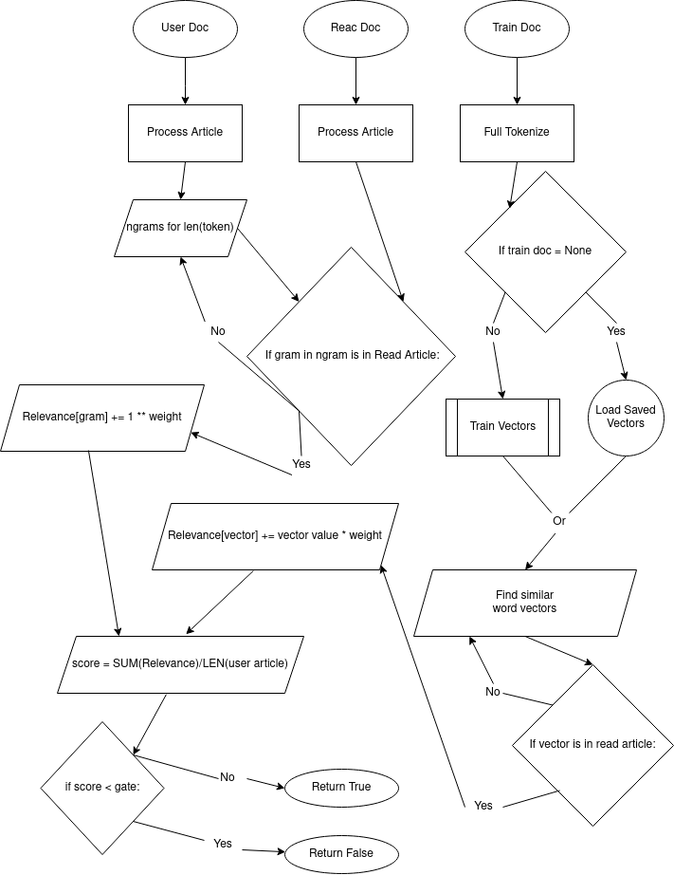
Notes:
This is the simplified flow chart of how we will be using the looping ngrams and Word2Vec model together.

Slide 7
Model Evaluation
TN | FP | FN | TP | accuracy | precision | recall | false_positive_rate
58 | 48 | 31 | 272 | 0.806845965770171 | 0.85 | 0.897689768976898 | 0.452830188679245
Notes:
Since this model ultimately results in a classification, we can evaluate using a confusion matrix.

Slide 8
Model Evaluation
- Random Search
TN | FP | FN | TP | accuracy | precision | recall | false_positive_rate
58 | 48 | 31 | 272 | 0.806845965770171 | 0.85 | 0.897689768976898 | 0.452830188679245
Notes:
To optimize evaluation time, we will evaluate the model using a random search. Unlike a grid search, this is statistically more likely to find better parameters in a shorter amount of time.

Slide 9

Model Evaluation
- Random Search
- Google Cloud Console
TN | FP | FN | TP | accuracy | precision | recall | false_positive_rate
58 | 48 | 31 | 272 | 0.806845965770171 | 0.85 | 0.897689768976898 | 0.452830188679245
gate | weight_mod | window | epochs | vector_scope | vector_weight
3 | 1.74327329492608 | 13 | 9 | 12 | 14.1647849325647
Notes:
Even with a random search and using a pre-trained model this takes a lot of time to evaluate. That’s why I used a compute engine on Google’s Cloud Console. Even with 32GB of RAM, 100 evaluations took ~17 hours.

Slide 10
Model Evaluation
- Random Search
- Google Cloud Console
gate | weight_mod | window | epochs | vector_scope | vector_weight
3 | 1.74327329492608 | 13 | 9 | 12 | 14.1647849325647
TN | FP | FN | TP | accuracy | precision | recall | false_positive_rate
58 | 48 | 31 | 272 | 0.806845965770171 | 0.85 | 0.897689768976898 | 0.452830188679245
Notes:
This is the best performance yet and is clearly over-fit. The gate is so low that the model will classify almost anything as true. After experimenting, I found these parameters with a gate of 20 works much better.

Slide 11
Use techniques to limit data.
- Narrow Scope
- Scripting
- Manual training mode
Notes:
Chatbots using NLP are expensive and difficult to maintain. For a better experience, I recommend using specific chat bots with pre written scripting. Narrow the scope of their knowledge to reduce training, and provide a manual training mode for maintenance on user input data.

