Slide 1
Kalen Willits
- Springboard Data Science Career Track
- Technical Support Professional
- Moving to Data Analytics.
In this project, we take the first steps to interactive consumer documentation by combining machine learning and chatbots. This tool will be an important part of
consumer/product interaction, reducing support call and frustration.

Slide 2
Term of Agreement.
This Agreement shall become effective as of the date of its execution and shall continue in effect for a period of two years from the date of execution. Thereafter, this Agreement shall continue automatically for successive annual periods, provided such continuance is specifically approved at least annually by (i) the Board or (ii) a vote of a “majority” (as defined in the 1940 Act) of the Portfolio’s outstanding voting securities, provided that in either event the continuance also is approved by a majority of the Board who are not “interested persons” (as defined in the 1940 Act) of any party to this Agreement, by vote cast in person at a meeting called for the purpose of voting on such approval. This Agreement is terminable, without penalty, at any time, by the Manager, by the Board, or by vote of holders of a majority (as defined in the 1940 Act) of the Portfolio’s shares; or on 60 days’ written notice by the Adviser, and will terminate five business days after the Adviser receives written notice of the termination of the Management Agreement between the Trust and the Manager. This Agreement also will terminate automatically in the event of its assignment (as defined in the 1940 Act).
Source: https://www.lawinsider.com/clause/term-of-agreement
[ ] Agree
Notes:
- How often have you seen this and clicked agree?
- How often have you actually read this?

Slide 3
If search engines have made the encyclopedia extinct, then why do we still have to read:
- Product Documentation
- Legal Documents
- Nutrition Labels?
Notes:
Documentation is becoming a pain point of product usage and lack of understanding results in frustration and support calls.

Slide 4
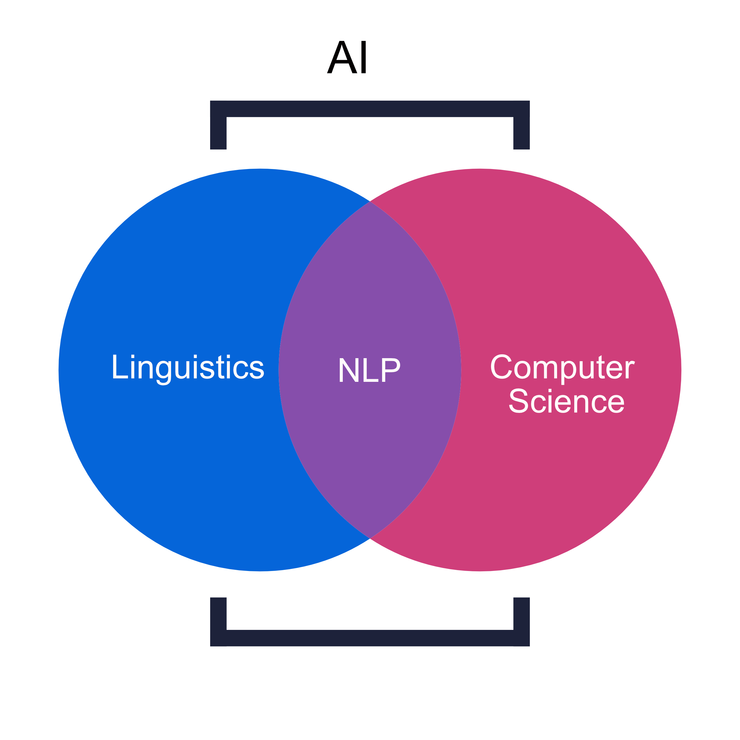
Natural Language Processing
Notes:
Natural language processing or NLP is the Key to machine understanding. NLP is a subset of machine learning that uses various tactics to process and model natural language.

Slide 5
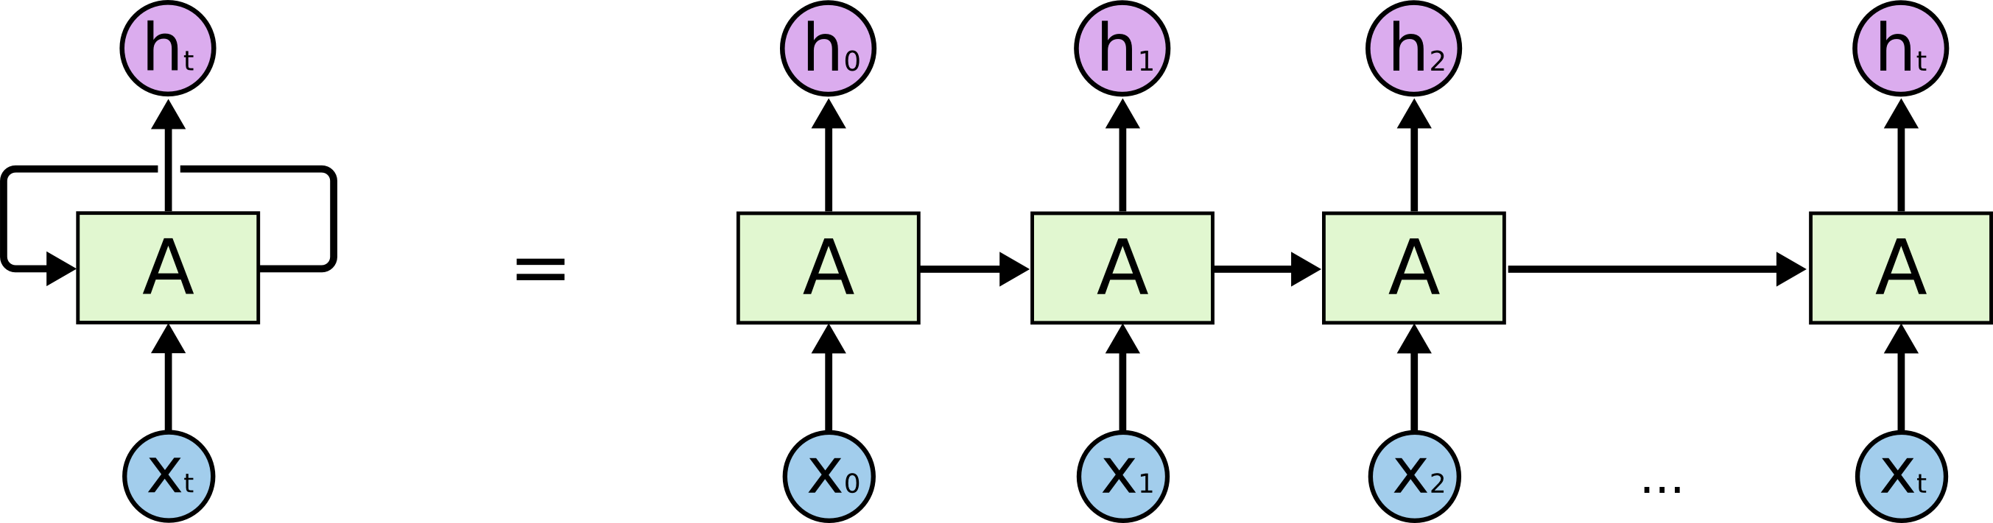
Long Term Short Memory
Notes:
Natural language processing or NLP is the Key to machine understanding. NLP is a subset of machine learning that uses various tactics to process and model natural language.

Slide 6
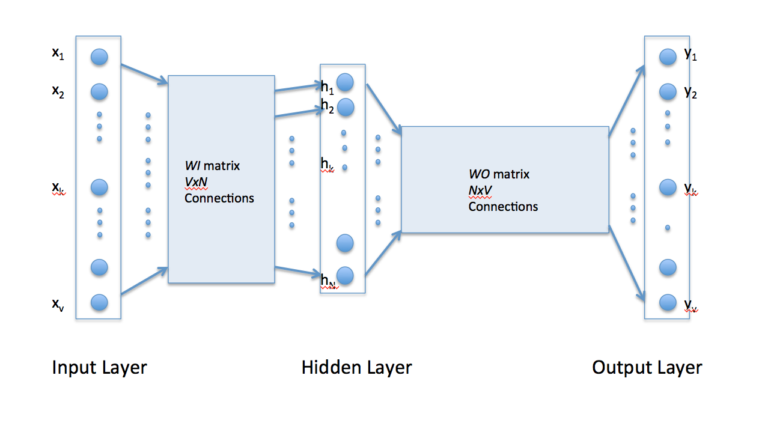
Neural Networks (Word2Vec)
Notes:
Natural language processing or NLP is the Key to machine understanding. NLP is a subset of machine learning that uses various tactics to process and model natural language.

Slide 7
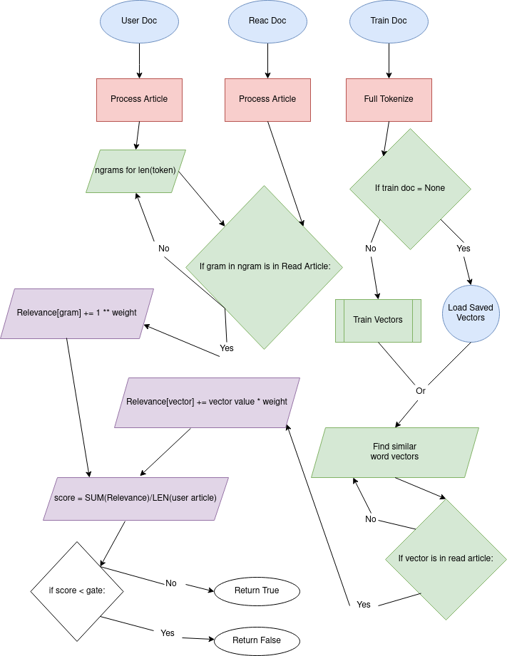
Legend of Model
ETL
User Input
Training
Record
Output
Notes:
This is the simplified flow chart of how we will be using the looping ngrams and Word2Vec model together.

Slide 8



Training Requirements
Scape Wiki articles
Store on GCP Bucket
Train Model on GCP Datalab
TN | FP | FN | TP | accuracy | precision | recall | false_positive_rate
58 | 48 | 31 | 272 | 0.806845965770171 | 0.85 | 0.897689768976898 | 0.452830188679245
Notes:
Since this model ultimately results in a classification, we can evaluate using a confusion matrix.

Slide 9
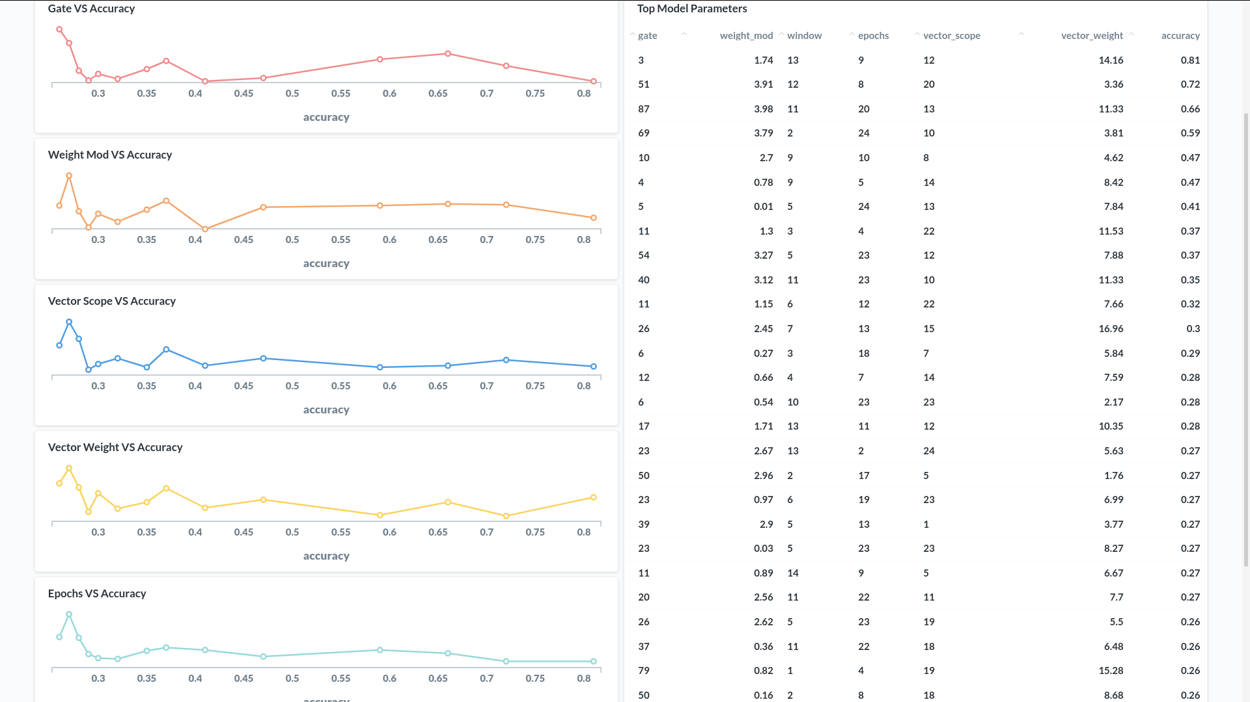
Notes:
Since this model ultimately results in a classification, we can evaluate using a confusion matrix.

Slide 10

Model Evaluation
- Random Search
- Google Cloud Console
gate | weight_mod | window | epochs | vector_scope | vector_weight
3 | 1.74327329492608 | 13 | 9 | 12 | 14.1647849325647
TN | FP | FN | TP | accuracy | precision | recall | false_positive_rate
58 | 48 | 31 | 272 | 0.806845965770171 | 0.85 | 0.897689768976898 | 0.452830188679245
Notes:
This is the best performance yet and is clearly over-fit. The gate is so low that the model will classify almost anything as true. After experimenting, I found these parameters with a gate of 20 works much better.

Slide 11
Conclusion
Narrow Scope:
- The amount of data required for general use chatbots is not practical. Focusing on specific chatbot topics and function increases it’s accuracy.
Personalize:
- Massive amounts of training data is required for an algorithm to gain understanding on natural language. This gap can be bridged by having the model accept user input as training data. Overtime, the model will get better at making predictions.
Market to B2B only:
- With the current status of NLP, the maintenance needed to keep the chatbot relevant is not something we can expect to accomplish at a consumer level .
Notes:
Chatbots using NLP are expensive and difficult to maintain. For a better experience, I recommend using specific chat bots with pre written scripting. Narrow the scope of their knowledge to reduce training, and provide a manual training mode for maintenance on user input data.

