Slide 1
Predicting Airline Flight Delays
Why is this important?

Slide 2
Why is this important?
Flight delays cause upset passengers.

Slide 3
Flight delays can upset passengers.
Predicting flight delays improve passenger experience.

Slide 4
Predicting flight delays improve passenger experience.
How do we communicate flight delays to passengers?

Slide 5
How do we communicate flight delays to passengers?
SUM(Delays) / SUM(All Flights) = Delay Ratio

Slide 6
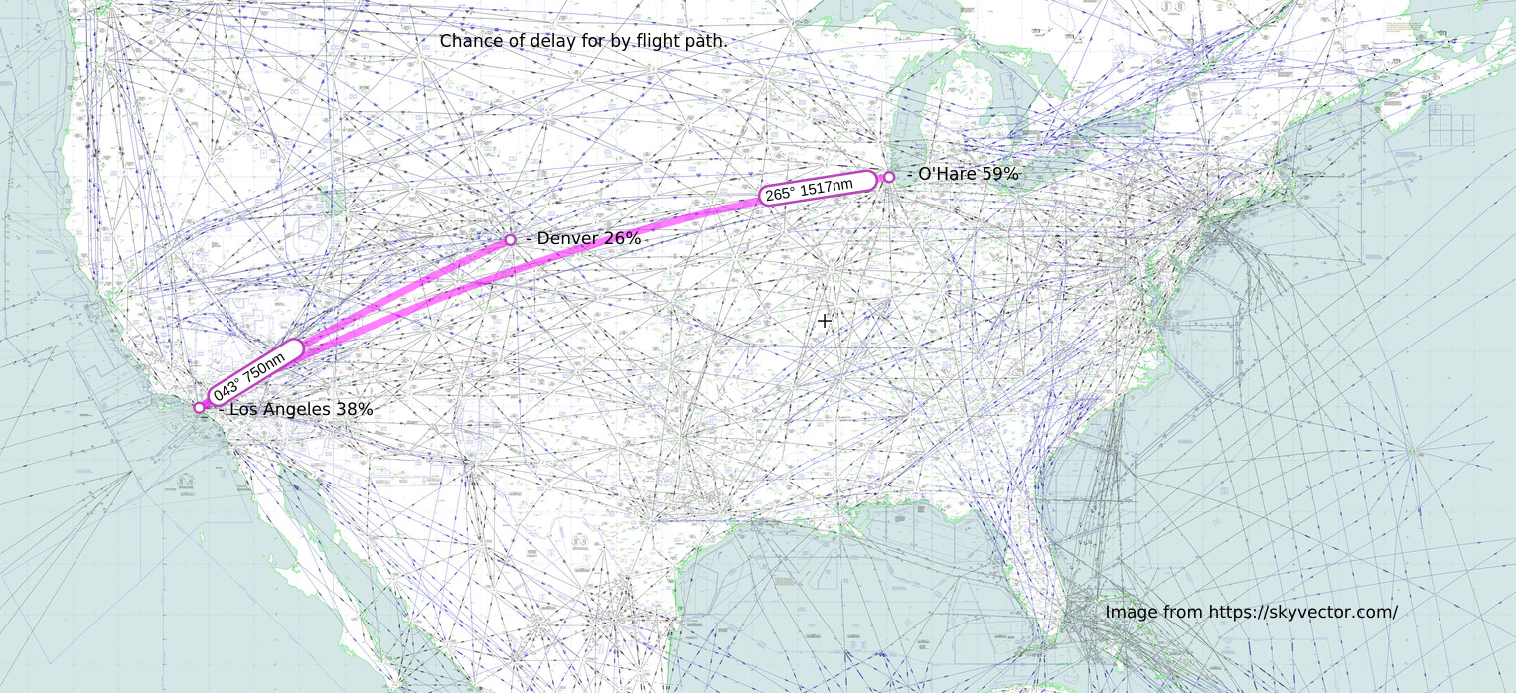
Delay ripples ignore geographic location

Slide 7
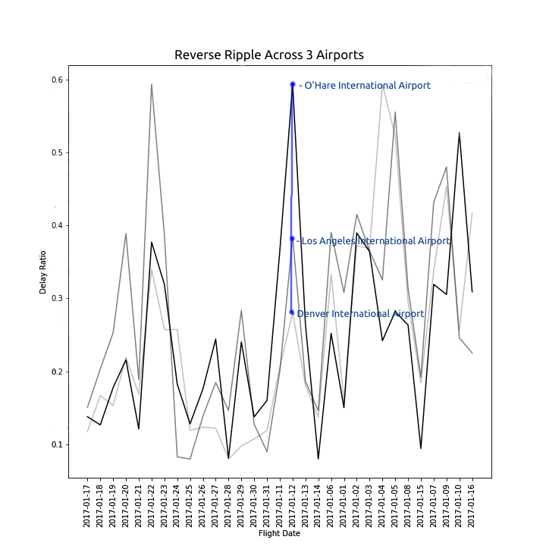
How do we communicate flight delays to passengers?

Slide 8
Use a linear machine learning model to make predictions.

Slide 9
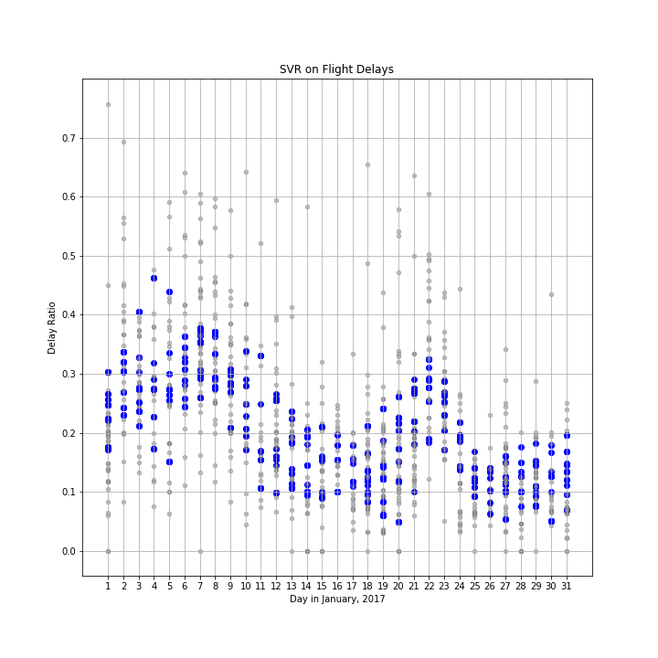

Slide 10
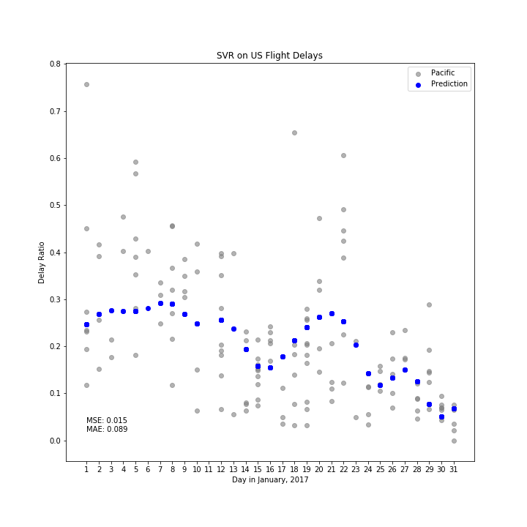

Slide 11
How do we use the forecast?

Slide 12
How do we use the forecast?
- Define Scope. (Location * Time)

Slide 13
How do we use the forecast?
- Define Scope. (Location * Time)
- Present static forecast at check in.

Slide 14
How do we use the forecast?
- Define Scope. (Location * Time)
- Present static forecast at check in.
- Offer active forecast in mobile app.

Slide 15
Proper passenger expectations around flight delays will provide passengers with better travel experiences.

