Slide 1
DATA ANALYTICS PROJECT
Student Performance
Analysis
Analyzing academic performance through study habits, attendance and
subject-wise scores — built with Python, Power BI and GitHub
Python
Pandas
Matplotlib
Power BI
Git & GitHub

Slide 2
PROJECT OVERVIEW
Turning Raw Data into Actionable Insight
Educational institutions generate large volumes of student data that is difficult to interpret directly. This project organizes and analyzes academic and demographic factors — study hours, attendance, gender, city and subject scores — to uncover patterns and support better decisions.
KEY OBJECTIVES
Analyze study hours vs. academic scores
Study the effect of attendance on performance
Compare Math, Science and English scores
Compare Pass vs. Fail student outcomes
DATASET SNAPSHOT
Identify patterns and outliers in the data
100
11
0
Build an interactive Power BI dashboard
Student Records
Columns Analyzed
Missing Values
STUDENT PERFORMANCE ANALYSIS
2

Slide 3
TASK 1 – 2
Git & GitHub: Setup and Workflow
REPOSITORY WORKFLOW
Clone
→
Modify
→
Add
→
Commit
→
Pull
→
Push
Repository: Student-Performance-Analysis | Initial Commit: 77b7ce5
MEANINGFUL COMMIT HISTORY
dcdafc5
Added project README documentation
5226fe9
Added student performance data analysis
173f79b
Added EDA findings and analysis documentation
Core commands: git clone · git pull origin main · git add . · git commit -m "message" · git push origin main
STUDENT PERFORMANCE ANALYSIS
3

Slide 4
TASK 3
Dataset Selection & Preparation
DATA CLEANING STEPS
DATASET INFO
student_performance.csv
1
Checked dataset shape, column names & data types
100
11
2
Verified zero missing values across all columns
Records
Columns
3
Confirmed no duplicate records with duplicated()
0
0
Missing
Duplicates
4
Converted numeric columns to proper data types
Columns: Student_ID, Student_Name, Gender, City, Study_Hours, Attendance, Math_Score, Science_Score, English_Score, Result, Average_Score (calculated)
5
Calculated Average_Score from three subject scores
STUDENT PERFORMANCE ANALYSIS
4

Slide 5
TASK 4
Exploratory Data Analysis
1
Descriptive Statistics
2
Correlation Analysis
Mean, median, std. deviation, quartiles and range calculated for study hours, attendance and subject scores.
Correlation matrix across Study_Hours, Attendance, and all subject & average scores.
3
Pattern & Trend Analysis
4
Outlier Analysis (IQR)
Compared average scores by result, study hours and attendance to find behavioral trends.
Interquartile Range method applied to detect unusual values across all numeric fields.
STUDENT PERFORMANCE ANALYSIS
5

Slide 6
TASK 5
Data Visualization
Five Matplotlib visualizations were created to make patterns easy to interpret.
1
Subject-wise Average Score
compares Math, Science & English performance
2
Average Score by Result
Pass vs. Fail academic comparison
3
Study Hours vs. Average Score
scatter plot of study effort and outcome
4
Attendance vs. Average Score
scatter plot of attendance and outcome
5
Number of Students by Result
bar chart of Pass/Fail counts
STUDENT PERFORMANCE ANALYSIS
6

Slide 7
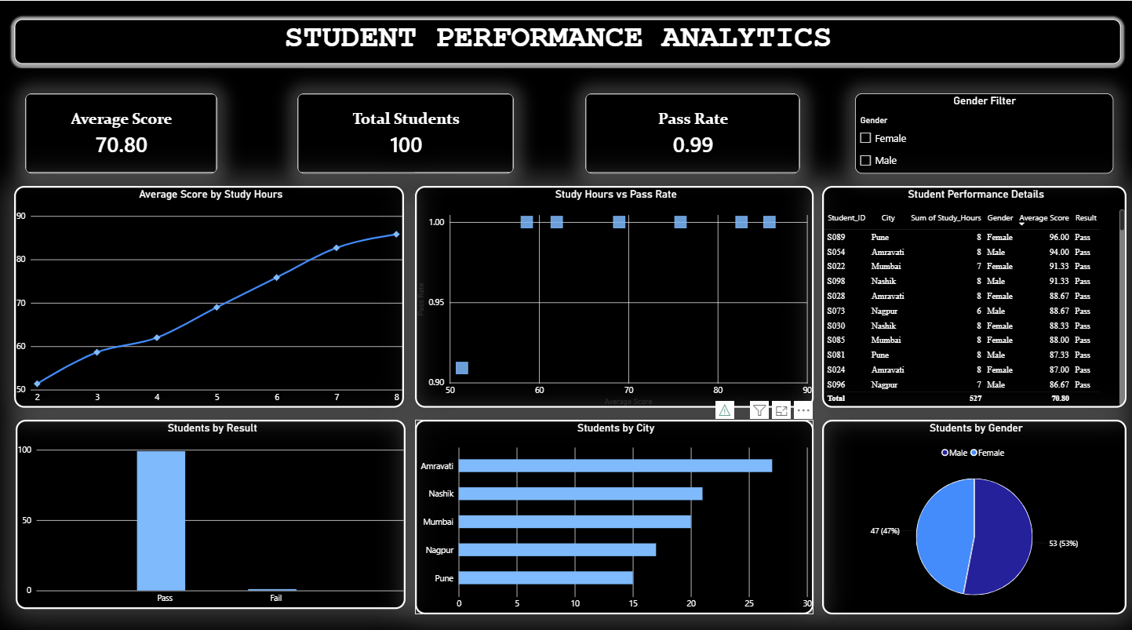
TASK 6
Power BI Dashboard
Interactive "Student Performance Analytics" dashboard with KPI cards, charts, slicer and detail table.
STUDENT PERFORMANCE ANALYSIS
7

Slide 8
TASK 6
Dashboard Highlights
70.80
100
0.99
Average Score
Total Students
Pass Rate
VISUALS INCLUDED
Average Score by Study Hours (line chart)
Students by City — Amravati, Nashik, Mumbai, Nagpur, Pune
Study Hours vs. Pass Rate
Students by Gender (pie chart)
Students by Result (column chart)
Student Performance Details table + Gender filter
STUDENT PERFORMANCE ANALYSIS
8

Slide 9
TASK 7
Business Insights
1
Study Hours Drive Performance
2
Attendance Matters
More study time is generally linked to better average scores.
Higher attendance correlates with stronger, more consistent results.
3
Subject Gaps Exist
4
Pass/Fail Visibility
Math, Science & English averages differ — highlighting areas needing support.
Dashboard makes it easy to spot students needing additional attention.
5
Performance Varies by City
6
Balanced Gender Distribution
Student counts and outcomes differ across Mumbai, Pune, Nagpur, Nashik & Amravati.
Population split roughly evenly between male and female students.
STUDENT PERFORMANCE ANALYSIS
9

Slide 10
RECOMMENDATIONS
Recommendations & Conclusion
1
2
Encourage Regular Study
Improve Attendance & Support
Promote consistent study schedules; provide study plans and practice activities to students with lower study hours.
Monitor low attendance and offer extra classes, revision sessions and subject-specific support to at-risk students.
CONCLUSION
Python, Power BI and GitHub together turned raw student records into clear, actionable insight — helping institutions identify students who need support and improve overall academic outcomes.
STUDENT PERFORMANCE ANALYSIS
10

