Slide 1
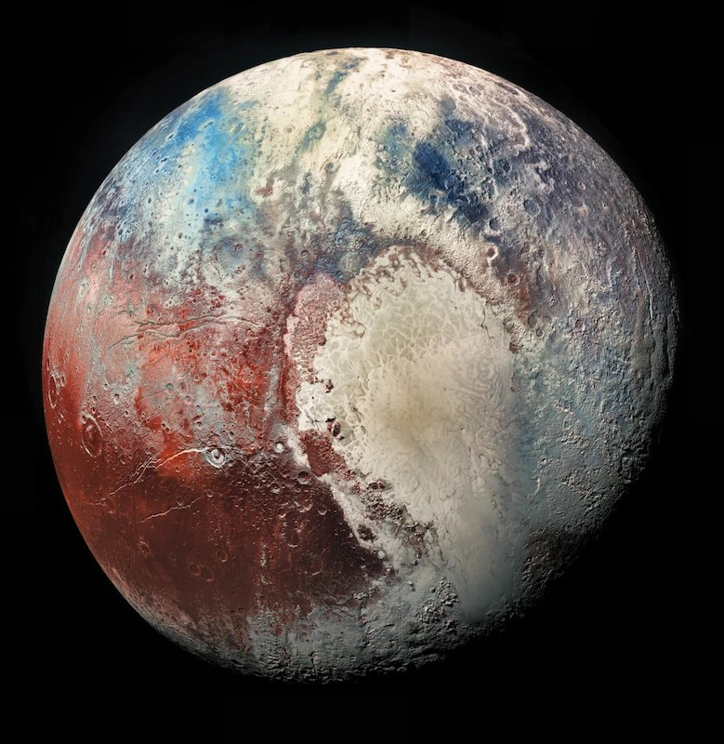
New Horizons
The first mission to Pluto and the Kuiper Belt
Pluto in enhanced color (New Horizons data)
Project 4.2.1 Unmanned Systems Investigation
Notes:
Hello. My unmanned system is NASA's New Horizons, the first spacecraft to visit Pluto and then continue into the Kuiper Belt. In about five minutes I will cover why it was built, how it works, what it found, and how it changed space exploration.

Slide 2
New Horizons reached Pluto, a world no spacecraft had visited
INTRODUCTION
Goal: map Pluto and its moons, then explore the Kuiper Belt.
9.5 years
4.9 billion
1st
from launch to Pluto
km traveled (3 billion miles)
spacecraft to visit Pluto
Outline
Why it was built
The spacecraft
The journey and findings
Conclusion and impact
1
2
3
4
Notes:
New Horizons is an unmanned spacecraft that traveled about 4.9 billion kilometers, roughly three billion miles, over nine and a half years to reach Pluto. It was built by the Johns Hopkins Applied Physics Laboratory for NASA, with the Southwest Research Institute leading the science. It launched on January 19, 2006 on an Atlas V rocket, and it works in deep space far from the Sun. My outline: why it was built, the spacecraft itself, the journey and what it found, and then my conclusion and its impact.

Slide 3



Pluto was the last unexplored world of the old nine planets
WHY IT WAS BUILT
Nov 2001
Jan 2006
Aug 2006
Feb 2007
Jul 2015
NASA selects the mission
Launch
Pluto becomes a dwarf planet
Jupiter gravity assist
Pluto flyby
Total unknown
Closing window
Kuiper Belt
Telescopes showed only a blurry dot.
Pluto's thin atmosphere may freeze as it moves away from the Sun.
An icy belt found in 1992 that no spacecraft had visited.
Notes:
Why build it? Pluto was the one world of the old nine planets that no spacecraft had visited, and telescopes showed it only as a blurry dot. Scientists also worried that as Pluto moved away from the Sun, its thin atmosphere would freeze, so there was a window to study it. And the Kuiper Belt, found in 1992, was unexplored. A 2003 US science survey made it a top priority, and NASA selected New Horizons in 2001. The spacecraft launched in January 2006. Seven months later, in August 2006, astronomers reclassified Pluto as a dwarf planet, but the mission went ahead unchanged. In 2007 Jupiter's gravity gave it a speed boost that saved about three years.

Slide 4
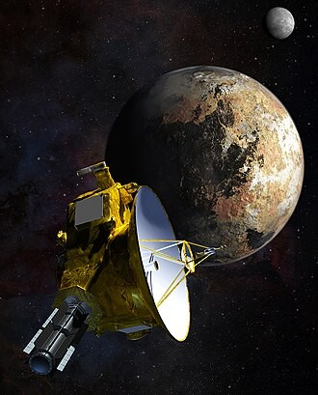



A piano-sized spacecraft that runs on plutonium power
THE SPACECRAFT
Energy
One plutonium RTG gives about 200 W at Pluto, where sunlight is 1/1000 of Earth's.
Communication
A 2.1 m dish sends data at about 1 kilobit per second. One-way signals take 4.5 hours.
Computers and instruments
Two backup 12 MHz computers run 7 instruments, including a student-built dust counter.
Artist's concept: New Horizons at Pluto and Charon
Notes:
New Horizons weighed 478 kilograms, about the size of a grand piano. For energy it uses one radioisotope generator that turns the heat of decaying plutonium into electricity, about 245 watts at launch and 200 at Pluto, because sunlight there is a thousand times weaker than on Earth. For communication it uses a 2.1 meter dish and X-band radio through NASA's Deep Space Network. A signal takes four and a half hours one way, and the data rate at Pluto is only about one kilobit per second. For information processing it has two redundant radiation-hardened computers, and it stores images on recorders until it can send them. On July 4, 2015 it switched itself to the backup computer, ten days before the flyby. Its seven instruments include cameras, spectrometers, and a dust counter built by university students.

Slide 5
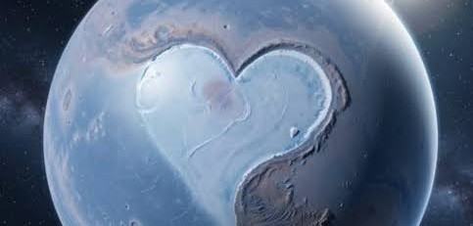
After 9.5 years, New Horizons found a geologically active Pluto
THE JOURNEY AND FINDINGS
Illustration of Pluto's heart-shaped icy plain
12,500 km
3,500 m
5 moons
closest approach
ice mountains
found around Pluto
Notes:
This chart shows how far from the Sun it was at four milestones. One AU is the distance from Earth to the Sun. It left Earth at about 58,000 kilometers per hour, the fastest launch of any spacecraft up to that time. On July 14, 2015 it passed 12,500 kilometers above Pluto. Pluto is only about a fifth of Earth's width, yet it has water-ice mountains up to 3,500 meters tall, glaciers of nitrogen ice in a heart-shaped region named after its discoverer Clyde Tombaugh, a blue haze, and five moons. A surface that young shows Pluto is still geologically active.

Slide 6



Conclusion
CONCLUSION AND IMPACT
Common thread
Major influences
Cause and effect
Curiosity about places humans cannot reach drives better machines.
Stronger rockets, nuclear power, tough electronics, and long-range radio.
Questions drive missions. Missions bring data that raise new questions.
Impact
The flyby was broadcast live, and its data took 16 months to arrive. New Horizons passed Arrokoth in 2019 and still works more than 60 AU from the Sun, in the same NASA program as Juno and Dragonfly.
Sources: NASA New Horizons mission pages; Johns Hopkins APL (pluto.jhuapl.edu); PLTW Project 4.2.1.
Notes:
To conclude. The common thread in unmanned systems is curiosity about places humans cannot go, which pushes engineers to invent better machines. The major influences were better rockets, nuclear power, radiation-hardened electronics, and long-range radio. The cause and effect is a loop: questions lead to missions, missions bring data and technology, and the data raises the next questions. On impact: NASA streamed the flyby live, the last of the data arrived in October 2016, the spacecraft flew past the icy object Arrokoth on January 1, 2019, and it is still working today. Thank you.

