Slide 1
Retail Sales Dashboard using Tableau Data Analytics Internship Project BY SWETHA KALERI

Slide 2
To analyze retail sales data and derive business insights
OBJECTIVES:
Tool: Tableau (Interactive Dashboard)
Dataset: Kaggle Retail Sales (Demographics + Transactions)
Deliverables: Dashboard + PPT Summary + GitHub Repo

Slide 3

WHY TABLEAU : 1.Creative Dashboard 2.User-Friendly 3. Handles Large Data 4.Interactive Analysis 5. Sharing & Collaboration

Slide 4
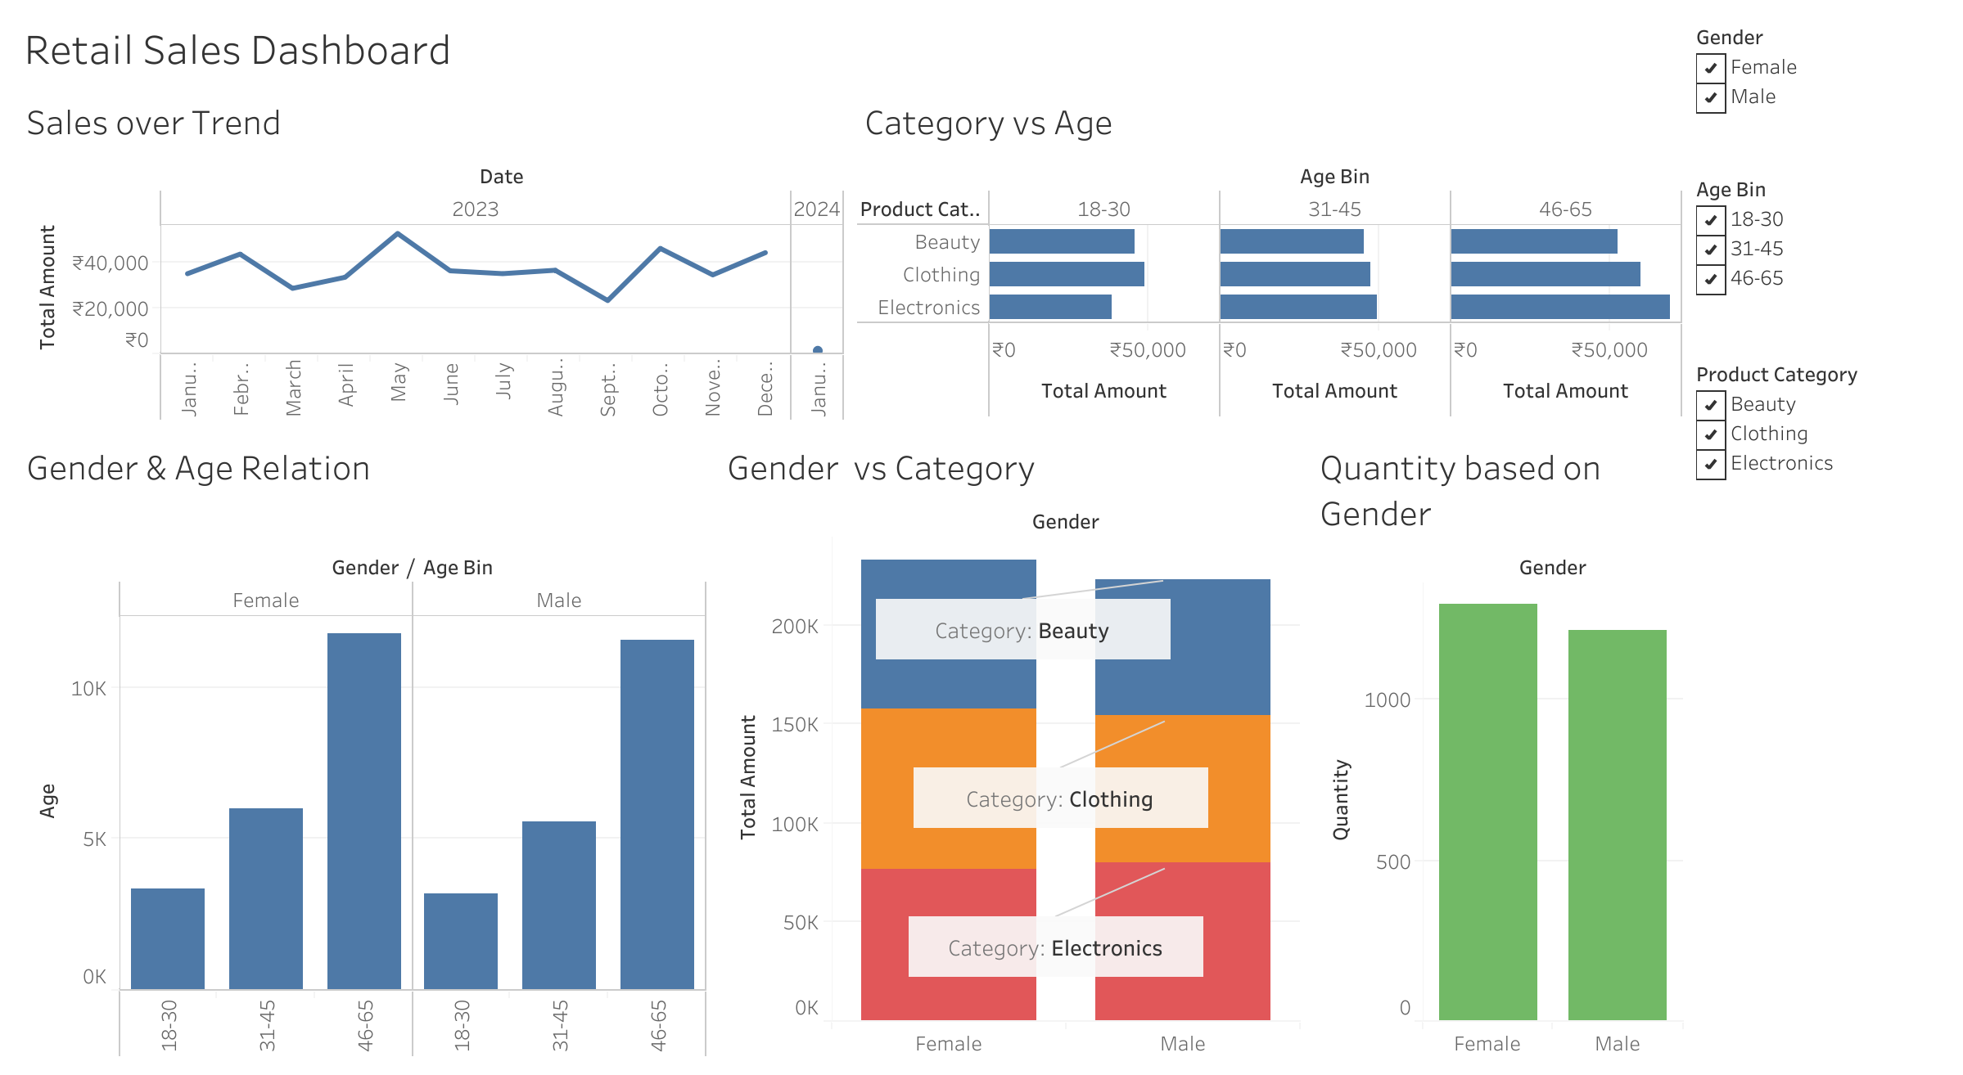

Slide 5
Key Insights
Sales peaked in May (₹53,150) and October (₹46,580); lowest in September (₹23,620).
Age Preferences: 18–30 → Clothing & Beauty; 31–45 → balanced; 46–65 → Electronics & Clothing.
Gender Preferences: Women spend more overall; dominate Beauty category (₹75K vs ₹68K).
Demographics: Highest customers from 46–65, lowest from 18–30

Slide 6
CONCLUSION
Electronics and Clothing categories attract wider age Groups, while Beauty is female-dominated.
Seasonal peaks suggest opportunities for targeted promotions in May & October.
The dashboard enables quick exploration of sales by demographics and category for better decision-making.

Slide 7
thank you
SWETHA KALERI
swethakaleri1230@gmail.com
Cell:7989922131

