Slide 1

US Wildfire Analysis
INFO 6105 - Data Science Engineering Methods and Tools
Rutuja Kale NU ID- 001592244

Slide 2
Outline
INTRODUCTION
PROBLEM STATEMENT
IMPORTING DATA AND CONTENT
DATA CLEANING AND PREPROCESSING
DATA VISUALIZATION
ANALYSIS USING ML ALGORITHM
CONCLUSION

Slide 3
Introduction
Each year, forest fires consume millions of acres of land, destroying thousands of homes and properties in the United States and around the world. Fires like the 100,277-hectare Lutz Creek fire in British Columbia in August 2018 and the Camp Fire in California in November 2018, which burned more than 142,000 acres, exact a costly economic and human toll. The need to study the relationships between environmental factors and fires to minimize risk is critical.
In this project, I will show you how to analyze, visualize the data and how implement various Machine Learning Algorithms to classify the causes of wildfires. The whole model will take the ‘fire’ part of this dataset and provide percentage accuracy for all possible reasons that could cause wildfires. ¹

Slide 4
Dataset Description & Source Link
Data Source : https://www.kaggle.com/rtatman/188-million-us-wildfires
This data publication contains a spatial database of wildfires that occurred in the United States from 1992 to 2015. It is the third update of a publication originally generated to support the national Fire Program Analysis (FPA) system.
The data were transformed to conform, when possible, to the data standards of the National Wildfire Coordinating Group (NWCG). Basic error-checking was performed, and redundant records were identified and removed, to the degree possible. The resulting product, referred to as the Fire Program Analysis fire-occurrence database (FPA FOD), includes 1.88 million geo-referenced wildfire records, representing a total of 140 million acres burned during the 24-year period. ²

Slide 5
Problem Statement
Objective? Analyzing and predicting the wildfire causes?
Data Analysis Data visualization
Figuring out the top fire-prone locations
Implement Machine Learning Algorithms to analyze and predict the causes of wildfires in United States

Slide 6
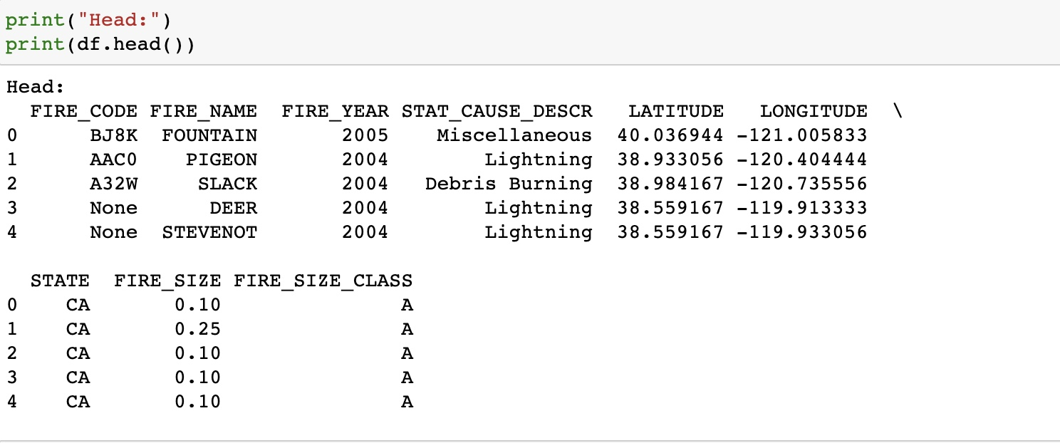
Dataset Content
Implemented sqlite3 to import the dataset.

Slide 7
Dataset Content This dataset is an SQLite database that contains the following information:
FIRE_CODE = Code used within the interagency wildland fire community to track and compile cost information for emergency fire suppression.
FIRE_NAME = Name of the incident, from the fire report (primary) or ICS-209 report (secondary).
FIRE_YEAR = Calendar year in which the fire was discovered or confirmed to exist.
STATCAUSEDESCR = Description of the (statistical) cause of the fire.
LATITUDE = Latitude (NAD83) for point location of the fire (decimal degrees).
LONGITUDE = Longitude (NAD83) for point location of the fire (decimal degrees).
STATE = Two-letter alphabetic code for the state in which the fire burned (or originated), based on the nominal designation in the fire report.
FIRE_SIZE = Estimate of acres within the final perimeter of the fire.
FIRESIZECLASS = Code for fire size based on the number of acres within the final fire perimeter expenditures (A=greater than 0 but less than or equal to 0.25 acres, B=0.26-9.9 acres, C=10.0-99.9 acres, D=100-299 acres, E=300 to 999 acres, F=1000 to 4999 acres, and G=5000+ acres). ³

Slide 8
Analysis Using Following Algorithm
Gaussian Naïve Bayes
Decision Tree
Random Forest

Slide 9
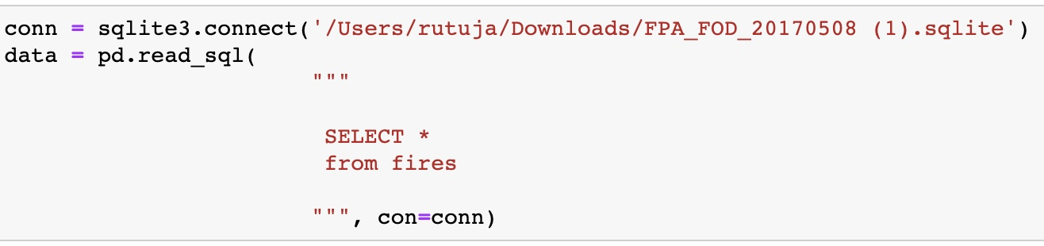
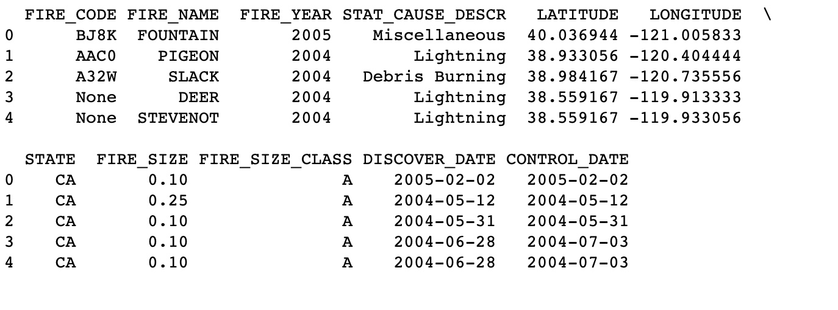
Reading and Pre-processing Data
Importing data from Kaggle

Slide 10
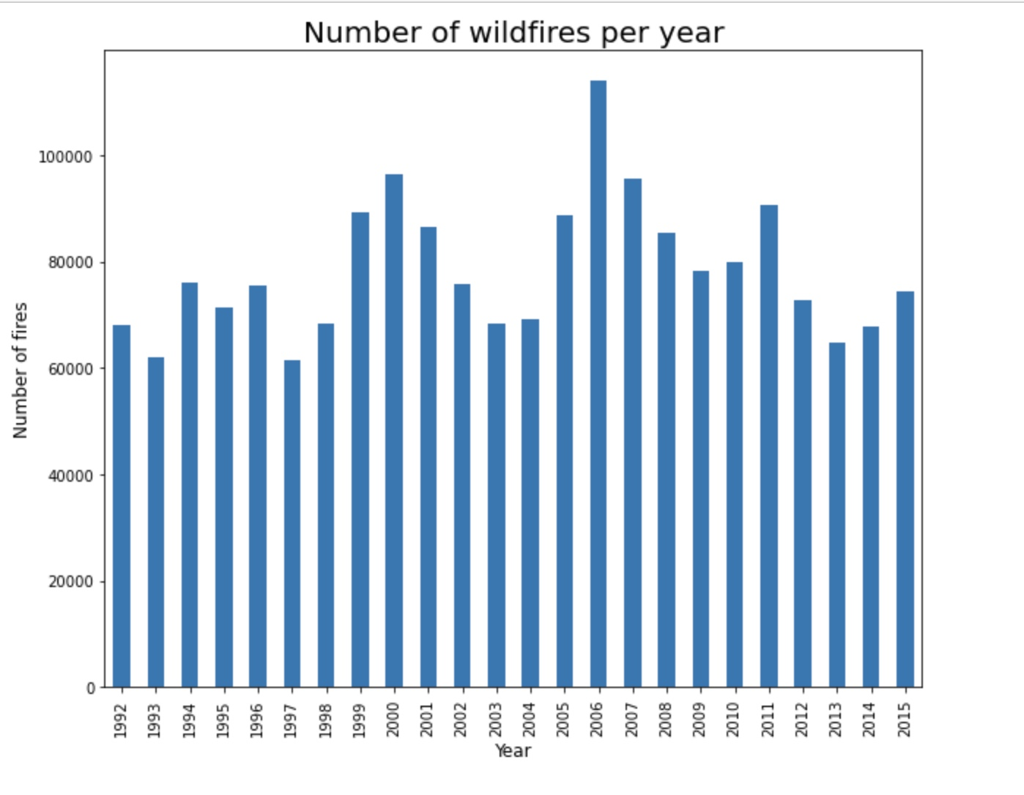
1. Number of Wildfires per year
Visualization
I have created a bar plot of fires per year.
In 2006 maximum incidents of wildfires took place.
Around 10,000 - 15,000 incidents of wildfire take place every year.

Slide 11
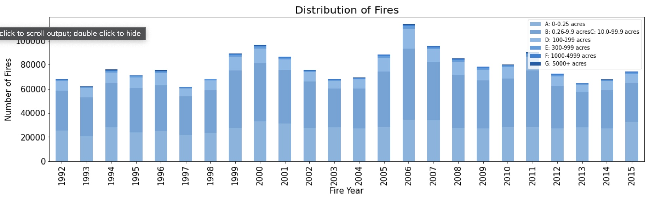
2. Number of fires for each class per year
Visualization
Analyze the wildfire occurrences based on fire size class.
Considering the FIRE_SIZE_CLASS column, were
A= 0- 0.25 acres,
B= 0.26-9.9 acres,
C=10.0-99.9 acres,
D=100-299 acres,
E=300 to 999 acres,
F=1000 to 4999 acres, and
G=5000+ acres
Analyzing the occurrence of large fires i.e., fire_size_class 'G'.

Slide 12
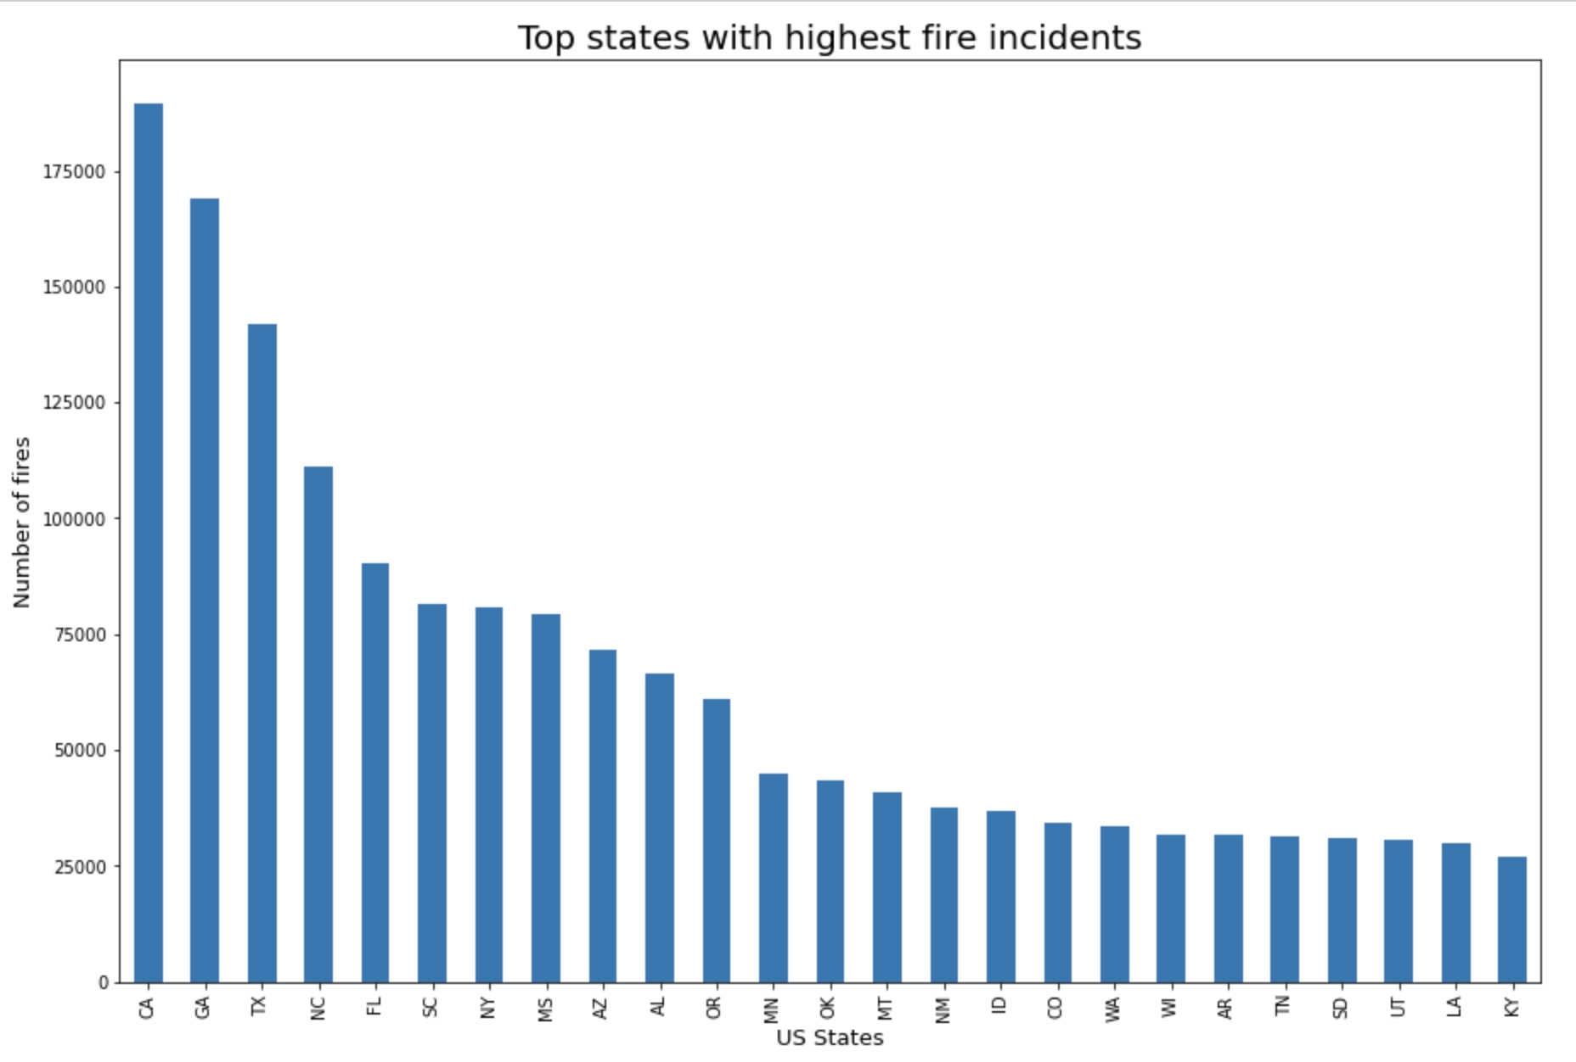
3. Top states with highest fire incidents
Visualization
Result :- CA, GA, TX, are more top three more susceptible to fire.
I have decided to use this data to predict the causes of wildfires.

Slide 13
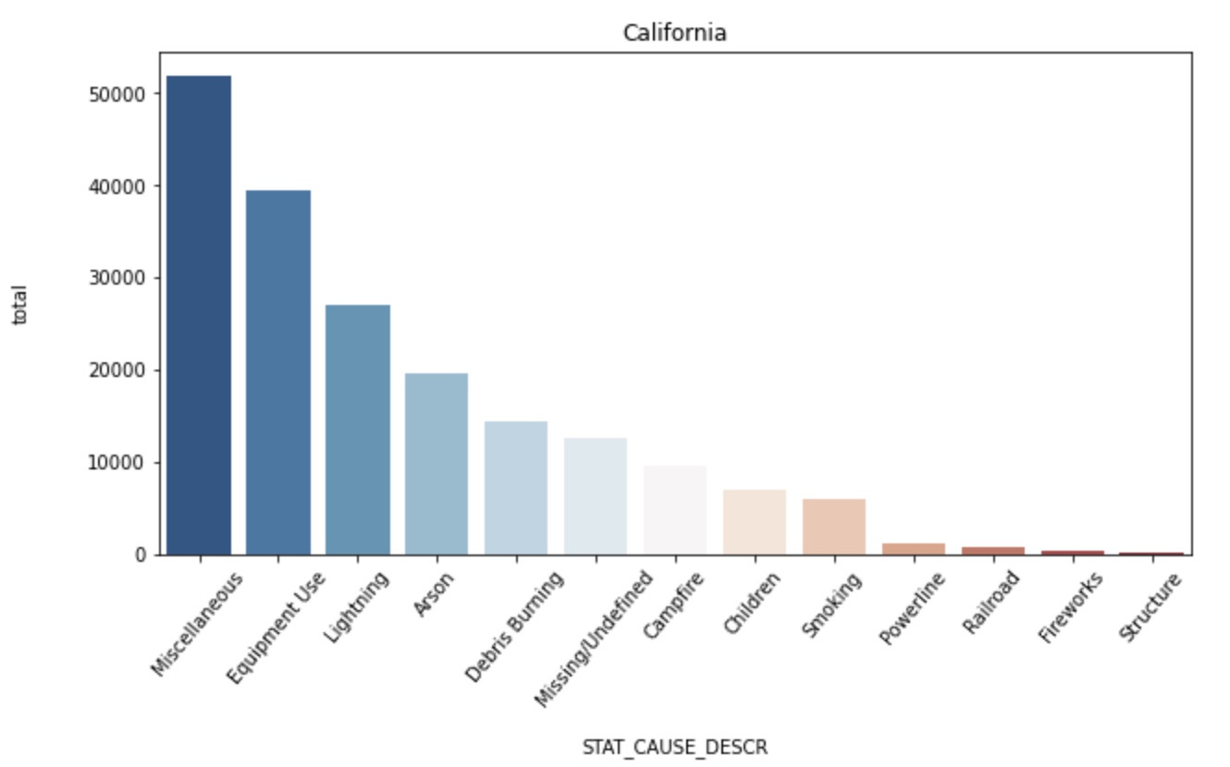
4. Number of Wildfires with Causes CA, TX, GA
Visualization
Next question comes is what caused this high probability of wildfire, so here I have picked top three states to identify the causes of wildfire.

Slide 14
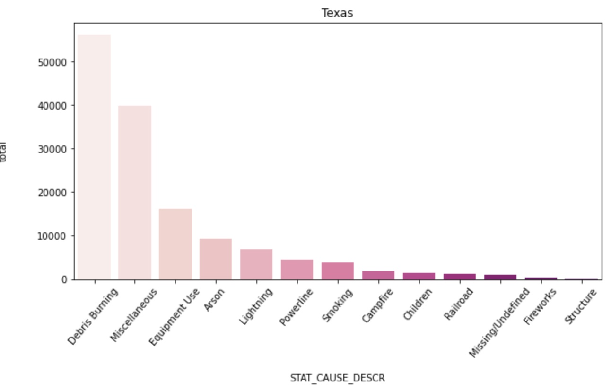
Number of Wildfires with Causes in Texas
Visualization

Slide 15
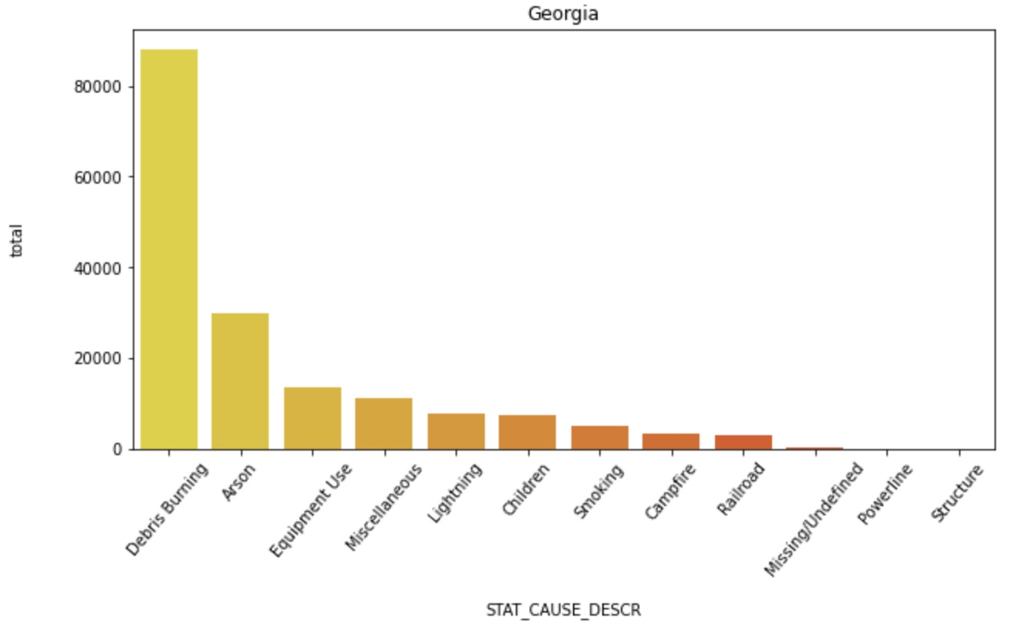
Number of Wildfires with Causes in Georgia
Visualization
There is a very small percentage of natural cause for wildfire. Most of the wildfire is initiated because of some or other human activity such as Debris Burning , Arson (malicious)

Slide 16
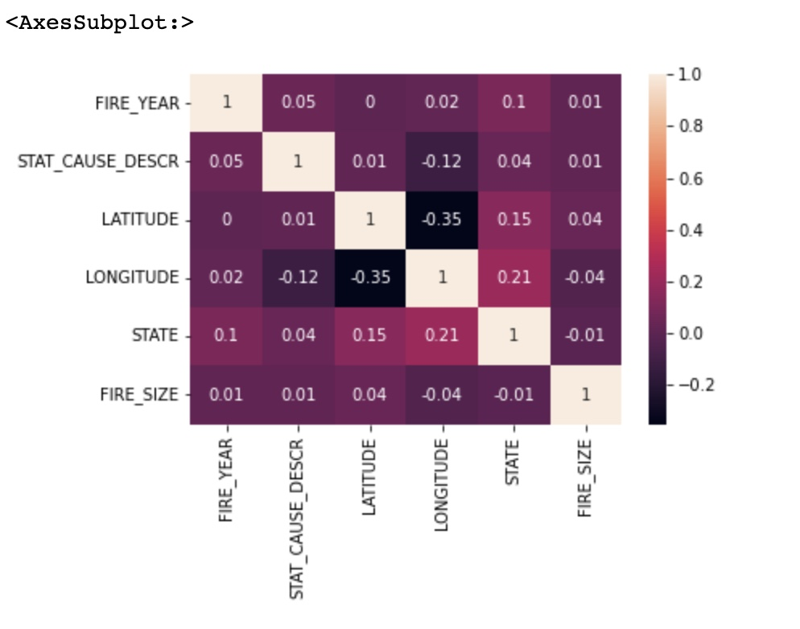
Correlation -
Visualization
I have transferred the states and causes to numeric numbers.
Tried to calculate the correlations but found out the dataset didn’t show a strong correlation.
It is difficult to predict the fire causes, I used ML algorithms on the dataset to analyze, predict wildfires.

Slide 17
Gaussian Naive Bayes
ML Algorithm
Naive Bayes is a statistical classification technique based on Bayes Theorem. It is one of the simplest supervised learning algorithms. Naive Bayes classifier is the fast, accurate and reliable algorithm. Naive Bayes classifiers have high accuracy and speed on large datasets.
Naive Bayes classifier assumes that the effect of a particular feature in a class is independent of other features. For example, a loan applicant is desirable or not depending on his/her income, previous loan and transaction history, age, and location. Even if these features are interdependent, these features are still considered independently. This assumption simplifies computation, and that's why it is considered as naive. ⁴

Slide 18
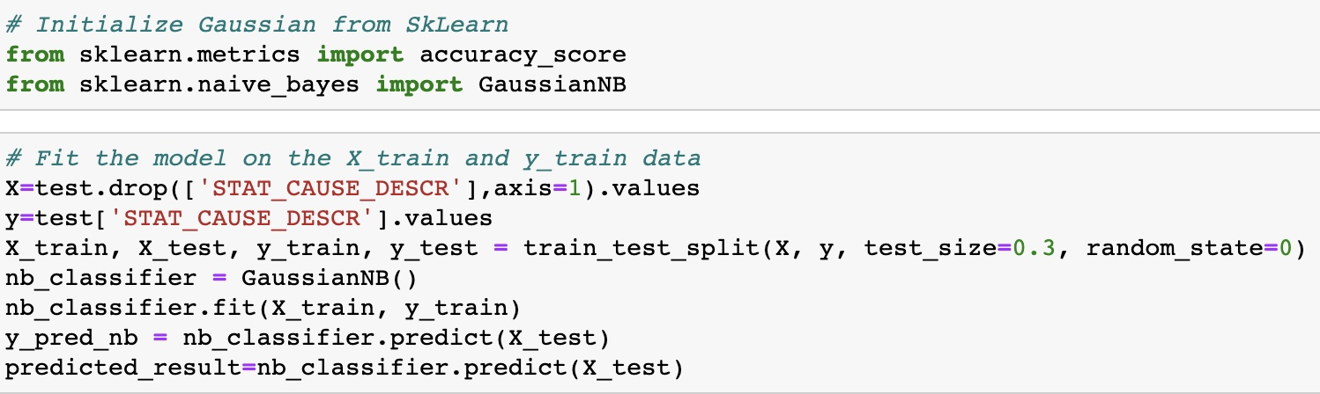
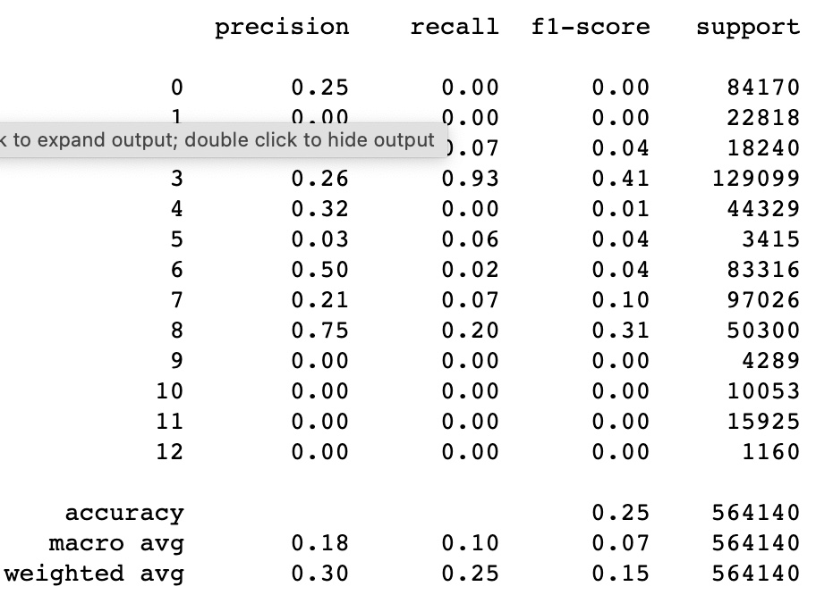
Gaussian Naive Bayes
Imported the Gaussian Naive Bayes model, created a Gaussian Classifier.
Trained the model and predicted the response for the test dataset.
And finally came to an accuracy of around 25%, which is not good.

Slide 19
Decision Tree
Decision Trees (DTs) are a non-parametric supervised learning method used for classification and regression. The goal is to create a model that predicts the value of a target variable by learning simple decision rules inferred from the data features. A tree can be seen as a piecewise constant approximation.²
The concept of entropy plays an important role in calculating Information Gain.
Information Gain is applied to quantify which feature provides maximal information about the classification based on the notion of entropy, i.e., by quantifying the size of uncertainty, disorder or impurity, in general, with the intention of decreasing the amount of entropy initiating from the top (root node) to bottom(leaves nodes).⁵

Slide 20
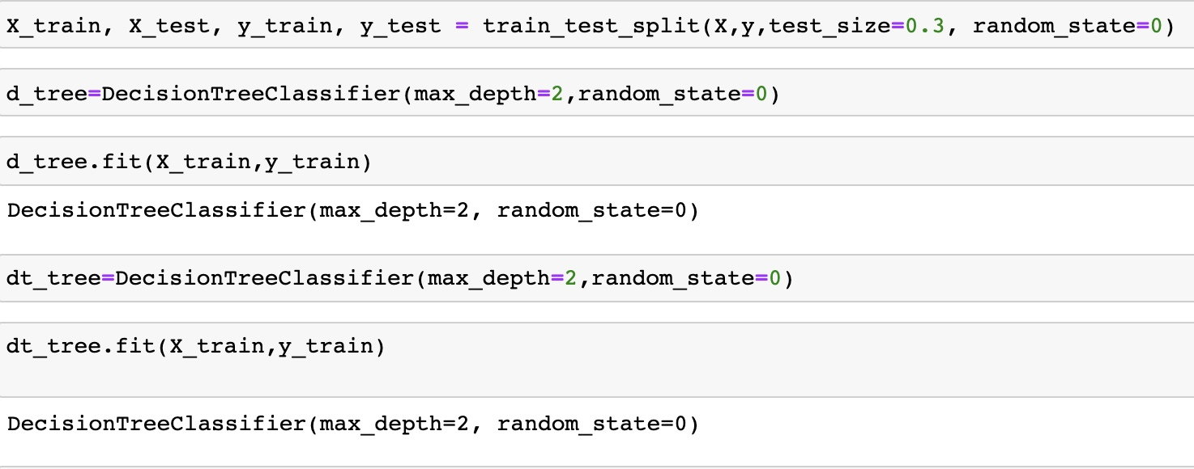
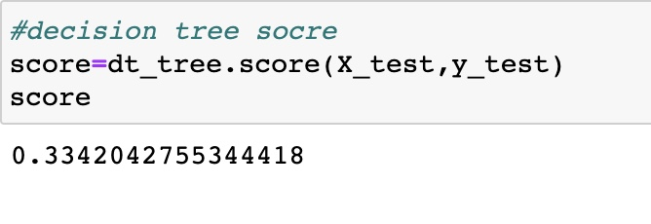
Decision Tree
Collected the data required and converted data to numeric numbers.
The trained data came out with a score of 33%.

Slide 21
Random forest
Random forest is a supervised learning algorithm. It can be used both for classification and regression.
It is also the most flexible and easy to use algorithm. A forest is comprised of trees. It is said that the more trees it has, the more robust a forest is.
Random forests creates decision trees on randomly selected data samples, gets prediction from each tree and selects the best solution by means of voting. It also provides a pretty good indicator of the feature importance. ⁶
Random forests has a variety of applications, such as recommendation engines,
image classification and feature selection. It can be used to classify loyal loan applicants, identify fraudulent activity and predict diseases. It lies at the base of the Boruta algorithm, which selects important features in a dataset ^{7,8}

Slide 22
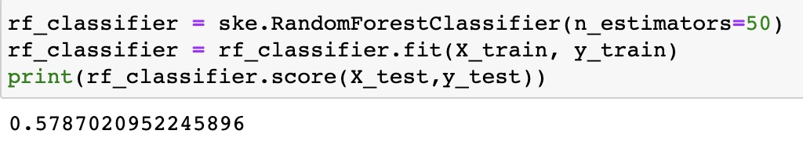
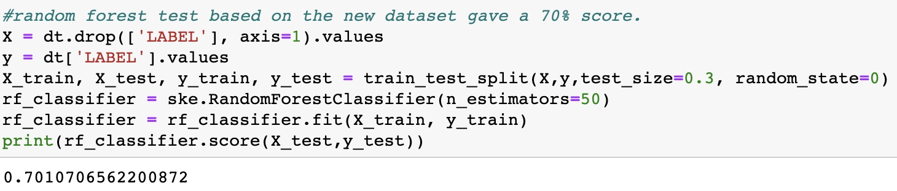
Random forest
The 58% score was much better than before.
I have decided to classify the causes into 4 classes: Natural, Accidental, Malicious and Other.
Then, did a random forest test based on the new dataset, which gave a 70% score.

Slide 23
Model Improvement
After reducing the number of attributes model gave the accuracy 70% using random forest. But the accuracy is not good for malicious part which is Arson.
The previous model has the US wildfires and try to classify the causes into four classes. So, I have decided to perform random forest algorithm on single state with one fire cause, malicious.
Next step is to predict malicious fires on top three state. CA, GA and TX. In order to improve the accuracy, drop some columns to do that.⁹

Slide 24
Random Forest
To improve the model, I have created a filed Arson.
Hence, I was able to predict fire cause in 3 states, with a better accuracy of 94%.
CA (California) State the accuracy is 91%
GA (Georgia) State the accuracy is 85 %
TX (Texas) State the accuracy is 94%

Slide 25
Conclusion
Performed necessary data pre-processing , apply various classification and regression models to predict the causes for wildfires. Also, improve the accuracy of the predictions using tuning and validation methods.
In this project, I have implemented multiple machine learning methods to predict wildfire causes. The models I have attempted to apply include Decision Tree, Gaussian Naïve bayes , and Random Forest machine learning algorithms. But observed limited accuracy among all models on the current dataset.
Random forest turn out to be the best model and gave accuracy around 70 % but didn’t work well for the Arson part. Hence, in the next model I drop few columns which are not required and work on only one state to check the wildfire cause in that state is malicious or not. And finally got 94 % accuracy.
Random Forest accuracy is 94 % which is a great to predict the causes of wildfires in United States.

Slide 26
References
https://earthdata.nasa.gov/learn/toolkits/wildfires
https://www.kaggle.com/rtatman/188-million-us-wildfires
https://www.kaggle.com/rtatman/188-million-us-wildfires
https://www.datacamp.com/community/tutorials/naive-bayes-scikit-learn
https://scikit-learn.org/stable/modules/tree.html
https://medium.com/analytics-steps/understanding-the-gini-index-and-information-gain-in-decision-trees-ab4720518ba8
https://www.datacamp.com/community/tutorials/random-forests-classifier-python
https://mrdatascience.com/how-to-predict-the-cause-of-wildfires-using-a-random-forest-classifier/
https://www.usgs.gov/news/data-release-combined-wildfire-datasets-united-states-and-certain-territories-1878-2019

Slide 27
Thank You

