Slide 1

US Wildfire Analysis
INFO 6105 - Data Science Engineering Methods and Tools
Rutuja Kale NU ID- 001592244

Slide 2
Outline
INTRODUCTION
PROBLEM STATEMENT
IMPORTING DATA AND CONTENT
DATA CLEANING AND PREPROCESSING
DATA VISUALIZATION
ANALYSIS USING ML ALGORITHM
CONCLUSION

Slide 3
Introduction
Every year, the wildfires are destroying the areas, houses near the forest in the United States and around the world. It’s high time to study the causes of wildfires in the area to avoid the situation in the future. Which will benefit the government to prevent the forest area from such activities.
I will be working on wildfire data, how to use ML algorithm to predict the wildfire causes in the United States. I am taking the ‘fire’ column of this wildfire dataset and calculating the percentage accuracy for all possible causes that could initiate fires in top states. ¹

Slide 4
Problem Statement
Objective? Analyzing and predicting the wildfire causes?
Data Analysis Data visualization
Figuring out the top fire-prone locations
Implement Machine Learning Algorithms to analyze and predict the causes of wildfires in United States

Slide 5
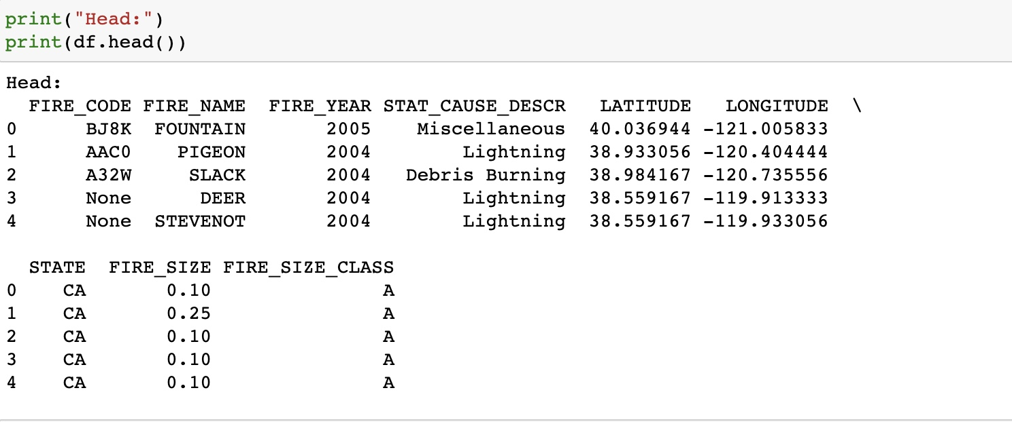
Dataset Content
Implemented sqlite3 to import the dataset.
Data Source : https://www.kaggle.com/rtatman/188-million-us-wildfires

Slide 6
Dataset Content This dataset is an SQLite database that contains the following information:
FIRE_CODE = Code used within the interagency wildland fire community to track and compile cost information for emergency fire suppression.
FIRE_NAME = Name of the incident, from the fire report (primary) or ICS-209 report (secondary).
FIRE_YEAR = Calendar year in which the fire was discovered or confirmed to exist.
STATCAUSEDESCR = Description of the (statistical) cause of the fire.
LATITUDE = Latitude (NAD83) for point location of the fire (decimal degrees).
LONGITUDE = Longitude (NAD83) for point location of the fire (decimal degrees).
STATE = Two-letter alphabetic code for the state in which the fire burned (or originated), based on the nominal designation in the fire report.
FIRE_SIZE = Estimate of acres within the final perimeter of the fire.
FIRESIZECLASS = Code for fire size based on the number of acres within the final fire perimeter expenditures (A=greater than 0 but less than or equal to 0.25 acres, B=0.26-9.9 acres, C=10.0-99.9 acres, D=100-299 acres, E=300 to 999 acres, F=1000 to 4999 acres, and G=5000+ acres). ³

Slide 7
Analysis Using Following Algorithm
Gaussian Naïve Bayes
Decision Tree
Random Forest

Slide 8
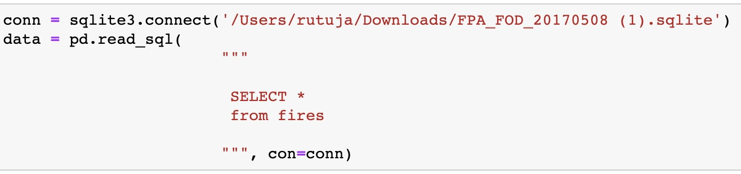
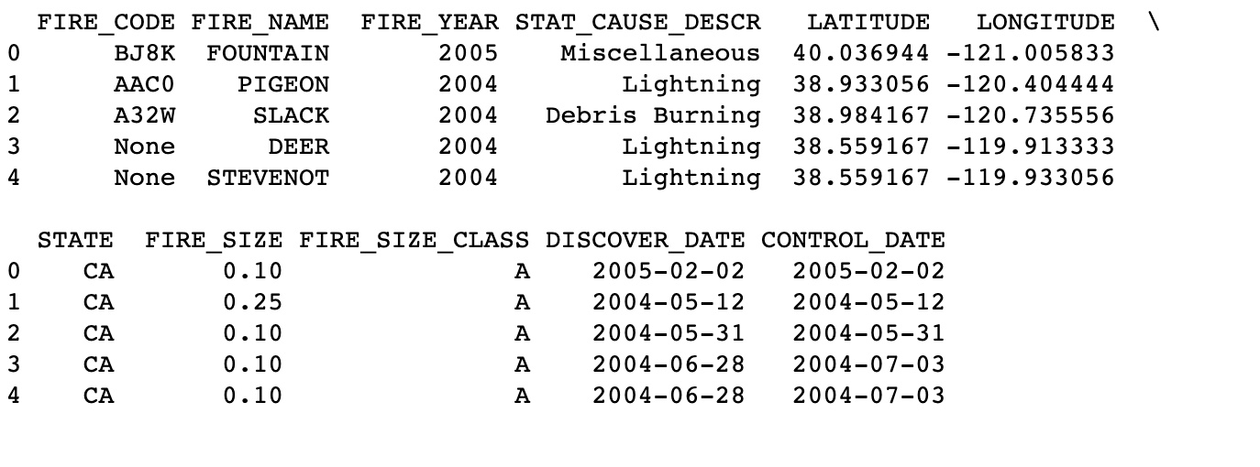
Reading and Pre-processing Data
Importing data from Kaggle

Slide 9
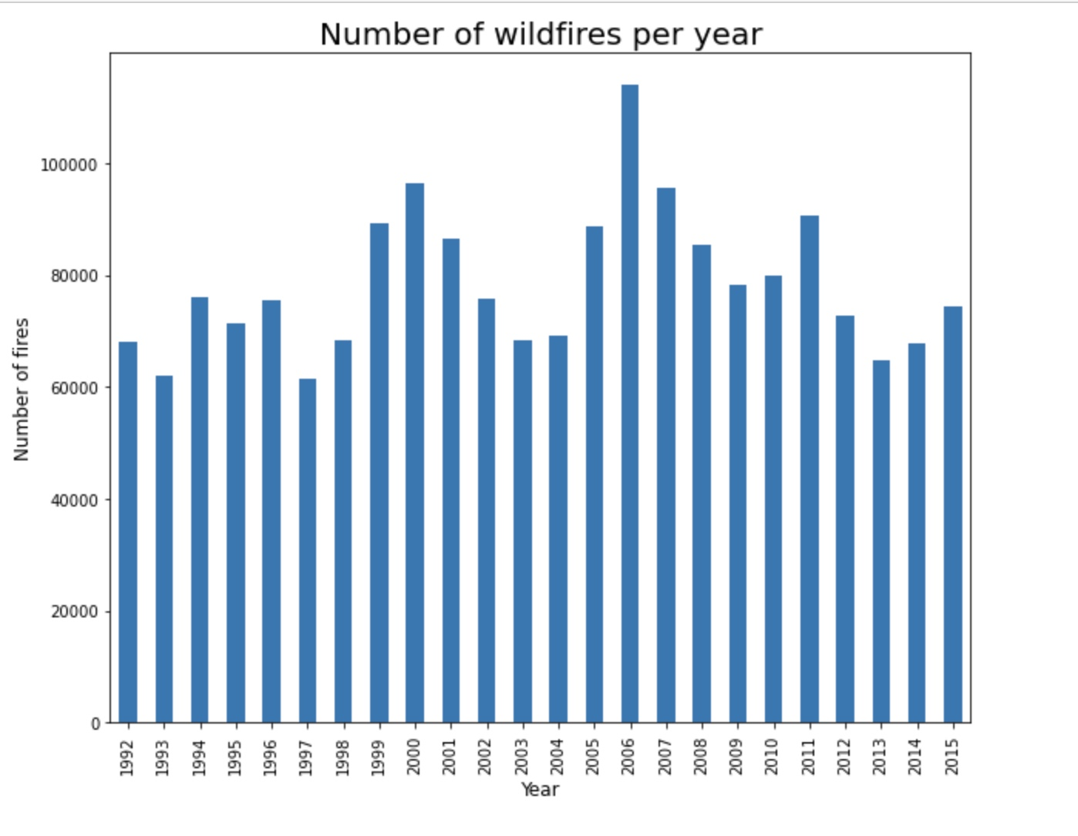
1. Number of Wildfires per year
Visualization
I have created a bar plot of fires per year.
In 2006 maximum incidents of wildfires took place.
Around 10,000 - 15,000 incidents of wildfire take place every year.

Slide 10
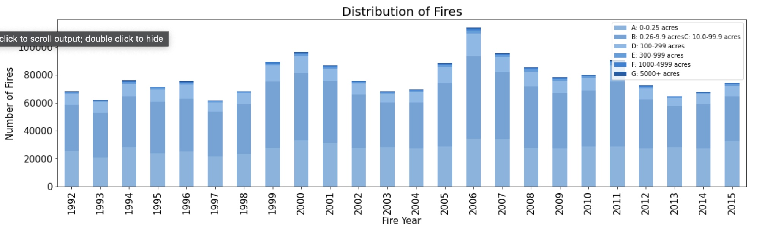
2. Number of fires for each class per year
Visualization
Analyze the wildfire occurrences based on fire size class.
Considering the FIRE_SIZE_CLASS column, were
A= 0- 0.25 acres,
B= 0.26-9.9 acres,
C=10.0-99.9 acres,
D=100-299 acres,
E=300 to 999 acres,
F=1000 to 4999 acres, and
G=5000+ acres
Analyzing the occurrence of large fires i.e., fire_size_class 'G'.

Slide 11
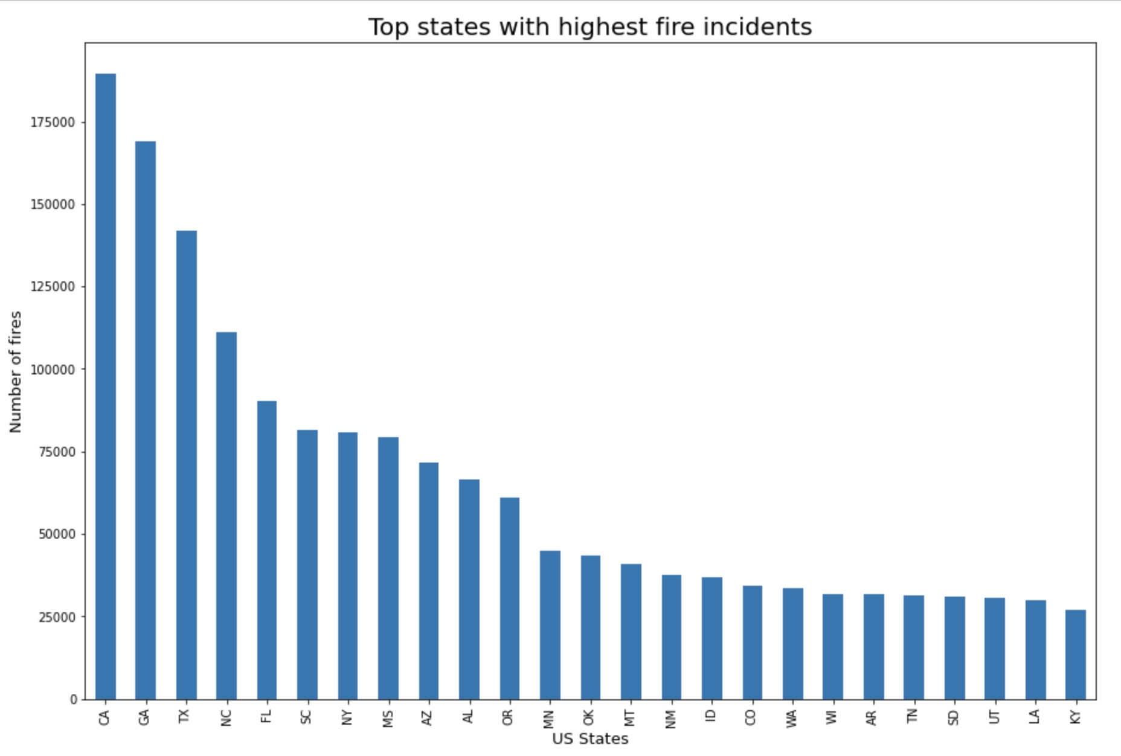
3. Top states with highest fire incidents
Visualization
Result :- CA, GA, TX, are more top three more susceptible to fire.
I have decided to use this data to predict the causes of wildfires.

Slide 12
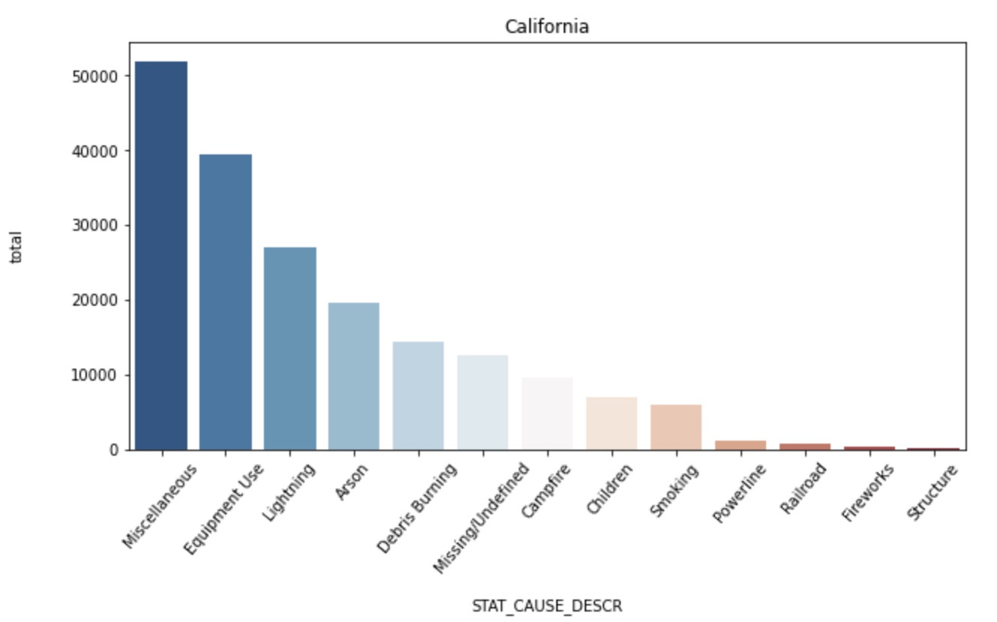
4. Number of Wildfires with Causes CA, TX, GA
Visualization
Next question comes is what caused this high probability of wildfire, so here I have picked top three states to identify the causes of wildfire.

Slide 13
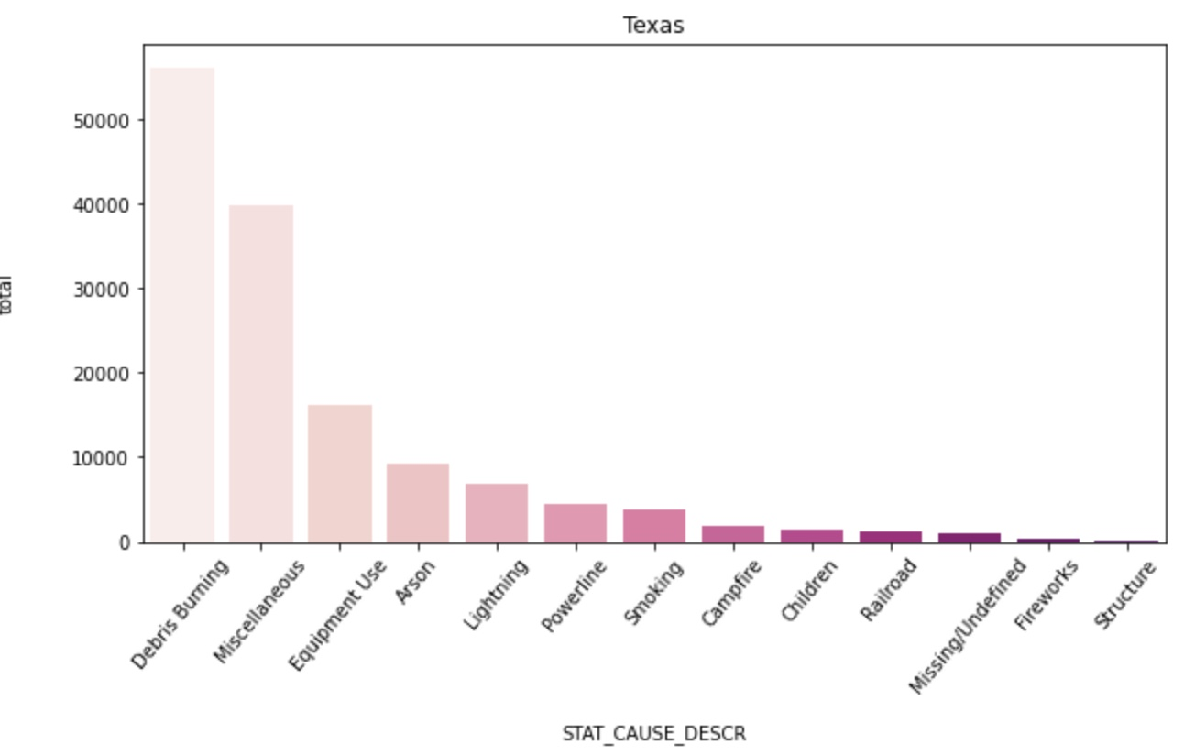
Number of Wildfires with Causes in Texas
Visualization

Slide 14
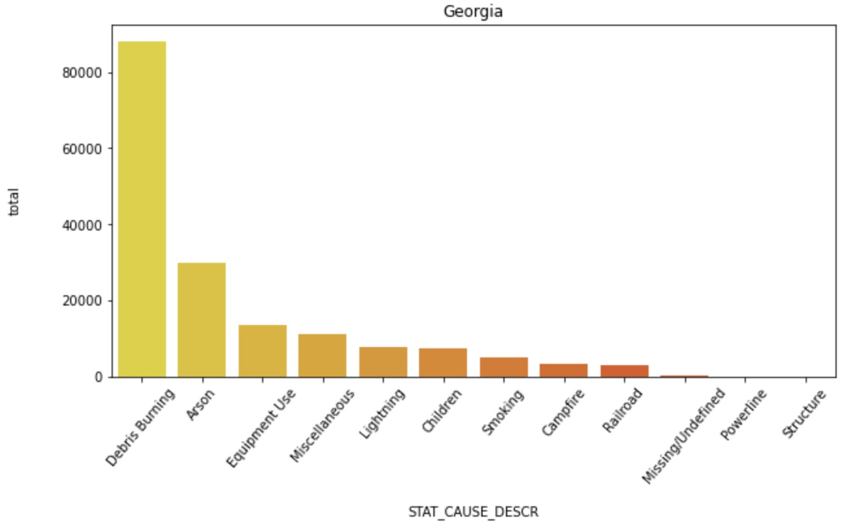
Number of Wildfires with Causes in Georgia
Visualization
There is a very small percentage of natural cause for wildfire. Most of the wildfire is initiated because of some or other human activity such as Debris Burning , Arson (malicious)

Slide 15
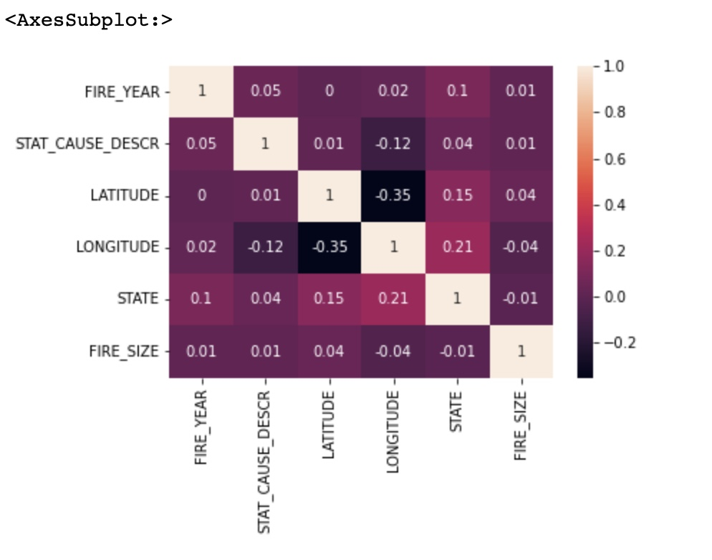
Correlation -
Visualization
I have transferred the states and causes to numeric numbers.
Tried to calculate the correlations but found out the dataset didn’t show a strong correlation.
It is difficult to predict the fire causes, I used ML algorithms on the dataset to analyze, predict wildfires.

Slide 16
Gaussian Naive Bayes
ML Algorithm
Naive Bayes is a statistical classification technique based on Bayes Theorem. It is one of the simplest supervised learning algorithms. Naive Bayes classifier is the fast, accurate and reliable algorithm. Naive Bayes classifiers have high accuracy and speed on large datasets.
Naive Bayes classifier assumes that the effect of a particular feature in a class is independent of other features. For example, a loan applicant is desirable or not depending on his/her income, previous loan and transaction history, age, and location. Even if these features are interdependent, these features are still considered independently. This assumption simplifies computation, and that's why it is considered as naive. ⁴

Slide 17
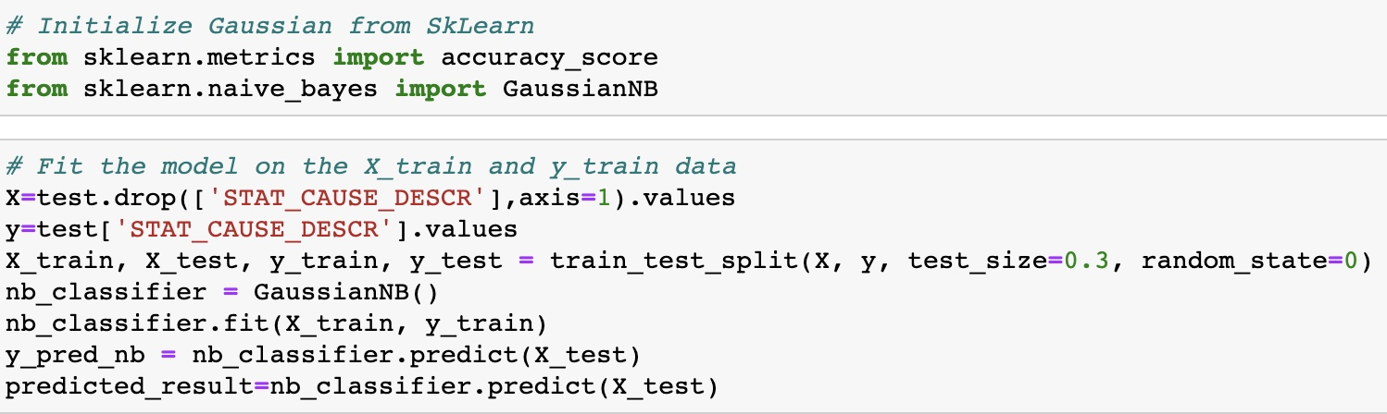
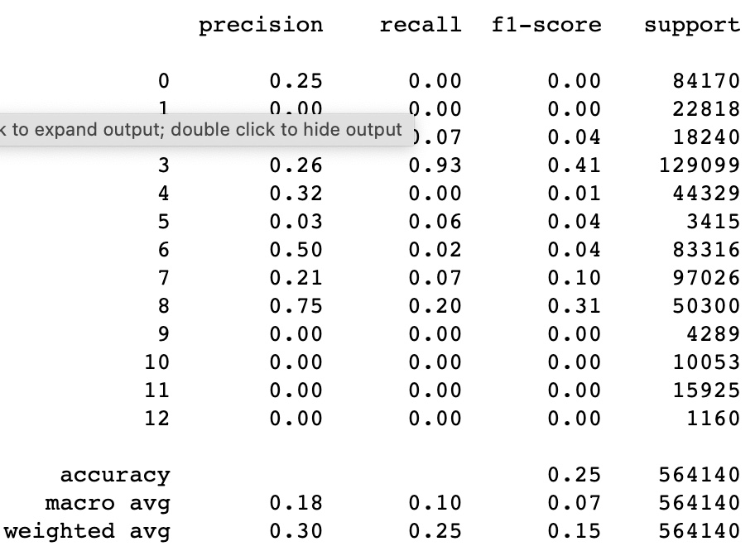
Gaussian Naive Bayes
Imported the Gaussian Naive Bayes model, created a Gaussian Classifier.
Trained the model and predicted the response for the test dataset.
And finally came to an accuracy of around 25%, which is not good.

Slide 18
Decision Tree
Decision Trees (DTs) are a non-parametric supervised learning method used for classification and regression. The goal is to create a model that predicts the value of a target variable by learning simple decision rules inferred from the data features. A tree can be seen as a piecewise constant approximation.²
The concept of entropy plays an important role in calculating Information Gain.
Information Gain is applied to quantify which feature provides maximal information about the classification based on the notion of entropy, i.e., by quantifying the size of uncertainty, disorder or impurity, in general, with the intention of decreasing the amount of entropy initiating from the top (root node) to bottom(leaves nodes).⁵

Slide 19
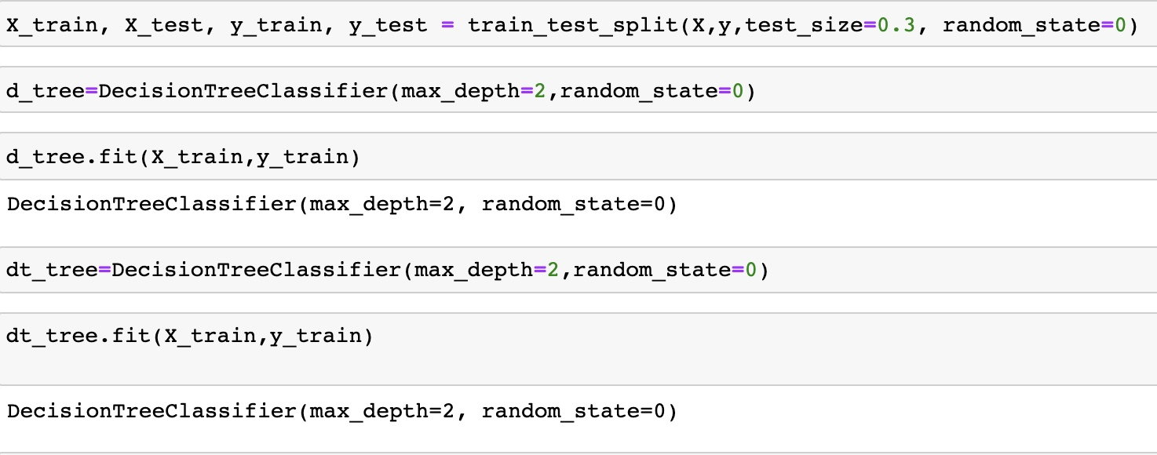
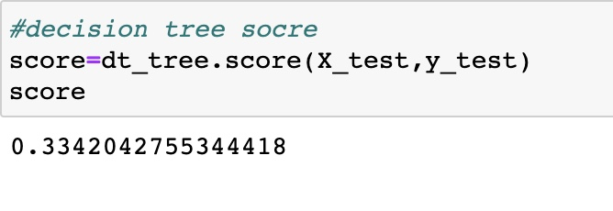
Decision Tree
Collected the data required and converted data to numeric numbers.
The trained data came out with a score of 33%.

Slide 20
Random forest
Random forest is a supervised learning algorithm. It can be used both for classification and regression.
It is also the most flexible and easy to use algorithm. A forest is comprised of trees. It is said that the more trees it has, the more robust a forest is.
Random forests creates decision trees on randomly selected data samples, gets prediction from each tree and selects the best solution by means of voting. It also provides a pretty good indicator of the feature importance. ⁶
Random forests has a variety of applications, such as recommendation engines,
image classification and feature selection. It can be used to classify loyal loan applicants, identify fraudulent activity and predict diseases. It lies at the base of the Boruta algorithm, which selects important features in a dataset ^{7,8}

Slide 21
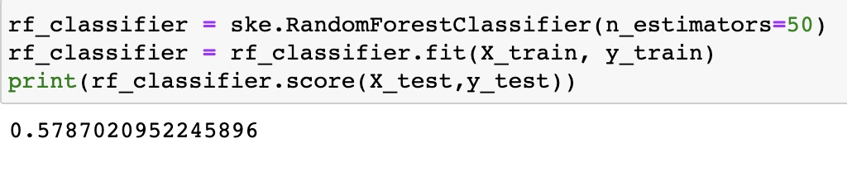
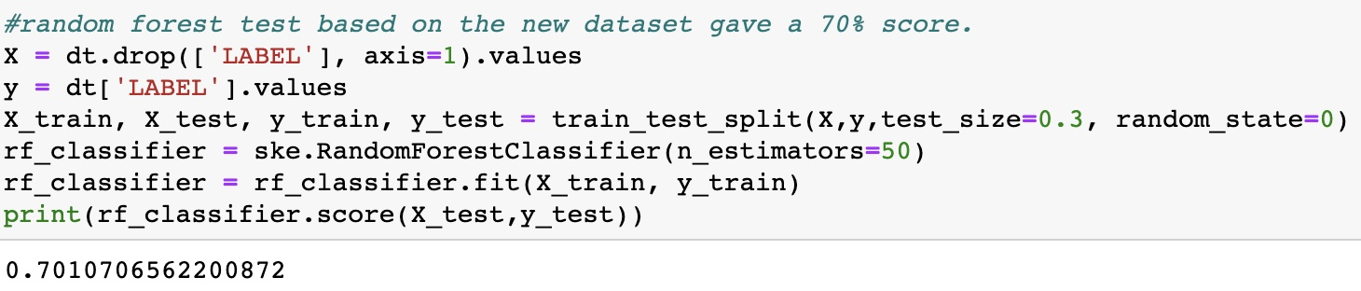
Random forest
The 58% score was much better than before.
I have decided to classify the causes into 4 classes: Natural, Accidental, Malicious and Other.
Then, did a random forest test based on the new dataset, which gave a 70% score.

Slide 22
Model Improvement
After reducing the number of elements model gave the accuracy of 70% using a random forest algorithm. But the accuracy is not good for malicious part which is Arson.
The previous model has the US wildfires and try to classify the causes into four classes. So, I have decided to perform random forest algorithm on single state with one fire cause, malicious.

Slide 23
Random Forest
To improve the model, I have created a filed Arson.
Hence, I was able to predict fire cause in 3 states, with a better accuracy of 94%.
CA (California) State the accuracy is 91%
GA (Georgia) State the accuracy is 85 %
TX (Texas) State the accuracy is 94%

Slide 24
Conclusion
Implemented required data pre-processing, apply numerous classification and regression models to predict the causes for wildfires. Also, increase the accuracy of the predictions using modification and validation methods. In this project, I have implemented multiple machine learning methods to predict wildfire causes. The models I have attempted to apply to include Decision Tree, Gaussian, and Random Forest machine learning algorithms. But observed partial accuracy amongst all models on the present dataset. Random forest came out to be the finest model and gave an accuracy of around 70 % but didn’t work well for the Arson portion. Hence, in the next model, I drop a few columns and work on only 1 state to check the wildfire caused in that state is Arson or not. Random Forest overall percentage accuracy is 91 % which is inordinate to predict causes of wildfires in the United States.

Slide 25
References
k, R. (2021, December 15). Wildfires. NASA. Retrieved December 15, 2021, from https://earthdata.nasa.gov/learn/toolkits/wildfires
1.88 million US wildfires. Kaggle. (n.d.). Retrieved December 15, 2021, from https://www.kaggle.com/rtatman/188-million-us-wildfires
Sklearn naive Bayes classifier python: Gaussian naive Bayes Scikit-Learn tutorial. DataCamp Community. (n.d.). Retrieved December 15, 2021, from https://www.datacamp.com/community/tutorials/naive-bayes-scikit-learn
1.10. decision trees. scikit. (n.d.). Retrieved December 15, 2021, from https://scikit-learn.org/stable/modules/tree.html
Tyagi, N. (2020, September 30). Understanding the Gini index and information gain in decision trees. Medium. Retrieved December 15, 2021, from https://medium.com/analytics-steps/understanding-the-gini-index-and-information-gain-in-decision-trees-ab4720518ba8 Sklearn Random Forest classifiers in Python. DataCamp Community. (n.d.). Retrieved December 15, 2021, from https://www.datacamp.com/community/tutorials/random-forests-classifier-python
Science, M. D. (2021, August 17). How to predict the cause of wildfires using a random forest classifier. Mr. Data Science. Retrieved December 15, 2021, from https://mrdatascience.com/how-to-predict-the-cause-of-wildfires-using-a-random-forest-classifier

Slide 26
Thank You

