Slide 1

Project Title - Seasonal Agriculture Performance Analysis
Utkarsha Ramesh Kale
Sinhgad College of Engineering
AICTE STU ID : STU6a6c2cd42e6ea1785474260

Slide 2

PROBLEM STATEMENT
Agricultural activities are influenced by seasonal variations in environmental conditions, farming practices, resource availability and market conditions.
As a result, agricultural performance may differ from one season to another.
However, raw agricultural data does not clearly explain how agricultural performance changes across seasons or what patterns can be observed in different seasonal conditions.
The problem is to analyze the given agricultural dataset and investigate seasonal differences in agricultural performance by identifying meaningful patterns, trends, relationships and variations within the available data.

Slide 3
Project Description
Agricultural crop production varies significantly across seasons, regions, and farming conditions. Factors such as crop type, weather conditions, irrigation, soil nutrients, fertilizer and pesticide usage, and market conditions can influence crop yield.
The Seasonal Agriculture Data Analytics project aims to analyze historical agricultural data to understand how crop yield changes across different seasons and regions and how various agricultural, environmental, and economic factors contribute to these variations. The project uses data preprocessing, exploratory data analysis, statistical analysis, and visualization techniques to discover meaningful patterns and relationships.
The analysis will help identify high-yielding crops in different seasons, regional variations in production, the influence of agricultural inputs and natural conditions on yield, and important trends in agricultural production, thereby supporting data-driven agricultural planning and decision-making.

Slide 4

WHO ARE THE END USERS?
Farmers
Agricultural Officers
Researchers
Government
Policymakers

Slide 5

Technology Used
Python
NumPy
Pandas
Matplotlib & Seaborn
Excel
Jupyter Notebook

Slide 6
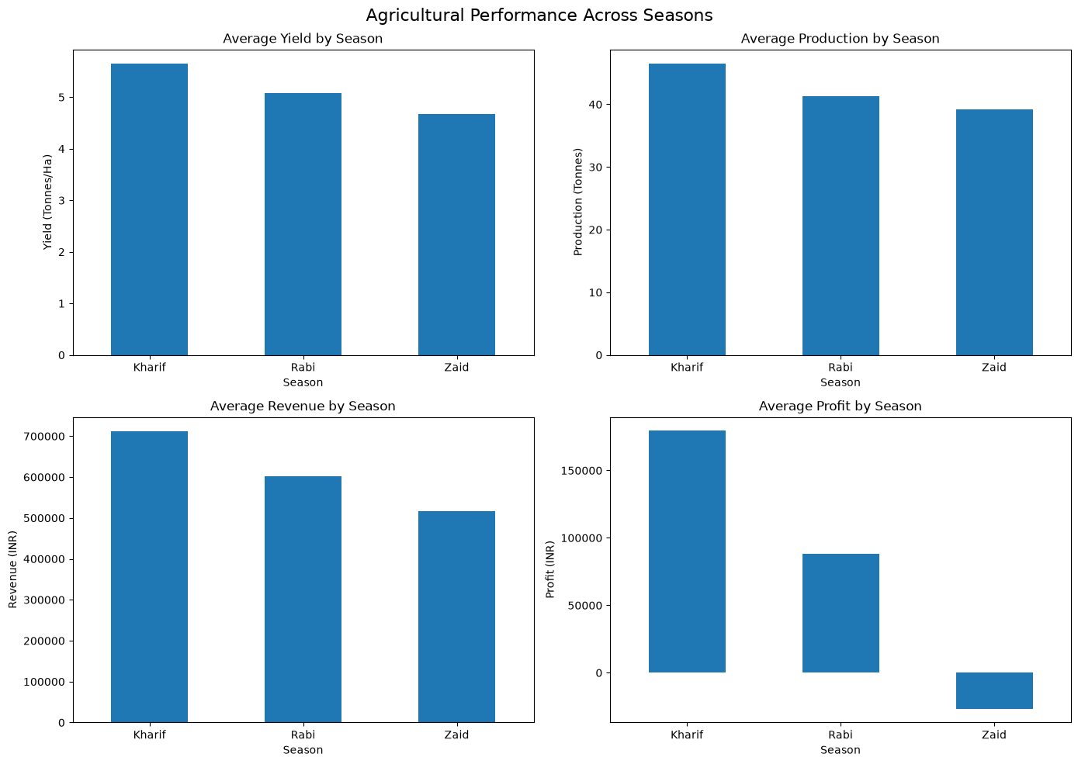
RESULTS
Overall, Kharif demonstrates the strongest agricultural and economic performance, with the highest yield, production, revenue, and profit.
Zaid shows the weakest performance.
Rabi falls between the two seasons in overall performance.

Slide 7
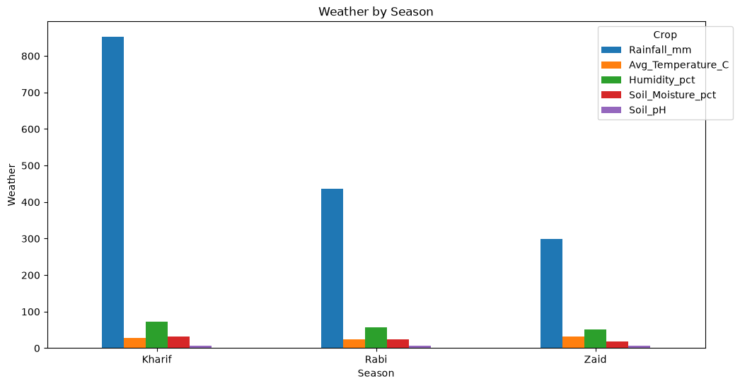
RESULTS
The analysis shows clear seasonal variation in environmental conditions. Kharif is characterized by higher rainfall, soil moisture, and humidity, while Zaid experiences higher temperatures. In contrast, soil pH remains relatively stable across seasons, indicating limited seasonal variation in soil acidity or alkalinity.

Slide 8
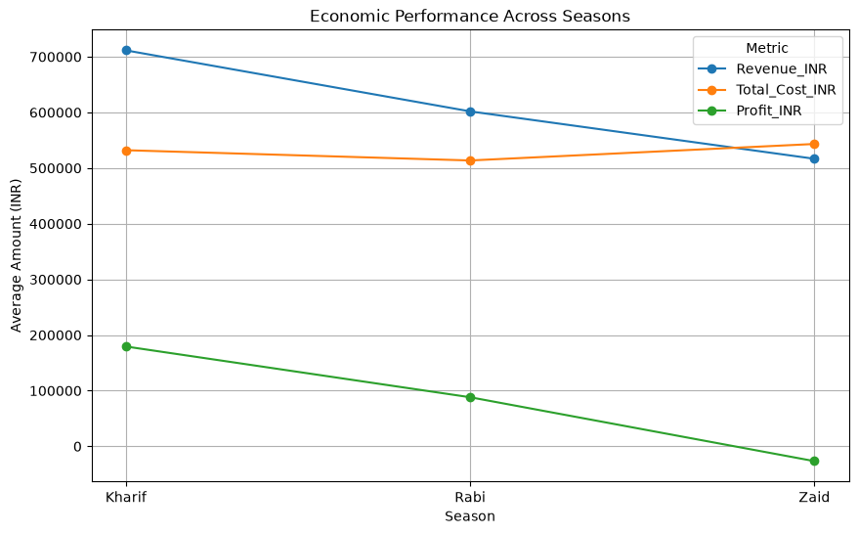
RESULTS
Observation
This graph demonstrates that kharif season has better Economic Performance than Rabi and Zaid.

Slide 9
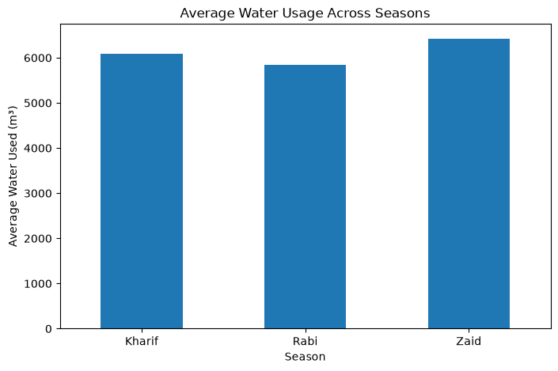
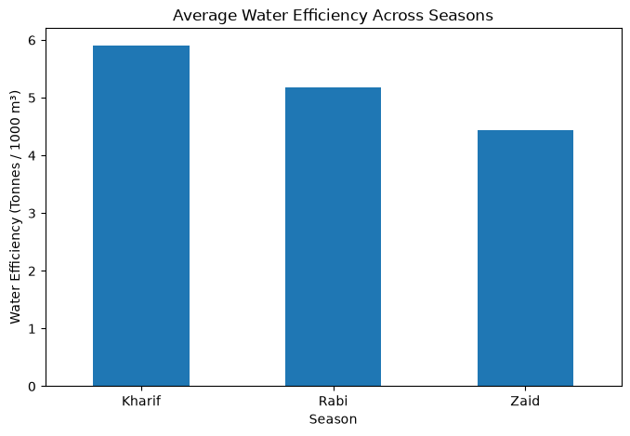
RESULTS
Water_Used_m3 Fertilizer_kg_ha Pesticide_Litre_ha
Season
Kharif 6094.046275 187.041027 5.078736
Rabi 5837.238955 185.282016 5.025669
Zaid 6423.076401 184.233447 5.162598
Resource consumption varies across seasons. Zaid records the highest average water and pesticide usage, while Kharif has the highest fertilizer application. Rabi shows comparatively lower usage across these resources. The variation is most noticeable in water consumption

Slide 10
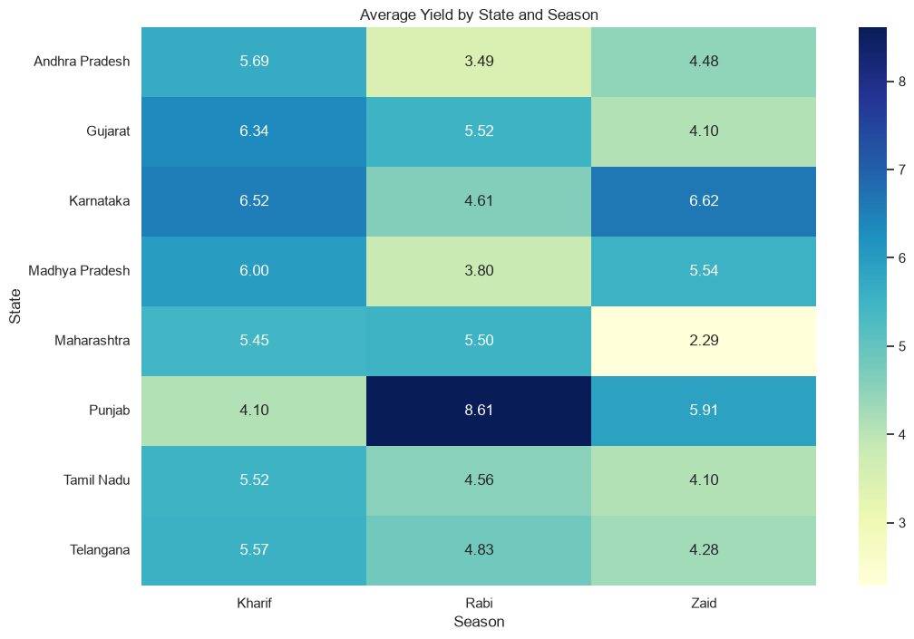
RESULTS

Slide 11
Future scope
Crop Yield Prediction Develop machine learning models to predict crop yield based on rainfall, temperature, soil moisture, fertilizer usage, and other factors.
Weather-Based Crop Recommendations Recommend suitable crops for a particular season and region using historical weather and soil conditions.
Real-Time Data Integration Integrate live weather and soil-moisture data from APIs and IoT sensors for continuous monitoring.
Smart Irrigation Management Develop a system that recommends the required amount of irrigation based on season, soil moisture, rainfall, and crop requirements.
Market Price Prediction Incorporate historical and real-time market prices to predict crop prices and help farmers choose more profitable crops.
Early Pest & Disease Detection Use machine learning and agricultural data to predict disease and pest risks for different crops and seasons.

Slide 12
GitHub Link
https://github.com/kaleutkarsha56-cmd/Seasonal-Agriculture-Performance-Analysis.git

Slide 13

VOIS Course completion certificate - Course name- Data Visualization

Slide 14
Thank you
.
.

