Slide 1
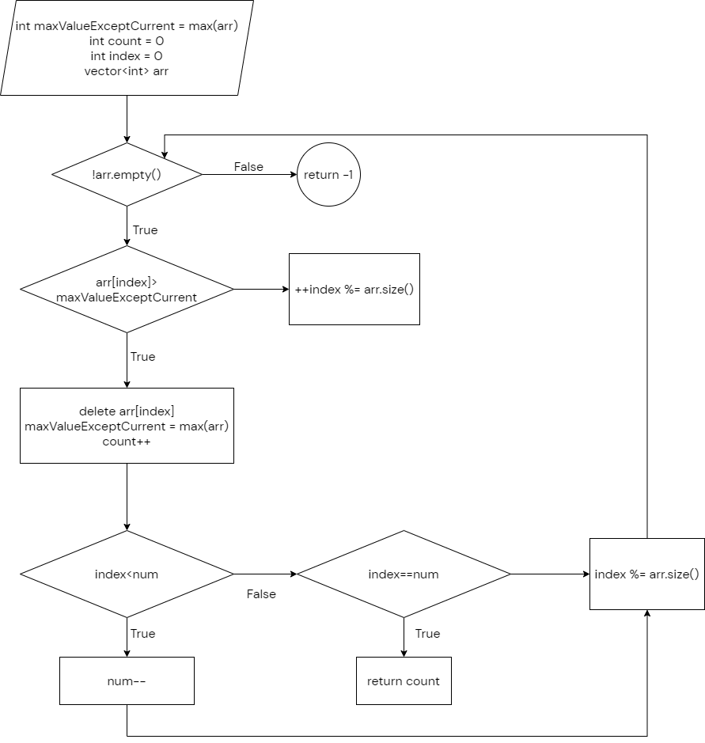

Slide 2
1
1
9
1
1
1

Slide 3
1 | 1 | 9 | 1 | 1 | 1

