Slide 1
Rewriting Pre-Training Data Boosts LLM Performance in Math and Code
How transform-and-retain corpora beat the best filtered datasets — by 17 points on HumanEval.
Paper: Fujii et al., arXiv:2505.02881v4 (March 2026)
Institution: Institute of Science Tokyo & AIST
Kalhar Mayurbhai Patel | SJSU ID: 019140511 | CMPE 255 — Data Mining

Slide 2


The Data Quality Gap
Why open code & math models still trail closed frontier models
Closed frontier models
Public datasets
Qwen3, DeepSeek-V3, GPT-4 etc.
✓ Excellent code & math performance
✗ Pre-training corpora are NOT released
✗ Open community cannot reproduce or improve
→ Open models stuck behind a wall
The Stack v1/v2, Finemath-4+, Stack-Edu
✓ Open and reproducible
✗ Rule-based extraction from web crawls
✗ Classifier-based filtering DISCARDS noisy data
✗ Inconsistent style, missing context, broken deps
→ Lower ceiling on downstream performance
SwallowCode & SwallowMath | CMPE 255 Short Story
2 / 18

Slide 3




The Big Idea
Don't throw bad code away. Rewrite it.
The transform-and-retain paradigm
Filter
Rewrite
Retain
Drop only the unfixable
(syntax errors, comment-only files)
Use a 70B LLM to fix style,
structure, and semantics
Keep the diversity of real-world
code — don't synthesize from scratch
SwallowCode & SwallowMath | CMPE 255 Short Story
3 / 18

Slide 4
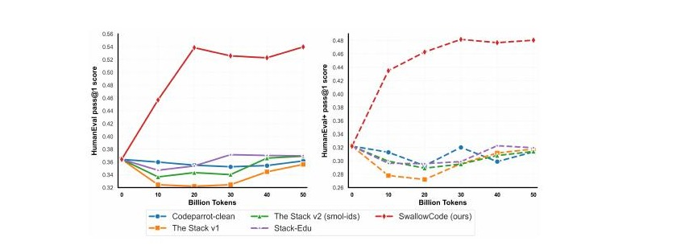
Headline Result
Same Llama-3.1-8B base. Same 50B-token budget. Only the data changes.
+17.0
+16.1
+12.4
+7.6
HumanEval pass@1
HumanEval+ pass@1
GSM8K accuracy
MATH accuracy
vs Stack-Edu
vs Stack-Edu
vs Finemath-4+
vs Finemath-4+
Figure 1 — SwallowCode (red) crushes every comparable open Python corpus
SwallowCode & SwallowMath | CMPE 255 Short Story
4 / 18

Slide 5

Why Llama-3.1-8B (and not a frontier model)?
"Frontier models already saturate code & math benchmarks — additional data yields only marginal gains. That obscures whether improvements come from the dataset or incidental model factors."
Too strong
Just right
Too weak
Qwen-2.5/3, gpt-oss
Already ~saturated.
Tiny gains hide whether
data even helped.
Llama-3.1-8B
Strong baseline, but
genuinely improvable.
Gains attributable to data.
Smaller / older models
Low ceiling, noisy.
Results won't transfer to
realistic LLM training.
SwallowCode & SwallowMath | CMPE 255 Short Story
5 / 18

Slide 6
The Four-Stage SwallowCode Pipeline
From 41M raw Python files → 16.1B tokens of high-quality, self-contained code
Source
Stage 1
Stage 2
Stage 3
Stage 4
Stack v2-Smol
Syntax filter
Pylint filter
SGCR rewrite
SCOR rewrite
41.0M
36.1B tok
36.7M
30.5B tok
24.1M
20.2B tok
Style-Guided
rewriting
Self-Contained
optimization
Filtering Stages 1 + 2
Rewriting Stages 3 + 4
Stage 1 — Syntax filter:
Compile each snippet with Python's compile(). Drop anything that doesn't parse. (-9.7%)
Stage 2 — Pylint filter (threshold ≥ 7.0):
Style + structure check. Custom comment-ratio penalty kills near-empty 'doc-only' files. (-34.3%)
Stage 3 — SGCR (Style-Guided Code Rewriting):
10-criterion Google Python Style Guide rewrite — names, docstrings, type hints, error handling.
Stage 4 — SCOR (Self-Contained Optimization):
Inline missing deps. Replace inefficient algorithms. Turn trivial snippets into instructive ones.
SwallowCode & SwallowMath | CMPE 255 Short Story
6 / 18

Slide 7
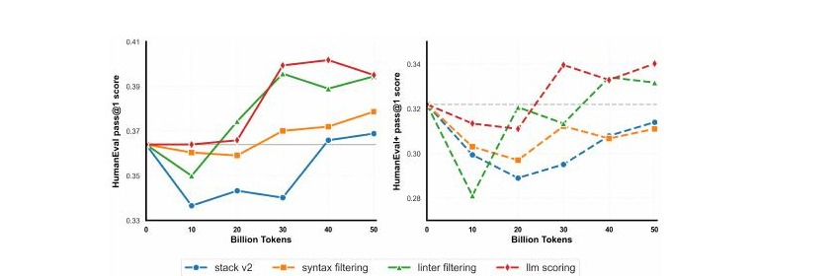
Filtering: Worth It, But Plateaus Fast
Key takeaways
✓ Syntax filter helps consistently
Removes ~10% of files that don't even compile.
✓ Linter filter adds ~1 point
Pylint ≥ 7.0 + comment-ratio penalty.
✗ LLM-based scoring: barely worth it
<1 point gain, ~19,500 H100-hours of compute.
→ Filtering plateaus around +1–2 pts.
Figure 3 — Filtering on HumanEval / HumanEval+
SwallowCode & SwallowMath | CMPE 255 Short Story
7 / 18

Slide 8
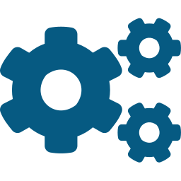
Two-Stage Rewriting: SGCR + SCOR
Why two passes? LLMs drift when juggling 19 directives — split style from semantics.
SGCR — Style-Guided Code Rewriting
SCOR — Self-Contained Optimization Rewriting
Enforces 10 criteria from the Google Python Style Guide:
Descriptive variable names
Useful comments + docstrings
Type annotations
Modular function design
Sensible variable scopes
Proper error handling
Standard formatting
Effect: +7 to +9 pts on HumanEval
Fixes the three semantic failures of SGCR-only data:
Missing dependencies
Inline imports, satisfy undefined helpers
Inefficient algorithms
Replace O(n²) with linear / DP solutions
Trivial snippets
Turn print("hi") into instructive examples
Effect: +5 to +6 pts on top of SGCR
SwallowCode & SwallowMath | CMPE 255 Short Story
8 / 18

Slide 9
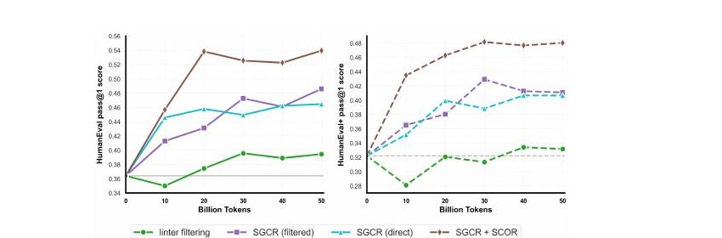
Where the Real Gains Come From
~14 pts
from rewriting alone
Breakdown (HumanEval pass@1)
Filtering only (Stage 1+2)
+1 to +2 pts
+ SGCR
+7 to +9 pts
+ SCOR (on top of SGCR)
+5 to +6 pts
Figure 4 — Rewriting stages dwarf filtering
→ Rewriting > 7× more impact than filtering.
SwallowCode & SwallowMath | CMPE 255 Short Story
9 / 18

Slide 10
A Cautionary Tale: The MBPP Drop
Why SGCR appeared to hurt one benchmark — and what it really tells us
What MBPP expects:
What SGCR-trained model writes:
def is_Power_Of_Two(x):
return x and (not(x & (x - 1)))
def differ_At_One_Bit_Pos(a, b):
return is_Power_Of_Two(a ^ b)
def is_power_of_two(x: int) -> bool:
"""Return True if x is a power of 2."""
return bool(x) and not (x & (x - 1))
The verdict: benchmark artifact, not capability regression
MBPP hard-codes function names like is_Power_Of_Two. SGCR rewrites them to snake_case (PEP-8). Result: harness reports "is not defined" — even when the logic is perfect. The authors disclose this honestly and exclude MBPP from evaluation.
Lesson: benchmarks embed assumptions. Always ask what's actually being measured.
SwallowCode & SwallowMath | CMPE 255 Short Story
10 / 18

Slide 11
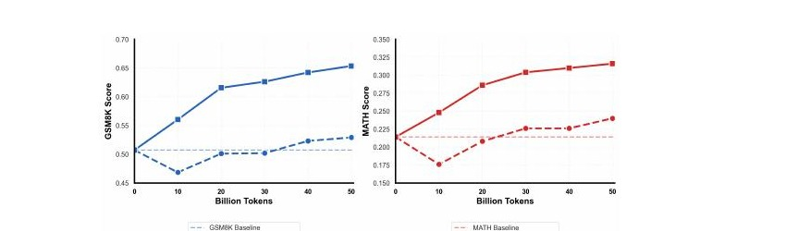
SwallowMath: Same Playbook, Math Domain
Apply the transform-and-retain paradigm to Finemath-4+ — does it transfer?
Math rewriting prompt — 5 steps
1
Strip web headers, footers, privacy notices
2
Remove timestamps + irrelevant metadata
3
Restore missing context in incomplete Q/A
4
Rewrite derivations: concise but complete
5
Format clear step-by-step solutions
Figure 5 — GSM8K +12.4, MATH +7.6
→ Transform-and-retain transfers beyond code.
Steps 1–2 = filtering analog. Steps 3–5 = SGCR/SCOR analog.
SwallowCode & SwallowMath | CMPE 255 Short Story
11 / 18

Slide 12
Does It Generalize Beyond Llama?
Appendix B — repeat the experiment from a Qwen2-7B base, 20B-token budget
Two big +10.3 lifts
HumanEval: 39.3 → 49.6 (+10.3)
HumanEval+: 34.3 → 44.6 (+10.3)
Same dataset, totally different base model — same dramatic improvement.
→ The pipeline produces genuinely better data, not just data tuned to Llama-3 quirks.
SwallowCode & SwallowMath | CMPE 255 Short Story
12 / 18

Slide 13


Did They Cheat? (No.)
Decontamination + self-contamination checks (Appendix H)
1. Direct test-set leakage
2. Rewriter self-contamination
Streamed entire 16.1B-token corpus. Checked against:
HumanEval / HumanEval+ prompts (code)
GSM8K / MATH prompts + solutions (math)
Tests:
exact-match search
Jaccard similarity ≥ 0.8
Result: no matches found.
Concern: Llama-3.3-70B-Instruct (the rewriter) has Dec 2023 cutoff — could it have seen GSM8K?
Test:
Evaluate on GSM-Plus, released after the cutoff.
Result:
Finemath-4+: 35.75
SwallowMath: 46.52
Gains hold on data the rewriter has never seen.
SwallowCode & SwallowMath | CMPE 255 Short Story
13 / 18

Slide 14

Is the Compute Cost Worth It?
Yes — and the asset compounds across the open community
23.7K
1.22×
16.1B
H100-hours
compute over scoring
tokens released
to rewrite SwallowCode
but ~10× the gains
as a community asset
Higher data efficiency
Reusable community asset
Stack-Edu would need >100B tokens to maybe match SwallowCode at 50B — and trends suggest it never quite gets there. Rewrite once, save tokens forever.
Tokyo Tech paid the rewriting cost once. Anyone can download SwallowCode and reuse it for free — across many models, many studies. Cost amortizes across the field.
SwallowCode & SwallowMath | CMPE 255 Short Story
14 / 18

Slide 15
Limitations the Authors Acknowledge
Source-data biases persist
Rewriting cleans surface noise but inherits distributional biases of The Stack v2 / Finemath-4+. The 70B rewriter also imposes its own preferences (variable naming, solution style).
Only Python tested
Pipeline is in principle language-agnostic — needs only a syntax checker + linter. Multi-language validation deferred to future work due to compute constraints.
50B-token budget
All ablations capped at 50B for controllability. Behavior at 500B / 1T tokens unproven; trends are encouraging but not a guarantee.
Rewriter is the ceiling
Quality of SwallowCode is bounded by Llama-3.3-70B-Instruct. Newer rewriters (Llama 4, gpt-oss, Qwen3) could lift the ceiling — that's both a limitation and an opportunity.
SwallowCode & SwallowMath | CMPE 255 Short Story
15 / 18

Slide 16
My Take — Five Things That Stick
1
The methodology > the dataset
SwallowCode is great. The transform-and-retain paradigm is the real contribution — generalizable to any language or domain.
2
Data is the new model
As open rewriters improve, every dataset built this way regenerates for free. Compounding returns architecture changes can't match.
3
Filtering plateaus, rewriting compounds
+1–2 pts from filters. ~14 pts from rewriting. The community has been spending its energy in the wrong place.
4
Two-stage prompting beats one-stage
SGCR + SCOR split is a generalizable insight. When you have many objectives, decouple them. Don't stuff into one prompt.
5
Benchmarks are not neutral
MBPP punishing snake_case is a perfect example. Always interrogate what your benchmark is actually measuring.
SwallowCode & SwallowMath | CMPE 255 Short Story
16 / 18

Slide 17


If You're Training a Code or Math Model in 2026
Practical takeaways from the SwallowCode pipeline
For code
For math
Don't just filter — rewrite. Even a small rewriting pass on top of filtered data is likely worth it.
Decouple style from semantics. Two prompts, two passes. SGCR then SCOR.
Filter first, rewrite second. Both stages compound; rewriting raw garbage wastes 70B tokens of compute.
Audit your benchmark for naming conventions. MBPP is a cautionary tale.
Decontaminate aggressively, including against the rewriter — use post-cutoff benchmarks.
Boilerplate stripping (privacy notices, timestamps) helps more than you'd think.
Step-by-step solution rewriting is a major source of GSM8K gains.
Same pipeline as code, just adjust the prompt for math content.
SwallowCode & SwallowMath | CMPE 255 Short Story
17 / 18

Slide 18

Thank You
Paper
Rewriting Pre-Training Data Boosts LLM Performance in Math and Code
Fujii et al., Institute of Science Tokyo & AIST
arXiv:2505.02881v4 — March 2026
Kalhar M. Patel
SJSU ID: 019140511
CMPE 255 — Data Mining
Short Story Assignment
Resources
Spring 2026
Datasets: huggingface.co/collections/tokyotech-llm/swallowcode
Pipeline: github.com/rioyokotalab/swallow-code-math
Medium article: on my profile (link in repo README)
Questions?
18 / 18

