Slide 1
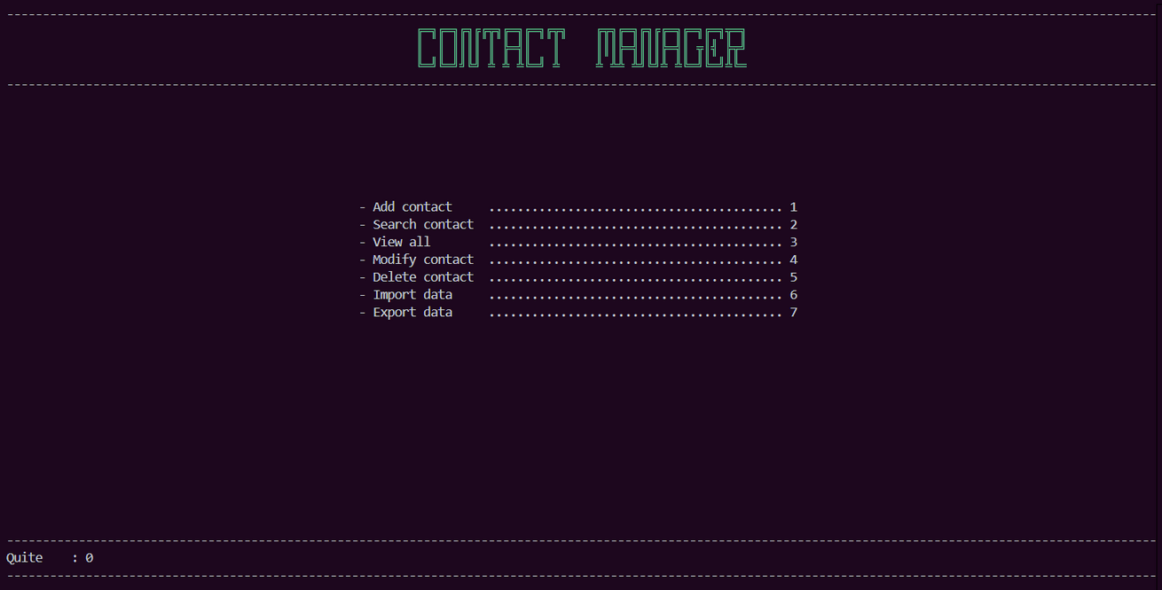
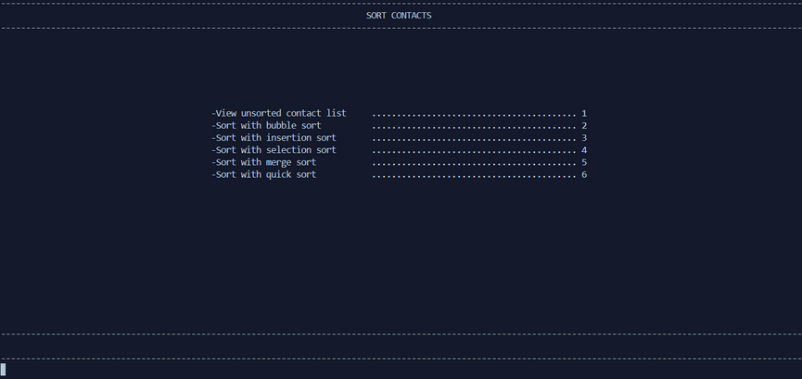
Contact
Management
System
Developing a system to efficiently manage, search, and sort contact records using various sorting algorithms.
GRUOP 43
EG/2022/5164 - LAKMIKA P.G.S
EG/2022/5232 - PANDIGAMA Y.C
EG/2022/5118 - KALHARA T.G.C.K
Page 01/03

Slide 2
Advanced Contact Management System
Key Features:
Basic CRUD Operations (Create, Read, Update, Delete)
Search Contacts
Sort Contacts (A-Z)
Customizable Searching & Sorting Algorithms
Task Time Measurement
Export & Import Data (.txt file)
Page 02/10

Slide 3
Data Structures & Algorithms Used
Data Structures:
Arrays
Dynamic Arrays
Sorting Algorithms & Complexity
Bubble Sort – O(n²) (8.058ms)
Insertion Sort – O(n²) (8.530ms)
Selection Sort – O(n²) (6.762ms)
Merge Sort – O(n log n) (6.146ms)
Quick Sort – O(n log n) (1.667ms)
Searching Algorithms & Complexity
Linear Search – O(n)
Binary Search – O(log n)
Page 02/10

Slide 4
Performance & Flexibility
Customizable Algorithms – Choose the best algorithm for efficiency
Performance Tracking – Measure execution time of operations
Data Management – Easily import & export contacts
Optimized Searching & Sorting – Efficiently manage large contact lists
Page 03/10

