Slide 1
National CyberShield Hackathon 2025

Slide 2
Problem Statement – Money laundering detection pattern
Team Name - AuraFarmers
College Name – VIT Bhopal University

Slide 3
Our Idea
Proposed Solution: Netra - An AI-Powered Intelligence Platform for Detecting and Dismantling Complex Money Laundering Networks.
Provides a unified view of financial networks for law enforcement and financial intelligence units.
Uses hybrid risk-scoring (rule-based + ML), graph analytics, and AI summarization to identify anomalous patterns.
Key components: Risk scoring engine, interactive network graphs, AI case summaries, investigation workspace, automated PDF reports, and secure authentication.
Innovation and Uniqueness:
Hybrid engine combines traditional rules with ML (Isolation Forest) for superior anomaly detection.
Real-time interactive visualizations powered by Neo4j for uncovering hidden connections in financial flows.
AI-driven automation (via Google Gemini) for narrative generation, reducing manual effort in investigations.
Unique focus on synthetic data with embedded money laundering patterns for realistic testing and training.

Slide 4
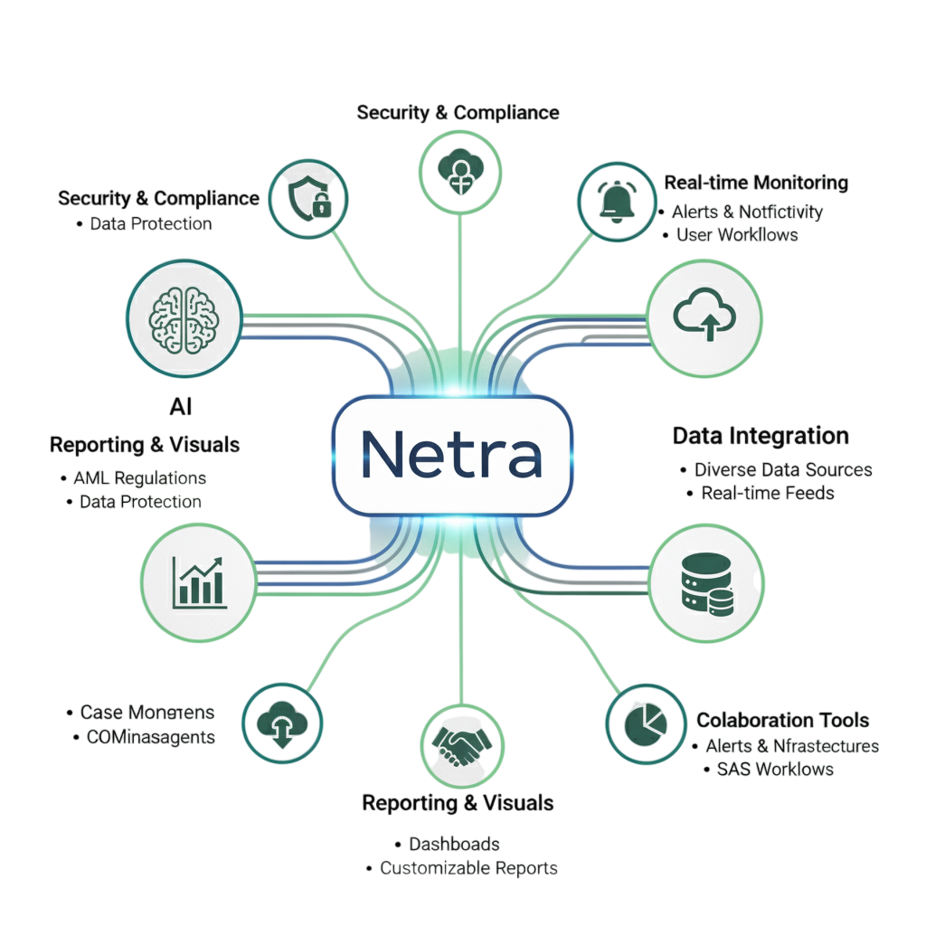
What Netra covers

Slide 5
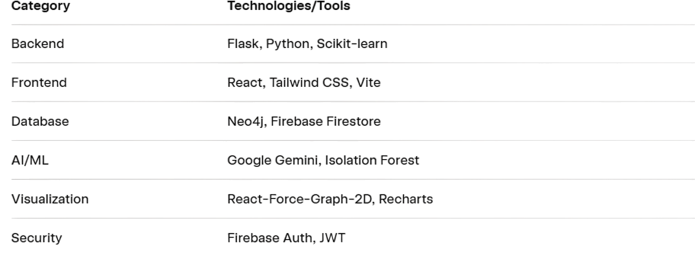
Technical Approach
We have used also some other tools and platforms like Faker (synthetic data generation), Celery (background processing), Redis (caching).

Slide 6
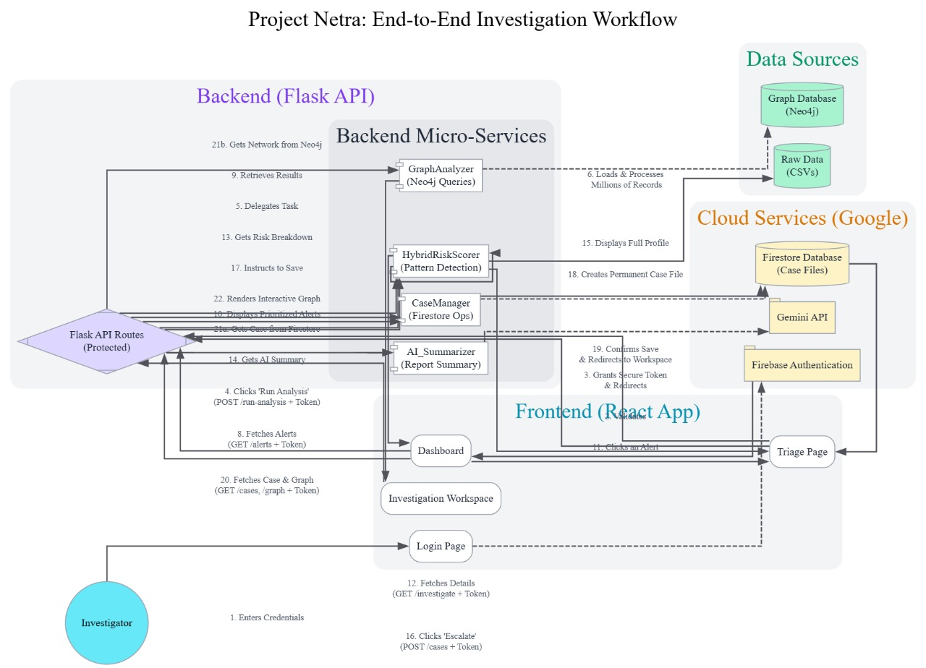
Methodology and process for implementation

Slide 7
Implementation of Netra
Implementing NETRA

Slide 8
Feasibility And Viability
Feasibility Analysis:
Technical: Relies on open-source tools like Neo4j, Flask and React with low setup cost and would easily be scalable via cloud services like Neo4j Aura, Google Firebase, etc.
Economic: Minimal hardware needs like standard servers and being open source would reduce licensing costs as well.
Operational: Can be deployed quickly. Moreover, synthetic data enables testing without using real sensitive information.
Potential Challenges and Risks:
Data Privacy: Handling sensitive financial data could lead to breaches.
Scalability: Large graphs in Neo4j may slow queries with massive datasets.
AI Accuracy: Summaries can be subjected to hallucinations by the API used.
Dependency on APIs: Outages in Google Gemini or Firebase could disrupt service.
Detection Evasion: Criminals may adapt patterns to bypass rules/ML.

Slide 9
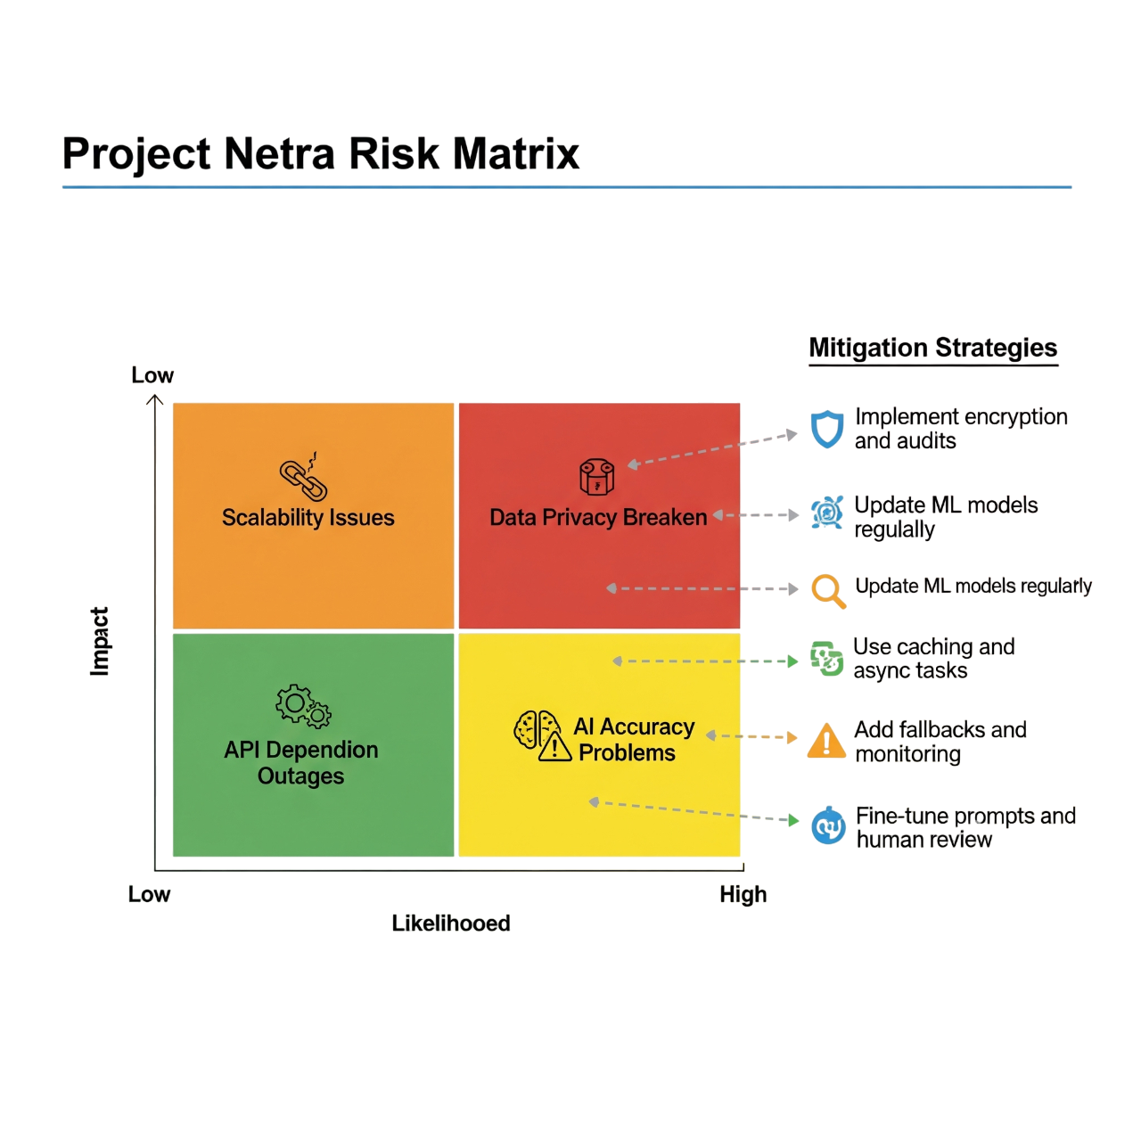
Strategies for Overcoming Challenges:
Privacy: Implement audit trails, encryption, and compliance with data laws (e.g., GDPR-like). Also we can indigenously build and train our own AI models so that the data would not be shared anyhow to the owners of the API used.
Scalability: Use Redis caching and Celery for async tasks; optimize Neo4j queries.
AI: Fine-tune prompts and add human review workflows.
APIs: Add fallback mechanisms (e.g., offline mode) and monitoring.
Evasion: Regularly update ML models with new patterns; use ensemble methods.
Risk matrix for feasibility and viability

Slide 10
Impact and Benefits
Potential Impact on Target Audience:
Law Enforcement/Financial Departments: Faster detection of money laundering, reducing investigation time from weeks to hours.
Society: Disrupts criminal networks, preventing funding for terrorism or fraud.
Financial Institutions: Better compliance tools to avoid penalties.
Benefits of the Solution:
Social: Enhances public safety by curbing illicit finance as well as promote transparency in economies.
Economic: Reduces losses from financial crimes like structuring and tax evasion while saving costs on manual investigations.
Environmental: Digital platform reduces paper-based reporting while efficient detection minimizes resource waste in prolonged probes.

Slide 11
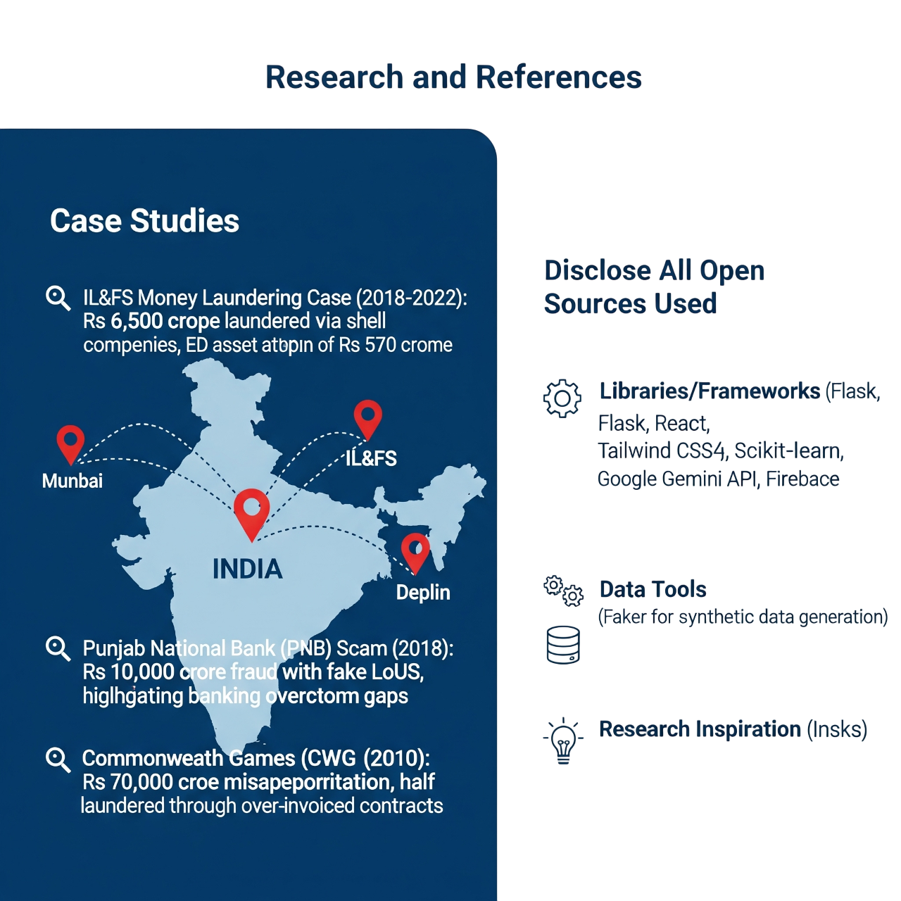
Research and References
Case Studies:
IL&FS Money Laundering Case (2018-2022):
Rs 6,500 crore laundered via shell companies.
ED asset attachment of Rs 570 crore.
Location: Central India (IL&FS pin).
Punjab National Bank (PNB) Scam (2018):
Rs 10,000 crore fraud with fake LoUs.
Highlights banking oversight gaps.
Location: Mumbai (PNB pin).
Commonwealth Games (CWG) (2010):
Rs 70,000 crore misappropriation.
Half laundered through over-invoiced contracts.
Location: Delhi (CWG pin).
Libraries/Frameworks:
Flask, React, Tailwind CSS, Scikit-learn, Google Gemini API, Firebase.
Data Tools:
Faker (for synthetic data generation).
Research Inspiration:
Insights from Indian financial crime investigations and enforcement actions.

Slide 12
Links to our project
NETRA Financial Crimes Investigation System
Use Investigator id “admin@netra.com” and secure access key as “netra123”
NETRA GitHub Repository
NETRA Software Demo Video
Implementation and Case Study Example of NETRA

Slide 13
Team Member Details
Registration No | Name | Year | Name of College | City | Male/ Female | Mail Id | Mobile No
1.23BCE11424 | Anurag Waskle | 3rd | VIT Bhopal University | Bhopal | Male | anurag.23bce11424@vitbhopal.ac.in | 8959759566
2.23BOE10060 | Soham S Malvankar | 3rd | VIT Bhopal University | Bhopal | Male | soham.23boe100060@vitbhopal.ac.in | 8976020137
3.23BCE11269 | Harshit Kushwaha | 3rd | VIT Bhopal University | Bhopal | Male | harshit.23bce11269@vitbhopal.ac.in | 7409064489
4.24BCE11511 | Deepti Singh | 2nd | VIT Bhopal University | Bhopal | Female | deepti.24bce11511@vitbhopal.ac.in | 6394628884
5.24BAI10594 | Aryan Kumar | 2nd | VIT Bhopal University | Bhopal | Male | aryan.24bai10594@vitbhopal.ac.in | 8092392744

Slide 14
Mentor Detail
Staff Id | Name | School/ Department | Mail Id | Phone . No
1. | Harshlata Vishwakarma | VIT Bhopal University (SCOPE) | harshlatavishwakarma@vitbhopal.ac.in | 8349780109
2.
3.
4.
5.
Note: Mentor Needs to be at least 4+ year industry/Academia experience.

Slide 15
Thanks

