Slide 1
Data Transmission Media
- S.SACHIN

Slide 2
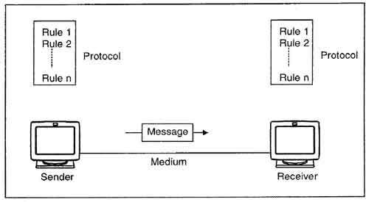
What is Data Communication?
DATA communication is a communication channel that carries the information from the sender to the receiver.
Data is transmitted through the electromagnetic signals.
The main functionality of the transmission media is to carry the information in the form of bits through LAN(Local Area Network).

Slide 3
What are the components of a communication system?
Message
Sender
Protocols
Transmission Media
Receiver

Slide 4
What is Transmission Media?
▶ Transmission Media in data communication refers to the pathway that carries the information from sender to receiver.
▶ Transmission media is usually free space, metallic cable or optical fiber which is use to transmit data over places in forms of electromagnetic or electrical signals.

Slide 5
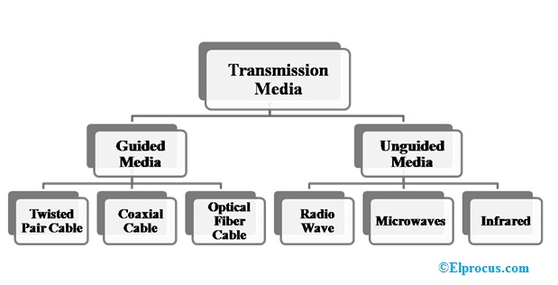
Classes of Transmission Media

Slide 6
Guided Media
▶ Guided medium transport electrical signals from the sender to the receiver by means of connected conductor between them.
▶ There exists a direct connection between the sender and the receiver.
▶ Exists in 3 form –
Twisted-Pair Cables.
Coaxial Cables.
Optical Fiber Cables.

Slide 7
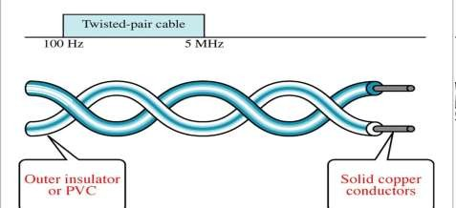
Twisted-Pair Cable
▶ Twisted pair consists of two conductor, each with its own plastic insulation, twisted together, as shown in figure.
▶ One of the wires is use to carry signals to the receiver, and the other is used only as a ground reference. The receiver use the difference between the two.

Slide 8
Twisted-Pair Cables cont..
Advantages
▶ Cheap.
▶ Easy to install and maintain.
▶ Can pass wide range of frequencies.
Disadvantages
▶ Low data rate.
▶ Short range.
▶ Higher the frequencies, more the attenuation.
Applications
▶ Used in telephone line to provide voice and data channels.
▶ Used in local area network where data transmission rate is low.

Slide 9
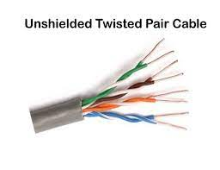
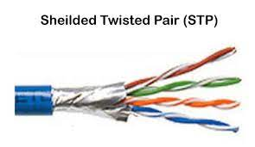
Types of Twisted pair Cables
Unshielded Twisted Pair (UTP): UTP consists of two insulated copper wires twisted around one another.
This type of cable has the ability to block interference and does not depend on a physical shield for this
purpose.
It is used for telephonic applications.
Shielded Twisted Pair (STP): This type of cable consists of a special jacket (a copper braid covering or a foil shield) to block external interference. It is used in fast-data-rate Ethernet and in voice and data channels of telephone lines.

Slide 10
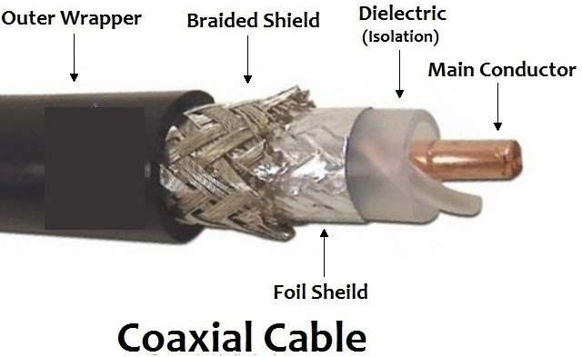
Coaxial Cables
Coaxial cable is very commonly used transmission media, for example, TV wire is usually a coaxial cable.
The name of the cable is coaxial as it contains two conductors parallel to each other.
It has a higher frequency as compared to Twisted pair cable.
The inner conductor of the coaxial cable is made up of copper, and the outer conductor is made up of copper mesh. The middle core is made up of non-conductive cover that separates the inner conductor from the outer conductor.

Slide 11
TYPES of Coaial cable
Baseband transmission: It is defined as the process of transmitting a single signal at high speed.
Broadband transmission: It is defined as the process of transmitting multiple signals simultaneously.

Slide 12
Coaxial Cables cont..
Advantages
▶ High Bandwidth compared to TP.
▶ High data rate compared to TP.
▶ Easy to install and maintain.
▶ Easy to expand.
Disadvantages
▶ Single failure can take down the entire network.
▶ Cost of installation and maintenance is high as compared to TP.
Applications
▶ Used in analog telephone network where one cable is used to carry 1000s of signal.
▶ Used by Cable TV networks.
▶ Is in Traditional Ethernet LAN because of high bandwidth and consequently
high data rate.

Slide 13
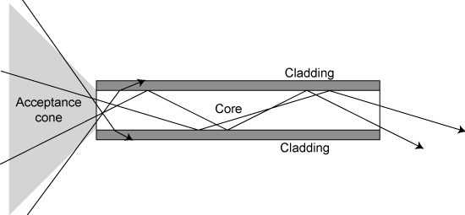
Fiber-Optic Cables
▶ A fiber-optic cable is made of glass and transmit signal in form of light.
▶ Optical fiber used reflection to guide light through a channel.
▶ A glass core is surrounded by a cladding of less dense glass or plastic as shown below.
▶ The difference between the density of the 2 layer is such that beam of light in the core is reflected off the cladding instead of being refracted. This phenomenon is called as Total Internal Reflection.

Slide 14
Fiber-Optic Cables cont..
Advantages
▶ High speed data transmission.
▶ Least attenuated by noise.
▶ High capacity of data transmission.
Disadvantages
▶ Most expensive medium.
▶ Installation and maintenance is
hard and requires skilled workers.
Applications
▶ Provides backbone in transmission media for various companies because of
its wide bandwidth is cost effective.
▶ Some cable TV companies use combination of optical fiber and coaxial cable thus creating a hybrid network where optical fiber provides the backbone structure and coaxial cable is used to connect to the user premises.

Slide 15
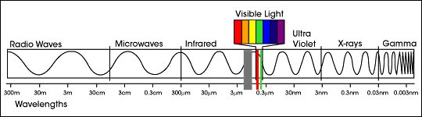
Unguided Media
▶ Unguided medium transport electromagnetic waves without using a physical conductor and are normally broadcast through free space.

Slide 16
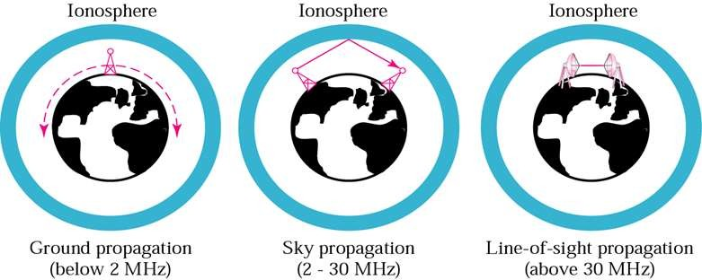
Unguided Media cont..
▶ Propagation methods

Slide 17
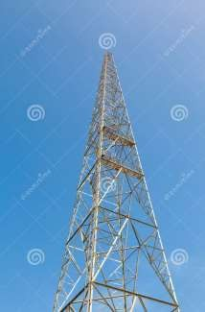
Radio Waves
▶ Frequencies ranging between 3kHz and 1 GHz.
▶ Radio waves, for the most part omnidirectional, when an antenna transmits a
radio signals they propagate in all direction.
▶ Advantage –
Sending and Receiving antenna need not to be aligned.
▶ Disadvantage –
Interference between signals from different antenna.

Slide 18
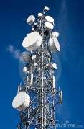
Microwaves
▶ Electromagnetic wave frequencies ranging between 1 and 300GHz.
▶ Microwaves are unidirectional.
▶ Advantages –
Interferences from other signal is minimized.
▶ Disadvantages –
It is a l-o-s propagation, thus towers mounted with antenna needed to be in direct sight of each other.
VHF microwaves cannot penetrate through walls making it difficult for the receivers placed inside buildings.

Slide 19
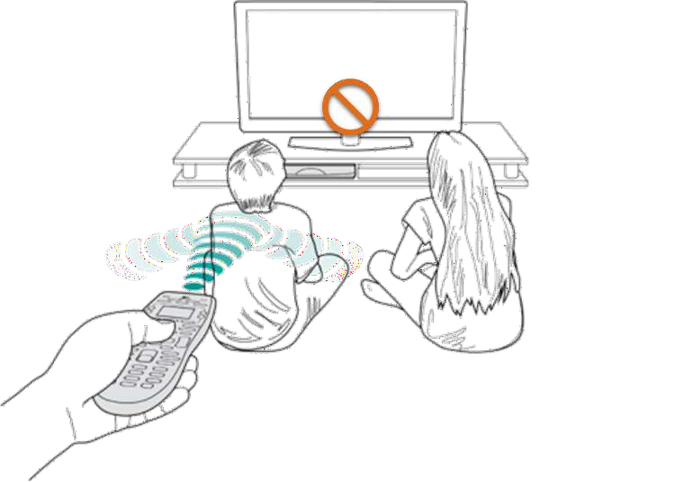
Infrared
▶ Infrared waves, with frequencies from 300 GHz to 400 THz, can be used for short range communication.
▶ Least interference between two signals.

Slide 20
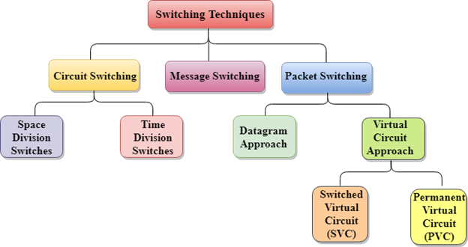
Switching Techniques
In large networks, there can be multiple paths from sender to receiver. The switching technique will decide the best route for data transmission.
Switching technique is used to connect the systems for making one-to-one communication.

Slide 21
Circuit Switching
Circuit switching is a switching technique that establishes a dedicated path between sender and receiver.
In the Circuit Switching Technique, once the connection is established then the dedicated path will remain to exist until the connection is terminated.
Circuit switching in a network operates in a similar way as the telephone works.
A complete end-to-end path must exist before the communication takes place.
Circuit switching is used in public telephone network. It is used for voice transmission.
Fixed data can be transferred at a time in circuit switching technology.

Slide 22
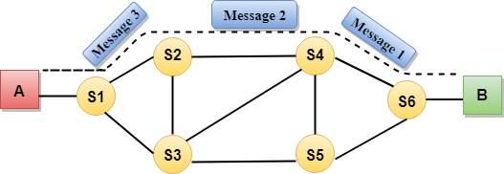
Circuit Switching has 3 phases:
Circuit establishment
Data transfer
Circuit Disconnect

Slide 23
Advantage:
In the case of Circuit Switching technique, the communication channel is dedicated.
It has fixed bandwidth.
Disadvantages:
Once the dedicated path is established, the only delay occurs in the speed of data transmission.
It takes a long time to establish a connection approx 10 seconds during which no data can be transmitted.
It is more expensive than other switching techniques as a dedicated path is required for each connection.
In this case, the connection is dedicated therefore no other data can be transferred even if the channel is free.

Slide 24
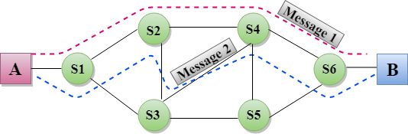
Message Switching:

Slide 25
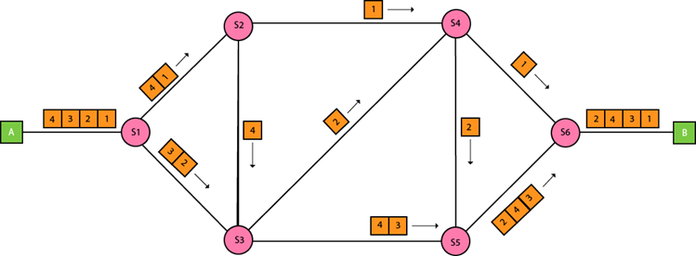
Packet Switching:

Slide 26


