Slide 1
Wireless LAN (802.11) - Physical Layer: Data and Signals - Performance
COMPUTER NETWORKS

Slide 2
Wireless LAN (802.11): Wireless LAN:
INTRO:
Wireless communication is one of the fastest-growing technologies. The demand for connecting devices without the use of cables is increasing everywhere
Architectural Comparison:
Let us first compare the architecture of wired and wireless LANs to give some idea of what we need to look for when we study wireless LANs.

Slide 3
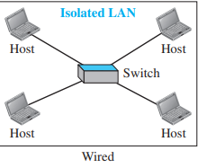
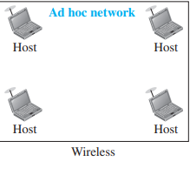
Medium:
Wired:
In a wired LAN, we use wires to connect hosts
the communication between the hosts is point to-point and full-duplex (bidirectional)
Wireless:
In a wireless LAN, the medium is air, the signal is generally broadcast. When hosts in a wireless LAN communicate with each other, they are sharing the same medium (multiple access)

Slide 4
Hosts:
In a wired LAN, a host is always connected to its network at a point with a fixed linklayer address
Of course, a host can move from one point in the Internet to another point. In this case, its link-layer address remains the same, but its network-layer address will change
it needs to be physically connected to the Internet
In a wireless LAN, a host is not physically connected to the network; it can move freely (as we’ll see) and can use the services provided by the network

Slide 5
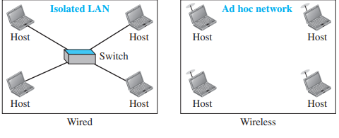
Isolated LANs:
A wired isolated LAN is a set of hosts connected via a link-layer switch (in the recent generation of Ethernet)
A wireless isolated LAN, called an ad hoc network in wireless LAN terminology, is a set of hosts that communicate freely with each other

Slide 6
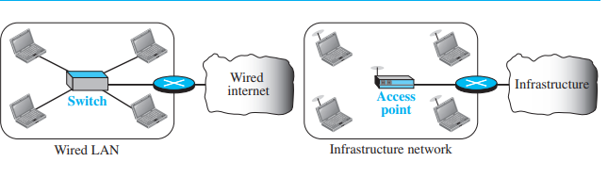
Connection of a wired LAN and a wireless LAN to other networks:

Slide 7
IEEE 802.11 PROJECT:
IEEE has defined the specifications for a wireless LAN, called IEEE 802.11.
some countries, including the United States, the public uses the term WiFi (short for wireless fidelity) as a synonym for wireless LAN

Slide 8
Architecture:
basic service set (BSS)
extended service set (ESS).

Slide 9
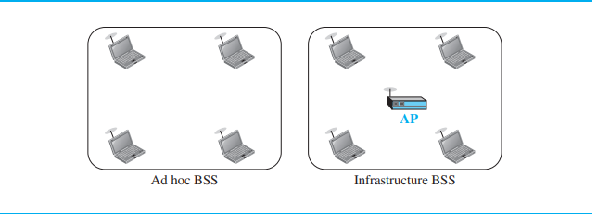
basic service set (BSS):
The BSS without an AP is a stand-alone network and cannot send data to other BSSs. It is called an ad hoc architecture
A BSS with an AP is sometimes referred to as an infrastructure BSS.

Slide 10
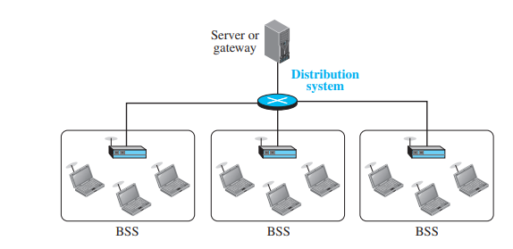
Extended Service Set:
An extended service set (ESS) is made up of two or more BSSs with APs

Slide 11
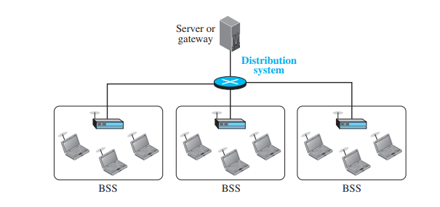
Station Types:
A station with no-transition mobility is either stationary (not moving) or moving only inside a BSS. A station with BSS-transition mobility can move from one BSS to another, but the movement is confined inside one ESS. A station with ESS-transition mobility can move from one ESS to another

Slide 12
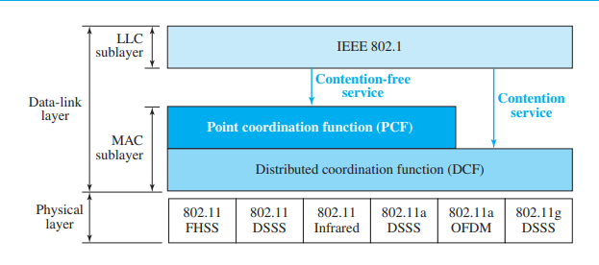
MAC Sublayer:
IEEE 802.11 defines two MAC sublayers: the distributed coordination function (DCF) and point coordination function (PCF).

Slide 13
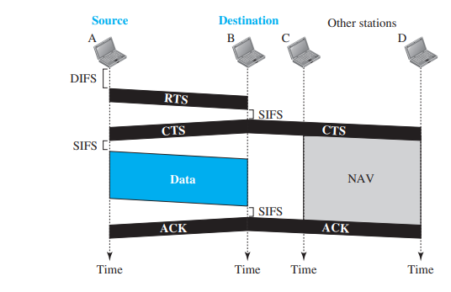
Distributed Coordination Function:
distributed interframe space (DIFS)
request to send (RTS)
short interframe space (SIFS)
clear to send (CTS)

Slide 14
Point Coordination Function (PCF):
The point coordination function (PCF) is an optional access method that can be implemented in an infrastructure network (not in an ad hoc network). It is implemented on top of the DCF and is used mostly for time-sensitive transmission.
To give priority to PCF over DCF, another interframe space, PIFS, has been defined. PIFS (PCF IFS) is shorter than DIFS. This means that if, at the same time, a station wants to use only DCF and an AP wants to use PCF, the AP has priority.

Slide 15
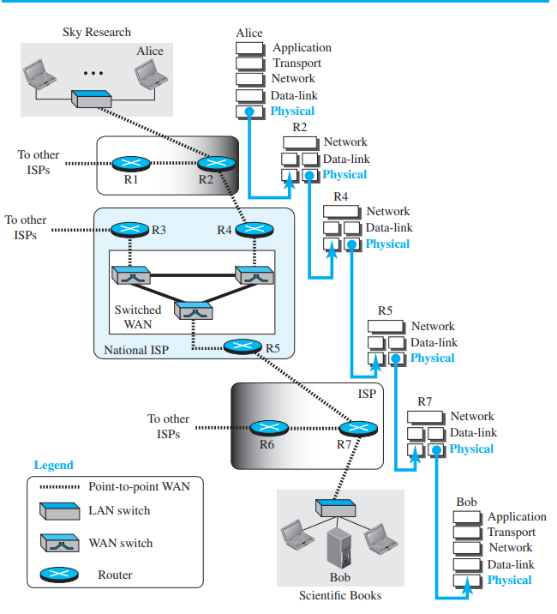
DATA AND SIGNALS:

Slide 16
shows a scenario in which a scientist working in a research company, Sky Research, needs to order a book related to her research from an online bookseller, Scientific Books.
We can think of five different levels of communication between Alice, the computer on which our scientist is working, and Bob, the computer that provides online service. Communication at application, transport, network, or data-link is logical; communication at the physical layer is physical. For simplicity, we have shown host-to-router, router-to-router, and router-to-host.
Although Alice and Bob need to exchange data, communication at the physical layer means exchanging signals. Data need to be transmitted and received, but the media have to change data to signals. Both data and the signals that represent them can be either analog or digital in form

Slide 17
Analog and Digital Data:
Data can be analog or digital. The term analog data refers to information that is continuous; digital data refers to information that has discrete states
For example, an analog clock that has hour, minute, and second hands gives information in a continuous form; the movements of the hands are continuous. On the other hand, a digital clock that reports the hours and the minutes will change suddenly from 8:05 to 8:06.
Analog data, such as the sounds made by a human voice, take on continuous values
data are stored in computer memory in the form of 0s and 1s. They can be converted to a digital signal or modulated into an analog signal for transmission across a medium.

Slide 18
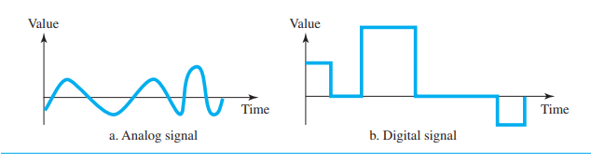
Analog and Digital Signals:
An analog signal has infinitely many levels of intensity over a period of time. As the wave moves from value A to value B, it passes through and includes an infinite number of values along its path.
A digital signal, on the other hand, can have only a limited number of defined values. Although each value can be any number, it is often as simple as 1 and 0.

Slide 19
Periodic and Nonperiodic:
A periodic signal completes a pattern within a measurable time frame, called a period, and repeats that pattern over subsequent identical periods. The completion of one full pattern is called a cycle.
A nonperiodic signal changes without exhibiting a pattern or cycle that repeats over time.

Slide 20
PERFORMANCE:
One important issue in networking is the performance of the network—how good is it?
Let us see the performance measures:

Slide 21
Bandwidth:
One characteristic that measures network performance is bandwidth. However, the term can be used in two different contexts with two different measuring values: bandwidth in hertz and bandwidth in bits per second.
Bandwidth in Hertz: We have discussed this concept. Bandwidth in hertz is the range of frequencies contained in a composite signal or the range of frequencies a channel can pass. For example, we can say the bandwidth of a subscriber telephone line is 4 kHz.
Bandwidth in Bits per Seconds: The term bandwidth can also refer to the number of bits per second that a channel, a link, or even a network can transmit. For example, one can say the bandwidth of a Fast Ethernet network (or the links in this network) is a maximum of 100 Mbps. This means that this network can send 100 Mbps

Slide 22
Example :The bandwidth of a subscriber line is 4 kHz for voice or data. The bandwidth of this line for data transmission can be up to 56,000 bps using a sophisticated modem to change the digital signal to analog.
Example :If the telephone company improves the quality of the line and increases the bandwidth to 8 kHz, we can send 112,000 bps by using the same technology as mentioned in Example 3.42.

Slide 23
Throughput:
The throughput is a measure of how fast we can actually send data through a network.
For example, we may have a link with a bandwidth of 1 Mbps, but the devices connected to the end of the link may handle only 200 kbps. This means that we cannot send more than 200 kbps through this link.
Imagine a highway designed to transmit 1000 cars per minute from one point to another. However, if there is congestion on the road, this figure may be reduced to 100 cars per minute. The bandwidth is 1000 cars per minute; the throughput is 100 cars per minute.

Slide 24
Latency (Delay):
The latency or delay defines how long it takes for an entire message to completely arrive at the destination from the time the first bit is sent out from the source
Latency =propagation time + transmission time + queuing time + processing delay
Propagation Time:Propagation time measures the time required for a bit to travel from the source to the destination. The propagation time is calculated by dividing the distance by the propagation speed.
Propagation time =Distance / (Propagation Speed)

Slide 25
Transmission Time:In data communications we don’t send just 1 bit, we send a message. The first bit may take a time equal to the propagation time to reach its destination; the last bit also may take the same amount of time. The transmission time of a message depends on the size of the message and the bandwidth of the channel.
Transmission time =(Message size) / Bandwidth
Queuing Time:The third component in latency is the queuing time, the time needed for each intermediate or end device to hold the message before it can be processed
The queuing time is not a fixed factor; it changes with the load imposed on the network. When there is heavy traffic on the network, the queuing time increases

Slide 26
Bandwidth-Delay Product:
Case 1:
Let us assume that we have a link with a bandwidth of 1 bps (unrealistic, but good for demonstration purposes). We also assume that the delay of the link is 5 s (also unrealistic). We want to see what the bandwidth-delay product means in this case. Looking at the figure, we can say that this product 1 × 5 is the maximum number of bits that can fill the link. There can be no more than 5 bits at any time on the link.
Case 2:
Now assume we have a bandwidth of 5 bps. Figure 3.33 shows that there can be maximum 5 × 5 = 25 bits on the line. The reason is that, at each second, there are 5 bits on the line; the duration of each bit is 0.20 s.

Slide 27
Jitter:
Another performance issue that is related to delay is jitter. We can roughly say that jitter is a problem if different packets of data encounter different delays and the application using the data at the receiver site is time-sensitive (audio and video data, for example). If the delay for the first packet is 20 ms, for the second is 45 ms, and for the third is 40 ms, then the real-time application that uses the packets endures jitter.

