Slide 1
Inter-AS routing
BGP

Slide 2
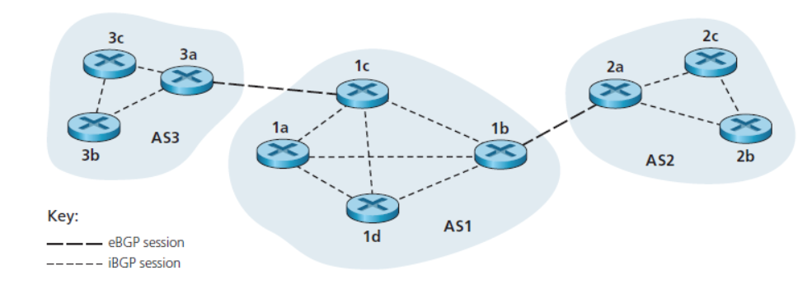
Inter-AS routing protocol
Routing paths are determined for source-destination pairs that span multiple ASs
Ex: Border Gateway Protocol version 4
1. Obtain subnet reachability information from neighboring ASs.
2. Propagate the reachability information to all routers internal to the AS.
3. Determine “good” routes to subnets based on the reachability information and on AS policy.

Slide 3
Semipermanent TCP
In BGP, pairs of routers exchange routing information over semipermanent TCP connections using port 179.
BGP TCP
connection for each link that directly connects two routers in two different ASs.
A TCP connection between two gateway routers in two different Ass
BGP peers
Each TCP connection, the two routers at the end of the connection are called BGP peers.
BGP session
the TCP connection along with all the BGP messages sent over the connection is called a BGP session.
External BGP (eBGP) session
a BGP session that spans two ASs is called an external BGP (eBGP) session,
Internal BGP (iBGP) session
BGP session between routers in the same AS is called an internal BGP (iBGP) session

Slide 4
BGP allows each AS to learn which destinations are reachable via its neighboring ASs. In BGP, destinations are not hosts but instead are CIDRized prefixes, with each prefix representing a subnet or a collection of subnets.
AS1 and AS2 exchange prefix reachability information through their gateway routers 1b and 2a. Also, when a gateway router (in any AS) receives eBGP-learned prefixes, the gateway router uses its iBGP sessions to distribute the prefixes to the other routers in the AS. Thus, all the routers in AS1 learn about AS3 prefixes, including the gateway router 1b.
The gateway router 1b (in AS1) can therefore re-advertise AS3’s prefixes to AS2. When a router (gateway or not) learns about a new prefix, it creates an entry for the prefix in its forwarding table,

Slide 5
Path Attributes and BGP Routes
In BGP, an autonomous system is identified by its globally unique autonomous system number (ASN) [RFC 1930].
AS numbers, like IP addresses, are assigned by ICANN regional registries.
When a router advertises a prefix across a BGP session, it includes with the prefix a number of BGP attributes.
Route
In BGP, a prefix along with its attributes is called a route. Thus, BGP peers advertise routes to each other. Two of the more important attributes are AS-PATH and NEXT-HOP
AS-PATH.
This attribute contains the ASs through which the advertisement for the prefix has passed. When a prefix is passed into an AS, the AS adds its ASN to the ASPATH attribute.
For example, consider Figure nd suppose that prefix 138.16.64/24 is first advertised from AS2 to AS1; if AS1 then advertises the prefix to AS3, AS-PATH would be AS2 AS1.
Routers use the AS-PATH attribute to detect and prevent looping advertisements; specifically, if a router sees that its AS is contained in the path list, it will reject the advertisement.
Routers also use the AS-PATH attribute in choosing among multiple paths to the same prefix

Slide 6
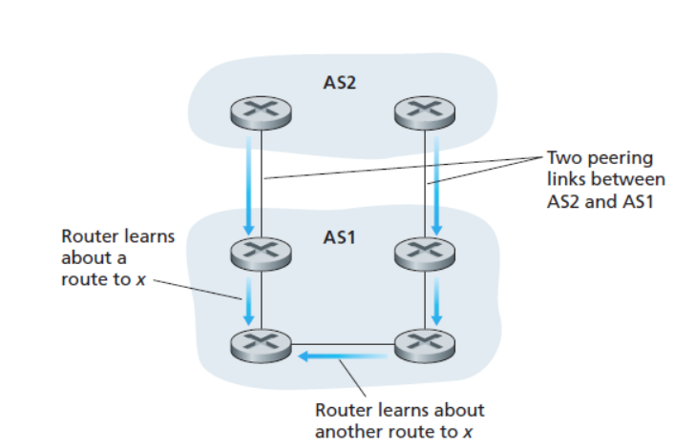
NEXT-HOP
The intra-AS routing algorithm has determined the least-cost path to all subnets attached to the routers in AS1, including to the subnet for the link between 1c and 3a. From this least-cost path from 1d to the 1c-3a subnet, 1d determines its router interface l that begins this path and then adds the entry (x, l) to its forwarding table.
These two routes could have the same AS-PATH to x, but could have different NEXT-HOP values corresponding to the different peering links.
Using the NEXT-HOP values and the intra-AS routing algorithm, the router can determine the cost of the path to each peering link, and then apply hot-potato routing to determine the appropriate interface.
BGP also includes attributes that allow routers to assign preference metrics to the routes, and an attribute that indicates how the prefix was inserted into BGP at the origin AS.
When a gateway router receives a route advertisement, it uses its import policy to decide whether to accept or filter the route and whether to set certain attributes such as the router preference metrics. The import policy may filter a route.
The gateway router also filter a route because it already knows of a preferable route to the same prefix.

Slide 7
BGP Route Selection
BGP uses eBGP and iBGP to distribute routes to all the routers within ASs. From this distribution, a router may learn about more than one route to any one prefix, in which case the router must select one of the possible routes.
If there are two or more routes to the same prefix, then BGP sequentially invokes the following elimination rules until one route remains:
Routes are assigned a local preference value as one of their attributes. The local preference of a route could have been set by the router or could have been learned by another router in the same AS. This is a policy decision that is left up to the AS’s network administrator. The routes with the highest local preference values are selected.
From the remaining routes (all with the same local preference value), the route with the shortest AS-PATH is selected. If this rule were the only rule for route selection, then BGP would be using a DV algorithm for path determination, where the distance metric uses the number of AS hops.
From the remaining routes (all with the same local preference value and the same AS-PATH length), the route with the closest NEXT-HOP router is selected determined by the intra-AS algorithm, is the smallest. this process is called hot-potato routing.
If more than one route still remains, the router uses BGP identifiers to select the route

Slide 8
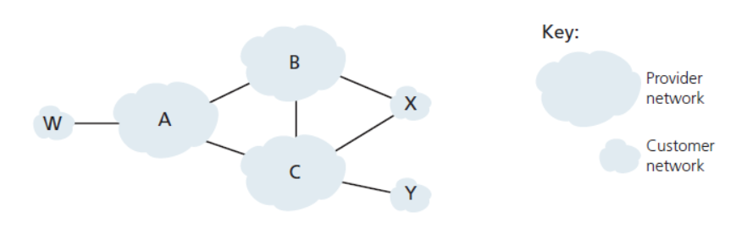
Routing Policy: Basic concepts of BGP routing policy with a simple example.
Figure shows six interconnected autonomous systems: A, B, C, W, X, and Y.
It is important to note that A, B, C, W, X, and Y are ASs, not routers.
Let’s assume that autonomous systems W, X, and Yare stub networks
A, B, and C are backbone provider networks. also assume that A, B, and C, all peer with each other, and provide full BGP information to their customer networks.
All traffic entering a stub network must be destined for that network, and all traffic leaving a stub network must have originated in that network.
W and Y are clearly stub networks.
X is a multihomed stub network, since it is connected to the rest of the network via two different providers.
In particular, X will function as a stub network if it advertises (to its neighbors B and C) that it has no paths to any other destinations except itself. That is, even though X may know of a path, say XCY, that reaches network Y, it will not advertise this path to B. Since B is unaware that X has a path to Y, B would never forward traffic destined to Y (or C) via X.
Suppose that B has learned (from A) that A has a path AW to W. B can thus install the route BAW into its routing information base. Clearly, B also wants to advertise the path BAW to its customer, X, so that X knows that it can route to W via B.

Slide 9
Disadvantages
BGP is subject to security issues like BGP Hijacking. This occurs when attackers distribute false routing information to misdirect traffic

Slide 10
Quiz
1 Which is a example for Inter-AS routing ?
A. LSP
B. Distance vector
C. Border Gateway Protocol
D.None of these

Slide 11
Quiz
A BGP session that spans two ASs is called ----
A. Internal BGP (eBGP) session
B. External BGP (eBGP) session
C. BGP session
D. All the above

Slide 12
Quiz
3. BGP session between routers in the same AS is called ----
A. Internal BGP (eBGP) session
B. External BGP (eBGP) session
C. BGP session
D. All the above

Slide 13
Quiz
4 . prefix reachability information represent the ----
A. ISP
B. LAN
C. Subnet
D. All the above

Slide 14
Quiz
5 . BGP would be using a ______ algorithm for path determination
A. LSP
B. RIP
C. DV
D. None of these

